Slide 1
RecipeWiz
Recipes Recommendation System
CMPE 256, Fall 2022
Presented by,
Team OdeToCode
Sanjana Kothari
Soumyendra Shrivastava
Chirudeep Gorle

Slide 2
Problem Statement

Slide 3
What is RecipeWiz?
“RecipeWiz” is an engine that can help users find a subset of recipes available on Food.com. However, it is just not a recipe collection but offers a range of recommendations based on several search criteria pertaining to recipes as well as factors like user ratings and reviews.
Our goal is to offer users with a wide range of options based on different criteria like similar ingredients, similar nutritional value, similar method of preparation, etc., by leveraging the powerful techniques of item-item collaborative filtering. When a user searches for a recipe, multiple carousels with recommended recipes will be displayed where each carousel shows recipes similar to the searched one. Clicking on a recipe will show all the details of that recipe like ingredients, preparation steps, nutritional information, etc.

Slide 4
Knowledge Discovery in Databases (KDD)

Slide 5
KDD process
Data Cleaning
Missing values
Cleaning textual columns
Removing outliers
Other business-based cleaning
Data Integration
Two datasets: one gives the details about the recipes themselves and the other gives the ratings and reviews for the recipes. For our recommendation engine, we combine the two datasets on the recipe_id so that we have each row giving details about the recipe and the ratings and reviews given to that recipe. Due to this, we get ‘n’ rows for each recipe where ‘n’ is the number of reviews for that recipe.

Slide 6
KDD process
Data Selection
Data Transformation -
Imputing missing ratings with the median.
New features like the cuisine and type of meal - veg/ non-veg and sweet/savory are derived from the ingredients and tags column respectively.
Using the nutrition values, recipes are classified as healthy or unhealthy.
Techniques of lemmatization, tokenization, and stop word removal.
Data Mining -
Memory-based techniques use statistical methods like cosine similarity and correlation to suggest similar recipes. It is purely mathematical and hence forms the base models.
Model-based methods utilize more sophisticated techniques like clustering and deep learning. These methods, among others, have the ability to understand the vector space and the underlying patterns more closely, therefore providing highly similar recipes to the searched one.

Slide 7
KDD process
Pattern Evaluation -
Recommendation-centric metrics:
Diversity in recommendations offered
Coverage - the ability of the recommender system to recommend all items from a train set to users.
Business-oriented metrics:
Click-through rates - measurement of how many users click on the recommendations.
User behavior and engagement - By showing more relevant recommendations, user engagement is estimated to increase.
Knowledge Presentation -
As the final deliverable, RecipeWiz is a website that allows search functionality and then recommends similar recipes. These recipes are displayed as carousels on the website that the user can scroll through and open. On opening, these recipes will open up as separate articles with all details about the recipe.

Slide 8
Algorithms & Metrics

Slide 9
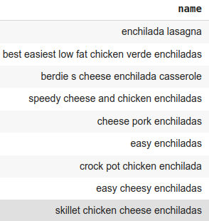
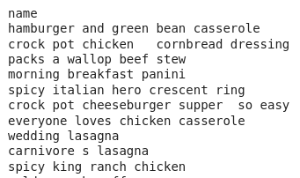
Algorithms
Term Frequency Inverse Document Frequency : The TfidfVectorizer is trained on ingredients in all records and when a recipe is queried by name, the ingredient embeddings of the searched recipe are extracted from the database, and recipes with the highest cosine similarity are returned.
Test recipe name - ‘chicken tortilla enchilada bake’
Pearson Correlation Coefficient : The correlation of nutrition values of the searched recipe with respect to all other recipes is found and the recipes with a correlation > 99.9 are returned.
Test recipe name - ‘chicken tortilla enchilada bake’

Slide 10
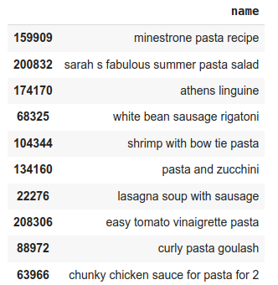
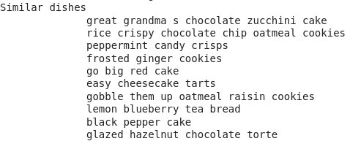
Algorithms
Sent2Vec : The recipe steps of preparation are embedded using Sent2Vec. The searched recipe’s steps are matched with the recipes that follow a similar method of preparation, using cosine similarity measure.
Test recipe name - ‘lemon sugar cookies’
Word2Vec : The embeddings of ingredients and steps of the searched recipe are compared to the embeddings of other recipes using cosine similarity.
Test ingredients - ‘tomato pasta vegetables’

Slide 11
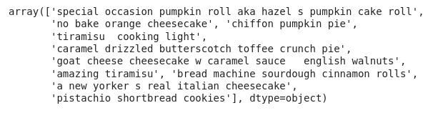
Algorithms
FAISS Approximate Nearest Neighbor: IVFPQ index, i.e. Inverted File Product Quantization, is used to create an indexing of the text column containing the ingredients, type of recipe, type of meal, cuisine, healthiness, recipe tags, and the encoded query is searched in the index. Finally, the recipes with the highest cosine similarity score are returned as recommendations.
Test query - ‘american orange cake with frosting’

Slide 12
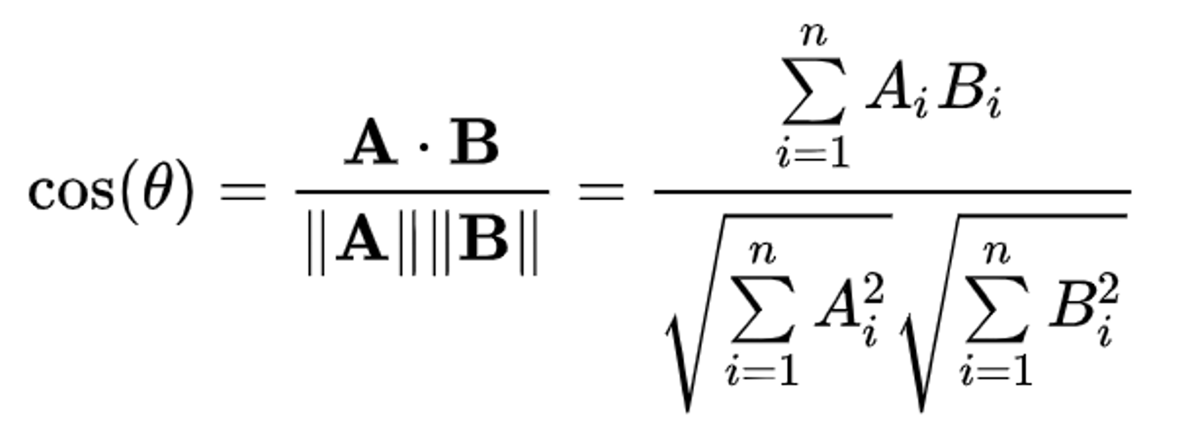
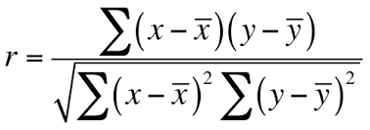
Metrics
Cosine Similarity measure is used to find the top 20 related recipes to the searched recipe.
Pearson correlation coefficient measures the statistical relationship between two continuous variables, in our case, the nutrition values.

Slide 13
RecipeWiz web application

Slide 14
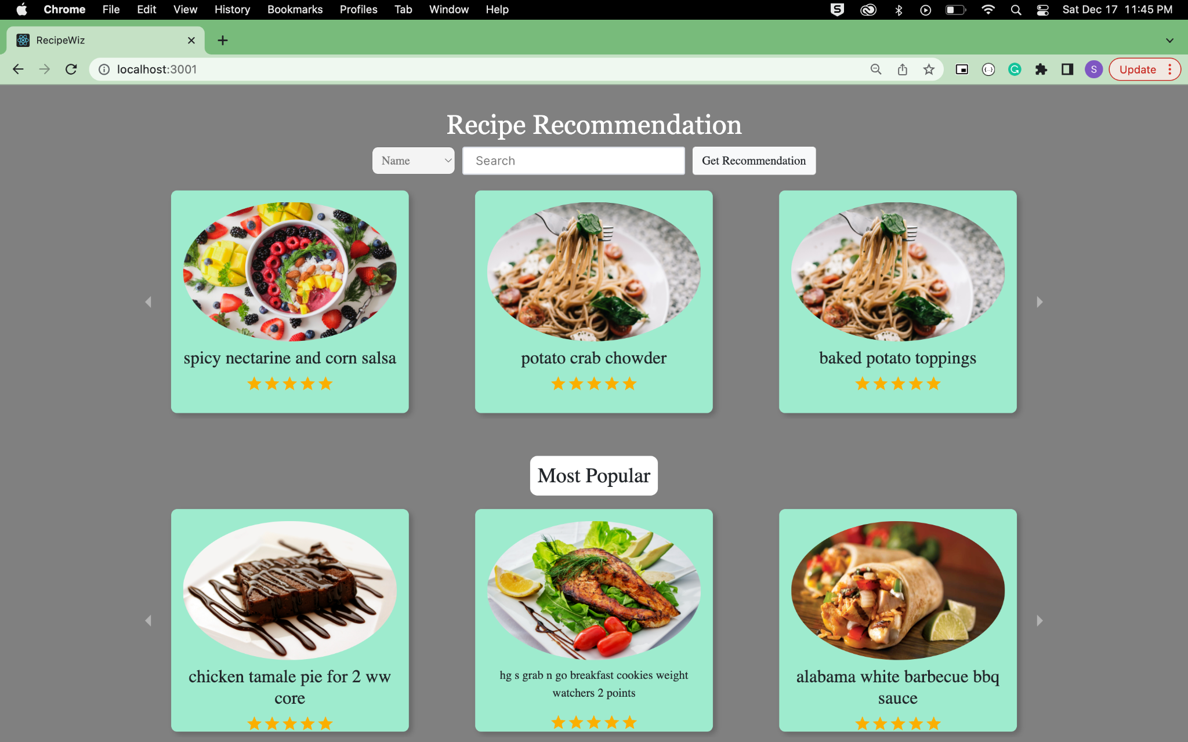
Landing Page of RecipeWiz

Slide 15
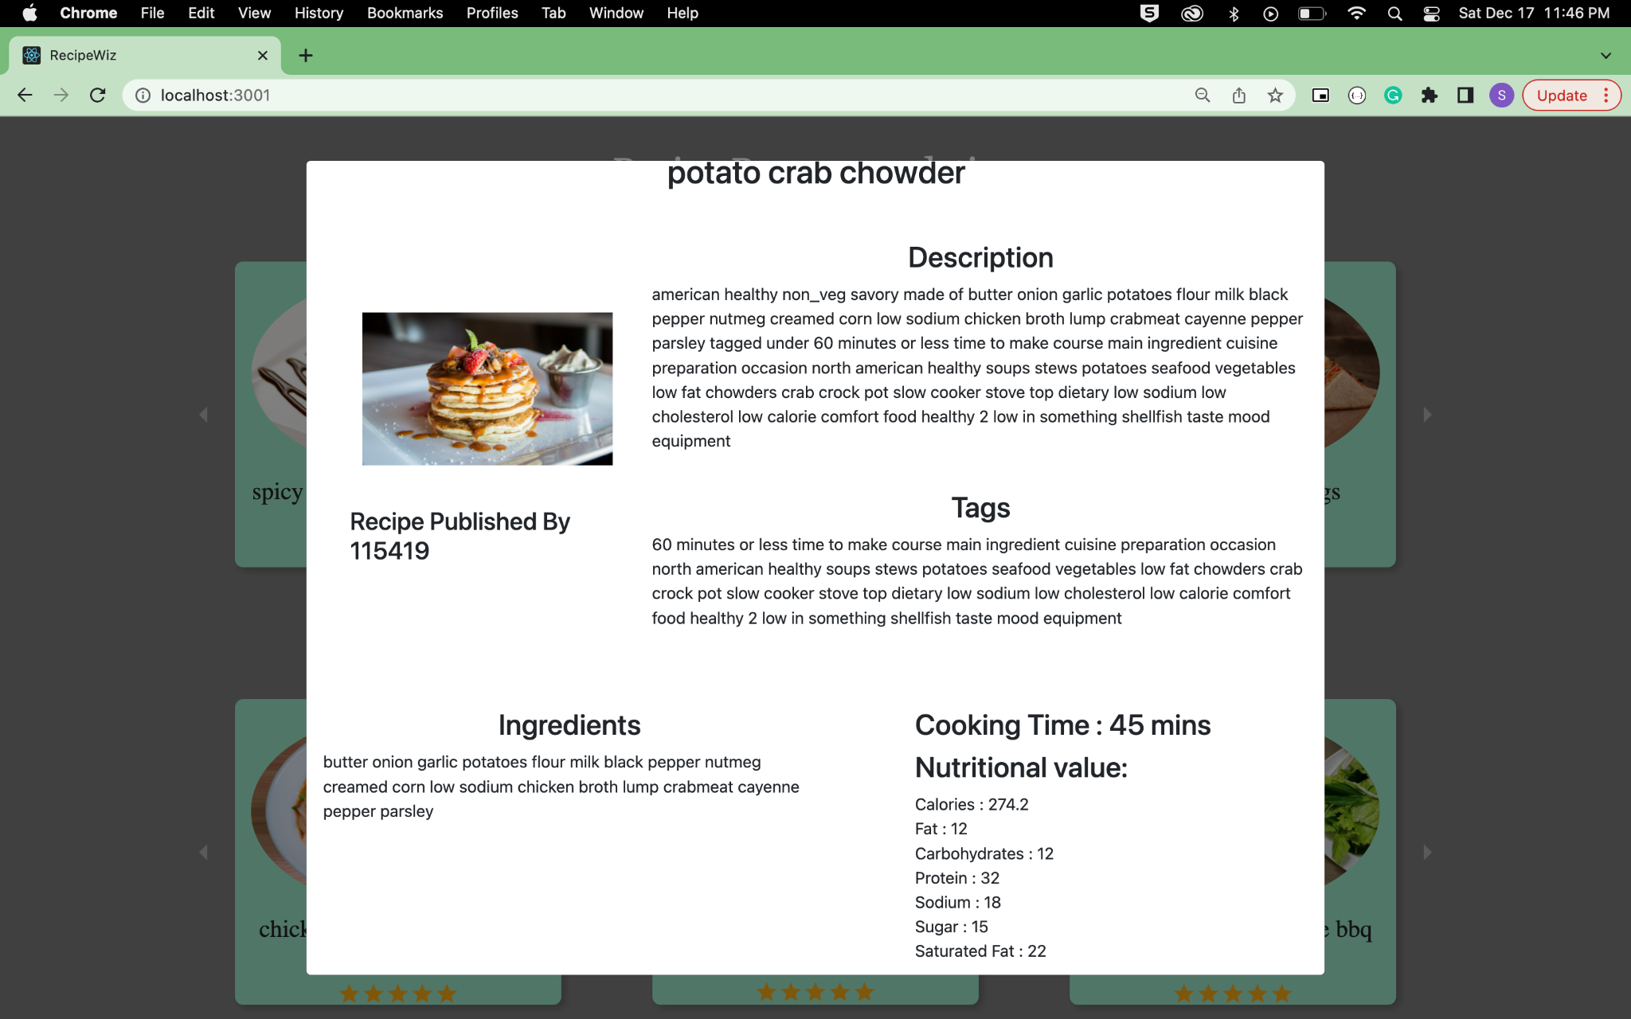
Recipe Details

Slide 16
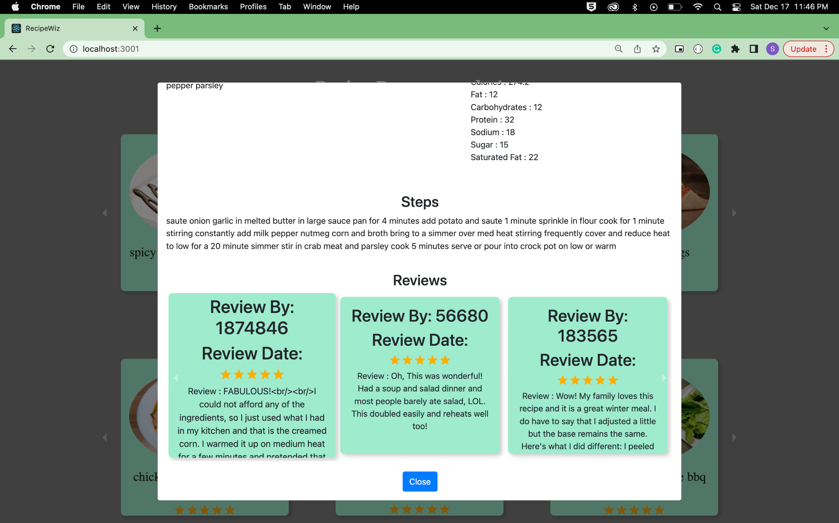
Recipe Details

Slide 17
Thank you!

