Slide 1

Fake News Detection using LSTM
Prepared by:
Soumyendra Shrivastava (016670121)
Siddhant Sancheti (016710421)
Wesley Shih (014561313)

Slide 2
Data
Fake Title
Correct Title
Fake Text
Correct Text
For this data set the title is fake
For this data set the title is correct
For this data set the text is fake
For this data set the text is correct

Slide 3
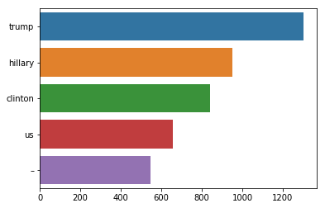
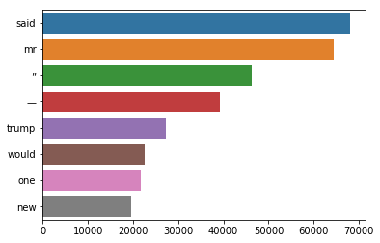
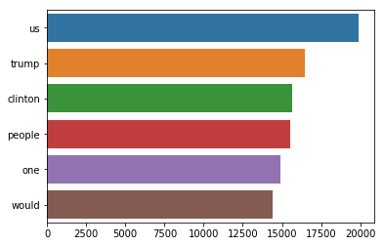
Exploratory Data Analysis (EDA) – Corpus Analysis
Corpus Analysis is the process of analyzing text at a large scale and collect information about all the textual objects present in the text.
This is a form of text analysis which helps us to make comparisons between texts.
Fake Title
Correct Title
Correct Text
Fake Text

Slide 4
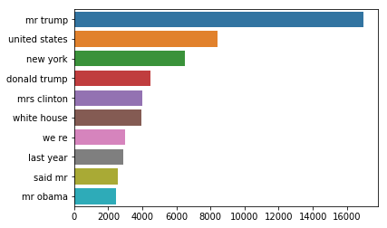
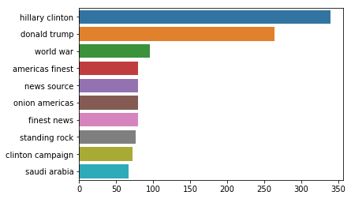
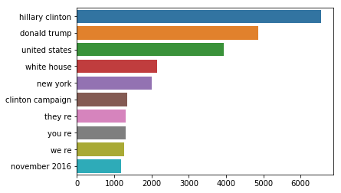
Exploratory Data Analysis (EDA) – NGRAM Analysis
NGRAM Analysis is the process of collecting ‘n’ items that may occur in succession in text.
The items can include numbers, words or symbols.
Correct Title
Fake Title
Correct Text
Fake Text

Slide 5
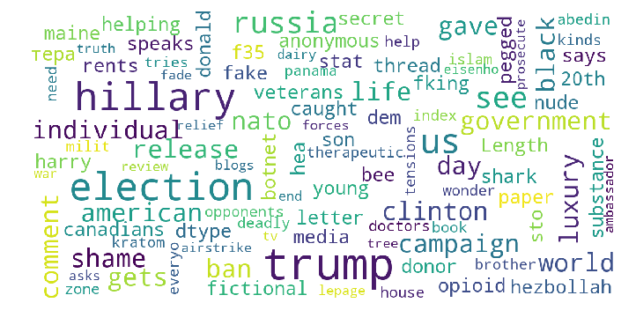
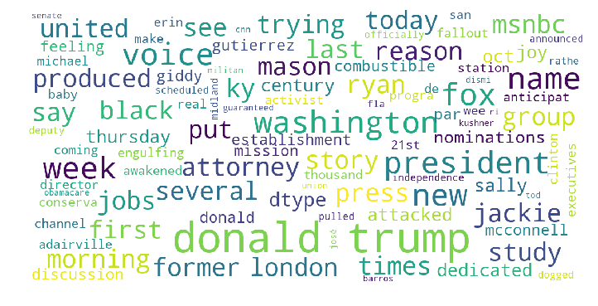
Exploratory Data Analysis (EDA) – Word Cloud
Fake Title
Correct Title

Slide 6
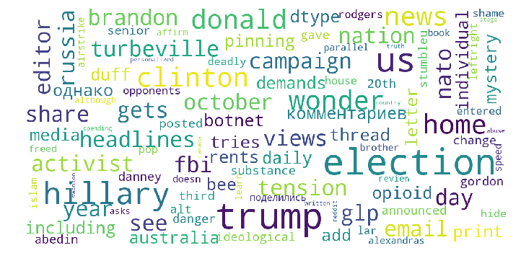
Exploratory Data Analysis (EDA) – Word Cloud
Fake Text
Correct Text

Slide 7
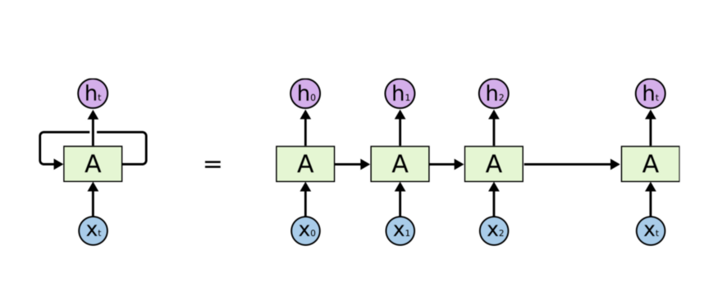
Model Use (1/4)
Why Long Short Term Memory (LSTM)
LSTM is a variant of Recurrent Neural Network (RNN) which has a memory cell. It performs better than vanilla RNN on long sequential data.
LSTM was designed to overcome the vanishing gradient problem in RNN.

Slide 8
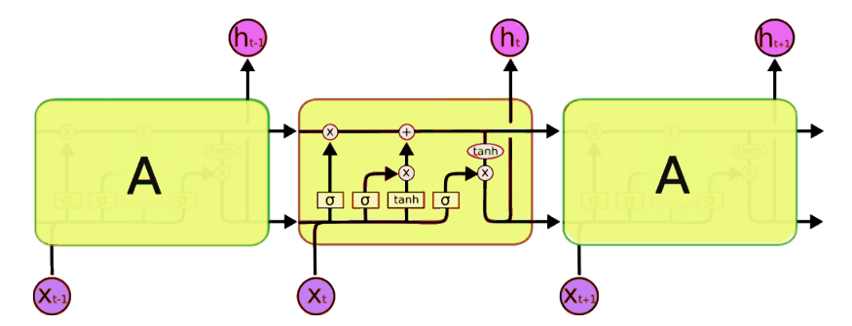
Model Use (2/4)
This is a vanilla recurrent neural network.
They are basically designed in such a way that they can deal with sequential data.
RNN’s recurrently take the input and output of the previous node.
In LSTM all the vanilla cells of RNN are replaced with a LSTM cell.

Slide 9
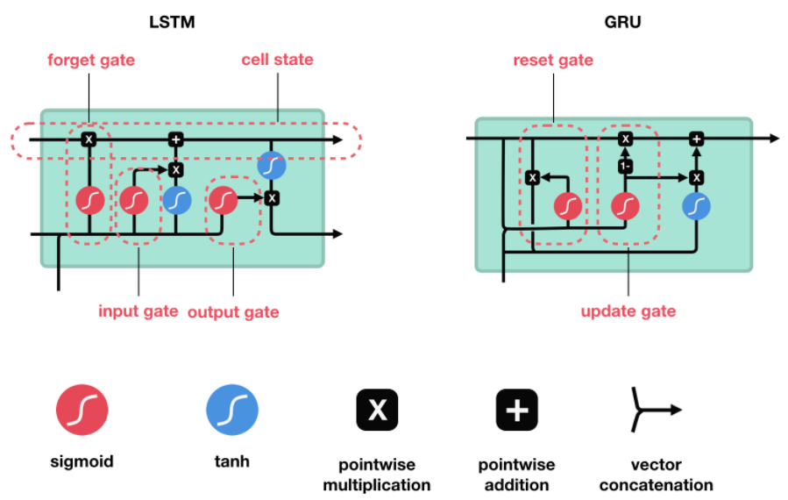
Model Use (3/4)
LSTM cells are composed of several gates like input, output and forget gates to preserve memory to a certain extent.
At each timestep, LSTM cell can choose to read, write or reset the cell by using an explicit gating mechanism.

Slide 10
Model Use (4/4)
One Hot for Embedding lAyers:- we will be one hot encoding the sentences in the corpus for embedding layers. While one-hot encoding the words in sentences will take the index from the vocabulary size.
Padded Embedded Documents:- All the neural networks require to have inputs that have the same shape and size. But, naturally, some of the sentences are longer or shorter. We need to have the inputs of the same size, this is where the padding is necessary

Slide 11
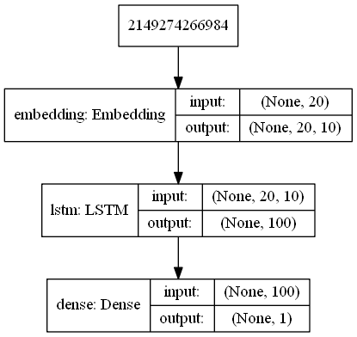
Model Architecture

Slide 12
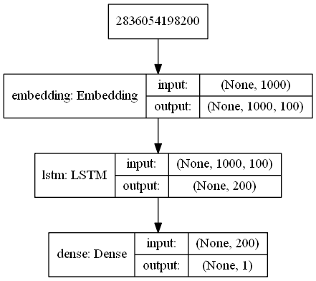
Model Architecture

Slide 13
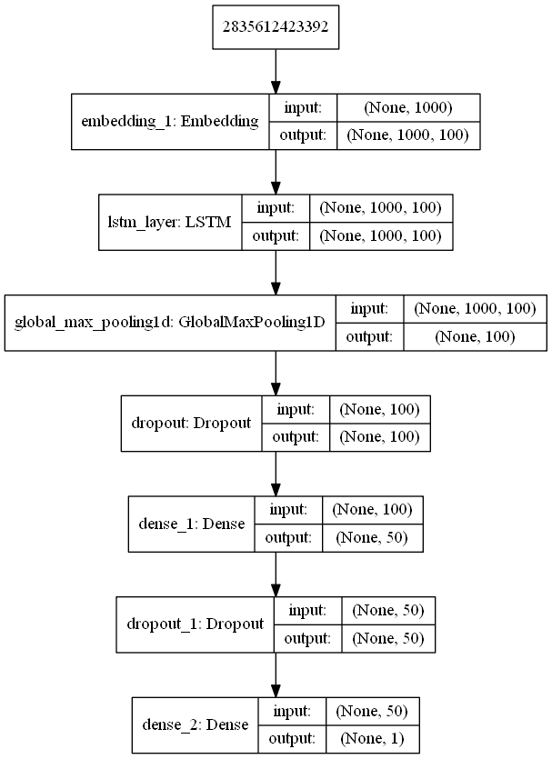
Model Architecture

Slide 14
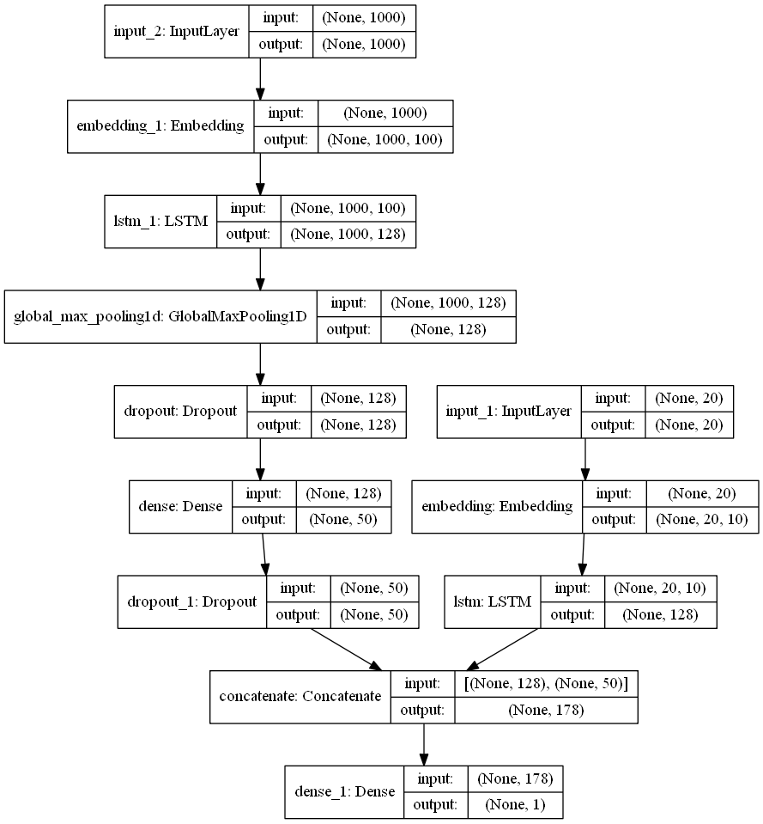
Model Architecture

Slide 15
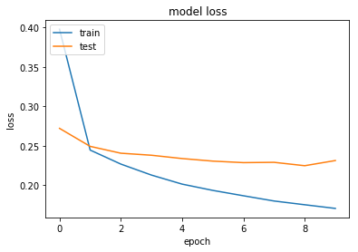
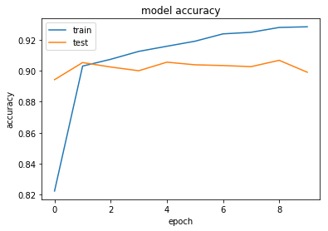
Model Metrics - Title

Slide 16
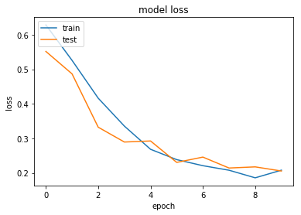
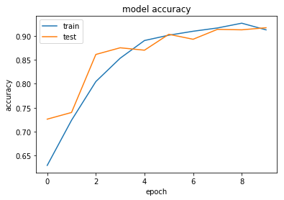
Model Metrics - Text

Slide 17
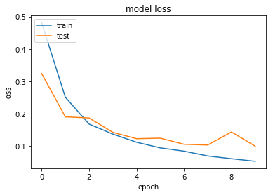
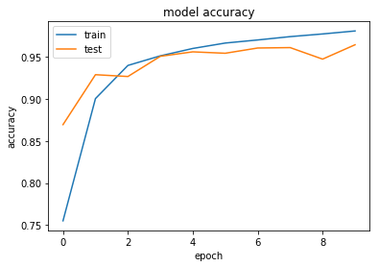
Model Metrics – Multi Input

Slide 18

Conclusion
We have done mainstream work on processing the data and building the
model. We could have indulged in changing the NGRAMS while vectorizing the text data.
We took 2 words and vectorized them. We can preserve the sentence structure by using RNN in comparison to Bag of Words methods.
The use of glove vectors was an important step in reducing the number of parameters we had to train, hence reducing the risk of overfitting.
We can further increase model size, tweak the hyperparameters, use Bidirectional LSTM and test if the model performs better.

Slide 19
Thank You!

