Slide 1
Stock Market state classification and Prediction using Markov chain
-Soumy Ladha (13AE3FP09)
Supervisor: Prof. Somesh Kumar

Slide 2
Introduction
Time series is one of the way to analyse complex systems.
The correlation has been a powerful tool in the analysis of time series.
Time series analysis is done on stationary data yet most natural processes are non-stationary.
In non-stationary situations analysis becomes arduous and model robustness is lost.
To overcome these challenges we need superior models which are less vulnerable to non-stationarity of data.

Slide 3
Literature Review (1/2)
Title of the paper | Author/Source | Description
Stock Market Prediction Using Hidden Markov Models | Aditya Gupta and Bhuwan Dhingra | This article presents the Maximum a Posteriori HMM approach for forecasting stock values for the next day given historical data.
Application of Markov Chains to Stock Trends | Kevin J. Doubleday and Julius N. Esunge | This article analyses Dow Jones Industrial Average using a discrete time stochastic model, (Markov Chain). Two models are build, where the DJIA was considered as being in a state of (1) gain or loss and (2) small, moderate, or large gain or loss.

Slide 4
Literature Review (2/2)
Title of the paper | Author/Source | Description
Predicting Stock Prices | Shuchi S. Mitra and Michael J. Riggieri | In this article author uses markov chain to predict the immediate future stock prices for a given company. They applied Markov Chain calculations to the data to create a 4x4 transitional probability matrix. Using this transition matrix they found four steady states which represented the probability that a stock price for a given day would fall into one of the four states.

Slide 5
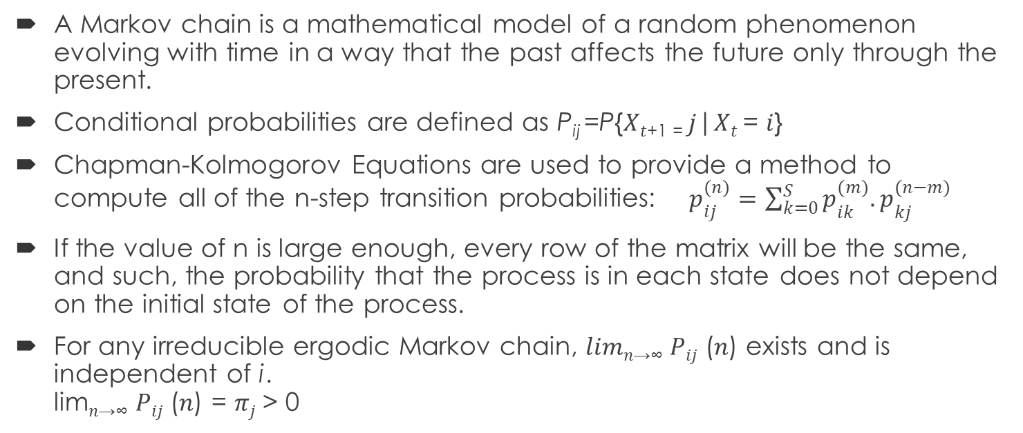
Markov Chain
A Markov chain is a mathematical model of a random phenomenon evolving with time in a way that the past affects the future only through the present.
Conditional probabilities are defined as P_{ij} =P{𝑋_{𝑡+1 =} 𝑗|𝑋_{𝑡} = 𝑖}
Chapman-Kolmogorov Equations are used to provide a method to compute all of the n-step transition probabilities: $p_{ij}^{(n)}=\sum_{k=0}^{S}{p_{ik}^{(m)}.p_{kj}^{(n−m)}}$
If the value of n is large enough, every row of the matrix will be the same, and such, the probability that the process is in each state does not depend on the initial state of the process.
For any irreducible ergodic Markov chain, 𝑙𝑖𝑚_{𝑛→∞} 𝑃_{𝑖𝑗} (𝑛) exists and is independent of i. lim_{𝑛→∞} 𝑃_{𝑖𝑗} (𝑛) = 𝜋_{𝑗} > 0

Slide 6
Clustering
Classifying unlabelled data into similar groups is called clustering. In a cluster data items are similar but dissimilar from another cluster.
K-means clustering is a clustering algorithm, which is used when you have unlabelled data (i.e., data without defined categories or groups). In this algorithm we classify data into K-clusters.
Data assignment step: Each centroid defines one of the clusters. In this step, each data point is assigned to its nearest centroid, based on the squared Euclidean distance.
Centroid update step: In this step, the centroids are recomputed. This is done by taking the mean of all data points assigned to that centroid's cluster.

Slide 7
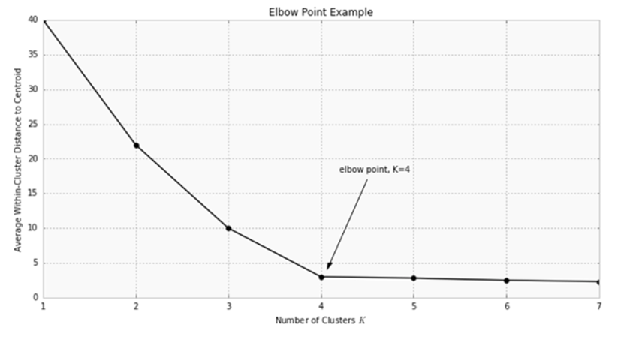
Choosing K
K is plotted and the "elbow point," where the rate of decrease sharply shifts, can be used to roughly determine K.

Slide 8
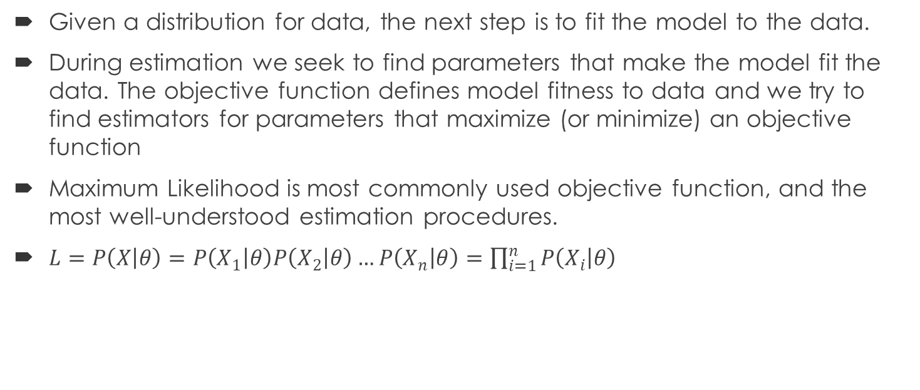
Maximum Likelihood estimation
Given a distribution for data, the next step is to fit the model to the data.
During estimation we seek to find parameters that make the model fit the data. The objective function defines model fitness to data and we try to find estimators for parameters that maximize (or minimize) an objective function
Maximum Likelihood is most commonly used objective function, and the most well-understood estimation procedures.
$L=P\left(X | θ\right)=P\left(X_{1} | θ\right)P\left(X_{2} | θ\right)…P\left(X_{n} | θ\right)=\prod_{i=1}^{n}{P\left(X_{i} | θ\right)}$

Slide 9
Dataset
The dataset for method 1 consisted of daily closing values of Sensex for the period of 2000 to 2017. The dataset for method 2 consisted of daily closing prices of following indices as well as it constituents (Stocks) for period of 2002 to 2017. Both of datasets were downloaded using Bloomberg terminal.
Bankex | Fast moving consumer goods (FMCG) | Metal
Capital Goods | Health Care | Oil and Gas
Consumer Durables | Information Technology (IT) | Public Sector Units
Sensex | Auto

Slide 10
Method (1)
The first step is making a moving window having Sensex data of last 50 days
Build an Auto-Regressive Integrated Moving Average (ARIMA) model on the 50 days data. Then forecast the value for next day i.e. 51st day.
Using that forecasted value and actual value we calculate the error corresponding to the prediction. Using moving windows we generate an array of daily error.
Then we perform adf-test, in which we found data to be stationary.
Plot the histogram and box-plot to detect any outliers thus remove them from the analysis.
Calculate minimum and maximum of the error array.

Slide 11
Method (1)
Calculate the difference between Maximum and Minimum and divide it by 8, let’s say this value be ‘α’ and also calculate the average of maximum and minimum and let this value be ‘β’.
Generate 4 intervals as follows [Minimum, ‘β’-‘α’), [‘β’-‘α’, ‘β’), [‘β’, ‘β’+‘α’], (‘β’+‘α’, Maximum].
Each of these intervals corresponds to a state, example if an error in particular day lies between [Minimum, ‘β’-‘ α’) then it in state ‘1’ likewise to ‘2’, ‘3’ and ‘4’ thus we binned the data in 4 states.
State ‘1’ corresponds to the market being Very Low. State ‘2’ corresponds to the market being Low. State ‘3’ corresponds to the market being High. State ‘4’ corresponds to the market being Very high.

Slide 12
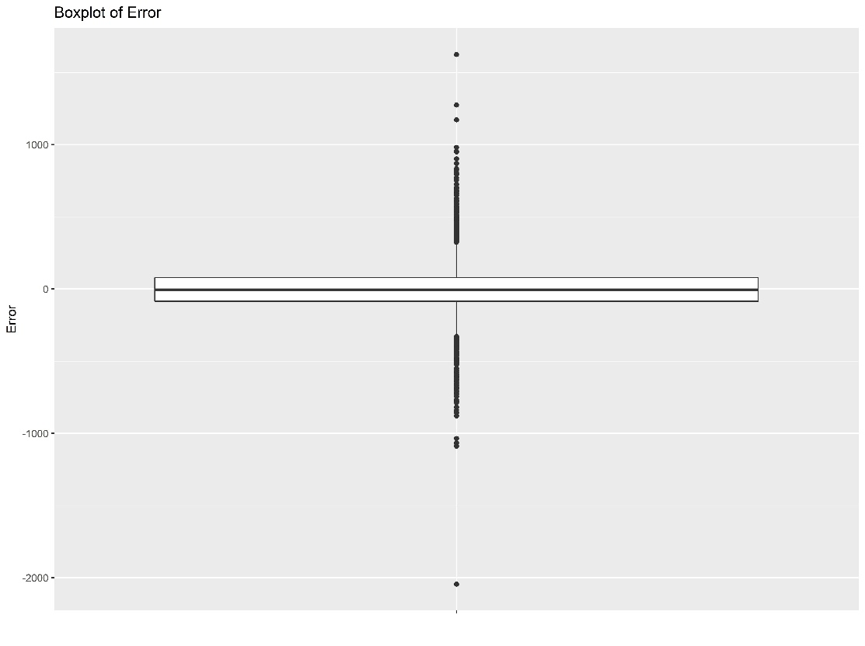
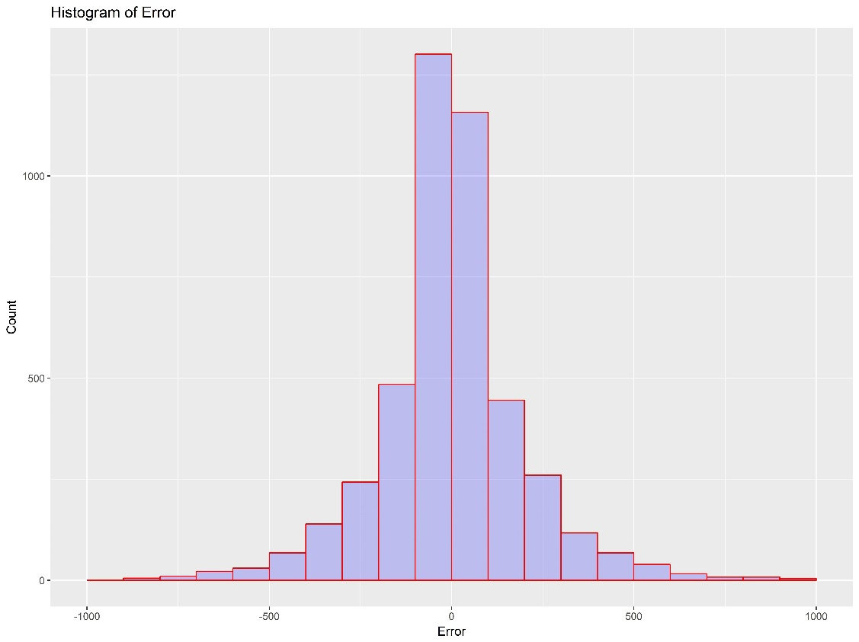
Method (1)
Box plot of error
Histogram of error

Slide 13
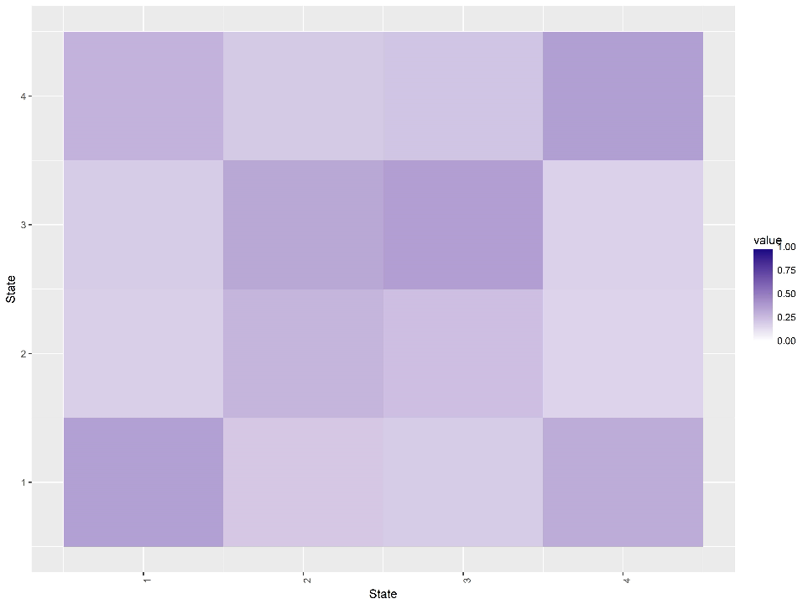
Method (1): Results
Transition probability matrix
 | 1 | 2 | 3 | 4
1 | 0.36 | 0.17 | 0.19 | 0.28
2 | 0.20 | 0.27 | 0.33 | 0.20
3 | 0.19 | 0.24 | 0.36 | 0.21
4 | 0.31 | 0.16 | 0.17 | 0.36
Stationary probability
Very Low | Low | High | Very High
0.27 | 0.21 | 0.26 | 0.27
Heatmap of Transition matrix

Slide 14
Method (2)
We calculate daily logarithmic return corresponding to these indices.
Using a moving window of 20 days we estimated correlation matrix among 11 variables thus we have an array of correlation matrix with the number of entries being (number of days in 2002-2017) minus 20.
Using two loops calculate norm of the difference between every element in an array
Divide that norm by the number of columns in the correlation matrix
We have the matrix in which ‘i_{th}’ row and ‘j_{th}’ column is the norm of the difference between ‘i_{th}’ element of the array and ‘j_{th}’ element of the array.
Using ‘Heatmap’ command in ‘R’ we generate the heatmap

Slide 15
Method (2)
Then we applied k-NN clustering algorithm. The steps of clustering are explained below:
k-NN clustering can directly be applied using “kmeans” command in ‘R’ but we need to determine optimal number of clusters.
Using loop iterate number of the cluster from 1-40, calculate error on each cluster values and plot them.
Using elbow method as explained choose the most appropriate number of clusters i.e. 10. For further analysis set the appropriate number of clusters as 10
Obtain cluster centers using the command in ‘R’, then classify the elements of correlation matrix array to appropriate clusters.
We have an array in which every element is an indicator variable taking one value from 1 to 10 which denotes the state of the market at a particular time.

Slide 16
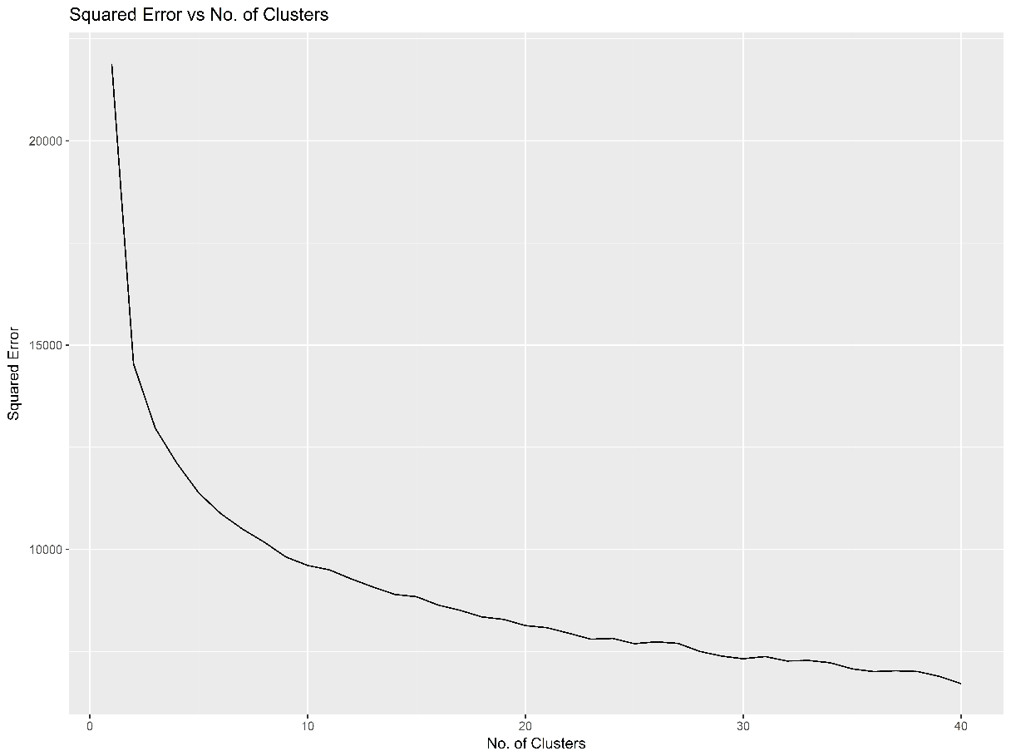
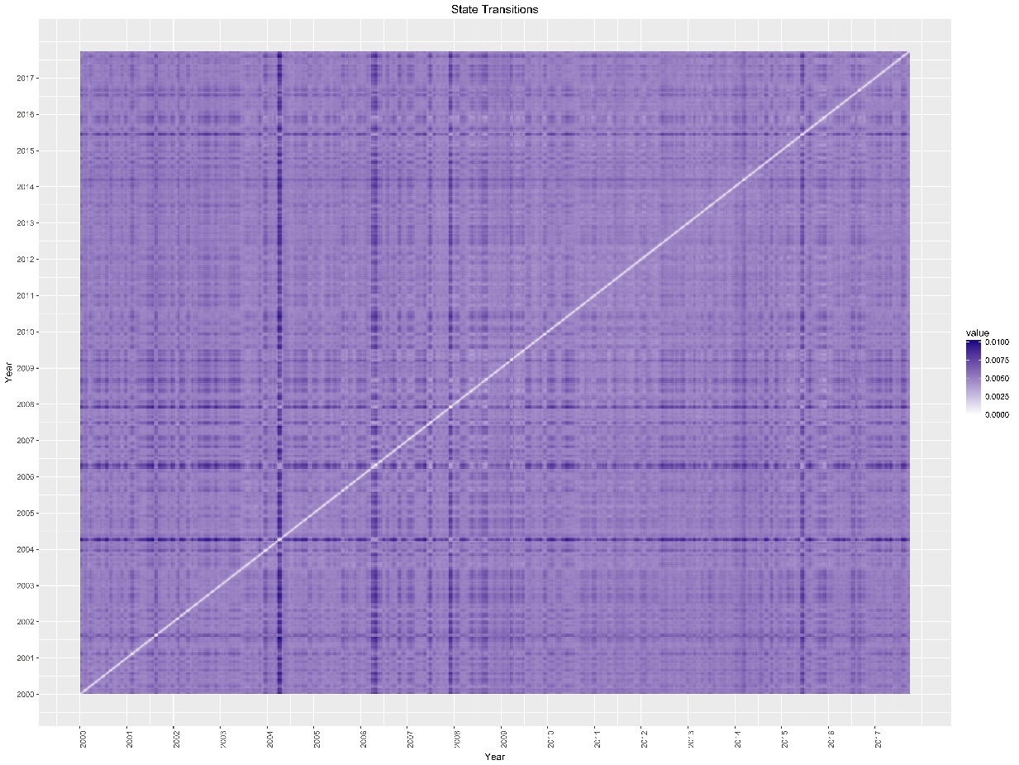
Method (2)
Squared error vs. Number of clusters
Heatmap representing change in correlation matrix (sector wise stock) at different time

Slide 17
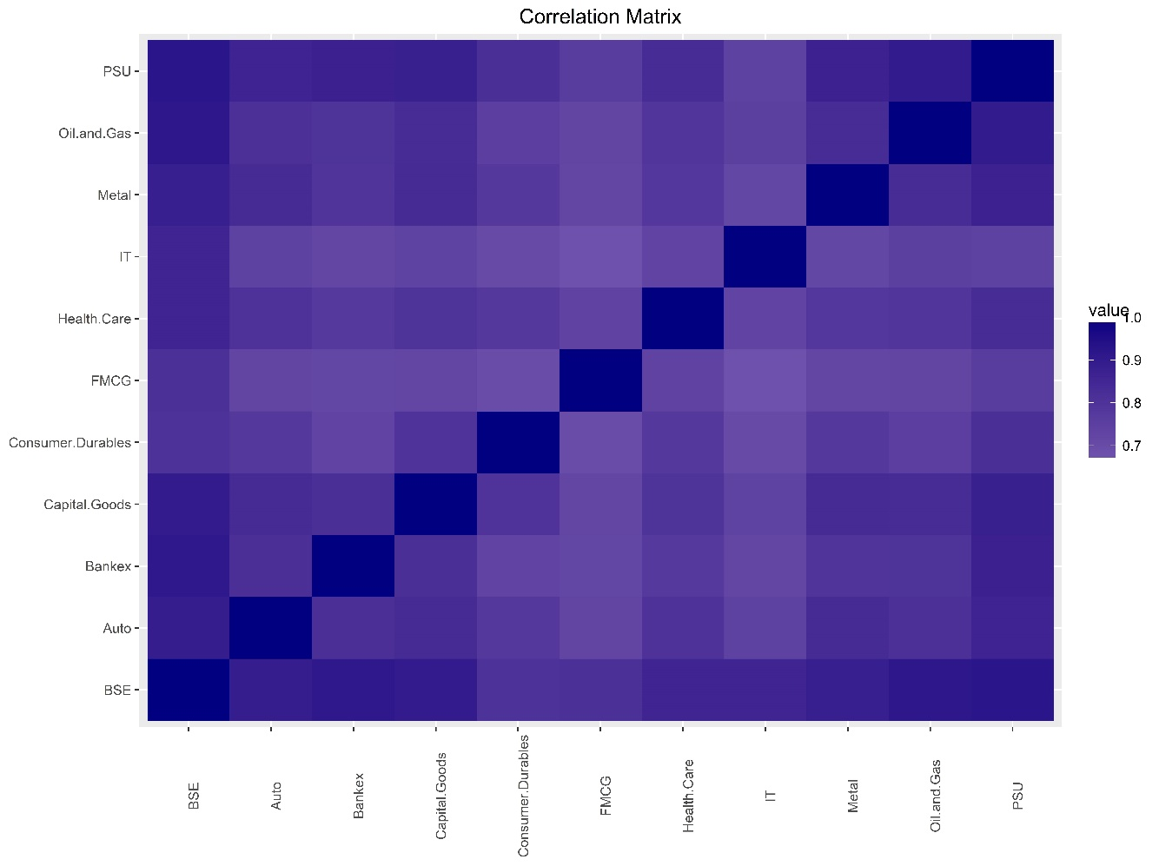
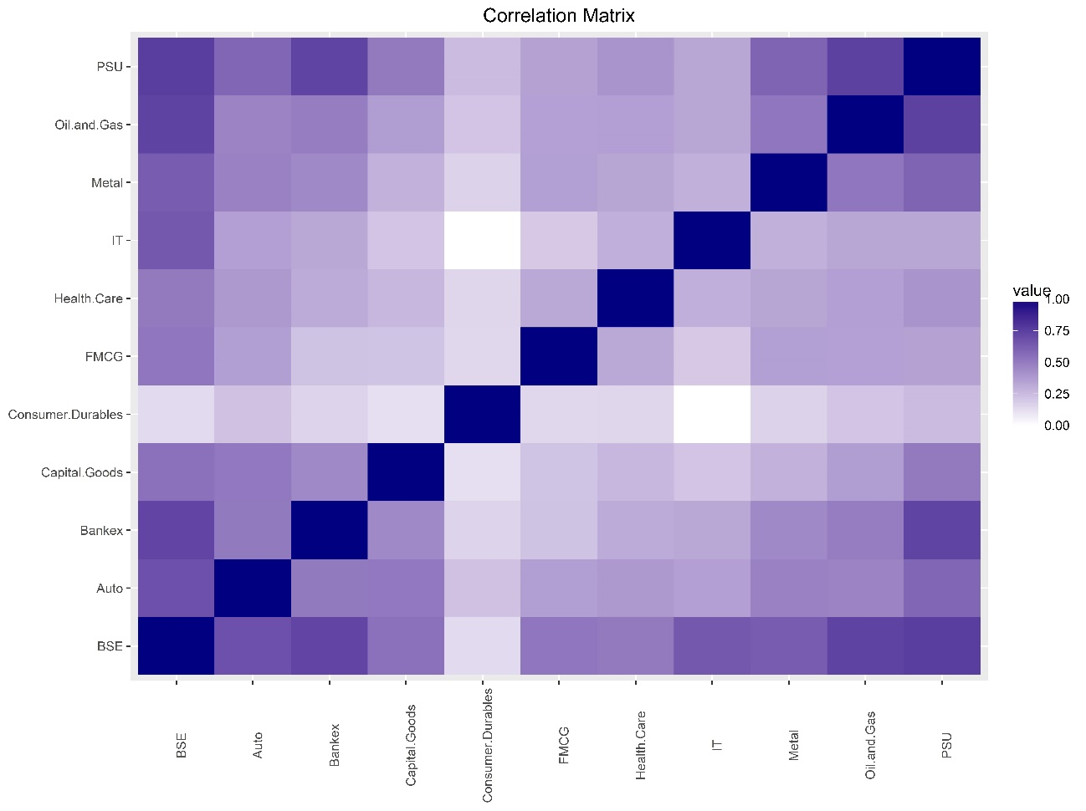
Method (2): Results
Correlation Matrix for State 1
Correlation Matrix for State 2

Slide 18
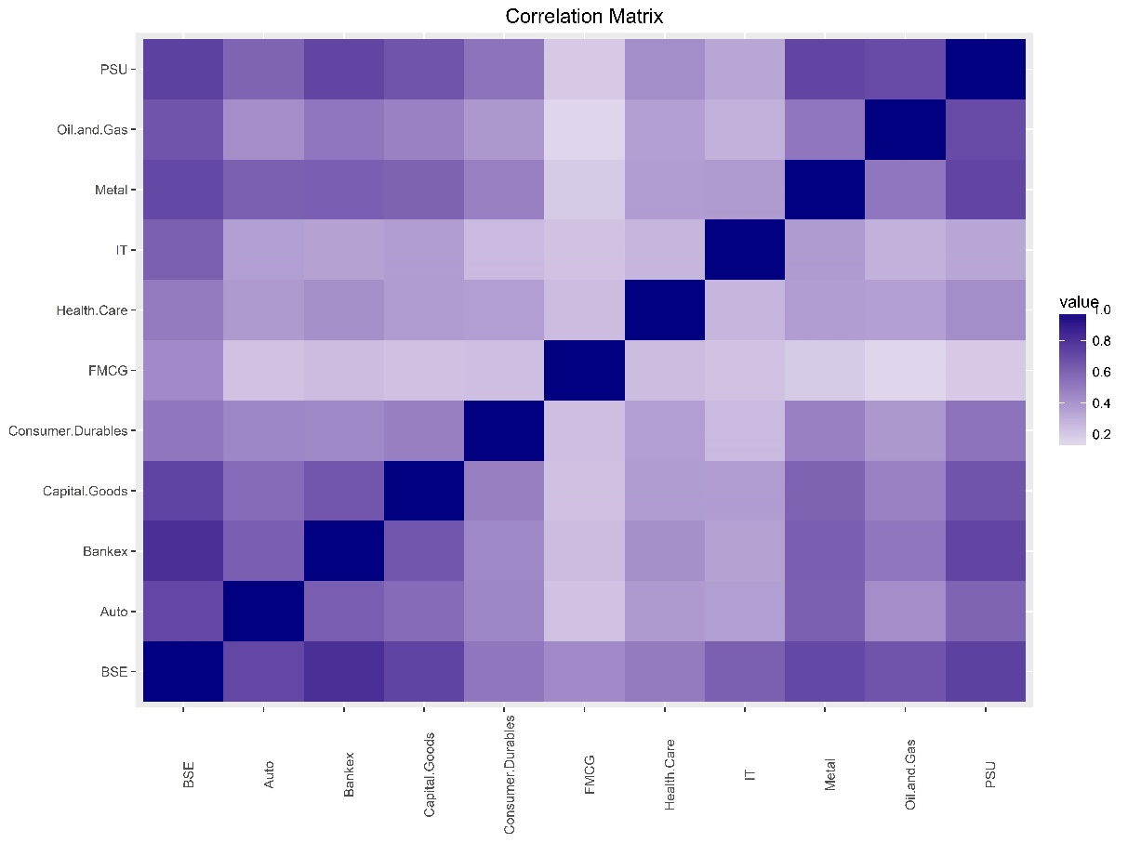
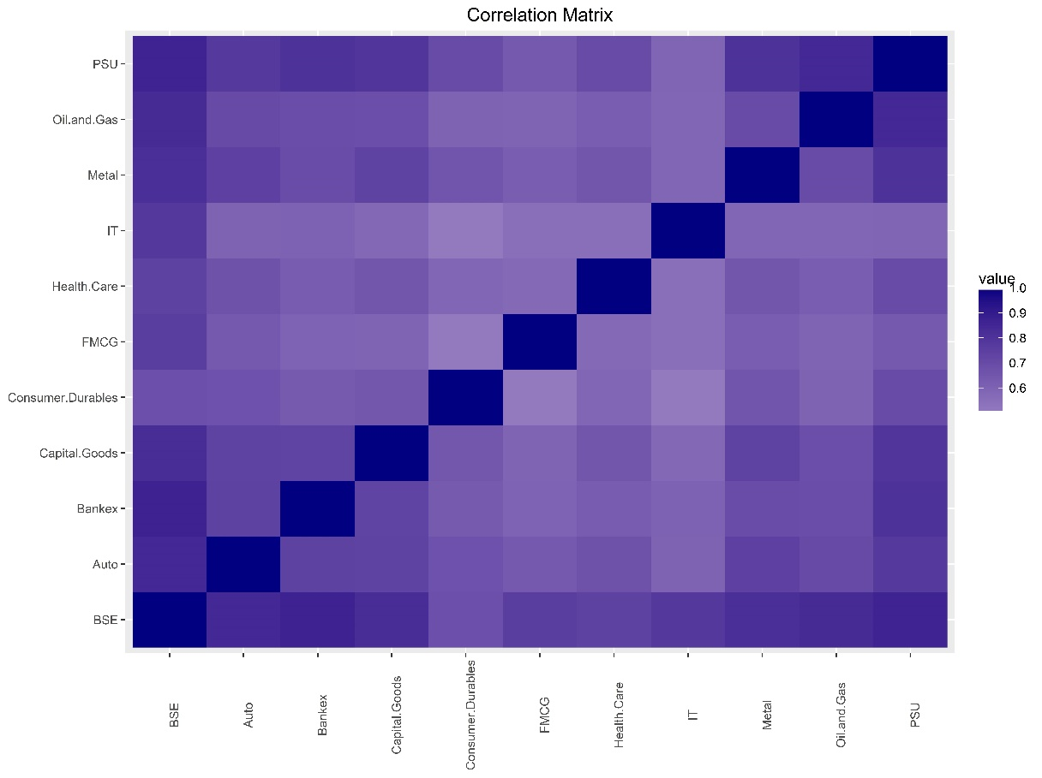
Method (2): Results
Correlation Matrix for State 3
Correlation Matrix for State 4

Slide 19
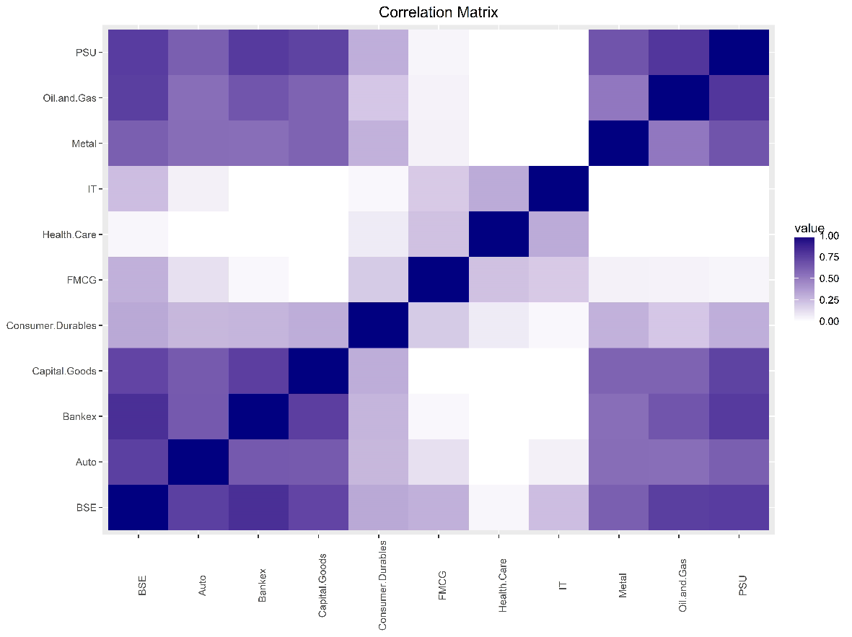
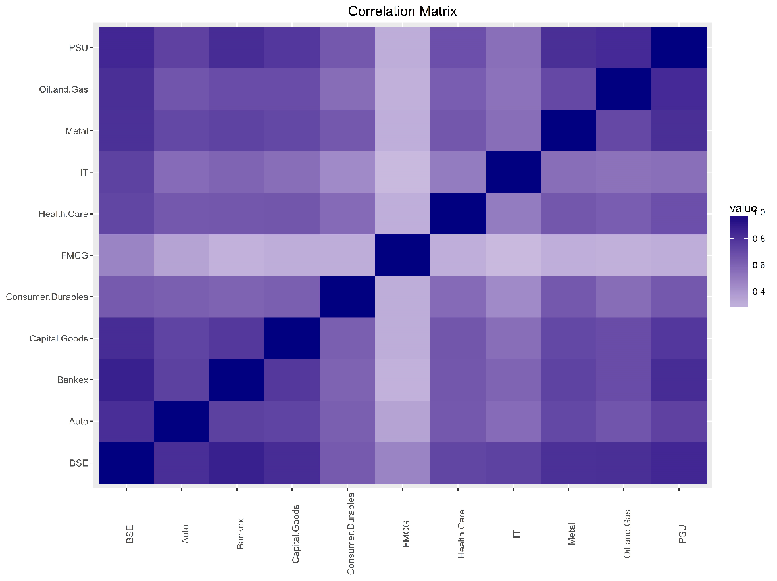
Method (2): Results
Correlation Matrix for State 5
Correlation Matrix for State 6

Slide 20
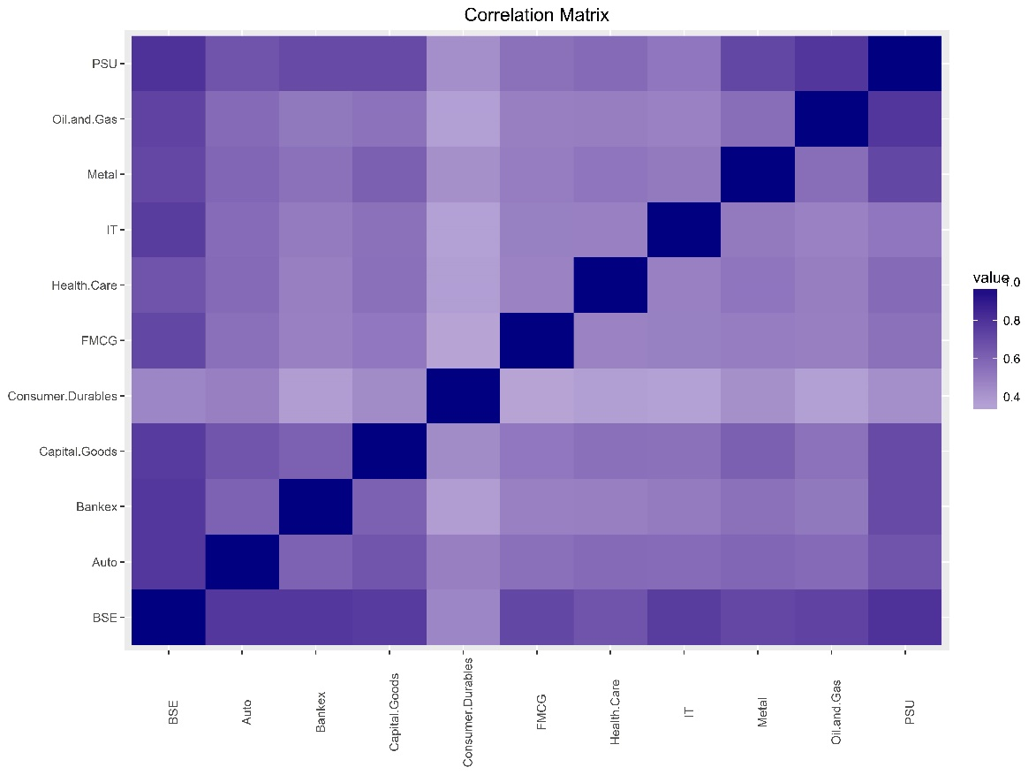
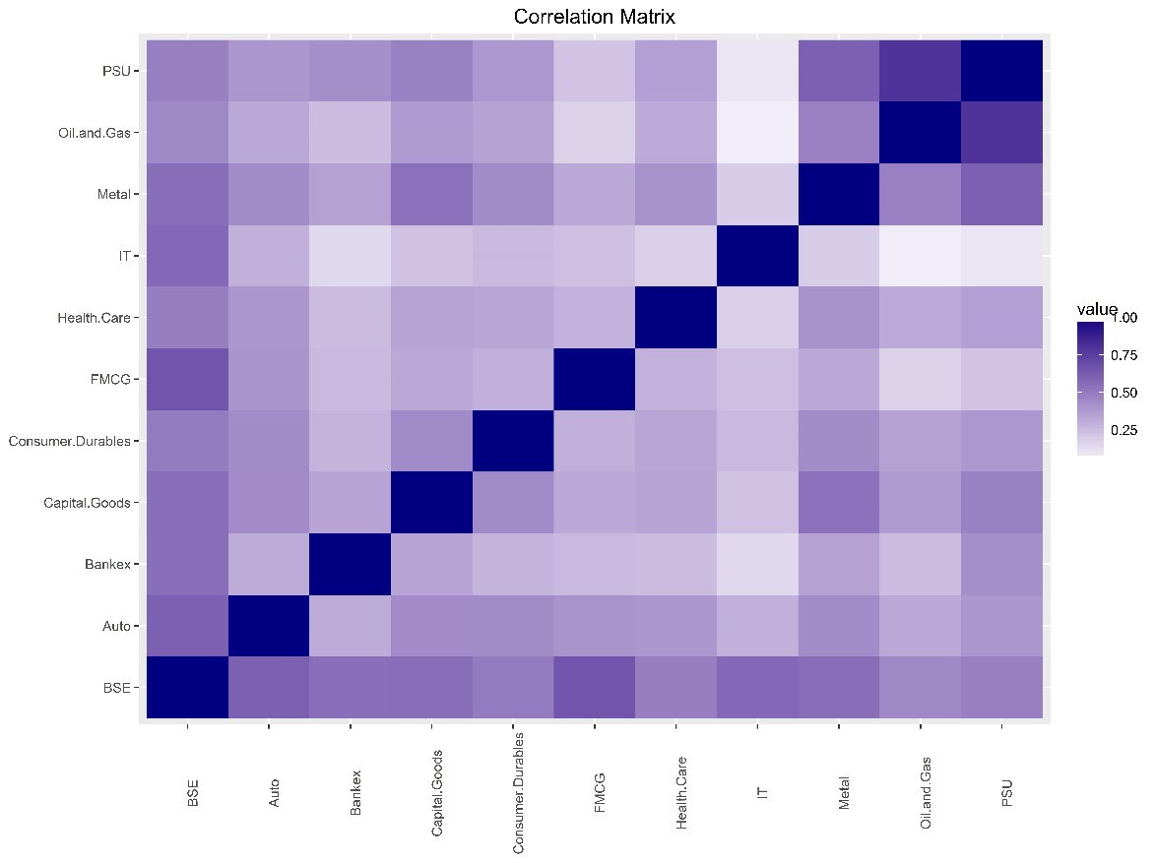
Method (2): Results
Correlation Matrix for State 7
Correlation Matrix for State 8

Slide 21
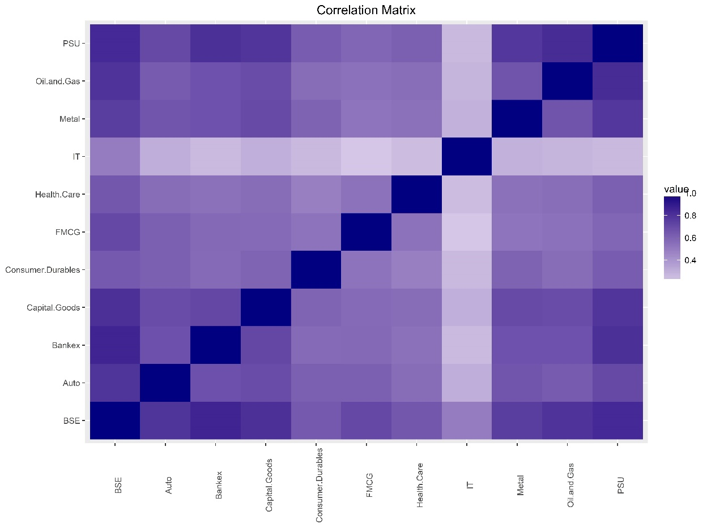
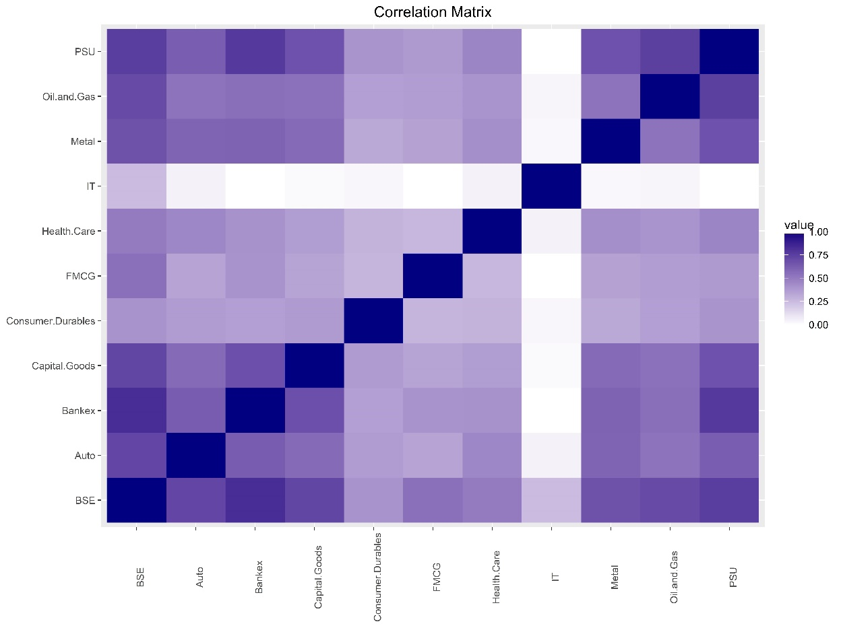
Method (2): Results
Correlation Matrix for State 9
Correlation Matrix for State 10

Slide 22
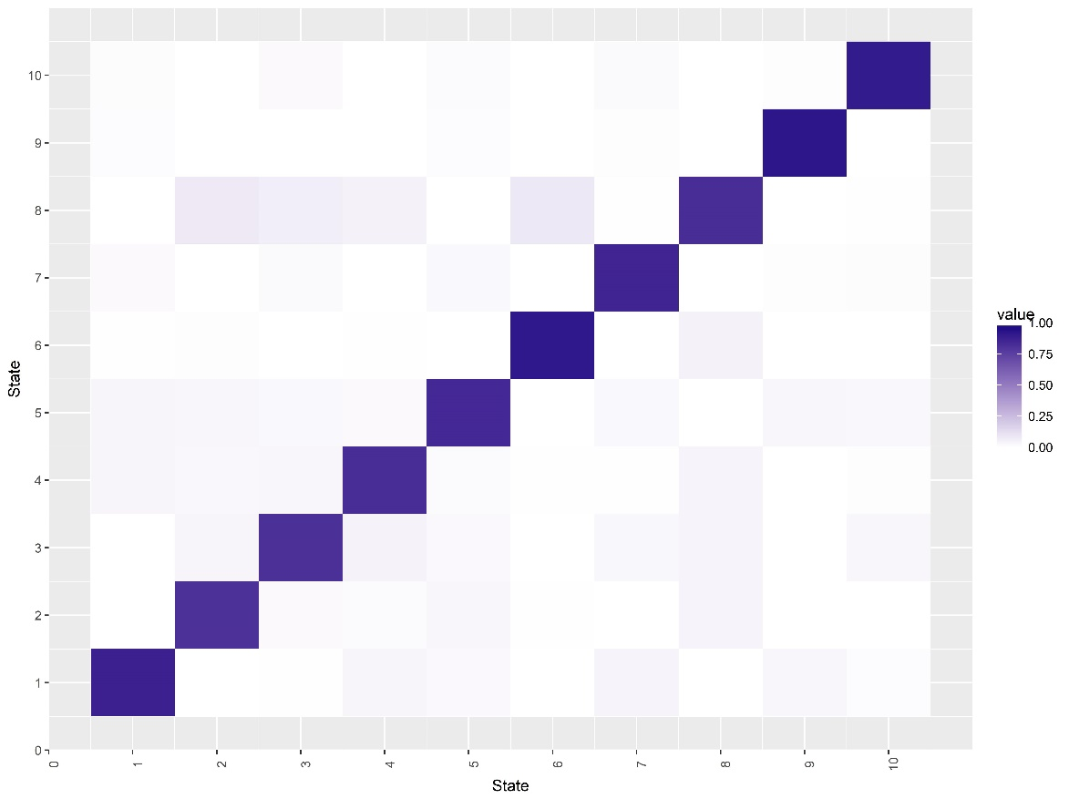
Method (2): Results
Transition probability matrix
 | 1 | 2 | 3 | 4 | 5 | 6 | 7 | 8 | 9 | 10
1 | 0.875 | 0.000 | 0.000 | 0.038 | 0.038 | 0.003 | 0.020 | 0.000 | 0.015 | 0.013
2 | 0.000 | 0.812 | 0.038 | 0.028 | 0.035 | 0.006 | 0.000 | 0.082 | 0.000 | 0.000
3 | 0.002 | 0.021 | 0.814 | 0.031 | 0.027 | 0.000 | 0.023 | 0.062 | 0.000 | 0.021
4 | 0.036 | 0.018 | 0.047 | 0.825 | 0.020 | 0.002 | 0.000 | 0.052 | 0.000 | 0.000
5 | 0.024 | 0.031 | 0.024 | 0.020 | 0.844 | 0.000 | 0.026 | 0.000 | 0.013 | 0.018
6 | 0.000 | 0.002 | 0.000 | 0.002 | 0.000 | 0.912 | 0.000 | 0.084 | 0.000 | 0.000
7 | 0.042 | 0.000 | 0.031 | 0.004 | 0.027 | 0.000 | 0.862 | 0.004 | 0.008 | 0.023
8 | 0.000 | 0.040 | 0.041 | 0.040 | 0.002 | 0.050 | 0.000 | 0.827 | 0.000 | 0.000
9 | 0.035 | 0.000 | 0.000 | 0.000 | 0.035 | 0.000 | 0.006 | 0.000 | 0.919 | 0.006
10 | 0.016 | 0.000 | 0.031 | 0.006 | 0.028 | 0.000 | 0.013 | 0.003 | 0.000 | 0.903
Stationary probability
1 | 2 | 3 | 4 | 5 | 6 | 7 | 8 | 9 | 10
0.051 | 0.118 | 0.074 | 0.041 | 0.139 | 0.180 | 0.122 | 0.055 | 0.119 | 0.102
Heatmap of Transition matrix

Slide 23
Conclusions
We estimated states using error and we can see that market surely moves in states but states are not distinguishable by simple models. This can be concluded from the fact that the steady probabilities are similar and also not very different in terms of numerical value.
An important conclusion can be seen from heatmap of transition matrix is the presence of market inertia, we see that market is more likely to be in the same state than to make the transition to another state.
The steady state probabilities obtained in second method tell us that likelihood of state 6 in highest. Which can be justified, as in long term the consumption of consumer goods will slightly be affected by market, as dependence on this sector is high.
With this transition probability and State models, the traders and investors can design trading strategies based on the current states.

Slide 24
References
Robert G Gallager. "Discrete Stochastic Process". Springer, Boston, MA. (1996)
Michael C. Münnix, Takashi Shimada, Rudi Schäfer, Francois Leyvraz, Thomas H. Seligman, Thomas Guhr & H. Eugene Stanley. Identifying States of a Financial Market. Scientific Reports volume2, Article number: 644. (2012)
Faber, V. Clustering and the continuous k-means algorithm. Los Alamos Science 22, 138–144. (1994)
Tastan, H. Estimating time-varying conditional correlations between stock and foreign exchange markets. Physica A 360, 445–458. (2006)
Pelletier, D. Regime switching for dynamic correlations. Journal of Econometrics 131, 445–473. (2006)

Slide 25
Thank You

