Slide 1

HEALTH INSURANCE PREDICTION
BDNS ET Assignment Using SPARK ML
Soumyojit Basu
C23032
PGPDS
Praxis Business School

Slide 2
OBJECTIVE
To predict health insurance using various features

Slide 3
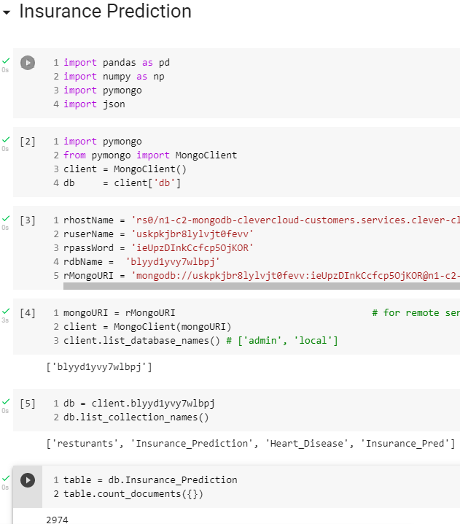
MONGO DB
Data stored in Mongo DB remote server.
Clever Cloud used to host the data
Data fetched from the cloud using Clever Cloud credentials and proceeded with EDA

Slide 4
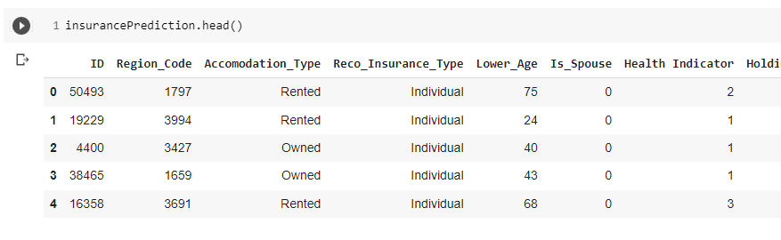
DATASET
Health Insurance dataset downloaded from Kaggle
There are 11 columns
The “Response” column is the target variable
There are no null values in the dataset
There are 2974 records

Slide 5
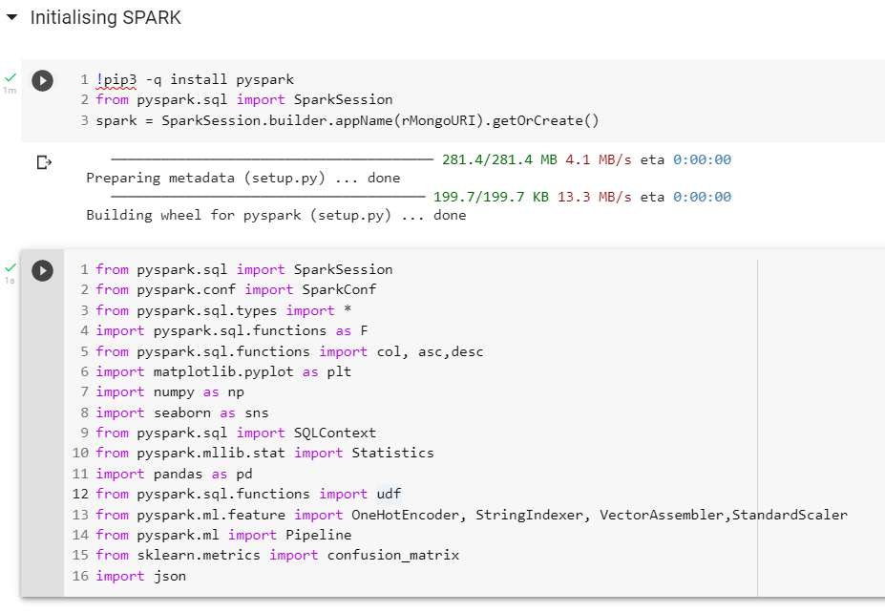
INITIALISING SPARK
Installed Pyspark in google colab
Imported all the necessary libraries

Slide 6
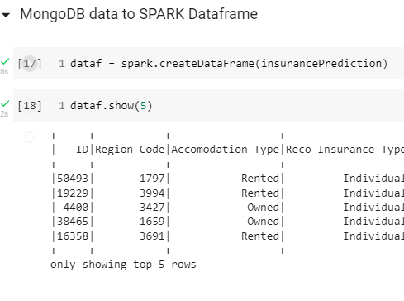
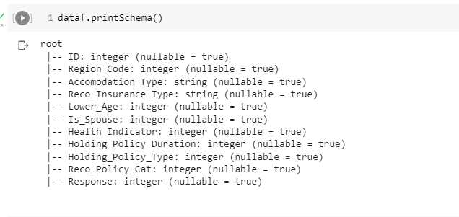
SPARK DATAFRAME & COLUMN DATATYPE
Created Spark Dataframe
Checked and converted the column datatypes as required

Slide 7
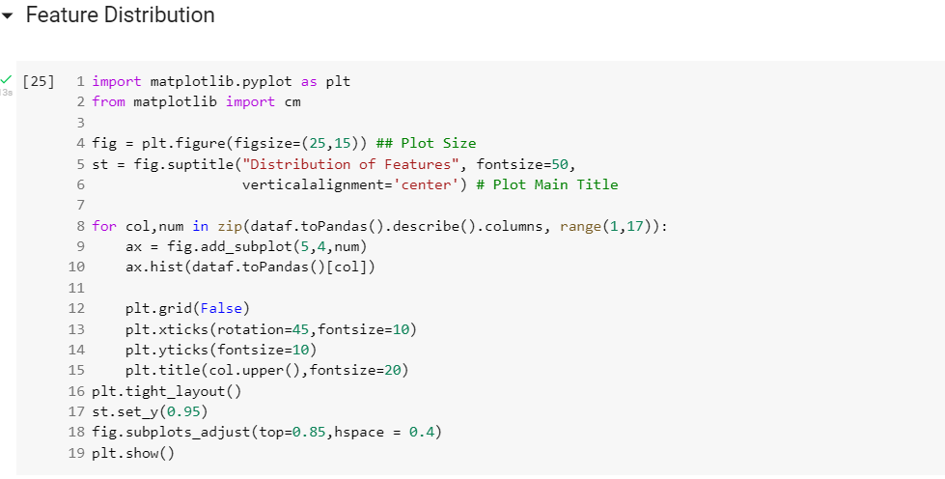
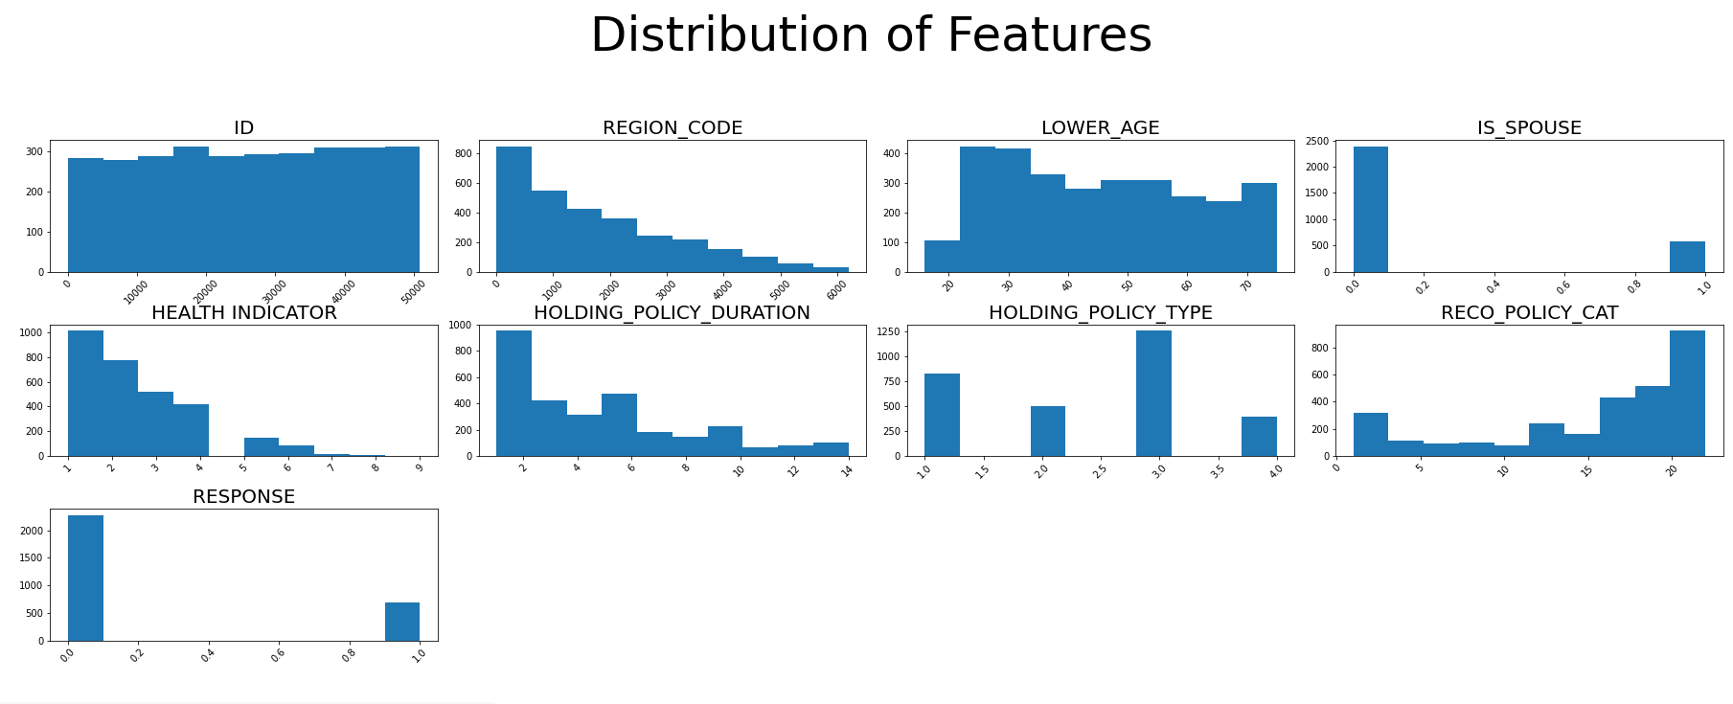
Feature Distribution

Slide 8
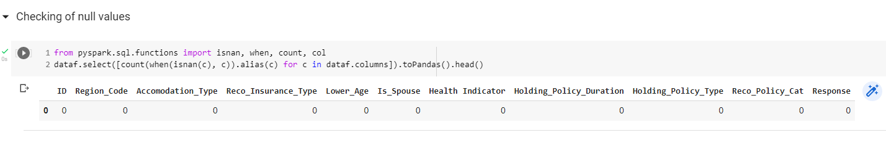
CHECKING FOR NULL VALUES

Slide 9
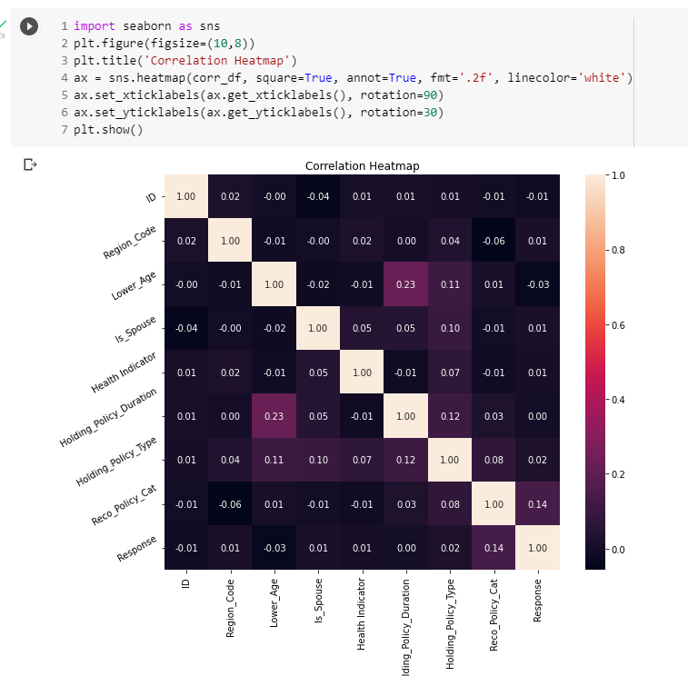
CORRELATION HEAT MAP
None of the variables have values more than 0.5
Thus there is minimal chance of multicollinearity

Slide 10
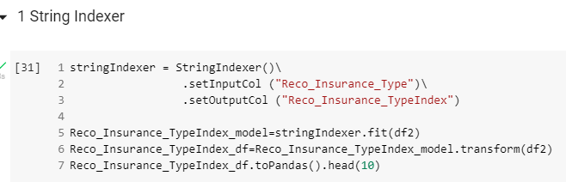
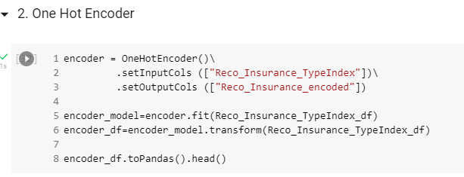
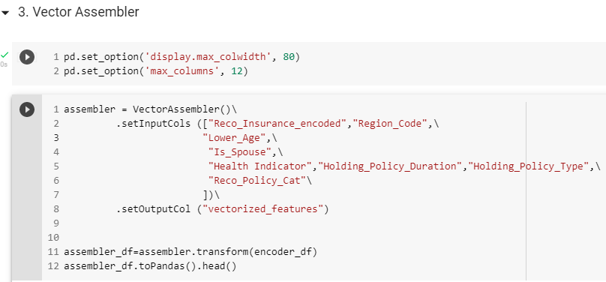
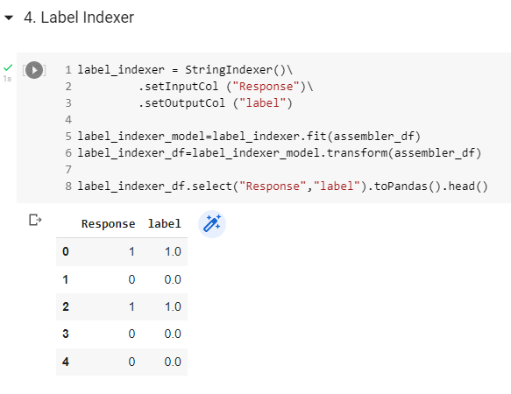
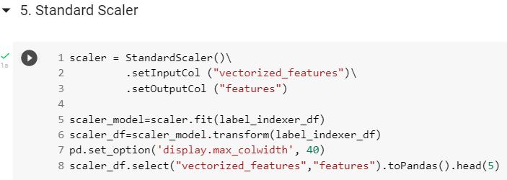
DATA PRE-PROCESSING
String Indexer
One Hot Encoder
Vector Assembler
Label Indexer
Standard Scaler

Slide 11
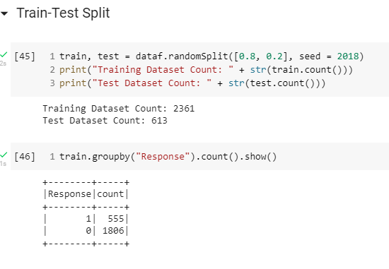
TRAIN TEST SPLIT
We split the data into two datasets – Train & Test
80% of the data for training
20% of data for testing

Slide 12
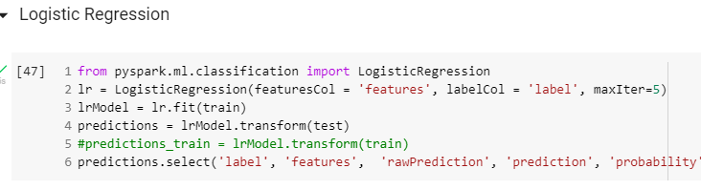
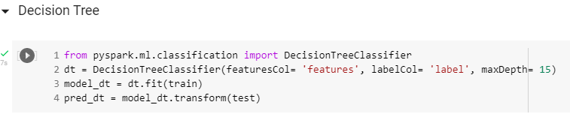
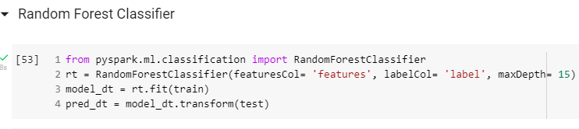
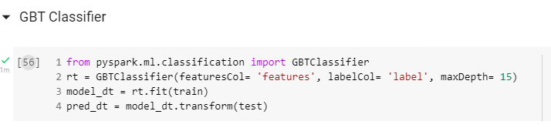
MODEL TRAINING
Logistic Regression
Decision Tree
Random Forest
GBT Classifier
4 different models used for training the data and the outputs were evaluated

Slide 13
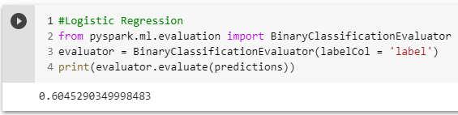
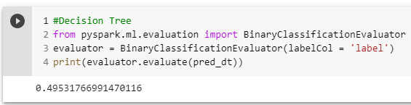
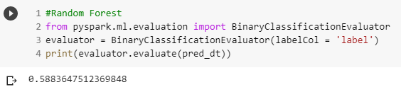
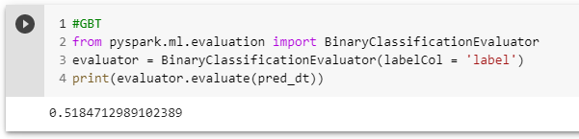
MODEL EVALUATION

Slide 14
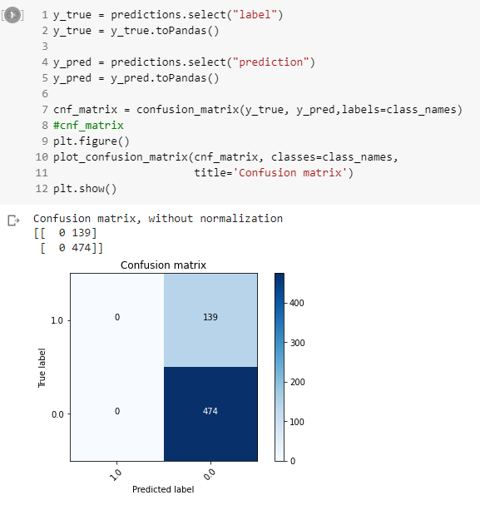
CONFUSION MATRIX

Slide 15
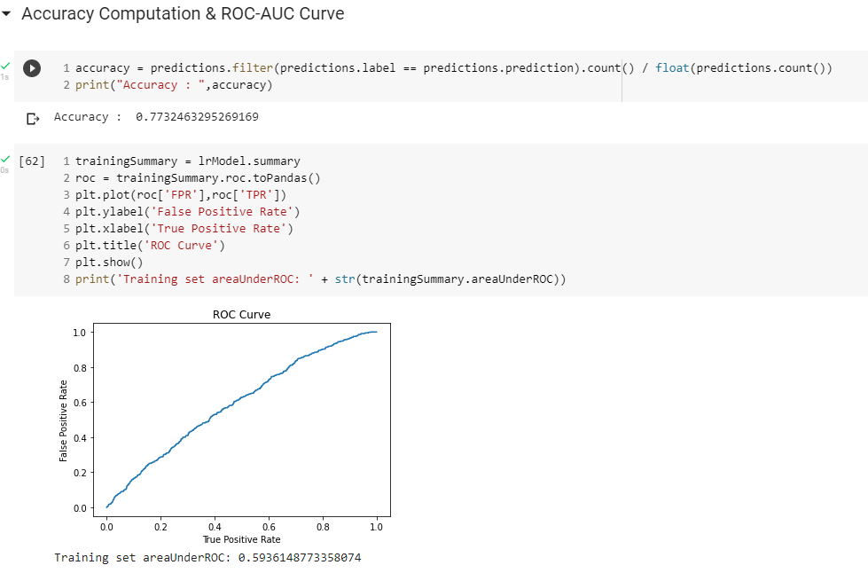
ROC CURVE

Slide 16
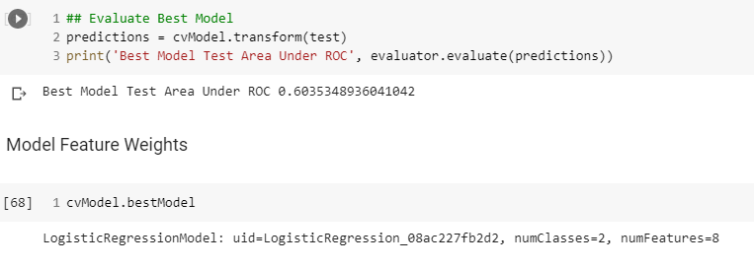
CONCLUSION - BEST MODEL

