Slide 1
IBM University Engagement Project Submission
“Exploring the Power of Agentic AI with IBM Granite and IBM Bob”

Slide 2
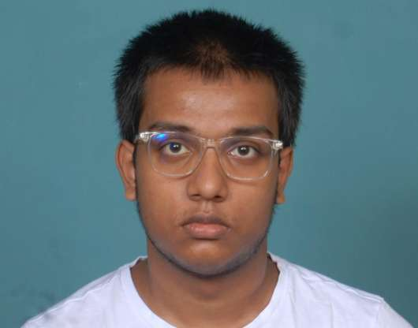
Project Tile – Street Vendor Digitalization Agent
Domain of Project – Micro-Entrepreneurship & MSME Development
Student Name | Recent Passport Photo | Email ID | Mobile number [WhatsApp]
Sounak Bose |  | sounakbose80@gmail.com | 9831480260
Recommended font style and size: Font Style: Arial Font Size (Heading): 28
Font Size (Content): 20

Slide 3
Problem Statement -
Problem Statement : Street Vendor Digitalization Agent
The Challenge
A Street Vendor Digitalization Agent, powered by RAG (Retrieval-Augmented Generation), helps local hawkers and micro-entrepreneurs become digitally visible by generating business profiles, UPI setup guides, local SEO strategies, and customer engagement tips. It retrieves real-time policies, MSME schemes, geolocation of business data, digital onboarding steps, and consumer behavior insights from government portals, fintech apps, and commerce platforms. Vendors can simply say, “I sell fruit in Pune’s Camp area,” and the agent will suggest pricing tips, online listing platforms, QR code setup, and promotional materials in their local language. This AI-driven assistant empowers informal businesses to grow digitally, unlock access to credit, and boost visibility in the hyperlocal economy.
The Objective
Bridging the digital divide for street vendors, hawkers, and informal-sector traders using AI-driven guidance, government scheme access, and zero-cost digital tools.
Bullet Points
Digital Visibility & Profile Creation —Generate shareable digital flyers, WhatsApp business bios, and Google Maps–ready profiles in seconds, with no prior tech knowledge required.
Hyperlocal SEO & Marketing Guidance —Deliver city-specific strategies (Pune, Mumbai, Delhi) covering Google Business Profile, Justdial listings, Instagram reels, and WhatsApp broadcast campaigns.
Fintech & UPI Onboarding Assistance —Provide step-by-step QR code setup walkthroughs for GPay, PhonePe, Paytm, and BHIM, enabling vendors to accept digital payments with zero transaction cost.
Scheme & Credit Access (PM SVANidhi / MSME Mudra) —Surface collateral-free loan eligibility, application pathways, and subsidy details grounded in verified government policy data.
Multilingual & Accessibility Focus —Support for English, Hindi, and Marathi with large-text, high-contrast, mobile-first UI optimised for low-end Android devices on 4G connectivity.

Slide 4
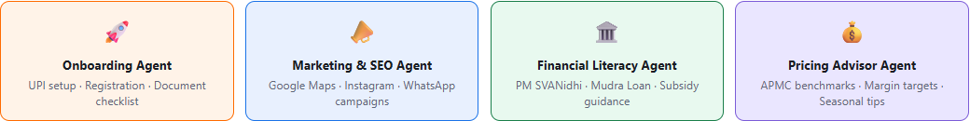
Proposed Solution -
An Agentic RAG Platform — From Query to Actionable Outcome
RAG Pipeline
The system is built on a Retrieval-Augmented Generation (RAG) pipeline powered by IBM's Granite language model. When a vendor submits a query — typed or voice-transcribed — the backend performs keyword-weighted retrieval across a curated knowledge base sourced from government portals (PM SVANidhi, MSME Mudra), fintech onboarding guides (UPI, QR setup), regional APMC pricing benchmarks, and hyperlocal marketing templates for Tier-1 and Tier-2 Indian cities. The top-3 most relevant context blocks are dynamically injected into a structured system prompt before being submitted to ibm/granite-4-h-small via the watsonx.ai generation API — ensuring every response is grounded in verified, policy-accurate information rather than model hallucination.
Multi-Agent Architecture & Interface
The solution employs a multi-agent orchestration model with four specialised agents operating in collaboration: an Onboarding Agent that guides vendors through registration and UPI setup; a Marketing & SEO Agent that generates localised digital content and listing strategies; a Financial Literacy Agent that surfaces scheme eligibility and loan application steps; and a Pricing Advisor Agent that computes optimal margin targets based on commodity type and city. This agentic layer sits above a mobile-first web dashboard built with Python (Flask), HTML5, CSS3, and vanilla JavaScript — requiring no app installation and running in any modern mobile browser.
Four Specialised Agents

Slide 5
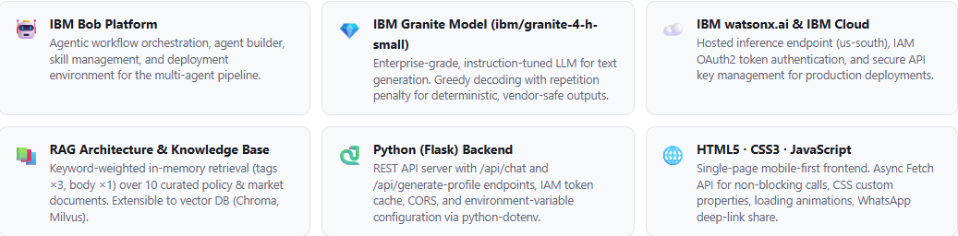
Technology Used
Full-Stack AI Technology — From Model to Mobile Browser
Technology Stack Cards
Bullet-List Version
IBM Bob Platform— Orchestration, workflow, and skill deployment
IBM Granite ibm/granite-4-h-small— Core language model for generation
IBM watsonx.ai & IBM Cloud— Inference API, IAM authentication, secure hosting
RAG Architecture / In-Memory Knowledge Base— Keyword-scored contextual retrieval
Python (Flask)— REST backend, token management, prompt engineering
HTML5 · CSS3 · Vanilla JavaScript— Mobile-first SPA, async API calls

Slide 6
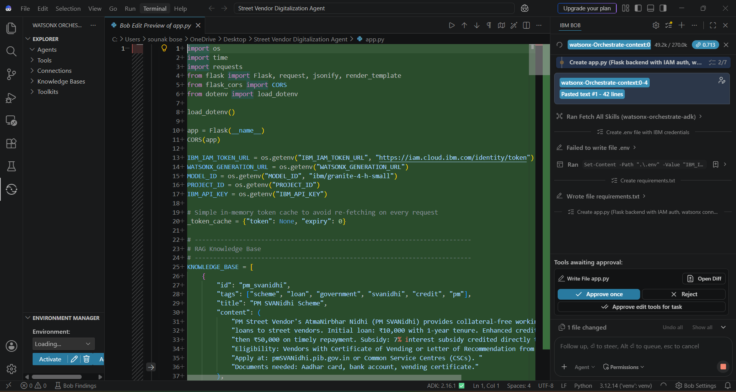
Required Files created using IBM bob -

Slide 7
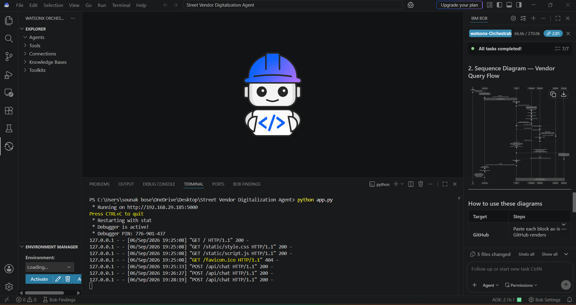
IBM Bob Screenshots:

Slide 8
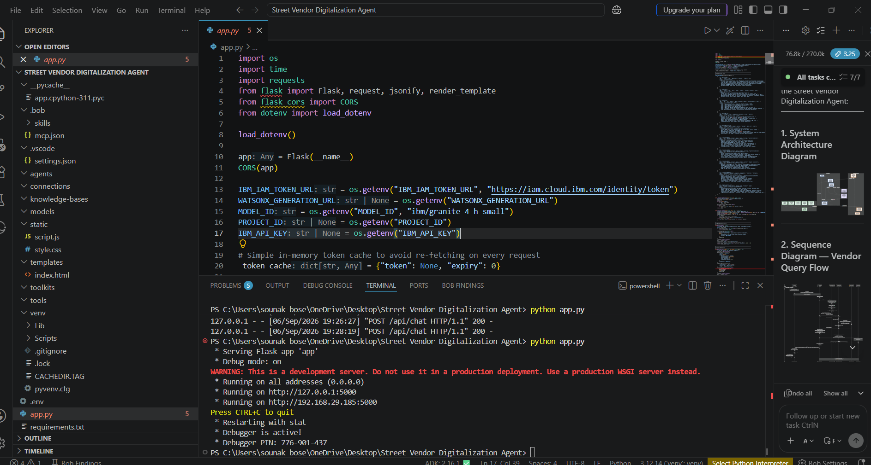

Slide 9
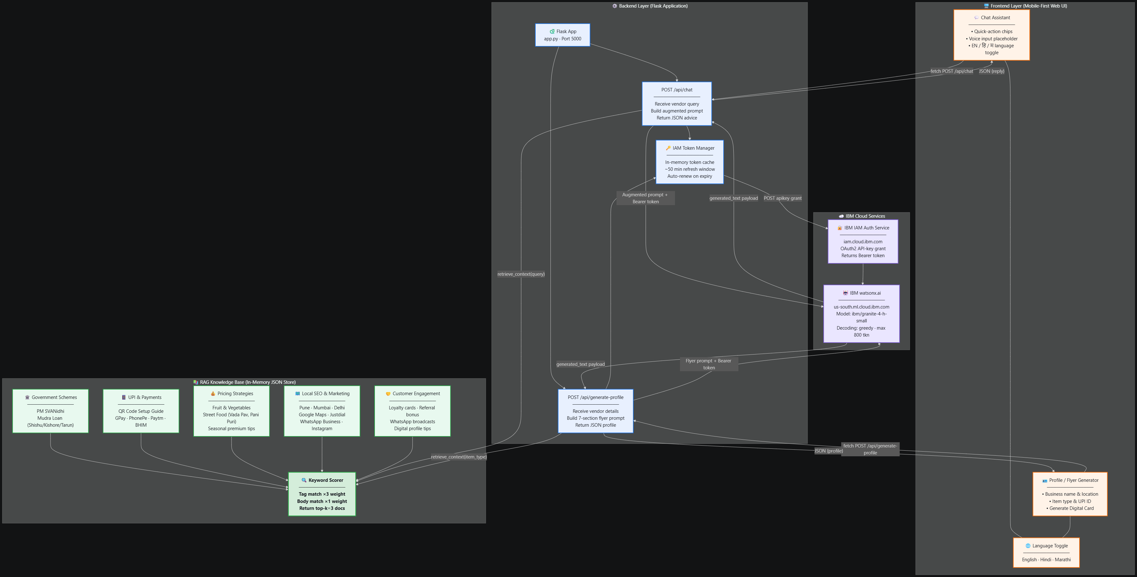
Architecture blueprint for IBM bob:

Slide 10
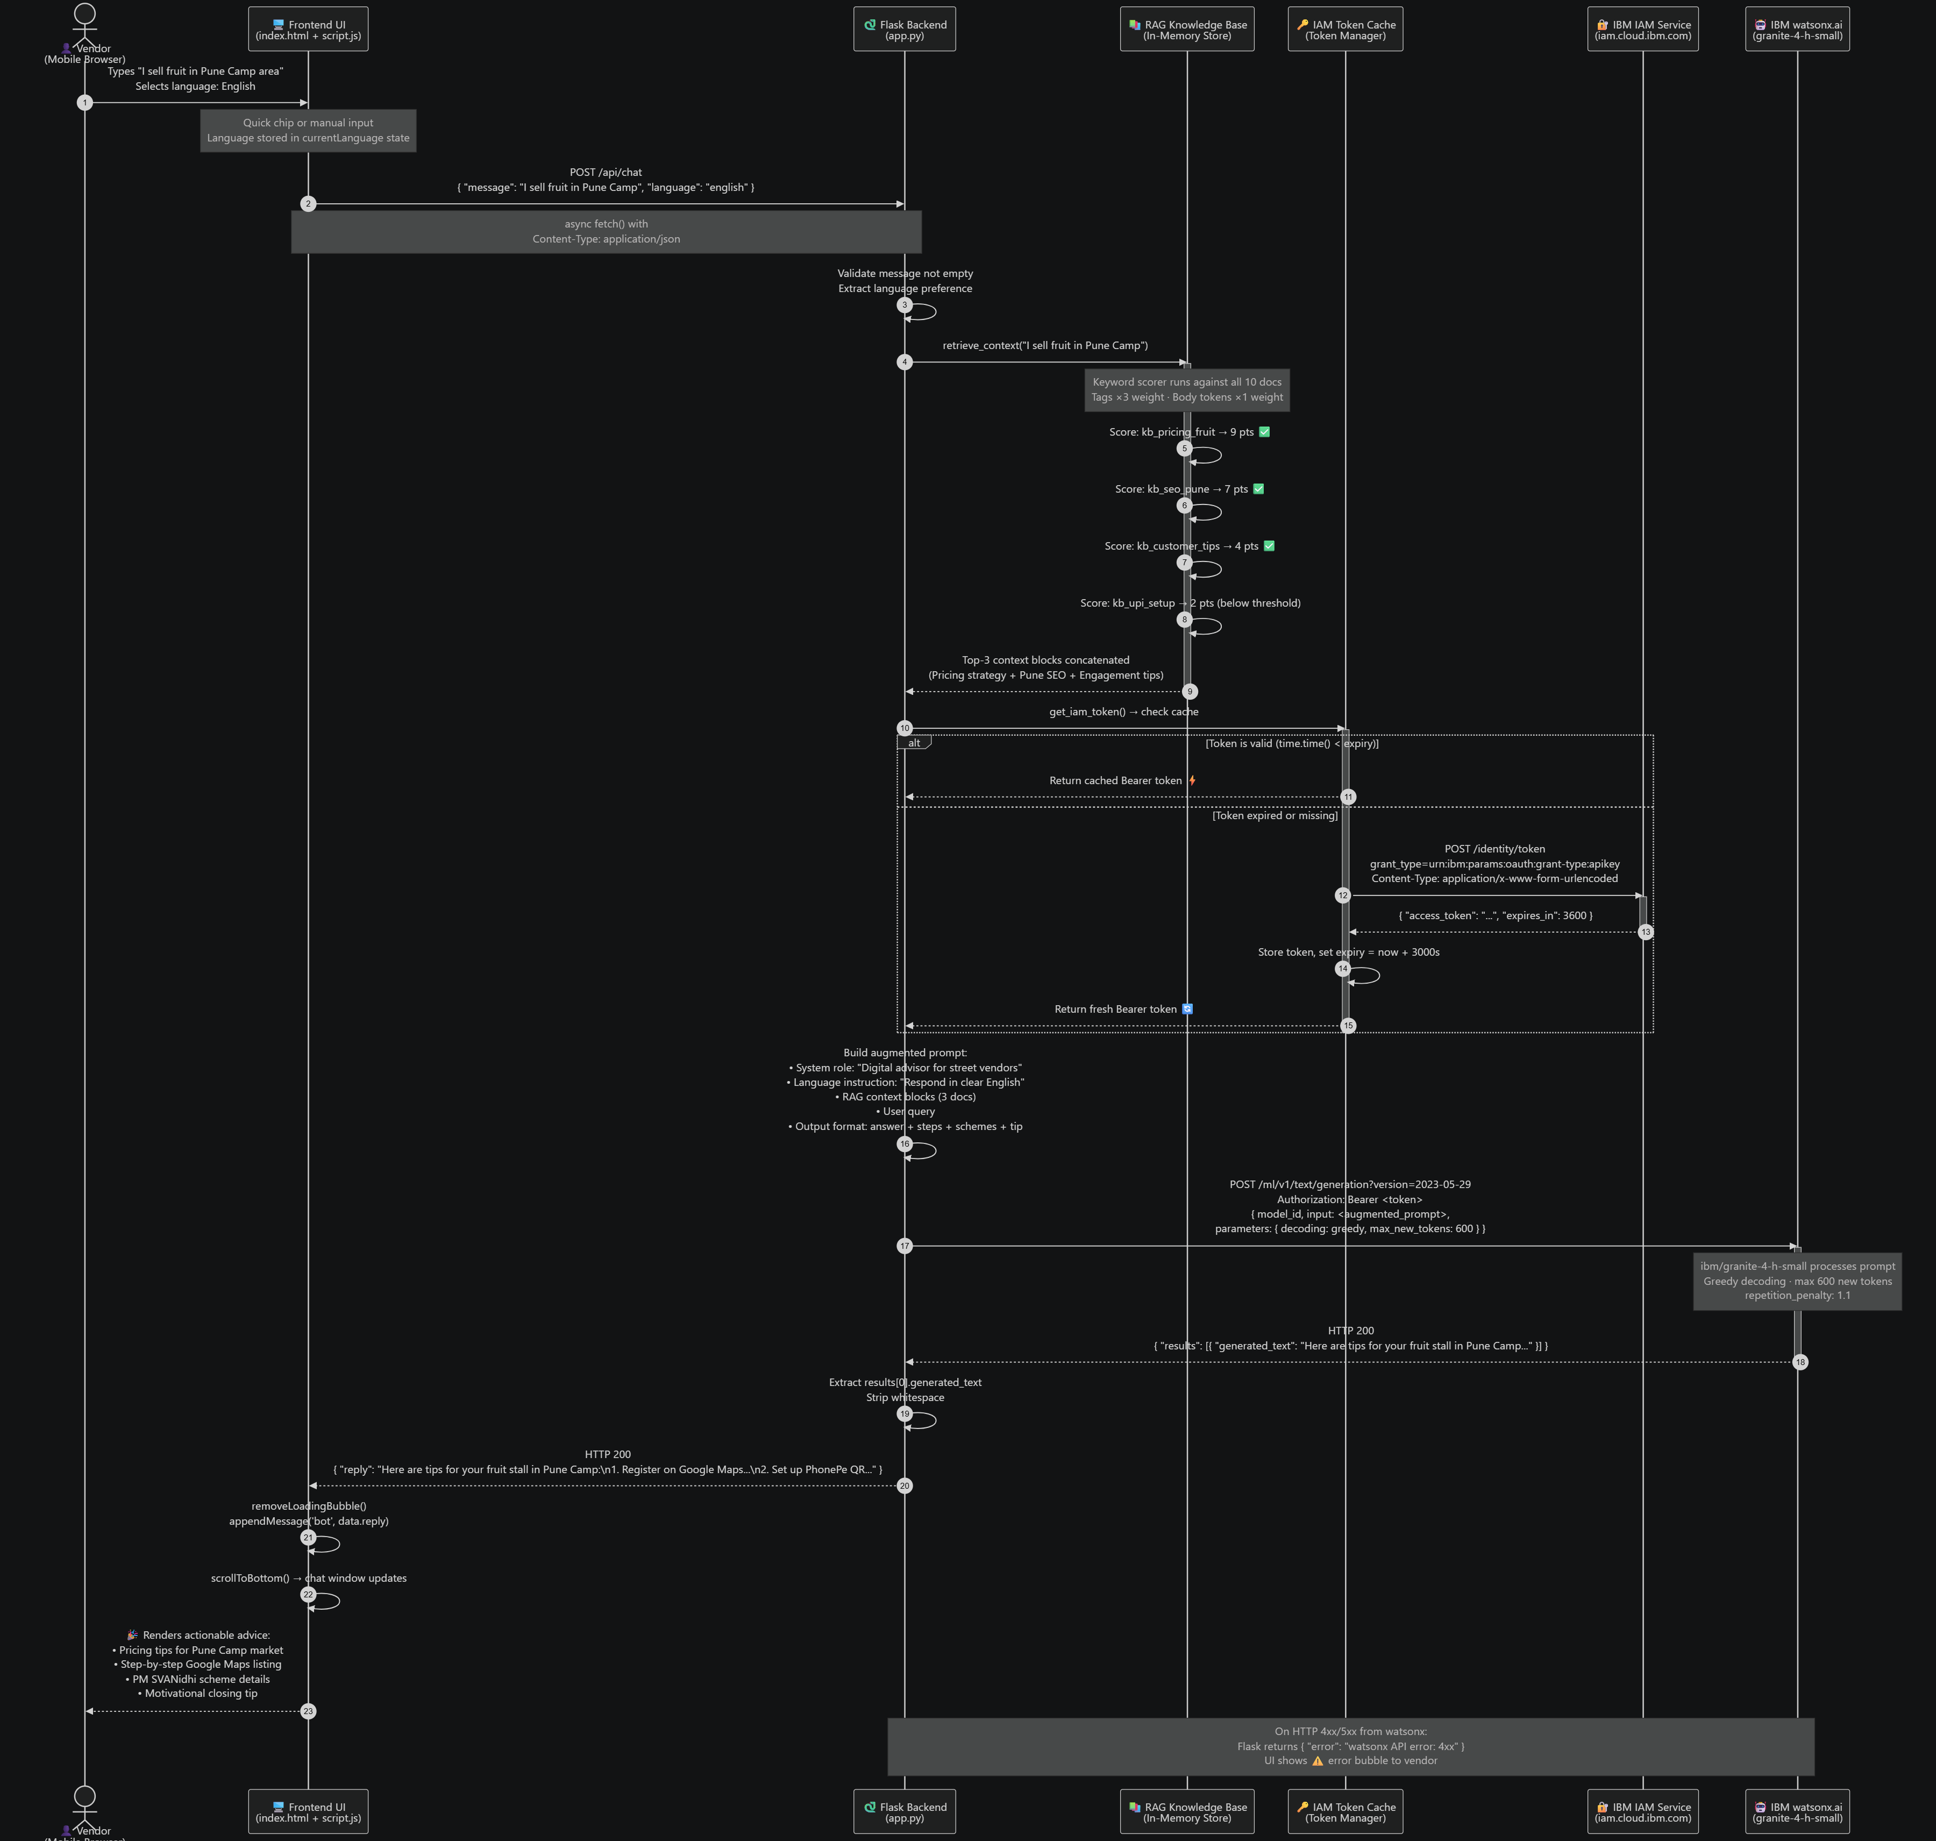
Sequence Diagram — Vendor Query Flow

Slide 11
Role of Agentic AI in the solution
Beyond Chatbots — A Proactive, Context-Driven Agent System
A conventional chatbot retrieves static FAQ responses. The Street Vendor Digitalization Agent operates as a goal-directed, autonomous multi-agent system — each agent perceives vendor context, selects tools, and executes multi-step tasks without manual intervention.
Bullet Points
Autonomous Multi-Agent Collaboration —Four specialised agents (Onboarding, Marketing & SEO, Financial Literacy, Pricing Advisor) coordinate in parallel. Each agent maintains its own domain knowledge and tool access, delegating sub-tasks between agents rather than relying on a single monolithic model call.
Context Awareness (Location · Vendor Type · Market Needs) —The system extracts implicit context from natural language input — inferring city (Pune, Mumbai, Delhi), commodity type (fruit, street food, garments), and business maturity level — to serve hyper-personalised, actionable output rather than generic guidance.
Proactive Recommendations & Step-by-Step Task Execution —Rather than answering a single question, agents decompose vendor goals into ordered sub-tasks (e.g., "Set up UPI → list on Google Maps → apply for PM SVANidhi → join local WhatsApp groups") and walk the vendor through each step sequentially.
Dynamic Adaptation Based on Vendor Input —Agents re-rank knowledge base retrieval, adjust prompt structure, and modify output language and complexity in real time based on vendor responses — delivering progressively refined advice as the conversation evolves.
Grounded Outputs via RAG — No Hallucination Risk —Every agent response is anchored to verified retrieval context before generation. IBM Granite is instructed to cite only facts present in the injected knowledge context, ensuring policy data (loan amounts, subsidy rates, application URLs) is always accurate.

Slide 12
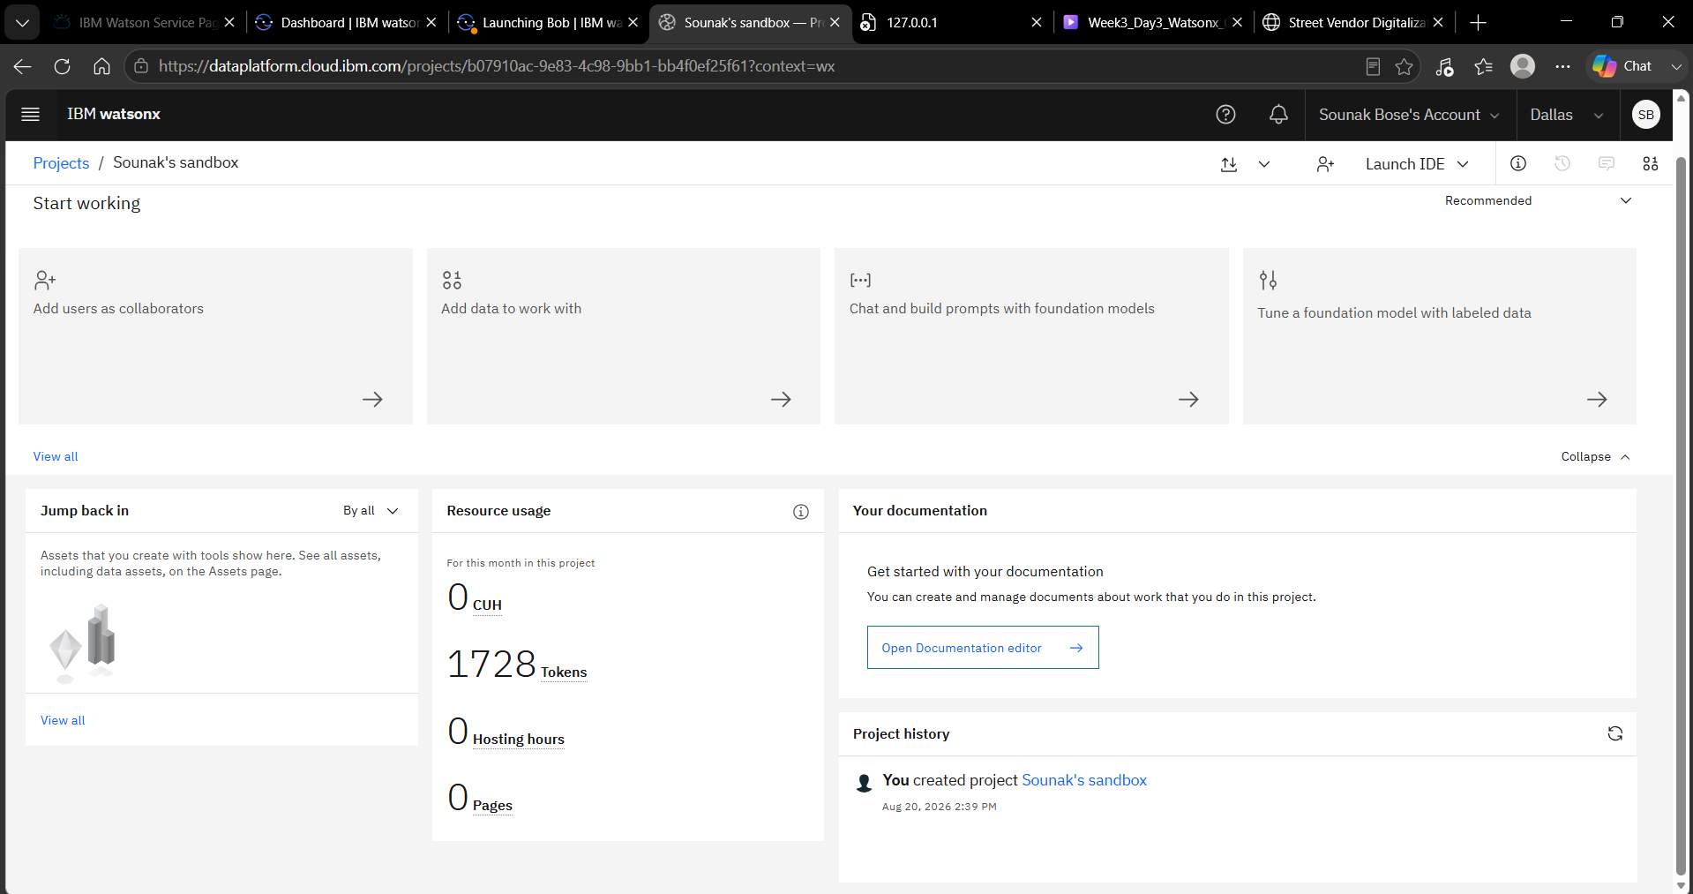
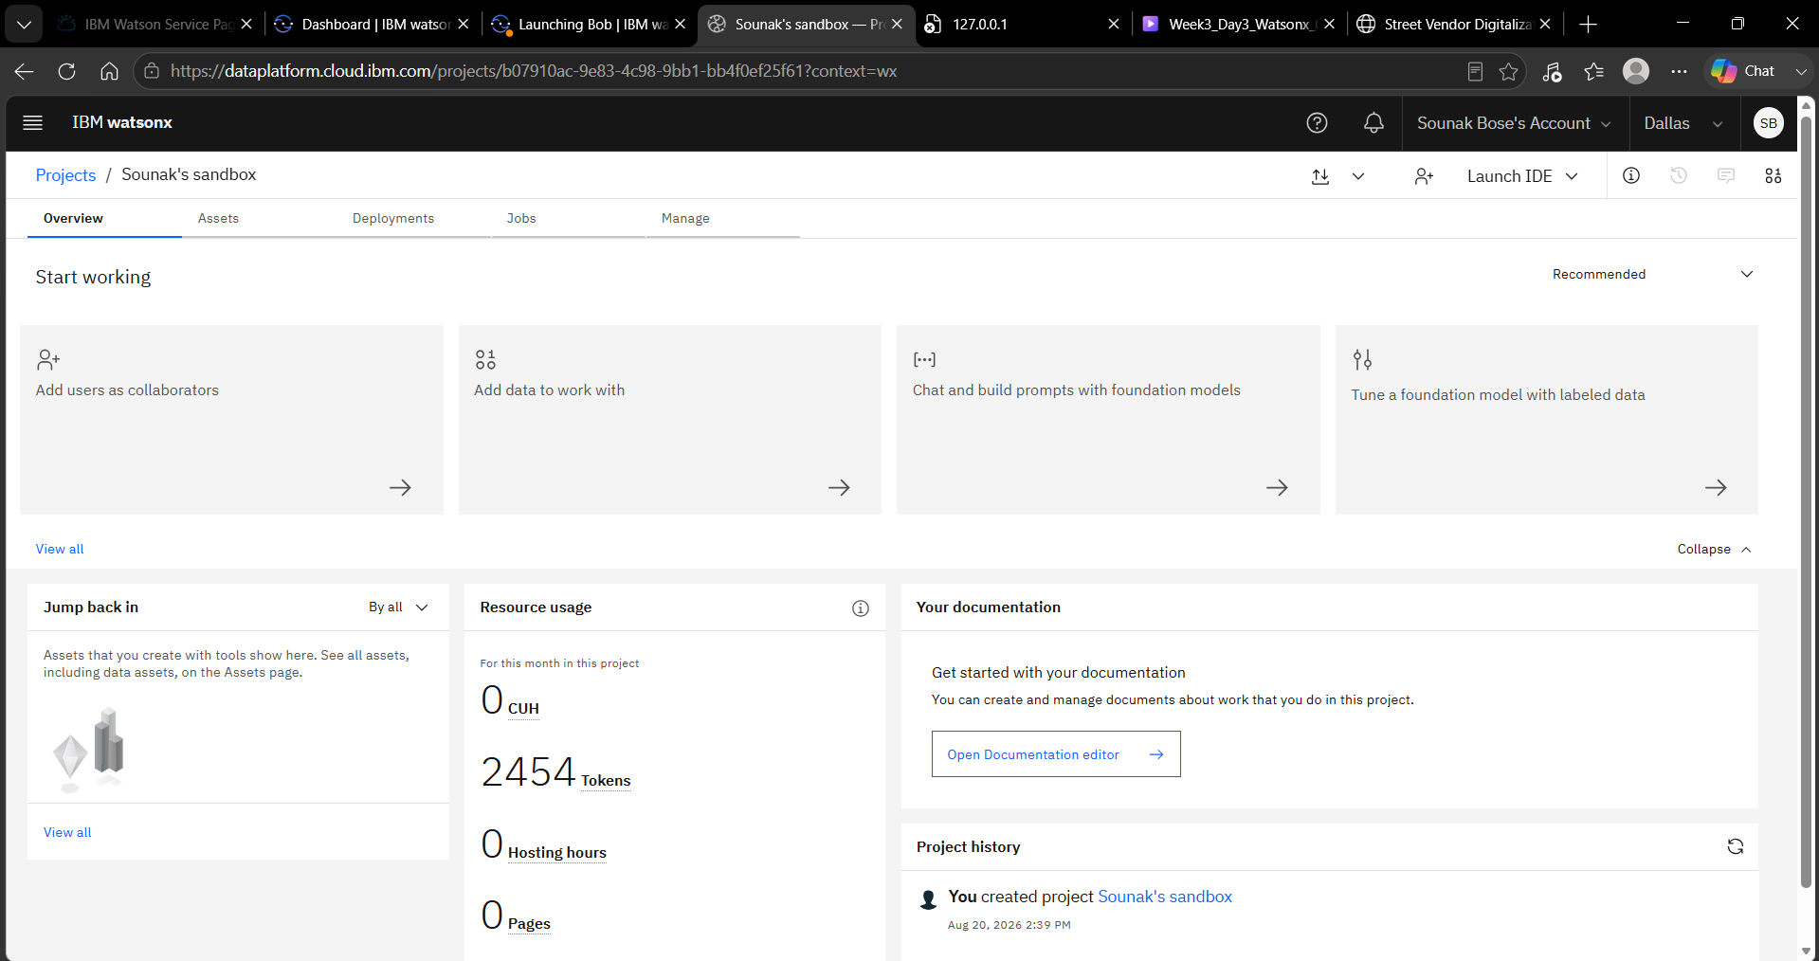
Token Usage
726 token are used
Before Prompt
After the Prompt
·
·
·

Slide 13
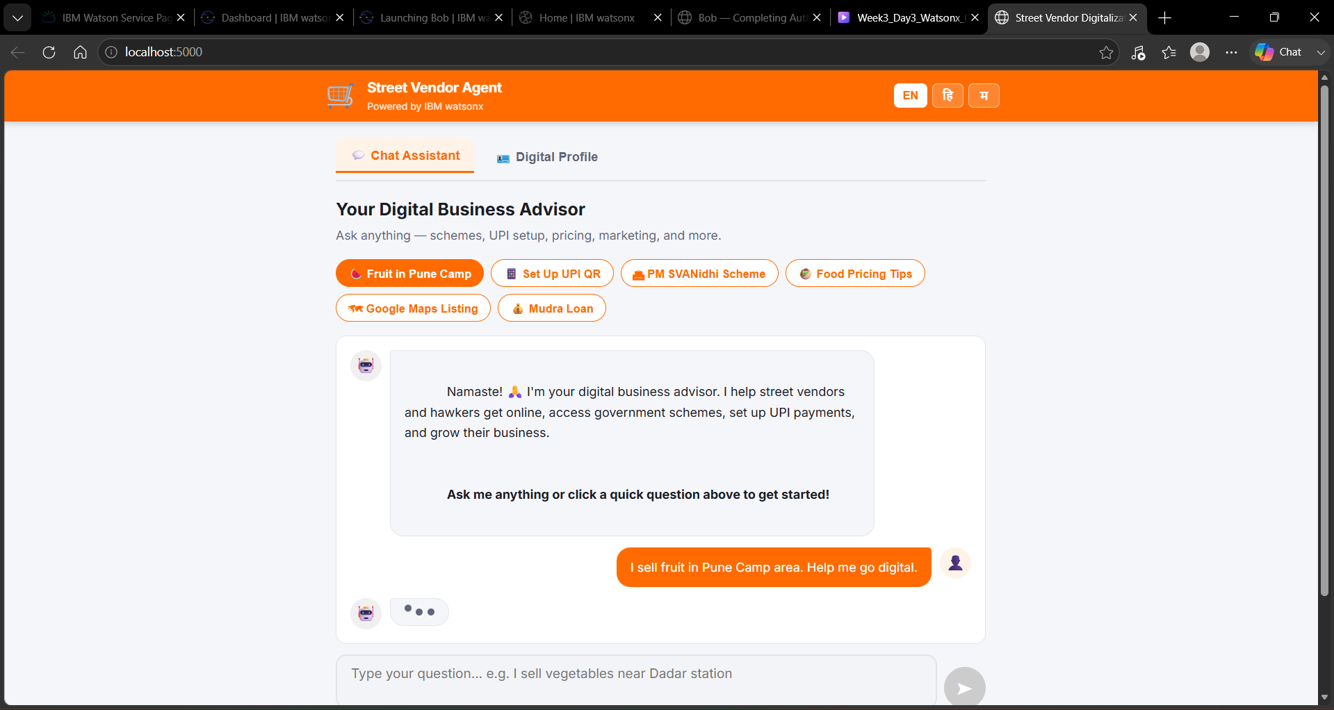
Project Output Screenshot
·
·
·

Slide 14
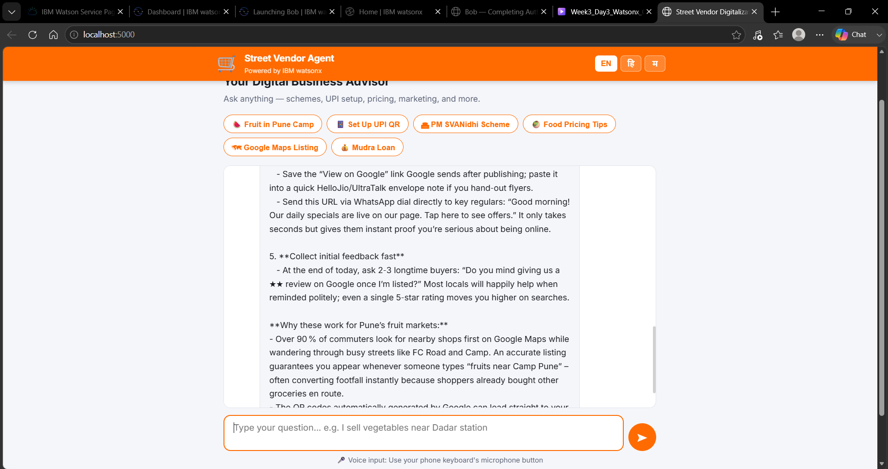
Project Output Screenshot
·
·
·

Slide 15
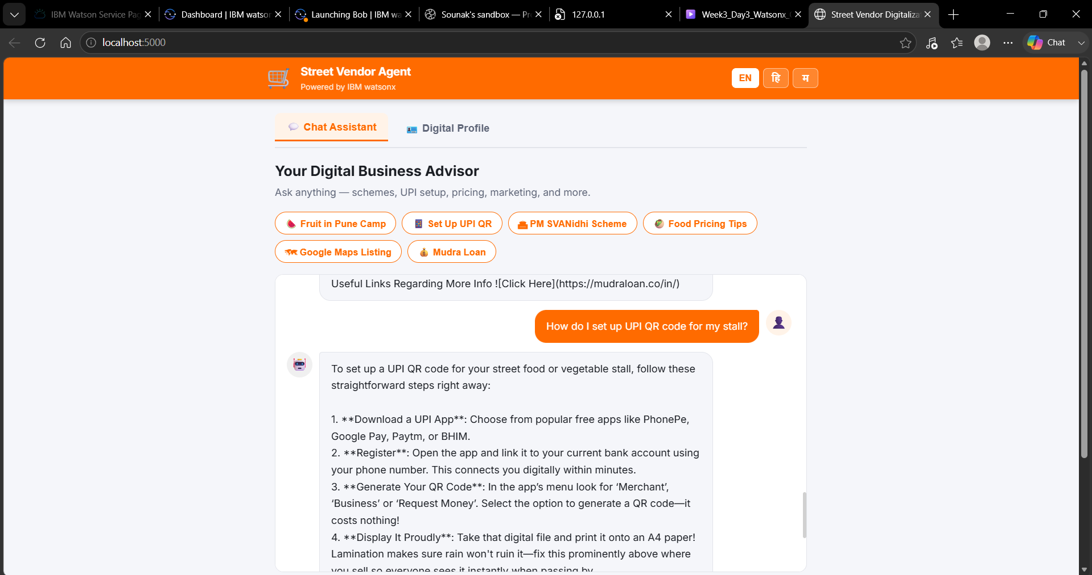
Project Output Screenshot
·
·
·

Slide 16
Novelty and Uniqueness
First-of-Kind AI Advisor Designed Exclusively for India's Informal Economy
Existing digital tools target SMEs with formal registration, English literacy, and smartphone proficiency. This solution is purpose-built for the last mile — unregistered vendors, oral-language users, and zero-internet-experience entrepreneurs.
Bullet Points
Hyperlocal & Informal-Sector Specialisation —Knowledge base is scoped exclusively to street-vendor contexts: APMC wholesale market timings, footfall-optimised locations, vending certificate workflows, and municipality-specific scheme access — not generic startup advice.
RAG-Grounded Verified Policy & Scheme Data —Unlike LLM-only chatbots prone to hallucination, all government scheme details (loan slabs, subsidy percentages, eligibility criteria, application portal URLs) are retrieved from curated, version-controlled documents — ensuring legal accuracy vendors can trust and act on.
Multi-Modal & Multi-Lingual Capability —Language toggle for English, Hindi (Devanagari), and Marathi directly instructs the Granite model to respond in the vendor's preferred language — with voice-input placeholder architecture ready for STT integration. No language is a barrier to digital access.
Zero-Jargon Simplified Business Onboarding —All outputs are engineered with a "plain language" instruction layer — financial and legal terminology is automatically translated into street-market analogies (e.g., "collateral-free" explained as "no deposit required, just your Aadhar"). Literacy barrier eliminated.
Instant Digital Asset Generation —The Profile Generator produces a complete 7-section business flyer — tagline, product descriptions, SEO keywords, WhatsApp bio, and UPI payment instructions — in under 30 seconds, replacing the need for a professional copywrite

Slide 17
Git Hub Link
· Please create public github repository (Enable Add README button while creating repository) with format –
Please test and Paste the working Github URL –
Make sure you have Uploaded following three files into your github repository 1) All Agent relevant files of IBM Cloud , 2) yourproblemstatement.pdf file 3) your projectpresntation.pptx file 4)any other files
·
·
·

Slide 18
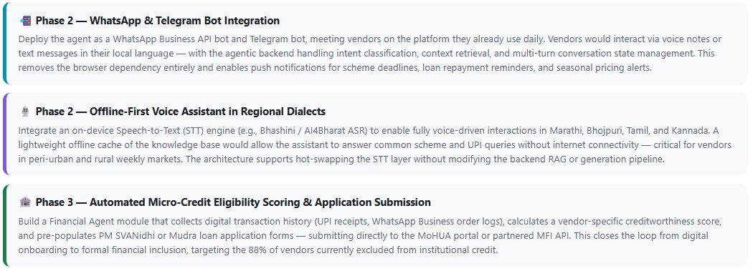
Future Scope
Roadmap — From Web App to National-Scale Digital Infrastructure
The current MVP validates the RAG + Granite architecture with a web interface. The following three enhancements form the production roadmap for Phase 2 and Phase 3 deployment.
Enhancement Cards
Bullet-List
WhatsApp / Telegram Bot Deployment— Meet vendors on existing platforms; push alerts for scheme deadlines and payment reminders
Offline-First Voice Assistant in Regional Dialects— Bhashini STT integration for Marathi, Bhojpuri, Tamil; on-device KB cache for no-internet scenarios
Automated Micro-Credit Scoring & Application Submission— UPI history → eligibility score → pre-filled MoHUA / MFI loan application via API
·
·
·

Slide 19
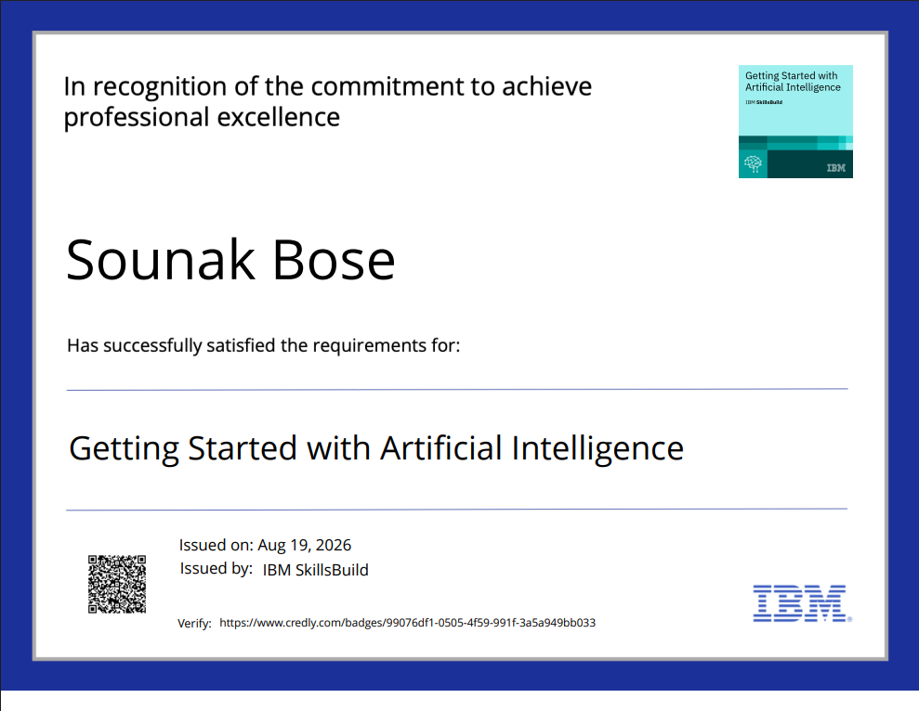
Certificates Earned:

Slide 20
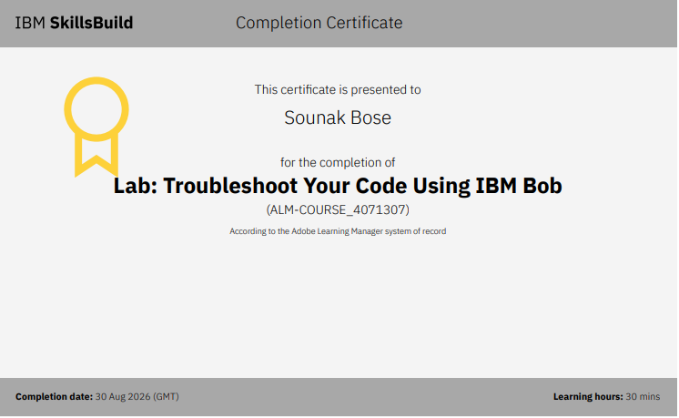
Certificates Earned:​

Slide 21


