Slide 1







A Gentle Introduction to Quantum Communication and Networking Engineering Quantum Networks
$${\text{Samuel} \text{Oslovich}}^{1}$$
$${\text{Sounak} \text{Kar}}^{1}$$
${}^{1}$Wehner Group, QuTech, TU Delft
Tutorial at IFIP Performance: Part II

Slide 2
Entanglement Distribution Network
Distribute end-to-end entanglement
Enables applications like
Teleportation
Quantum key distribution
Blind quantum computing [1]
[1] A. Broadbent, J. Fitzsimons and E. Kashefi, "Universal Blind Quantum Computation," 2009 50th Annual IEEE Symposium on Foundations of Computer Science, doi: 10.1109/FOCS.2009.36
Notes:
Our goal is to build an entanglement distribution network, where we distribute end-to-end entanglement to end nodes (or users) that can use this entanglement to execute applications.
These applications include some of those mentioned before, like Teleportation and Quantum Key Distribution. One other application I want to mention in particular is blind quantum computing.

Slide 3



Entanglement Distribution Network
Distribute end-to-end entanglement
Enables applications like
Teleportation
Quantum key distribution
Blind quantum computing [1]
Weak Client
Powerful Server
[1] A. Broadbent, J. Fitzsimons and E. Kashefi, "Universal Blind Quantum Computation," 2009 50th Annual IEEE Symposium on Foundations of Computer Science, doi: 10.1109/FOCS.2009.36
Notes:
Suppose we have a weak quantum computer, but we want to execute very large quantum algorithms.
Using blind quantum computing, our weak client can use entanglement to execute a large quantum algorithm on a powerful server.
We can obtain the outcome of our computation without the serving learning our computation.
This is very useful when privacy is a concern, for example in drug discovery where you want to patent your new drug, or in the medical sector where patient data is confidential
Quantum network icons sourced from: https://github.com/sfc-aqua/quisp/tree/master/Network%20icons

Slide 4
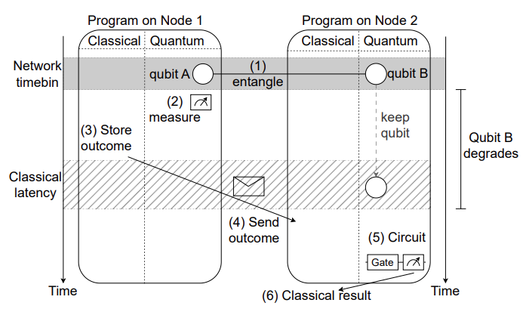

Network Architecture
Processing Node
Request entanglement
Store entanglement
Use entanglement
Photonic Client
Cheaper, reduced capabilities
No memory
Request entanglement
Use entanglement immediately
B. van der Vecht et al., “Qoala: an application execution environment for quantum internet nodes,” arXiv:2502.17296, 2025
Notes:
Our network consists of two types of end nodes, processing nodes and photonic clients with a fundamental cost-performance tradeoff between them
Processing nodes have full capabilities, they can
request entanglement from the network
Store entanglement in memory
Use entanglement along with local qubits to execute applications
Storing quantum states in memory is crucial for applications like teleportation and blind quantum computing.
These memory lifetimes are often quite short – can be on the scale of ms for specific trapped-ion platforms.
The longer it takes to generate entanglement, the worse the application performance will be, which puts hard requirements on scheduling and resource allocation within the network
For example, here we have two nodes.
1. they generate entanglement
2,3,4. Node 1 uses this entanglement for local computation, measures the qubit, and sends the outcome to Node 2
5. Node 2 receives the outcome from Node 1, measures their qubit, and 6. obtains a classical result.
During Node 1’s computation, qubit B is degrading in memory. This requires Node 1 to be very efficient in its execution to minimize the amount of time that qubit B degrades.
Photonic clients are a simpler and cheaper type of node
They cannot store entanglement in memory, instead they use it as soon as it is received.
They can only request entanglement from the network and must use it immediately.
By measuring entanglement, they can act as the client in blind quantum computing, allowing them to execute more powerful applications on a processing node (similar to how we use personal computers to access and execute more complex applications on HPC)

Slide 5


Network Architecture
Processing Node
Photonic Client
Notes:
In order to execute applications between different pairs or sets of nodes, we need some way to route or switch our connections.
In classical networks this is done with dynamically configurable routers or switches.

Slide 6

Network Architecture
Processing Node
Photonic Client
Metropolitan Hub
Notes:
In order to execute applications between different pairs or sets of nodes, we need some way to route or switch our connections
In classical networks this is done with dynamically configurable routers or switches
We accomplish this with metropolitan hubs, which connect nearby processing nodes and photonic clients, allowing them to share entanglement

Slide 7
Network Architecture
Processing Node
Photonic Client
Metropolitan Hub
< 50 km
Metropolitan scale network
Notes:
Processing nodes and photonic clients connected by a metropolitan hub form what we call a metropolitan scale network.
These are small scale networks, with end-to-end connections typically less than 50km.
This allows for direct connections with the hub, avoiding issues with long distance entanglement.
In order to create a larger network, we now need some way to connect our two metropolitan hubs together.
Connecting metropolitan hubs requires distributing entanglement over long distances.
We could just directly connect our metropolitan hubs…

Slide 8
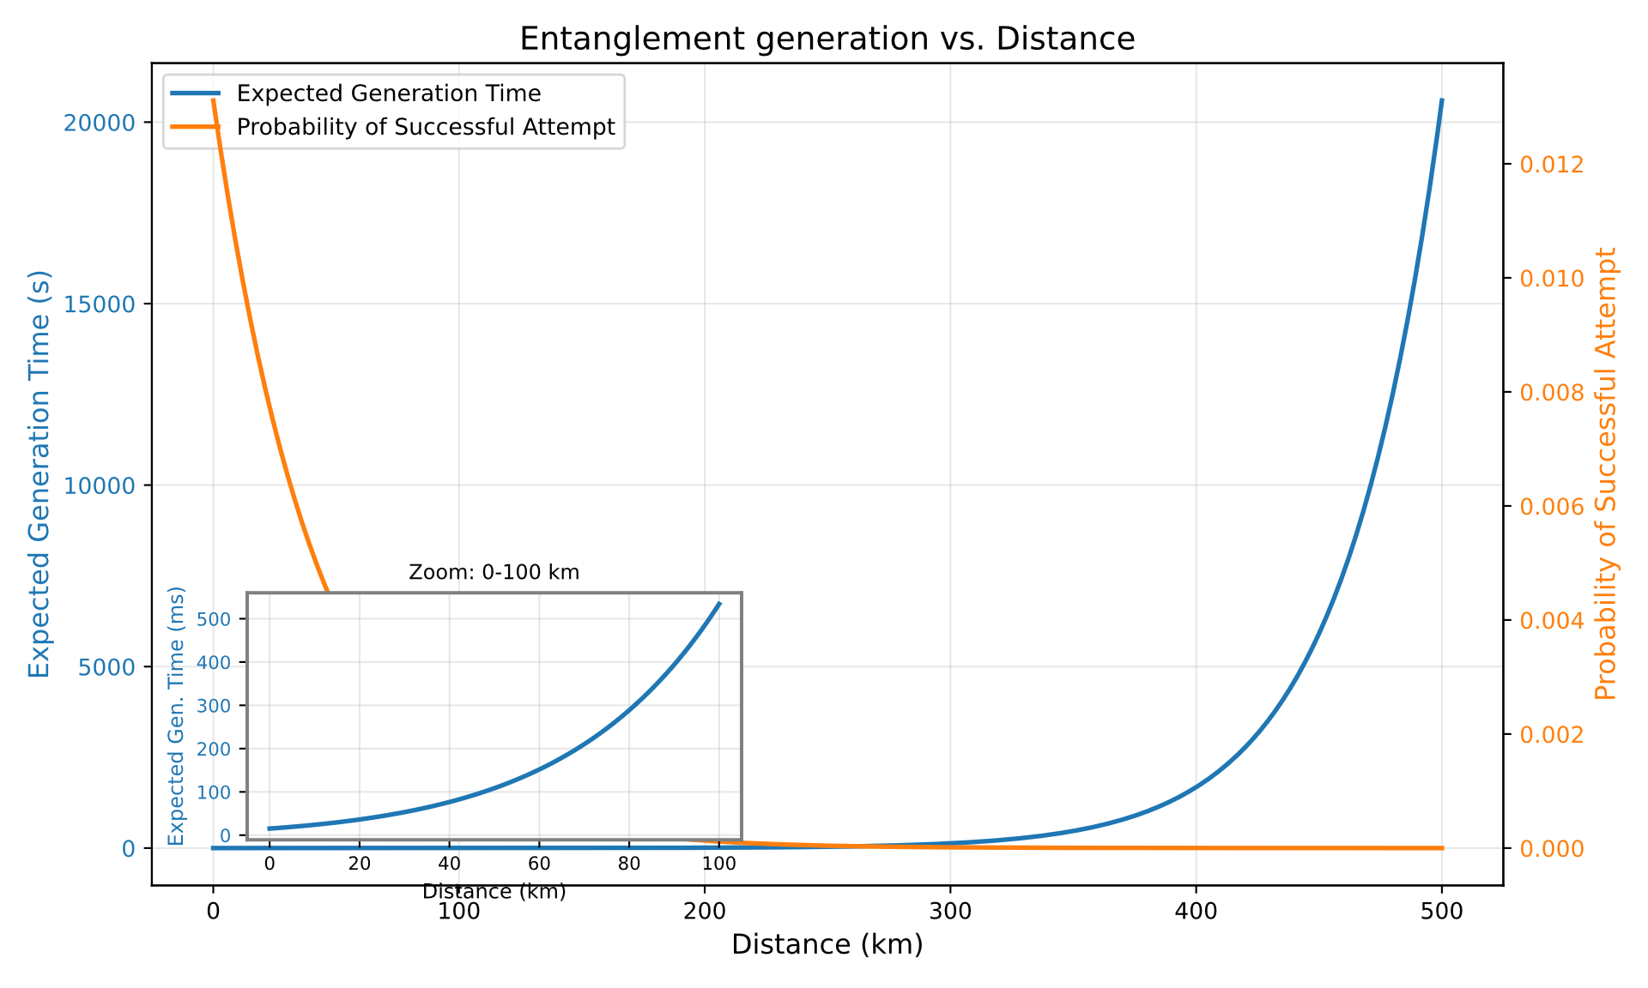
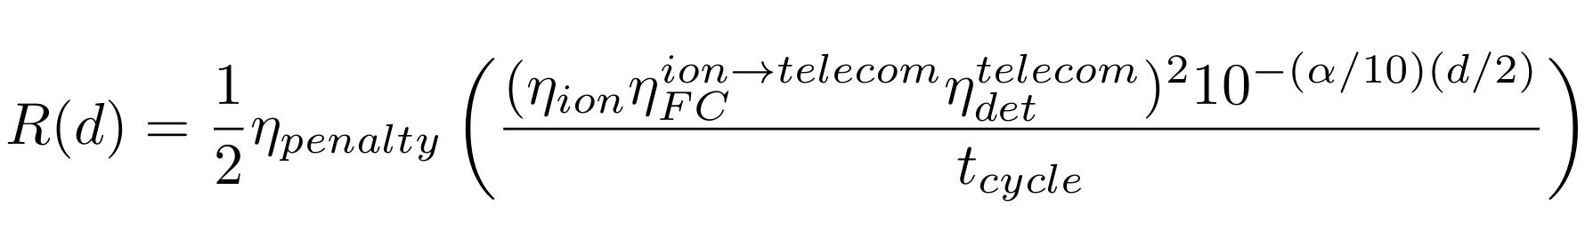
Long-distance entanglement
Entanglement generation rate decreases exponentially with distance
S. Oslovich et al., “Compilation strategies for quantum network programs using qoala,” arxiv:2505.06162, 2025
Notes:
However, you might recall from earlier that there are some problems with this.
Namely that due to photon losses in fiber, as we increase the distance our entanglement generation rate will decrease exponentially
Here we show on the right-hand y axis the probability of a single entanglement generation attempt succeeding, and on the left hand y axis the expected time to generate an entangled pair. These are inversely related.
We can see that as distance increases our success probability rapidly drops to 0.
Even for a relatively short distance of 100km it takes around half a second to generate a single pair. Since our quantum memory lifetimes are often on the scale of ms, this is far too long to be useful.
As previously mentioned, we can mitigate this using quantum repeaters

Slide 9

Network Architecture
Processing Node
Photonic Client
100+ km
Metropolitan Hub
Repeater
Long-distance backbone
Metropolitan scale network
Notes:
As previously mentioned, we can mitigate this using quantum repeaters.
By chaining multiple repeaters together we can distribute entanglement over long and longer distances.
This forms what we call the long-distance backbone that connects our two metropolitan networks. This backbone can be 100s of kms long.
This forms a small network of networks, or internet.
Finally, in order to use this network we need some way to allocate resources and control how entanglement is routed

Slide 10
Network Architecture
Central Controller (SDN)
Processing Node
Photonic Client
Metropolitan Hub
Repeater
Long-distance backbone
Metropolitan scale network
Notes:
Finally, in order to use this network we need some way to allocate resources and control how entanglement is routed
This is handled by a central SDN controller that accepts end node demands for entanglement and schedules resource allocation and configures the network to enable this.
This completes our prototype network, and in practice executing an application in the network will look something like this

Slide 11

Network Architecture
Central Controller (SDN)
Submit demand for entanglement to controller
Controller schedules resource allocation
Bob
Alice
Notes:
This completes our prototype network, and in practice executing an application in the network will look something like this
Let’s say that Alice wants to teleport a qubit to Bob.
Alice and Bob will submit a demand to the central controller asking for an entangled pair
The controller will allocate resources at a specific time for Alice and Bob to establish entanglement
The controller will install this resource allocation in the network
Alice, Bob, and the internal network components will generate entangled links, then these links can be combined using entanglement swapping
This process is repeated until Alice and Bob finally share end-to-end entanglement
Now Alice and Bob can use this entanglement to execute an application, like teleportation
One design consideration in this network you might be wondering about is why do we use a central controller for path/resource allocation?
This is reminiscent of circuit switching in old telephone networks. However in the classical internet we don’t require this level of control and just use packet switching.
The reason that we require a central controller for resource allocation is…

Slide 12






Network Architecture
Central Controller (SDN)
Submit demand for entanglement to controller
Controller schedules resource allocation
Allocated resources distribute entanglement
Alice and Bob share entanglement
Bob
Alice
Notes:
This completes our prototype network, and in practice executing an application in the network will look something like this
Let’s say that Alice wants to teleport a qubit to Bob.
Alice and Bob will submit a demand to the central controller asking for an entangled pair
The controller will allocate resources at a specific time for Alice and Bob to establish entanglement
The controller will install this resource allocation in the network
Alice, Bob, and the internal network components will generate entangled links, then these links can be combined using entanglement swapping to form longer and longer links.
This process is repeated until Alice and Bob finally share end-to-end entanglement
Now Alice and Bob can use this entanglement to execute an application, like teleportation
One design consideration in this network you might be wondering about is why do we use a central controller for path/resource allocation?
This is reminiscent of circuit switching in old telephone networks. However in the classical internet we don’t require this level of control and just use packet switching.
The reason that we require a central controller for resource allocation is…

Slide 13







Network Architecture
Why is resource allocation necessary?
Scarcity of resources
Low end-to-end entanglement generation rates
Short quantum memory lifetimes
Bob
Bob
Alice
Alice
Charlie
Notes:
The reason that we require a central controller for resource allocation is due to scarcity of resources in our network.
Memory lifetimes are short (on the scale of ms)
Entanglement generation rates are low (on the scale of Hz)
What happens if Alice and Bob need to share 2 entangled pairs and there is no resource allocation?
Suppose Alice and Bob have already created 1 entangled pair, but they need two pairs to execute their application.
After some time, a second link between metropolitan hubs might be generated. So now Alice and Bob just need to create connections to their metropolitan hubs.
However there may be other users in this network trying to establish entanglement, like Charlie. If Charlie creates his link first, then Alice and Bob will need to start from scratch to create their second link.
This can take some time, and due to short quantum memory lifetimes, by the time Alice and Bob create their second entanglement, their first entanglement may no longer be useful
Here having a central controller ensures that the resources in the network can only be used for Alice and Bob, ensuring they will be able to generate both entangled pairs in a usable amount of time.
Now that we’ve seen a prototype network architecture, I want to talk about how we use performance analysis to inform and evaluate our decisions.

Slide 14
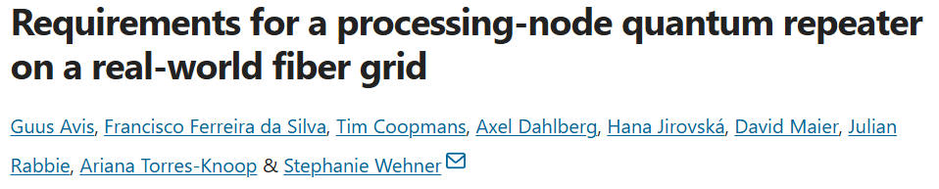
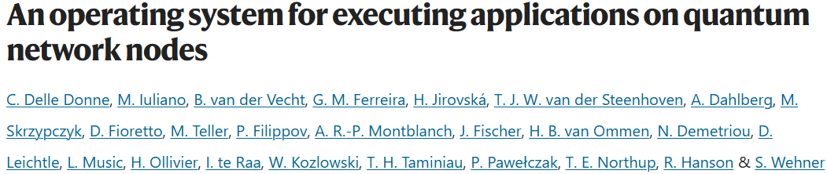
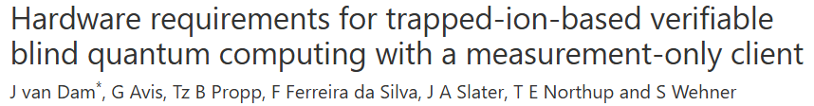
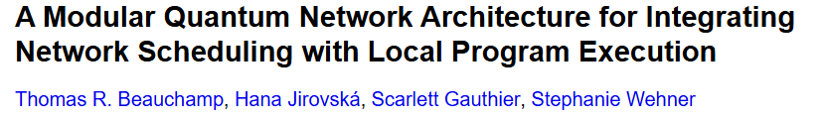
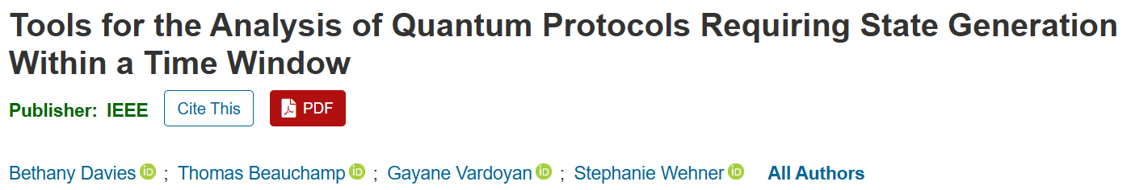
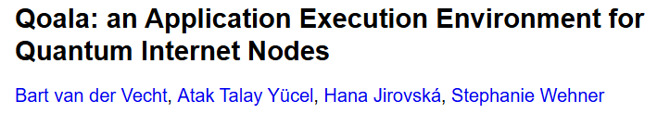
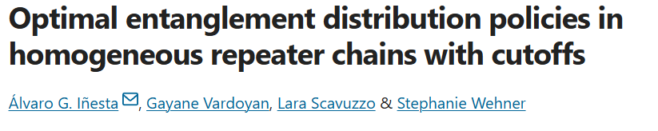

Performance Analysis
Determining hardware requirements
Architecture evaluation
Protocol optimization
Notes:
We use performance analysis in all parts of our system, from identifying hardware requirements, to optimizing protocols, and evaluating our architecture choices.
We use performance analysis for identifying what improvements need to be made to quantum hardware. For example we looked at the hardware requirements for a processing node and for a photonic client in order to execute blind quantum computing
We also use performance analysis to optimize protocols, for example looking at how we can create optimal policies in our long distance backbone for entanglement generation
And we use performance analysis to evaluate the decisions we made when designing our architecture, like evaluating our processing node operating system, and the performance of our central controller
Of course we don’t have time to cover all of them, so we will focus on how we can use performance analysis to evaluate our processing node operating system

Slide 15
Evaluating processing node performance
Notes:
Of course we don’t have time to cover all of this today, so I will just focus on how we can use performance analysis to evaluate our processing node operating system
The main role of our processing node is to use entanglement to execute quantum applications. We previously saw that our processing nodes need to be efficient since quantum memory lifetimes are quite short.

Slide 16
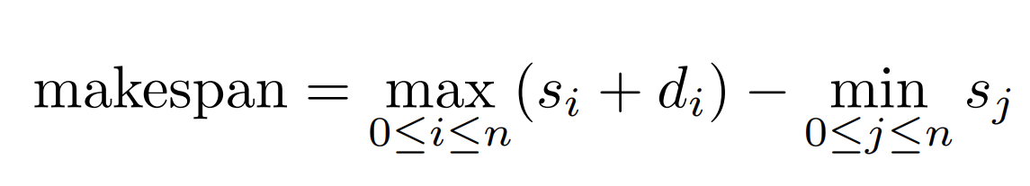
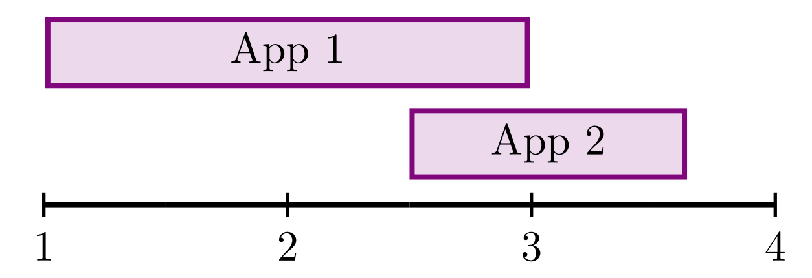
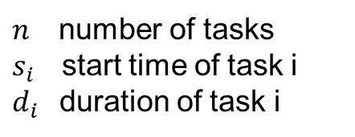
Performance metrics for processing nodes
Performance Metrics:
Execution time or makespan (classical)
$n_{}$ number of tasks
$s_{i}$start time of task i
$d_{i}$duration of task i
Execution time of App 1
Makespan
Notes:
The main role of our processing node is to use entanglement to execute quantum applications. We previously saw that our processing nodes need to be efficient since quantum memory lifetimes are quite short.
We can think a couple different aspects of performance we care about
How quickly can we execute applications?
This is encompassed by application execution time, or makespan when thinking about executing multiple applications
This is a purely classical metric

Slide 17
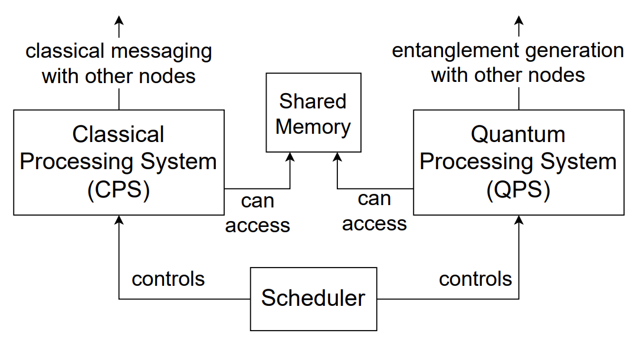
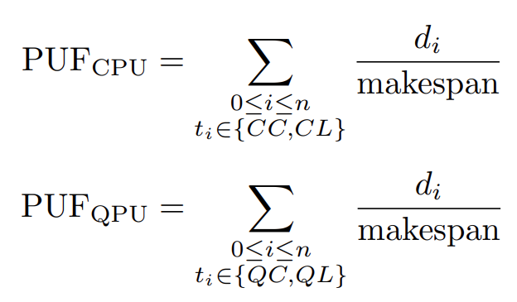
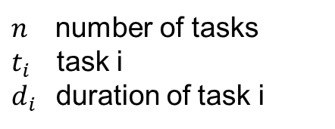
Performance metrics for processing nodes
Performance Metrics:
Execution time or makespan (classical)
Processor utilization (classical)
B. van der Vecht et al., “Qoala: an application execution environment for quantum internet nodes,” arXiv:2502.17296, 2025
Classical communication time (ms)
Synchronization for entanglement (ns)
$n_{}$ number of tasks
$t_{i}$task i
$d_{i}$duration of task i
Notes:
2. How efficient is our processing node?
We can measure the processor utilization, to see how efficiently our node uses its resources
Our architecture considers separate processors for quantum and classical operations, this is mainly due to differences in timing between classical and quantum operations
- Classical communications, especially over long distances can be on the order of milliseconds
- Entanglement generation requires high levels of synchronization with nanosecond precision
These are both classical metrics, but we know that quantum states experience noise.
Due to this noise, our quantum applications are probabilistic and may fail or produce an incorrect answer/outcome

Slide 18

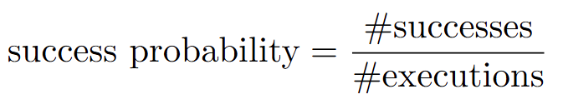
Performance metrics for processing nodes
Performance Metrics:
Execution time or makespan (classical)
Processor utilization (classical)
Success probability (quantum)
Notes:
These are both classical metrics, but we know that quantum states experience noise
Due to this noise, our quantum applications are probabilistic and may fail or produce an incorrect answer/outcome
We measure how well we can execute applications with success probability
We consider the execution of a quantum application a “success” if it produces the correct or expected outcome
For example if we teleport the |0> state, it is a success if we measure a |0>
We can then aggregate results over many executions to compute the success probability

Slide 19
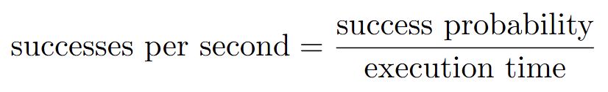
Performance metrics for processing nodes
Performance Metrics:
Execution time or makespan (classical)
Processor utilization (classical)
Success probability (quantum)
Successes per second (combined)
Notes:
Finally we can combine these metrics to see at what rate we can successfully execute applications, with successes per second
Since quantum and classical performance are often at odds this can give us a more holistic view of performance in our system
Now we will look at how we can use some of these performance metrics to evaluate task scheduling in our processing node

Slide 20

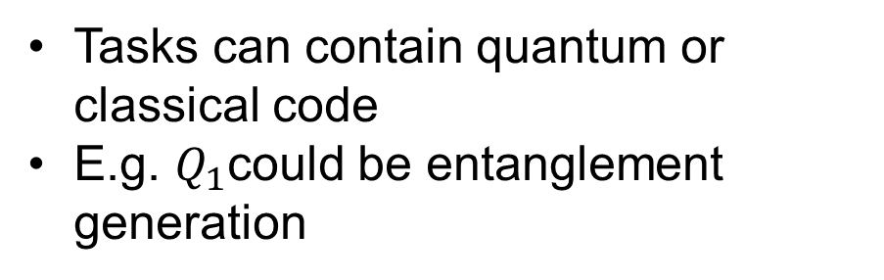





Processing node scheduling performance
Scheduling algorithms:
Baseline
FCFS (first come first serve)
EDF (earliest deadline first)
$$Q_{1}$$
$$Q_{2}$$
$$C_{3}$$
$$Q_{1}$$
$$C_{2}$$
$$Q_{3}$$
Task Availability
Program A
Program B
Tasks can contain quantum or classical code
E.g. $Q_{1}$could be entanglement generation
Notes:
Now we will look at how we can use some of these performance metrics to evaluate task scheduling in our processing node
We looked at three scheduling policies
Baseline
First come first serve scheduling
Earliest deadline first scheduling
Programs are represented using tasks, where each task corresponds to classical or quantum operations.
Here we denote the quantum tasks with a Q and the classical takes with a C
In the top right we show the order in which tasks become available to execute, and our scheduling policies will determine the order they are executed.

Slide 21






Processing node scheduling performance
Scheduling algorithms:
Baseline
FCFS (first come first serve)
EDF (earliest deadline first)
$$Q_{1}$$
$$Q_{2}$$
$$C_{3}$$
$$Q_{1}$$
$$C_{2}$$
$$Q_{3}$$
Task Availability
Program A
Waiting for classical communication
Program B
Tasks can contain quantum or classical code
E.g. $Q_{1}$could be entanglement generation
$$Q_{1}$$
$$C_{2}$$
$$Q_{3}$$
$$Q_{1}$$
$$Q_{2}$$
$$C_{3}$$
Task Execution
Notes:
Our Baseline policy executes all of program A, then all of program B and does not allow for interleaving of tasks.
This may cause gaps in our execution.
Here A has to wait for classical communication, for example receiving corrections for quantum teleportation.

Slide 22






Processing node scheduling performance
Scheduling algorithms:
Baseline
FCFS (first come first serve)
EDF (earliest deadline first)
$$Q_{1}$$
$$Q_{2}$$
$$C_{3}$$
$$Q_{1}$$
$$C_{2}$$
$$Q_{3}$$
Task Availability
Program A
Baseline makespan
Program B
$$Q_{1}$$
$$Q_{1}$$
$$Q_{2}$$
$$C_{2}$$
$$Q_{3}$$
$$C_{3}$$
Interleaving can reduce makespan
Task Execution
Baseline execution time of program A
Notes:
FCFS scheduling
- Whichever task is available first gets executed
- no notion of quantum performance
- we can see that the overall makespan is reduced compared to Baseline. This is great since we can execute programs in less time
However there is the tradeoff that the execution time for each individual program is increased, due to interleaving
This can be detrimental for our quantum performance since our quantum states will have to stay in memory longer, which causes them to decohere

Slide 23
Processing node scheduling performance
D=2ms
D=7ms
D=20ms
Scheduling algorithms:
Baseline
FCFS (first come first serve)
EDF (earliest deadline first)
$$Q_{1}$$
$$Q_{2}$$
$$C_{3}$$
$$Q_{1}$$
$$C_{2}$$
$$Q_{3}$$
D=0ms
D=3ms
D=5ms
Task Availability
Program A
D=2
Program B
D=1
$$Q_{1}$$
$$Q_{1}$$
$$C_{2}$$
$$Q_{3}$$
$$Q_{2}$$
$$C_{3}$$
Quantum memories have short lifetimes
Choose deadlines based off memory lifetimes
D=5
D=3
Task Execution
D=6
Notes:
Finally we have EDF which schedules the task with the earliest deadline first
Since our quantum memories have short lifetimes we want to execute our tasks before our quantum memories decay.
We can choose our deadlines based off of our quantum memory lifetimes to try to enforce this.
This allows us to balance our makespan with quantum performance.

Slide 24
Processing node scheduling performance
Evaluated using Qoala-sim (github.com/QuTech-Delft/qoala-sim)
Allows simulation of both software and hardware of real quantum network nodes executing quantum programs
Bob executes 2 programs
Classical processing task
New task arrives every 1ms
Quantum program
Initialize quantum state
Send message to Alice
Receive message from Alice
Measure quantum state
Alice
Bob
Notes:
These scheduling algorithms were evaluated through simulation. We use Qoala-sim, a simulator that we built in our research group. Qoala-sim allows for the simulation of both the software and hardware of quantum network nodes when executing quantum programs in a quantum network.
The example we will look at today consists of two nodes, Alice and Bob.
We will look at how different scheduling policies on Bob impact performance
Bob executes 2 programs. The first program is purely classical, and a new classical task arrives every ms.
The second program is a quantum program where Bob initializes a quantum state, sends a message to alice, receives a message from alice, and based on the message measures the quantum state.
We execute simulations of these programs using different scheduling policies on Bob.

Slide 25
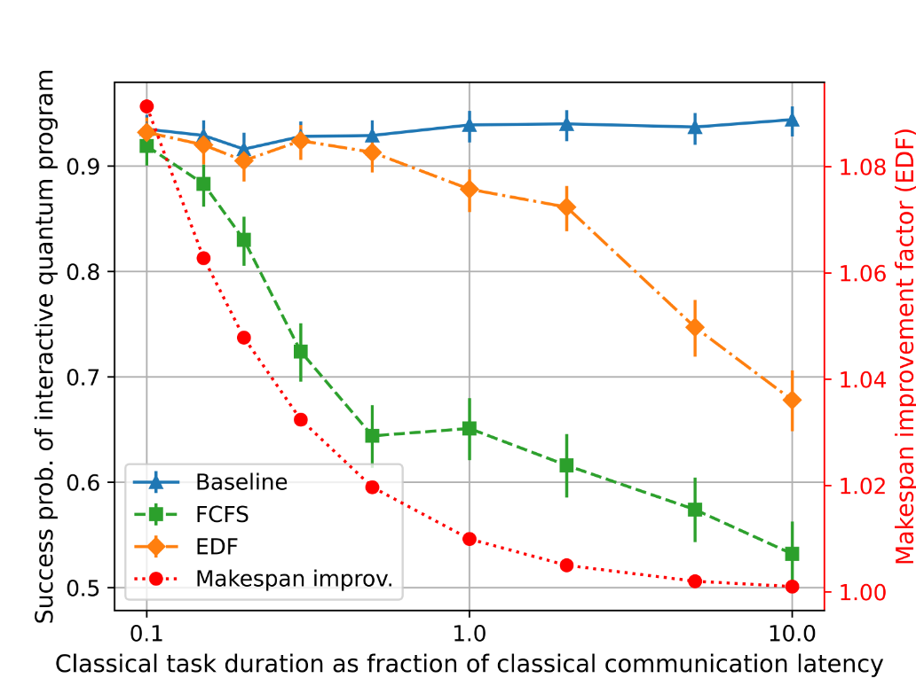
Processing node scheduling performance
Baseline achieves best quantum performance
EDF reduces makespan
Tradeoff between quantum and classical performance
B. van der Vecht et al., “Qoala: an application execution environment for quantum internet nodes,” arXiv:2502.17296, 2025
Notes:
Here we show the results, varying how long the classical tasks take.
On the left hand Y axis we show the success probability of the quantum program.
We see that the Baseline achieves the highest success probability. Since there is no interleaving, the quantum program never has to wait for the classical tasks to finish, resulting in the best performance.
Next best is EDF in orange, and FCFS performs the worst.
On the right hand Y axis we show the makespan improvement factor of EDF compared to the baseline
We see in all cases the makespan is improved, demonstrating that EDF reduces makespan. We also see for relatively short classical tasks that the EDF scheduler has almost as good success probability as the baseline.
We see this tradeoff between the classical performance, where EDF improves the makespan, but results in a decrease in success probability.

Slide 26
Recap
Architecture and components of prototype network
Challenges of quantum networks
Long-distance entanglement
Short memory lifetimes
Slow generation rates
Measuring performance and evaluating components
Processing node scheduling
Notes:
That brings us to the end of our talk. To recap, we saw an overview of the prototype network and learned how these different components interact
We also saw some of the difficulties and challenges when building quantum networks, like short memory lifetimes and slow entanglement generation rates and how that impacts our design choices.
Finally we saw how we can use performance metrics to evaluate components in our network, focusing on the example of processing node scheduling

Slide 27
Thank you!
Questions?
Contact me at s.o.oslovich@tudelft.nl

