Slide 1
Agate UI on HCC – Current State Architecture
Design Doc

Slide 2
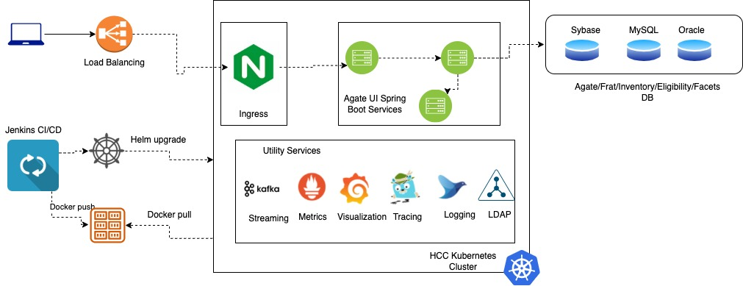
Design Diagram

Slide 3
Technologies Used
Kubernetes
Kafka
Spring Boot
LDAP
NGINX

