Slide 1
Innovation (phase 2-project)
R.SOUNDARIYA

Slide 2
AGENDA
Product Reviews
Wishlists
​Personalized Recommendations
User Engagement
​Integration With Social Media
Mobile Optimization
Continuous Improvement

Slide 3

Product Reviews
Allow users to leave reviews and ratings for products they have purchased.
Include a comment section for users to provide detailed feedback.
Display both positive and negative reviews to provide a balanced view.
Consider implementing a verified purchase badge to enhance credibility.
Send automated emails to customers encouraging them to review their purchased products.

Slide 4
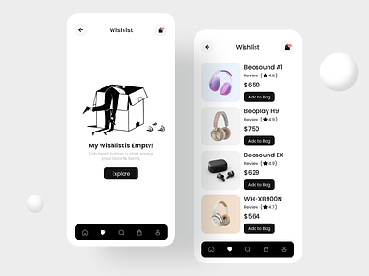
Wishlists
Enable users to create and manage wishlists of products they are interested in.
Allow users to share their wishlists with friends and family.
Implement wishlist notifications to inform users of price drops or product availability.
Provide the option to make wishlists public or private.
Integrate social media sharing options for wishlists.

Slide 5
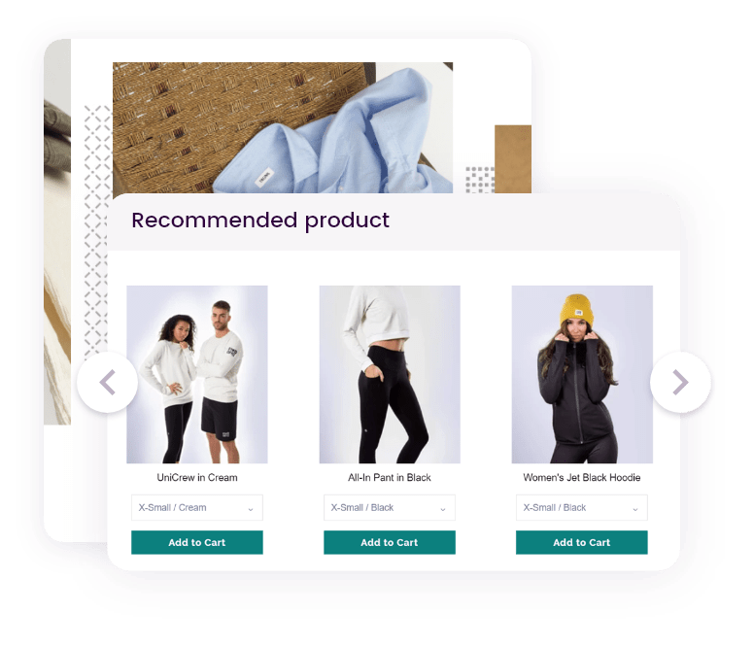
Personalized Recommendations
Implement machine learning algorithms to analyze user behavior and preferences.
Offer personalized product recommendations based on past purchases and browsing history.
Provide a "Recommended for You" section on the homepage or product pages.
Allow users to customize their preferences for more accurate recommendations.
Use data analytics to continuously improve the recommendation engine.

Slide 6

User Engagement
Implement a responsive and user-friendly design for the website.
Send personalized emails, such as abandoned cart reminders or product recommendations.
Create a loyalty program with rewards for repeat customers.
Host special events, promotions, or sales to encourage user engagement.
Implement a live chat feature for real-time customer support.

Slide 7

Integration with Social Media
Allow users to log in or sign up using their social media accounts.
Incorporate social sharing buttons for products and reviews.
Run social media campaigns and promotions.
Use social media analytics to understand user preferences and behavior.

Slide 8

Mobile Optimization
Ensure that the website is optimized for mobile devices to cater to users on various platforms.
Implement a mobile app for a more seamless and personalized shopping experience.

Slide 9
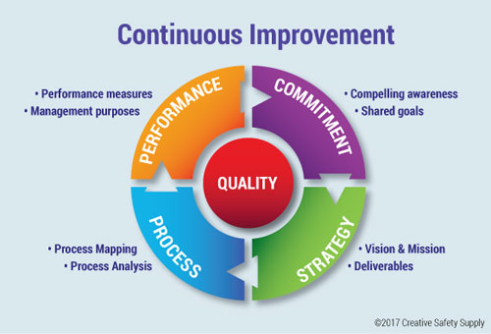
Continuous Improvement
Collect and analyze user feedback through surveys and customer support interactions.
Regularly update and optimize the website based on user behavior and preferences.
Stay informed about industry trends and technological advancements to implement new features.

Slide 10
THANK YOU
R.SOUNDARIYA
mathibanu792@gmail.com

