Slide 1
E-COMMERCE APPLICATION ON IBM CLOUD FOUNDRY
SOUNDARIYA.R

Slide 2
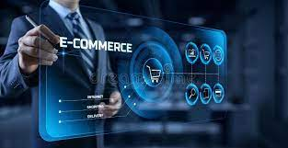
PHASE 1 PROJECT Abstraction Problem Definition Design Thinking

Slide 3

Phase 1 project 3
PROBLEM DEFINITION
This project is to build an artisanal e-commerce platform using IBM cloud
foundry . The goal is to connect skilled artisanal with a global audience
showcasing their handmade products and providing features like secure shopping
carts payment gateways and an intuitive checkout process. This involves designing
the ecommerce platform, implementing necessary features , and ensuring a
seamless user experience. Ensure that the application is intuitive and easy to use,
with a user-friendly interface that facilitates product search, selection, and
purchase. Ensure the application is highly available and reliable, minimizing
downtime and disruptions to customers.

Slide 4
DESIGN THINKING
Design your thought

Slide 5
DESIGN THINKING
PLATFORM DESIGN
PRODUCT SHOWCASE
USER AUTHENTICATION
PAYMENT INTEGRATION
SHOPPING CART AND CHECKOUT
USER EXPERIENCE

Slide 6
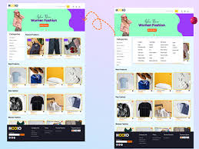
Presentation title PLATFORM DESIGN:
Design the platform layout with sections for product categories, individual
product pages , shopping cart , checkout and payment.
Product Categories:
•Below the header, create a section for product categories. This section should
display images and text links to different product categories.
•Each category image should be a clickable link leading to a category page.

Slide 7
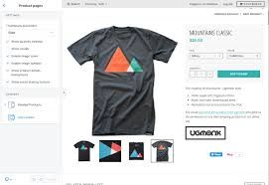
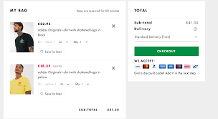
Individual product pages : •Each product should have an image, product name, price, and an "Add to Cart" button
Shopping cart and checkout payment:
• After adding items to the cart, users can proceed to checkout.
• On the checkout page, provide various payment options such as credit/debit card, PayPal, or other

Slide 8
PRODUCT SHOWCASE: Create a database to store product information such as images,descriptions, prices and categories.
Creating tables : Products Table:
Attributes:ProductID (Primary Key, Auto-incremented),ProductName (String),Description (Text),Price (Decimal),CategoryID (Foreign Key),ImageURL (String)
Categories Table:
Attributes:CategoryID (Primary Key, Auto-incremented),CategoryName (String)
Use Cases From Backend
Product Listing: Retrieve a list of products with their names, prices, and images for displaying on the website.
Sql query: SELECT ProductName, Price, ImageURL FROM
Products;
Category Filtering: Allow users to filter products by category by querying the "Products" table based on the CategoryID field.
Sql query: SELECT ProductName, Price, ImageURL
FROM Products
WHERE CategoryID = category_id;

Slide 9
Product Details: Display the detailed product description and price when a user selects a specific product. Sql query: SELECT ProductName, Description, Price,ImageURL FROM Products WHERE ProductID = product_id;
Adding New Products: Insert new products into the "Products" table, specifying the product's name, description, price, category, and image URL.
Sql query:INSERT INTO Products (ProductName, Description, Price,
CategoryID, ImageURL)
VALUES ('New Product Name', 'Product Description', 19.99, 1,
'image_url.jpg');
Updating Product Information: Modify product details such as price, description, or image URL when necessary.
Sql query:UPDATE Products
SET Price = 24.99, Description = 'Updated Description'
WHERE ProductID = product_id;
Deleting Products: Remove products from the database when they are no longer available.
Sql query:DELETE FROM Products WHERE ProductID = product_id;

Slide 10
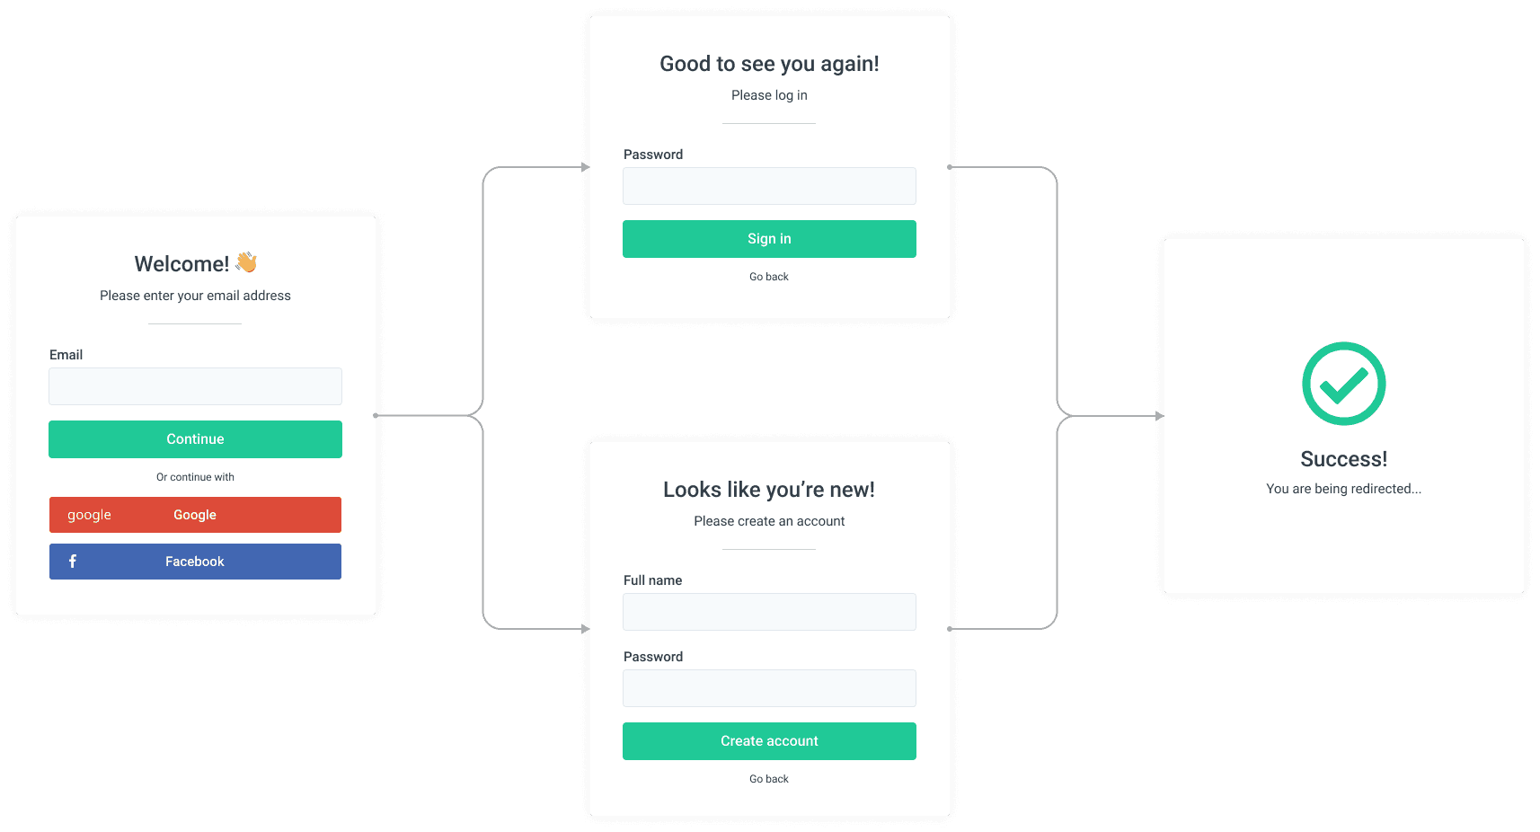
Presentation title USER AUTHENTICATION: Implement user registration and authentication features to enable artisans and customers to access the platform

Slide 11
SHOPPING CART AND CHECKOUT:
Design and develop the shopping cart functionality and a smooth checkout process.
1. Shopping Cart Functionality:Include a shopping cart icon or link in the website's header to give users easy access to their cart.
2. Smooth Checkout Process:Create a multi-step checkout process, with each step clearly labeled
3. Order Confirmation:Display a confirmation message and order number to users after successfully placing an order.
4. Error Handling and Validation:Implement robust error handling to gracefully manage issues such as payment failures, invalid addresses, or out-of-stock items.
5. Testing:Thoroughly test the entire checkout process with real and simulated transactions to identify and resolve any issues

Slide 12
Presentation title PAYMENT INTEGRATION:
Integrate secure payment gateways to facilitate transactions

Slide 13
Presentation title USER EXPERIANCE:
Focus on providing an intuitive and visually appealing user experience for both artisan

Slide 14
THANK YOU
SOUNDARIYA.R
mathibanu792@gmail.com

