Slide 1

VPC
Virtual Private Cloud

Slide 2
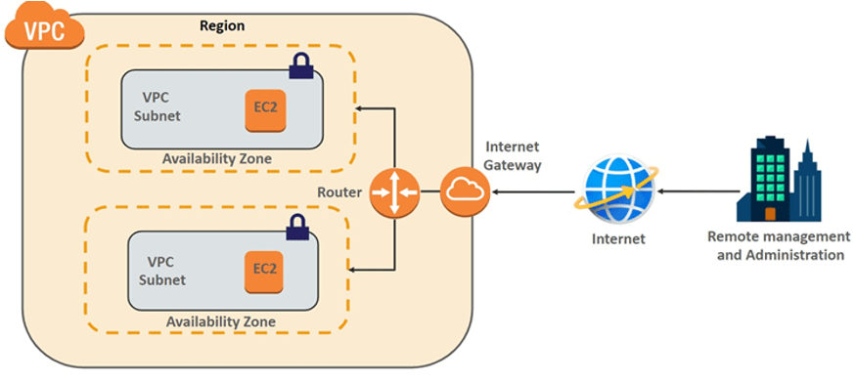
VPC Overview Diagram

Slide 3
IP Types
IPV4
-> IPv4 is a 32 Bit Address
-> N . N . N . N (10.0.0.1)
-> 232
IPV6

Slide 4
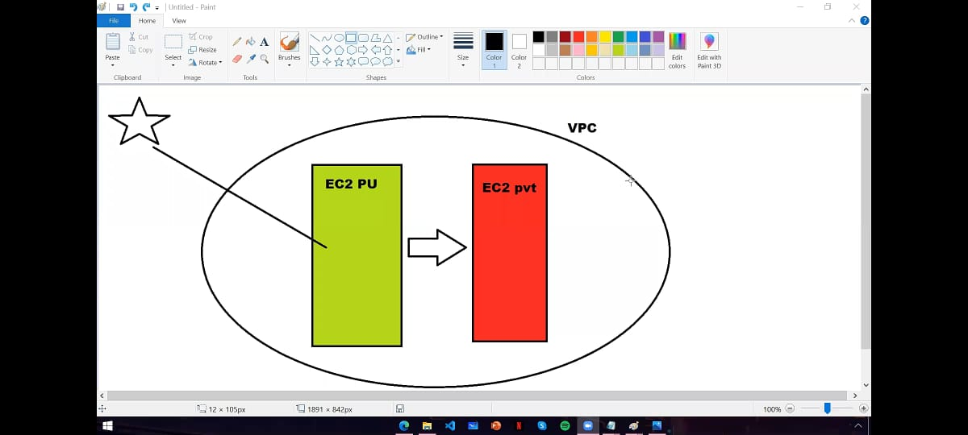

Slide 5
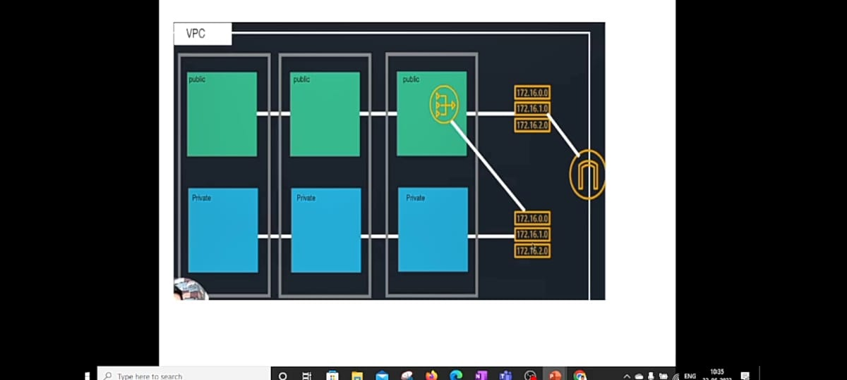

Slide 6
