Slide 1
23CSE452 BUSINESS ANALYTICS
Movie Performance Analysis and Prediction Using TMDB Data
Final Project Presentation
Team 6
Venkata Kanna Bhavan Surya Addap (CB.SC.U4CSE23467)
Parvathy Krishna A (CB.SC.U4CSE23739)
Balaji N (CB.SC.U4CSE23011)
Dareddy Tejeswara Reddy (CB.SC.U4CSE23614)
Soundarya Satalgoan (CB.SC.U4CSE23447)
Guide / Faculty: Rohini S
01
Notes:
Suggested time: 20 seconds. Introduce the team and the project: what makes a movie well rated, using data we collected ourselves from the TMDB API.

Slide 2
PROJECT OVERVIEW
Business problem and objectives
Business problem: Studios and streaming platforms must decide which movies to make, buy or promote, but ratings vary widely across genres, languages and periods, and it is unclear which characteristics go with well-rated films.
Objectives: (1) Predict whether a movie is high-rated (rating of 6.5 or more) with a model that clearly beats guessing (target AUC of 0.75 or more). (2) Identify the genres, trends and plot themes linked to higher ratings using time-series analysis and text mining.
Business decision: Which genres and themes to prioritise, and what rating to expect for a title before and after release.
Expected output: A high-rated classifier, a rating forecast and genre trends, plot themes, an interactive dashboard and recommendations.
02
Notes:
Suggested time: 40 seconds. State the problem for a studio or streaming platform. Stress that findings are associations, not causes.

Slide 3
UNITS 1 TO 3
Complete project workflow
Stage | Your implementation
Unit 1 | Data collected from the TMDB API (15,555 movies, 2000 to 2025), cleaned to 15,386; EDA of ratings, genres, languages and correlations; feature engineering
Unit 2 | Classification of high-rated movies (rating of 6.5 or more): baseline, Logistic Regression, Random Forest and XGBoost; 5-fold CV tuning; test AUC 0.836 (0.785 with content only)
Unit 3 | Time-Series Analysis (monthly average rating, decomposition, SARIMA and Holt forecasts) and Text Mining (LDA topics, word association and sentiment of plot overviews)
Final application | Interactive Streamlit dashboard (filters, forecast, topics, model results) and business recommendations
Completion status: 100% of Units 1 to 3 and the dashboard are implemented and integrated
03
Notes:
Suggested time: 30 seconds. Walk the four rows: Unit 1 data and EDA, Unit 2 prediction, Unit 3 time series and text mining, then the dashboard. [Confirm the 100% status with your team before presenting.]

Slide 4
DATASET ACROSS UNITS 1 TO 3
Overall dataset description
Source and collection method: Collected by us from the TMDB API v3 (/discover/movie and /genre/movie/list): 30 random pages per release year, sorted by popularity, with at least 10 votes, so obscure and popular films are both included. No pre-built dataset was used.
Final dataset size: 15,386 movies and 11 variables after cleaning (15,555 raw). 10,078 movies with 20 or more votes are used for modelling and text mining.
Coverage: Movies released from 2000-01-01 to 2025-12-31 (575 to 598 per year), 89 original languages (English about 53%) and 19 genres.
Unit mapping: Units 1 and 2: rating, votes, popularity, genres, language and year. Time series: release date with rating and popularity (300 monthly points). Text mining: plot overview with rating and genre.
04
Notes:
Suggested time: 45 seconds. Explain that TMDB limits queries to 500 pages, so we sampled random pages per year instead of taking only top results. Data dictionary: DATA_DICTIONARY.md.

Slide 5
FINAL PROJECT DATA
Sample dataset and key variables
title | release_date | genres | vote_average (votes) [target source]
Ground Zero | 2000-05-12 | Drama, Action | 4.1 (13 votes)
Blind Target | 2000-01-01 | Thriller, Drama | 3.4 (11 votes)
La Squale | 2000-11-29 | Drama | 6.1 (16 votes)
Key variables: title (text), release_date (date), genres (list of 19 categories), original_language (ISO code), overview (text), popularity (TMDB score), vote_average (0 to 10), vote_count (count). Target: high_rated = 1 if vote_average is 6.5 or more.
Sample rows are the first rows of the file and have under 20 votes, so they are kept for EDA but not used for modelling. Modelling and text mining use 10,078 movies with 20 or more votes; the time series uses 300 monthly averages.
05
Notes:
Suggested time: 35 seconds. Show the sample rows and explain the key variables and the target definition.

Slide 6
OVERALL VALIDATION FOR UNITS 1 TO 3
Dataset validation and preparation
Check | Finding | Correction / evidence
Missing values and duplicates | 0 NaN values and 0 duplicate IDs, but 105 blank overviews | 105 rows dropped; final data has 0 NaN and 0 duplicates
Types, ranges and consistency | Genres came as ID lists, dates as text; 64 rows had no genre or invalid values | IDs mapped to names; dates parsed (0 invalid, 0 in the future); ratings checked in 0 to 10; 64 rows removed
Suitability across all units | Models need rating, votes and genres; time series needs dates; text needs overviews | 10,078 movies (20+ votes) for models and text; 300 monthly points for time series; all 15,386 for EDA
Synthetic data, if applicable | Not applicable | All data came from the TMDB API (random pages per year)
Final validated dataset: 15,386 movies, 11 columns (tmdb_clean.csv); 10,078 used for modelling
06
Notes:
Suggested time: 45 seconds. 169 rows were removed in total (1.1%): 105 blank overviews and 64 with no genre or invalid values. Outliers in popularity (913) and vote count (653) were kept because they are genuine hits.

Slide 7
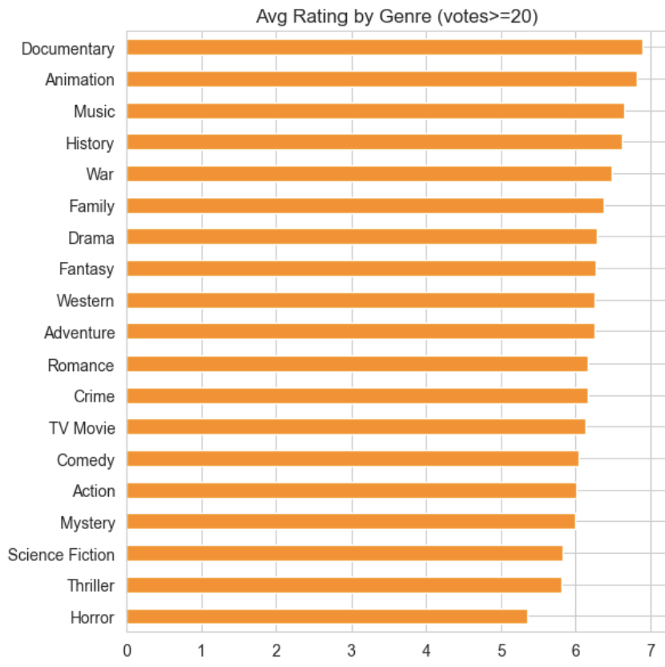
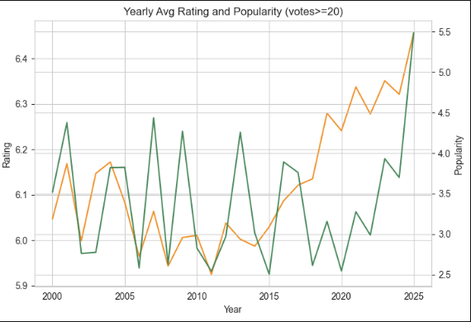
UNIT 1
Exploratory analysis and preprocessing
Key findings: Documentary (6.89) and Animation (6.82) rate highest and Horror (5.36) lowest. Ratings were flat near 6.06 until 2019, then rose to about 6.3 (orange line on the right chart). Correlations with rating are weak (0.11 to 0.23).
Preparation: 169 invalid rows removed, genres mapped to names and multi-hot encoded, top-10 languages one-hot encoded, log of popularity and votes, ratings analysed for movies with 20 or more votes.
07
Notes:
Suggested time: 55 seconds. Left: average rating by genre (movies with 20+ votes). Right: yearly average rating (orange) and popularity (green). Also mention: rating is bell-shaped; popularity and vote count are heavily right-skewed, so we use log transforms. Findings are associations only.

Slide 8
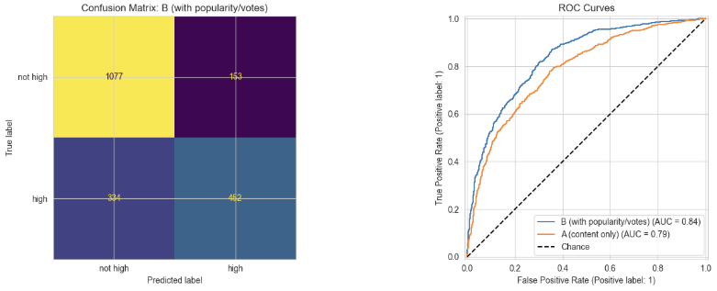
UNIT 2
Predictive modelling and final evaluation
Model (test set, 2,016 movies) | Accuracy | F1 (high) | AUC
Baseline (majority class) | 0.610 | 0.000 | 0.500
Logistic Regression, set B | 0.763 | 0.670 | 0.813
XGBoost, set B (tuned) | 0.771 | 0.677 | 0.834
Random Forest, set B (tuned, selected) | 0.758 | 0.650 | 0.836
Random Forest, set A: content only (tuned) | 0.736 | 0.608 | 0.785
Left: confusion matrix, Random Forest set B. Right: ROC curves for set B (AUC 0.84) and set A (AUC 0.79).
Evaluation setup: target high_rated (rating of 6.5 or more); stratified 80/20 split (8,062 training and 2,016 test movies, 39% high-rated in both); tuning by 5-fold CV on training data only; all models scored on the same test movies. Set A = genre, language, year, month, overview length, number of genres; set B = A plus log popularity and log votes.
Selected model and interpretation: Random Forest on set B (best CV AUC 0.819, test AUC 0.836). Set A reaches 0.785 with content only, so ratings are partly predictable before release. Of 786 high-rated test movies the model finds 452 (recall 0.575) and wrongly flags 153 others (precision 0.747). Set B uses post-release data.
08
Notes:
Suggested time: 65 seconds. Logistic Regression is the untuned linear model; Random Forest and XGBoost are tuned with 5-fold CV. Text (TF-IDF) features did not improve prediction, so text is used for interpretation. At 50+ votes (5,717 movies) the AUC is 0.841, so results do not depend on the 20-vote cut-off. Feature importance is in the backup slides.

Slide 9
UNIT 3
Selected advanced analytics methods
Selected method | Business question | Data used
Method 1: Time-Series Analysis | How do average ratings and genre mix change over time, and what rating level can we expect next? | release_date and vote_average of 10,078 movies (20+ votes) as 300 monthly points (2000 to 2024); yearly genre shares
Method 2: Text Mining | Which themes and words in plot summaries go with high or low ratings? | overview text of 10,078 movies with vote_average, high_rated and genres
Selected: Time-Series Analysis and Text Mining
09
Notes:
Suggested time: 30 seconds. Two Unit 3 methods: time series answers 'how are ratings changing', text mining answers 'what do high-rated plots look like'.

Slide 10
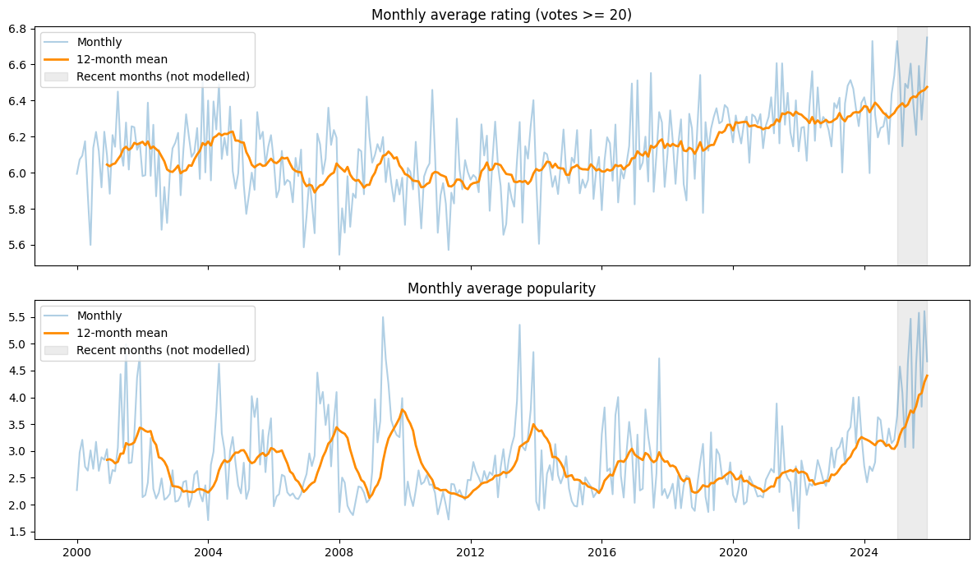
UNIT 3
Method 1 implementation
Selected method: Time-series analysis of the monthly average rating: trend, seasonality, stationarity and forecasting.
Input and preparation: Movies with 20 or more votes grouped by release month: 312 months, of which the last 12 are not modelled because they have few votes, leaving 300. Yearly shares of the top 6 genres.
Implementation: Python statsmodels: additive decomposition (period 12), ADF test (p = 0.0008, so no differencing), naive baseline, SARIMA (order (1,0,1) chosen by AIC), Holt-Winters and damped Holt; last 24 months held out.
Monthly average rating and popularity with a 12-month mean; grey band = recent months not modelled.
Output: Average rating was flat near 6.06 until 2019 and 6.31 for 2020 to 2024. Trend strength 0.41, seasonality only 0.07. Forecast average 6.36 (95% band 6.0 to 6.7). Horror and Thriller share rose 3.8 and 3.3 points, Drama fell 7.2.
10
Notes:
Suggested time: 45 seconds. Frequency is monthly; train on Jan 2000 to Dec 2022 and test on Jan 2023 to Dec 2024. We do not chart the number of releases per year because we sampled about 600 movies per year. Decomposition, seasonality and the final forecast chart are in the backup slides.

Slide 11
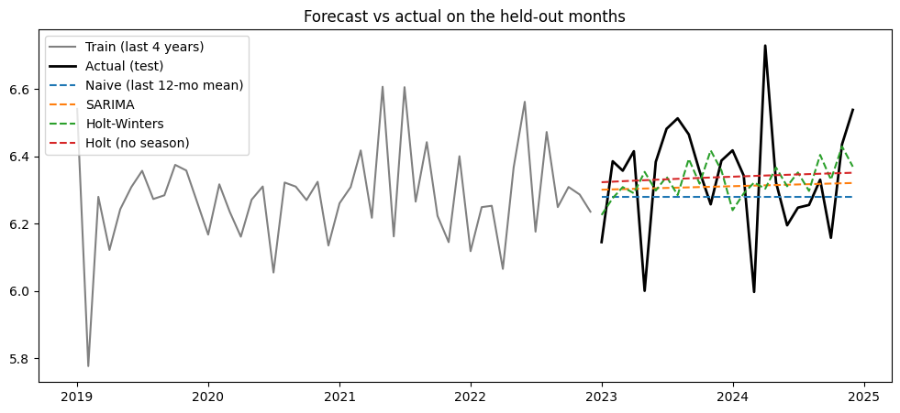
UNIT 3
Method 1 evaluation and comparison
Approach (same 24 test months) | MAE | RMSE | vs naive
Holt, damped, no season (selected) | 0.1252 | 0.1621 | -6.3%
SARIMA (1,0,1) | 0.1308 | 0.1645 | -4.9%
Holt-Winters (with seasonality) | 0.1326 | 0.1693 | -2.1%
Naive (last 12-month mean) | 0.1407 | 0.1729 | 0.0%
Forecast vs actual on the held-out months (Jan 2023 to Dec 2024)
Evaluation data: last 24 months of the monthly rating series; all models trained on Jan 2000 to Dec 2022 (276 months) and scored on the same months with MAE and RMSE.
Interpretation: Holt without seasonality is best but only about 6% better than the naive baseline, so ratings sit near a steady level with almost no seasonality (strength 0.07); residuals show no leftover pattern (Ljung-Box p = 0.18). The forecast covers 2025, months left out of modelling: their actual average (6.46) lies inside the 95% band (6.0 to 6.7) but above the forecast (6.36). Limitation: about 300 monthly points from a sampled dataset.
11
Notes:
Suggested time: 65 seconds. Lower error is better. The honest message: a small gain over the naive baseline means ratings are close to a steady level, so we do not claim a precise forecast. The forecast period is 2025, the months excluded from modelling because they have few votes so far.

Slide 12
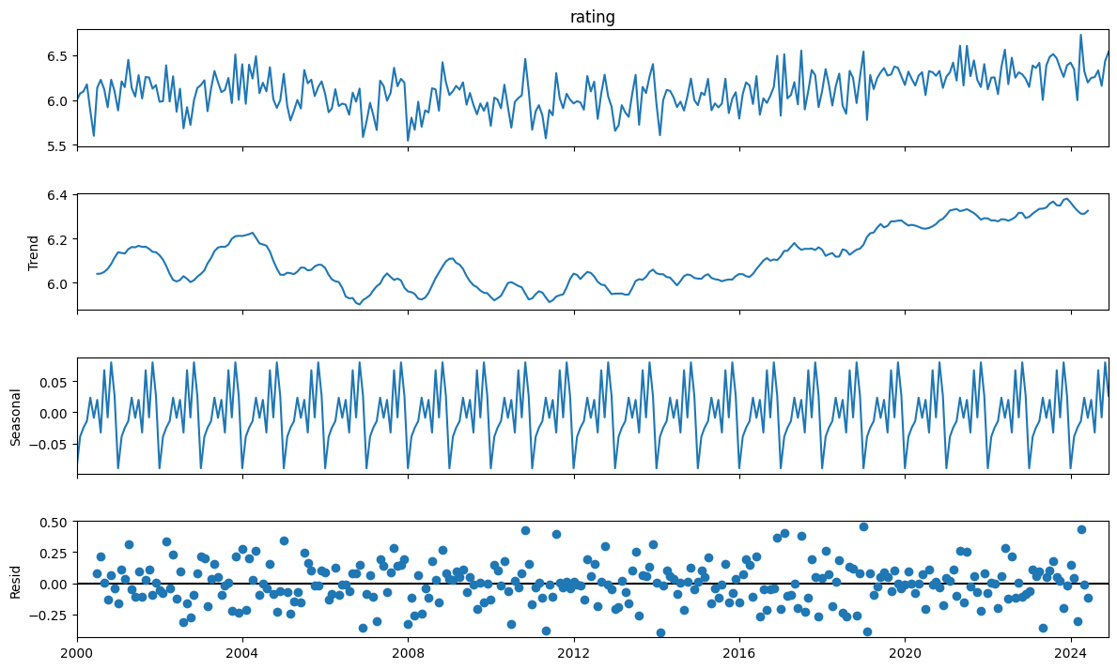
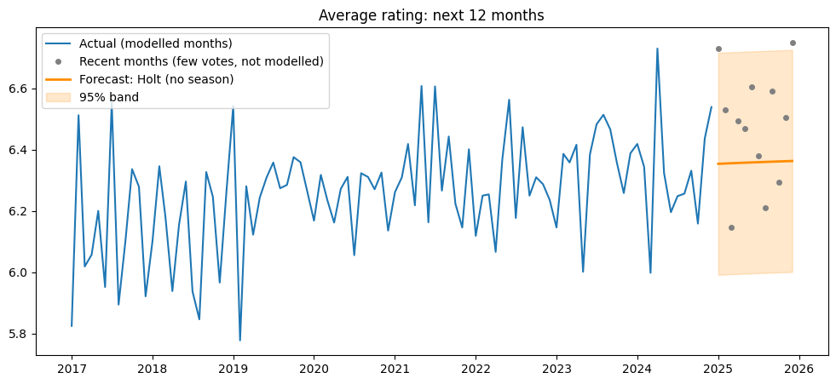
BACKUP: TIME SERIES
Time-series diagnostics and forecast
Forecast for Jan to Dec 2025 (Holt, no season) with a 95% band. These months were left out of modelling for having few votes; their actual average, 6.46, falls inside the band.
Decomposition of the monthly rating series (trend, seasonal, residual). Seasonal strength 0.07, trend strength 0.41; ADF p = 0.0008, so no differencing.
12
Notes:
Backup. Use if asked about the decomposition or the forecast band. The band is approximate for the Holt and naive models.

Slide 13
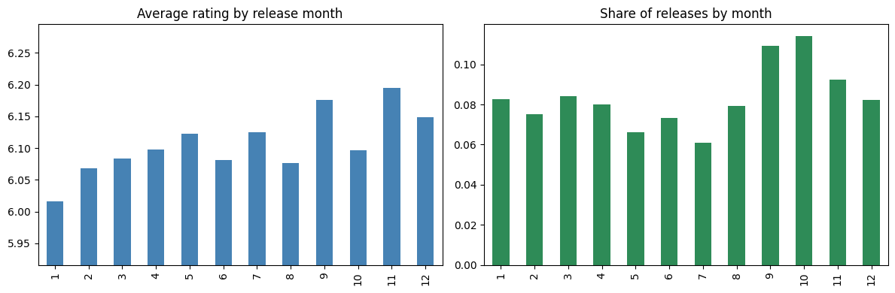
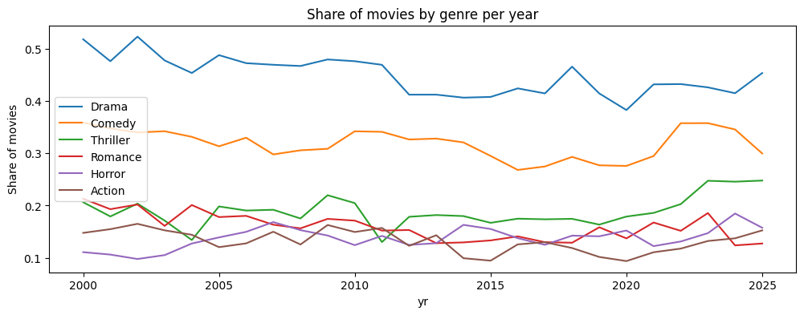
BACKUP: TIME SERIES
Seasonality and genre mix
Seasonality is weak: average rating by release month ranges only from 6.02 (January) to 6.20 (November), so release month is not a useful lever.
Genre mix is shifting: comparing 2000 to 2004 with 2020 to 2024, Horror share rose 3.8 points and Thriller 3.3, while Drama fell 7.2, Romance 4.1, Action 3.5 and Comedy 1.8. Shares are of our sampled movies.
13
Notes:
Backup. Left: rating and share of releases by month. Right: yearly share of the six biggest genres.

Slide 14
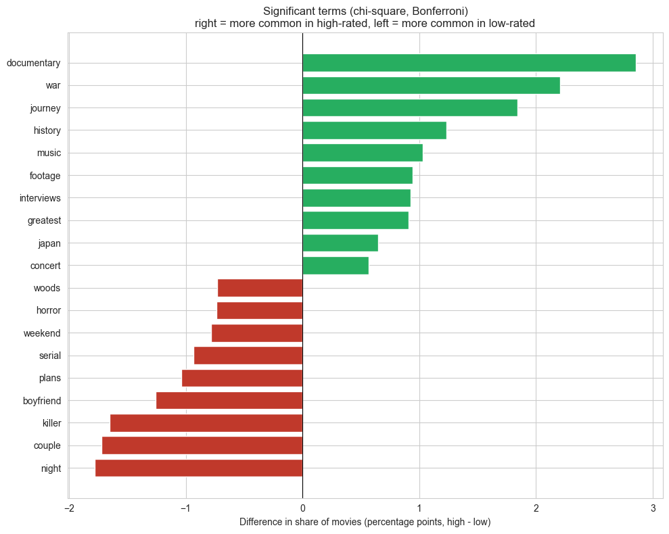
UNIT 3
Method 2 implementation
Selected method: Text mining of plot overviews to find the words, themes and tone linked to high-rated and low-rated movies.
Input and preparation: Overviews of 10,078 movies (20+ votes), about 50 words each. Lower-cased, letters only, 356 stop words removed; 2,000-term matrix; movies labelled high-rated (6.5 or more) or not.
Implementation: scikit-learn and TextBlob: share of movies containing each word by rating group with chi-square tests (Bonferroni), bigrams, word clouds, LDA topics (number chosen by coherence) and sentiment polarity.
Output: 19 of 2,000 words are significantly linked to rating. High-rated: documentary, war, journey, history, music, footage. Low-rated: killer, serial, boyfriend, couple, night. Four topics; plot tone is only weakly related to rating.
Significant words: right = more common in high-rated plots, left = more common in low-rated plots
14
Notes:
Suggested time: 45 seconds. Cleaning: lowercase, letters only, stop words. We compare the share of movies containing a word in each rating group (not raw counts, because the groups differ in size). Sentiment is the tone of the plot summary, not audience opinion. Word clouds, bigrams, topics over time and sentiment charts are in the backup slides.

Slide 15
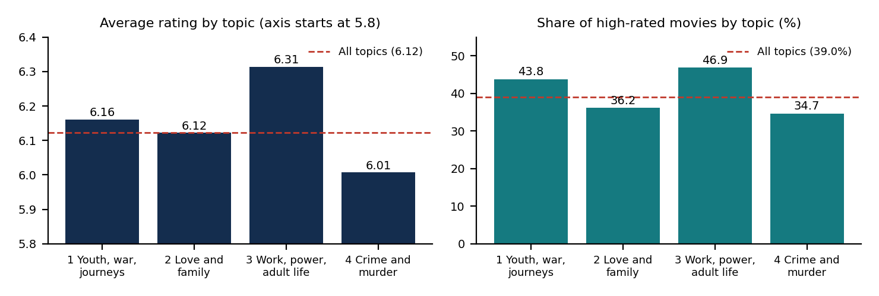
UNIT 3
Method 2 evaluation and comparison
Topic and top words (LDA, 4 topics) | Coherence | Movies | Avg rating | High-rated
1. Youth, war and journeys: school, high, war, team, children, fight | 0.008 | 2,015 | 6.16 | 43.8%
2. Love and family: love, family, girl, father, mother, past | 0.066 | 2,905 | 6.12 | 36.2%
3. Work, power and adult life: night, women, game, lives, power, career | 0.029 | 1,693 | 6.31 | 46.9%
4. Crime and murder: house, police, murder, death, killer, city | 0.032 | 3,465 | 6.01 | 34.7%
Evaluation data: 10,078 movies (20+ votes). Topic numbers 4, 6, 8, 10 and 12 were compared: mean coherence 0.034, 0.028, 0.023, 0.032, 0.021, so 4 was kept. Rating differs by topic (Kruskal-Wallis p = 8.5e-25; chi-square p = 1.6e-21).
Interpretation: Differences are real but small (6.31 vs 6.01). Topics are rough themes (topic 1 mixed, topic 3 vague). Plot tone is only weakly linked to rating (Spearman r = 0.083); Horror and Thriller summaries are the most negative.
15
Notes:
Suggested time: 65 seconds. Coherence measures whether a topic's top words appear together in the same plots; higher is better and values this low mean rough themes. Name the limits: short overviews, no lemmatisation, crude lexicon sentiment. Sentiment: polarity 0.065 for high-rated vs 0.036 for low-rated plots; Horror -0.065, Thriller -0.031, Romance +0.136, Family +0.103.

Slide 16
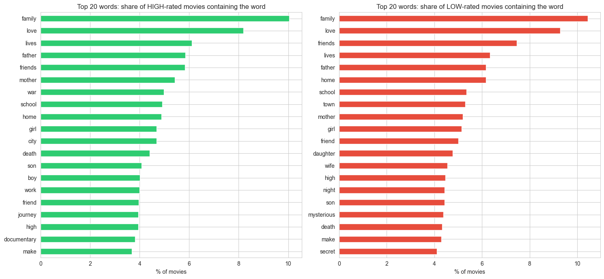
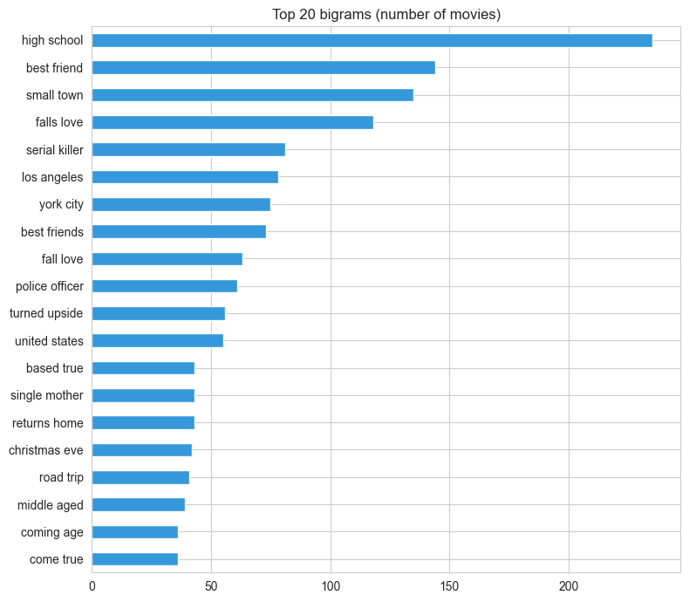
BACKUP: TEXT MINING
Words and phrases by rating group
Most common phrases: high school (235 movies), best friend (144), small town (135), falls love (118). 'Serial killer' appears more in low-rated plots (1.1% vs 0.4% of movies).
16
Notes:
Backup. Shares compare the percentage of movies in each rating group that contain the word, so the group sizes do not distort the comparison.

Slide 17
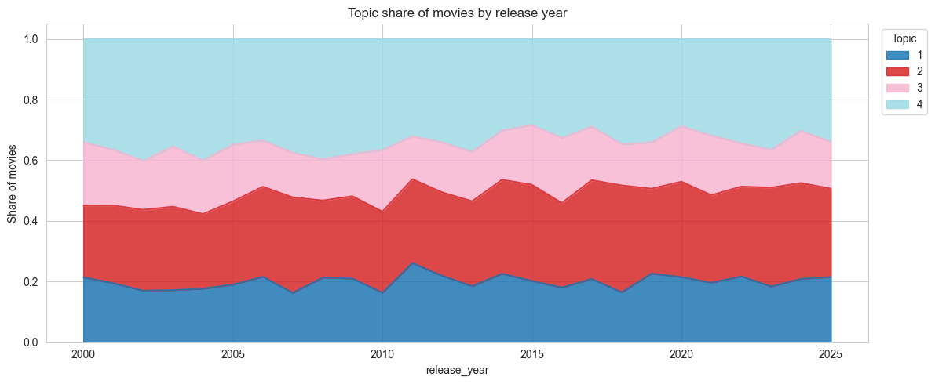
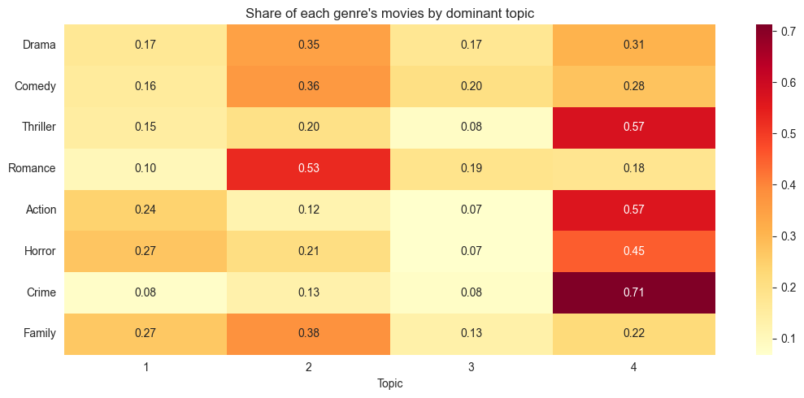
BACKUP: TEXT MINING
Topics over time and across genres
Reading the charts: the left chart shows the share of movies whose main topic is each theme in every release year; the right chart shows which topics dominate in each genre. Topic names are our own labels based on the top words.
17
Notes:
Backup. Link to time series: use the topic share by year to see whether any theme grows or shrinks, and compare with the rating trend.

Slide 18
BUSINESS OUTCOMES
Combined insights and recommendations
Evidence from the project | Recommended action | Expected benefit / limitation
Unit 2 + time series: content alone predicts high ratings (AUC 0.785); Documentary and Animation rate highest, Horror lowest; Horror and Thriller share rose 3.8 and 3.3 points | Judge each title against its own genre's usual rating; give extra quality review to horror and thriller pitches | Fewer weak titles in crowded genres. The model misses about 43% of high-rated movies, so use it as one input
Both Unit 3 methods: ratings are steady near 6.3 since 2020 (forecast about 6.4, wide band); high-rated plots use factual wording (documentary, war, history, music), low-rated ones words like killer, serial and boyfriend; crime and murder plots rate lowest (6.01 vs 6.31) | Plan for stable ratings, not further growth; check a pitch's theme against similarly rated plots, especially in crime and thriller | Realistic targets and an early warning. Topics are rough (coherence about 0.03) and the forecast band is wide
Unit 2: adding early votes and popularity lifts AUC from 0.785 to 0.836 | Track early audience votes after release to update expectations | Better post-release estimate; needs data only available after release
Business objective addressed: help studios and streaming platforms judge which genres and themes tend to be well rated, before and after release
18
Notes:
Suggested time: 55 seconds. Connect evidence to action. Say clearly that these are associations in a sampled TMDB dataset, not proof of cause.

Slide 19
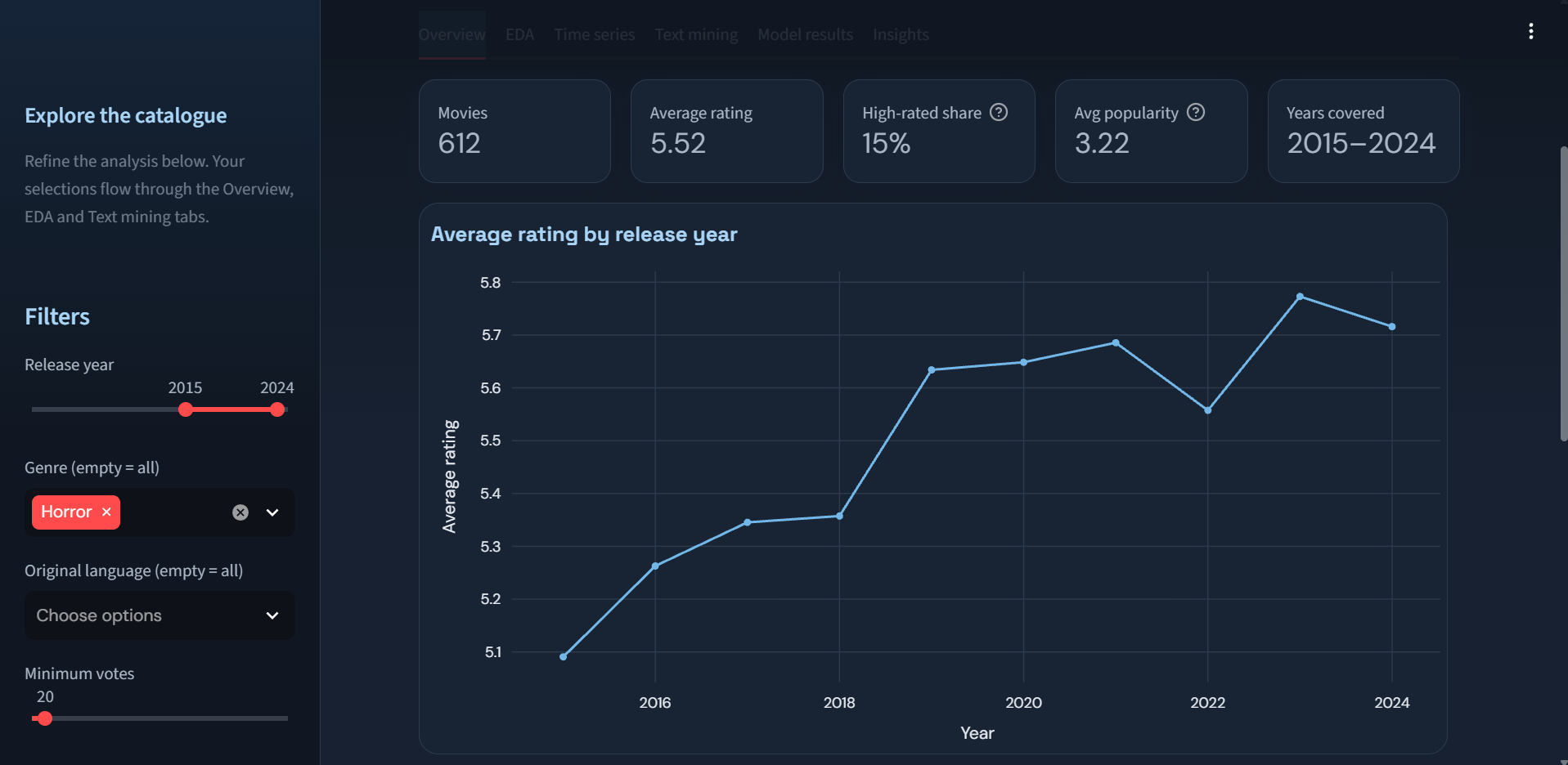
MANDATORY LIVE DEMONSTRATION
Interactive dashboard or website
Application: Streamlit dashboard. Launch: streamlit run dashboard/app.py (opens at http://localhost:8501)
Live demo: set Genre = Horror and Year 2015 to 2024 and show the rating, topic and sentiment charts update.
Business scenario: a streaming platform deciding whether to commission horror titles: check the genre's ratings, its rising share, the themes linked to higher ratings and the rating to expect.
19
Notes:
Suggested time: 120 seconds. Switch to the running app. 1) Overview tab: change the genre and year filters and show the numbers update. 2) EDA: genre ratings. 3) Time series: forecast and the model comparison table. 4) Text mining: topics, words linked to high and low ratings, movie explorer. 5) Model results. 6) Insights. Test the app before the panel.

Slide 20
100% PROJECT IMPLEMENTATION
Completion and individual contribution
Team member | Completed responsibility | Evidence / project-board task
Soundarya Satalgoan (CB.SC.U4CSE23447) | Issues 1 to 4: problem statement, dataset plan, documentation, TMDB API setup; time-series analysis; dashboard | Issues 1 to 4; TimeSeries.ipynb;
Balaji N (CB.SC.U4CSE23011) | Issues 5 to 7: data collection (15,555 movies), cleaning, data quality check; text mining [add part] | Issues 5 to 7; dashboard/app.py
Parvathy Krishna A (CB.SC.U4CSE23739) | Issues 8 to 10: numeric, genre/language and correlation EDA; text mining [add part] | Issues 8 to 10; TimeSeries.ipynb
Venkata Kanna Bhavan Surya Addap (CB.SC.U4CSE23467) | Issues 11 to 13: structured and text features, target definition, baseline; text mining [add part] | Issues 11 to 13; TextMining.ipynb
Dareddy Tejeswara Reddy (CB.SC.U4CSE23614) | Issues 14 to 17: model training, tuning, evaluation, interpretation; text mining [add part] | Issues 14 to 17; TextMining.ipynb
Project board: https://github.com/users/soundarya-satal/projects/4/views/4
20
Notes:
Suggested time: 45 seconds. Each member states their own row in one sentence. [Fill the Review 2 text-mining and other tasks per member, and the board and repository links, from your GitHub Projects activity history.]

Slide 21
FINAL PROJECT OUTCOME
Conclusion and limitations
Main outcome: A self-collected TMDB dataset (15,386 movies, 2000 to 2025); a model that predicts high-rated movies with AUC 0.785 from content alone and 0.836 with early engagement; rating trends and a forecast; plot themes and word patterns; and an interactive dashboard.
Business value: Genre is the strongest signal of rating (Documentary and Animation highest, Horror lowest), ratings have been steady near 6.3 since 2020, and plot wording differs by rating. This supports genre planning, rating expectations and early screening.
Limitations: Sample of about 600 movies per year; ratings from under 20 votes are noisy; popularity is a recent-activity score; recall is 0.575; about 300 monthly points make the forecast band wide; topics are rough; findings are associations, not causes.
Future scope: Add budget, cast and revenue data; better text processing (lemmatisation, stronger sentiment model); association rule mining on genre and theme combinations; scheduled data refresh and online deployment of the dashboard.
21
Notes:
Suggested time: 40 seconds. Core implementation is complete; future scope lists extensions only. Keep extra charts and code explanations for backup slides and questions.

