Slide 1
Energy Mix Optimization: Enhancing Sustainability
MI 6060 - ADVANCED DATABASE AND BIG DATA MANAGEMENT
Presented by: Soundarya Bachu and Deepa Palariya
Presented to: Dr. Vijayan Sugumaran

Slide 2
Introduction
Objective:
Optimize energy usage across sectors
Develop strategies for sustainability and reduced environmental impact
Approach:
Data-driven analysis using U.S. Energy Information Administration (EIA) data
Focus on recent 10-year period (2013-2023) and 24 key energy variables

Slide 3
Problem Description
Our project focuses on addressing the critical need for optimizing energy usage and promoting sustainability to reduce environmental impact. We aim to leverage data-driven approaches to achieve our goals and objectives, which include:
Conducting comprehensive data cleaning and filtering to prepare a robust dataset for analysis.
Analyzing energy consumption patterns across various sectors to identify trends and areas for optimization.
Developing strategies to enhance sustainability and reduce environmental impact through optimized energy mixes.
Our approach underscores the importance of adopting sustainable practices in response to global challenges related to climate change and resource conservation.
Notes:
The project involves leveraging crash investigation data from the National Highway Traffic Safety Administration (NHTSA), specifically sourced from The Fatality Analysis Reporting System (FARS). FARS provides comprehensive data on fatal traffic crashes across all 50 states, the District of Columbia, and Puerto Rico, making it a valuable resource for understanding traffic safety trends.

Slide 4
Project Deliverables
Data Preparation and Development :
Extensive cleaning and validation of Energy data.
Normalization for structured analysis.
Creation of MSSQL data objects, ETL and DW.
Relational Database for cleaned data.
SSAS and SQL Analysis:
Development of cubes for dice and slice of the data in SSAS.
Development of multiple queries for KPIs analysis in SQL Server
Insights on energy trends and contributing factors.
Power BI Integration:
Integration of database with Power BI.
Visualization of KPIs for stakeholders.
Notes:
The project involves leveraging crash investigation data from the National Highway Traffic Safety Administration (NHTSA), specifically sourced from The Fatality Analysis Reporting System (FARS). FARS provides comprehensive data on fatal traffic crashes across all 50 states, the District of Columbia, and Puerto Rico, making it a valuable resource for understanding traffic safety trends.
Upon data collection, the initial focus will be on extensive cleaning and validation due to the large volume of data, with each file containing millions of rows. This process is crucial to ensure the accuracy and reliability of the dataset. Following cleaning and validation, normalization techniques will be applied to prepare the data for further analysis.
Once the data setup is complete, the next step involves creating a data warehouse using Microsoft SQL Server (MSSQL). The data warehouse will serve as a centralized repository, housing the cleaned and normalized data in a structured format. This step facilitates efficient data management and enables seamless integration with analytical tools.
With the data warehouse in place, multiple SQL queries will be written to analyze key performance indicators (KPIs) related to vehicle safety. These queries will extract relevant insights from the dataset, such as crash trends, contributing factors, and demographic information of involved parties.
Finally, the project will integrate the data warehouse with Power BI, a powerful business intelligence tool. Power BI will be used to visualize the data and present the findings in an interactive and easily understandable format. The integration of the data warehouse with Power BI enhances the ability to explore and communicate insights effectively, enabling stakeholders to make informed decisions regarding vehicle safety initiatives.
Since the data is massive, I am going to limit my findings to 10 mid-west states: Michigan Illinois Indiana Iowa Kansas Minnesota Missouri Nebraska Ohio Wisconsin

Slide 5
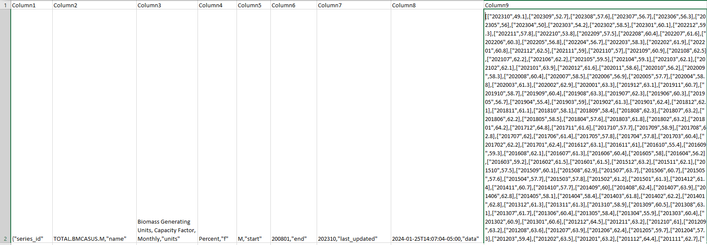
Making Relational data using Python
Raw Data:
Cleaned Data:
Notes:
The project involves leveraging crash investigation data from the National Highway Traffic Safety Administration (NHTSA), specifically sourced from The Fatality Analysis Reporting System (FARS). FARS provides comprehensive data on fatal traffic crashes across all 50 states, the District of Columbia, and Puerto Rico, making it a valuable resource for understanding traffic safety trends.

Slide 6
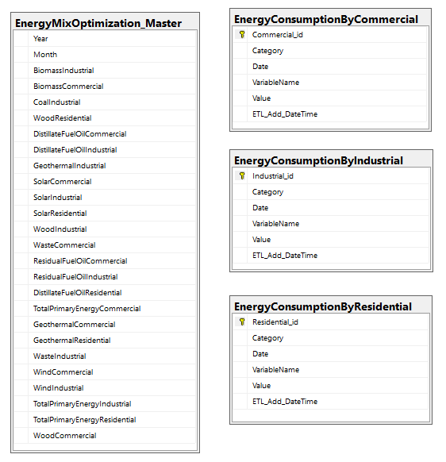
Implication DW/DB Application
Stage Tables Structure:
EnergyMixOptimization_Master table created as the foundation, storing energy consumption data for different sources and sectors on a monthly basis from cleaned data.
Data loaded from stage tables to corresponding Energy Consumption by Commercial, Industrial, and Residential tables by pivoting the data, ensuring data integrity.
Notes:
The project involves leveraging crash investigation data from the National Highway Traffic Safety Administration (NHTSA), specifically sourced from The Fatality Analysis Reporting System (FARS). FARS provides comprehensive data on fatal traffic crashes across all 50 states, the District of Columbia, and Puerto Rico, making it a valuable resource for understanding traffic safety trends.

Slide 7
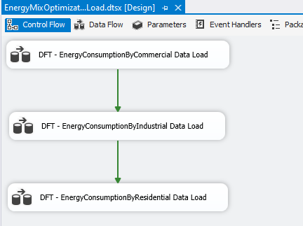
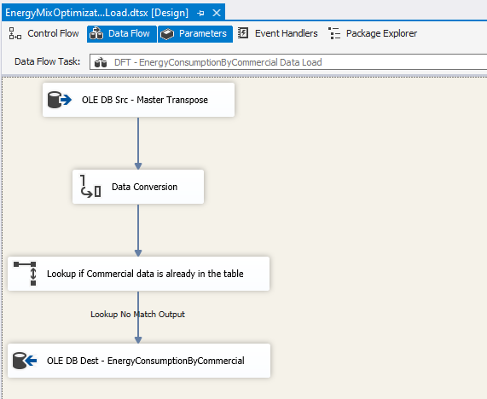
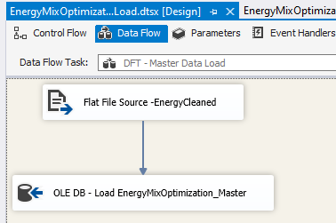
Implication DW/DB Application
EnergyMixOptimization_MasterDataLoad SSIS package utilized for data dump into the EnergyMixOptimization_Master table.
Data loaded from stage tables to corresponding Energy Consumption by Commercial, Industrial, and Residential tables using the EnergyMixOptimization_DataLoad SSIS package.
Notes:
The project involves leveraging crash investigation data from the National Highway Traffic Safety Administration (NHTSA), specifically sourced from The Fatality Analysis Reporting System (FARS). FARS provides comprehensive data on fatal traffic crashes across all 50 states, the District of Columbia, and Puerto Rico, making it a valuable resource for understanding traffic safety trends.

Slide 8
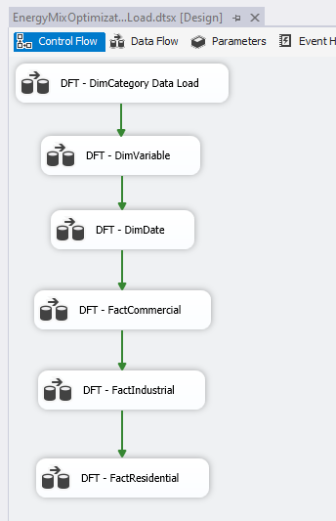
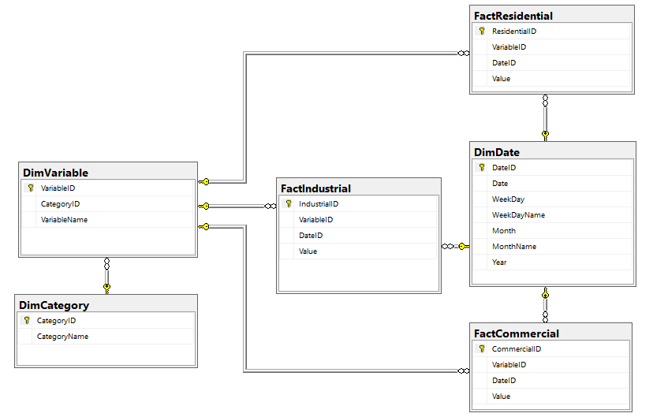
Normalized Table Structure Data Load
Dimensional modeling implemented, creating separate dimension and fact tables in SQL Server.
Dimensional modeling allows for organizing data into manageable parts, enhancing analytical capabilities.
Primary and foreign key relationships established between dimension and fact tables to maintain data integrity and enable efficient querying.

Slide 9
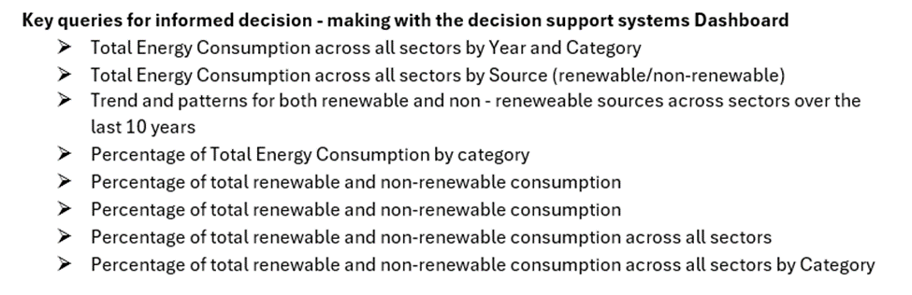
KPIs to address the problem

Slide 10
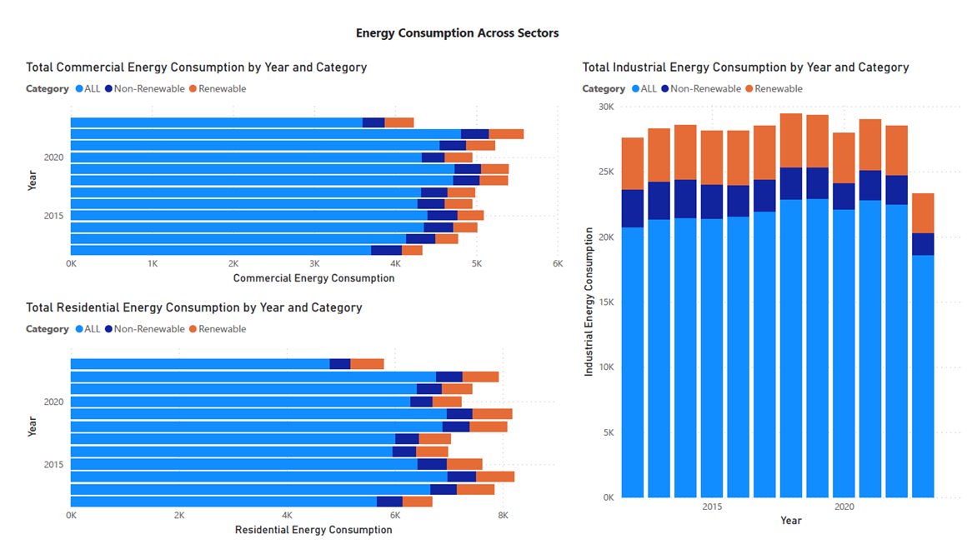

Slide 11
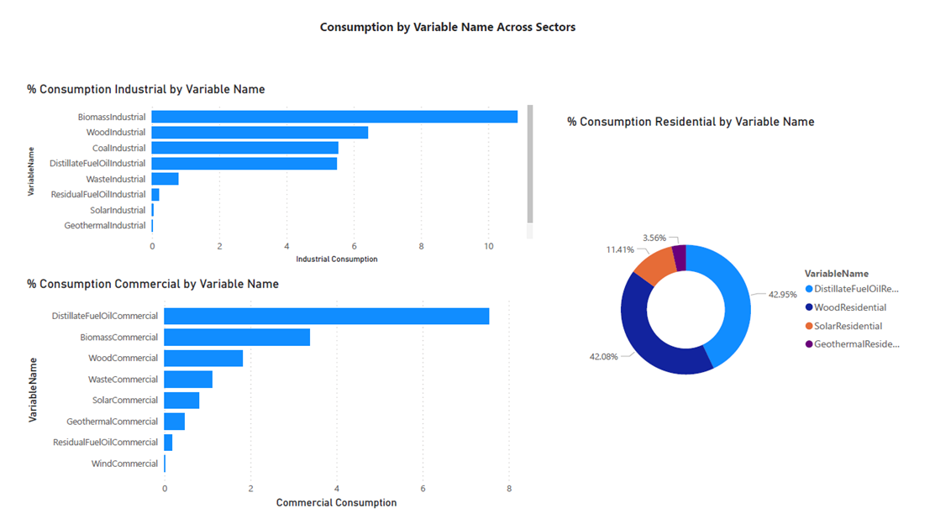

Slide 12
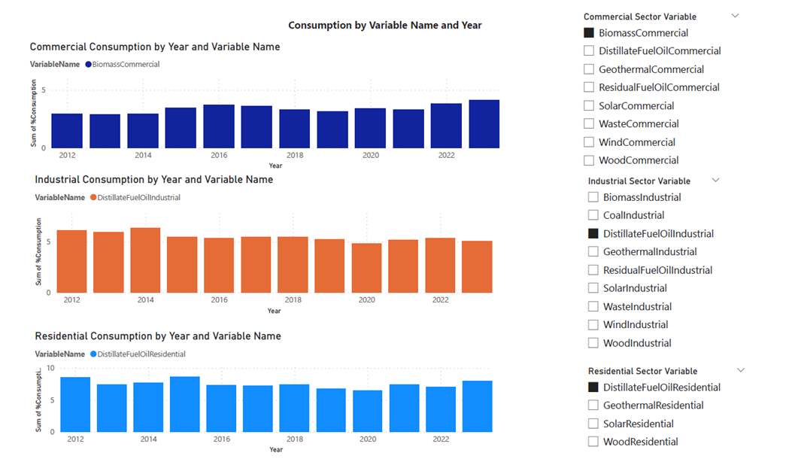

Slide 13
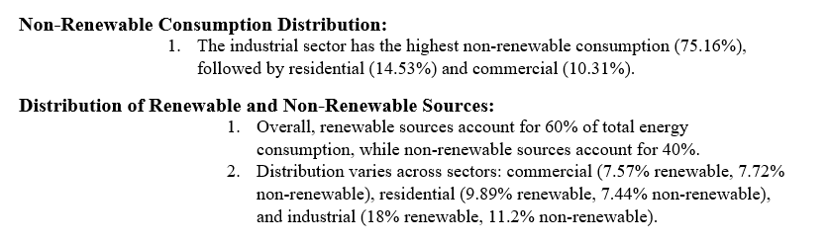
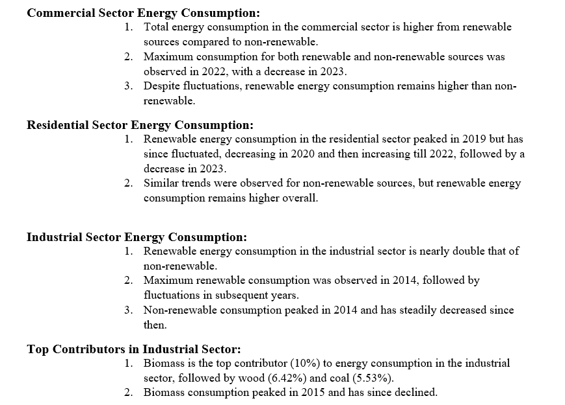
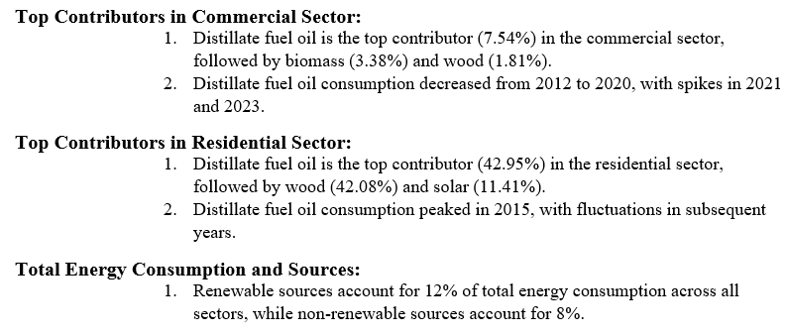
Findings:

Slide 14
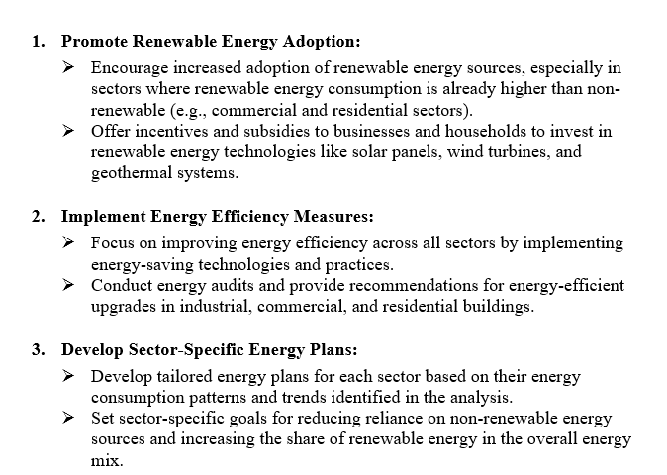
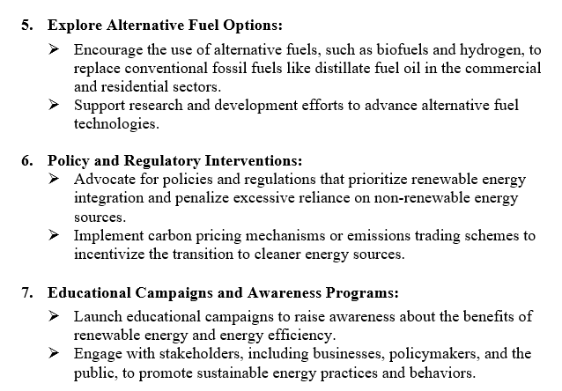
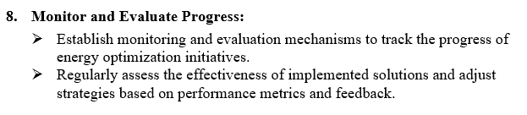
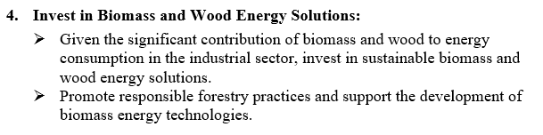
Solutions Proposed

Slide 15
Summary/Lessons Learned/Limitations
Summary:
Project focused on optimizing energy usage across sectors from 2013 to 2023.
Insights into consumption patterns, highlighting renewable energy dominance in certain sectors.
Importance of promoting renewable adoption for sustainability.
Utilization of tools like Power BI for effective data visualization.
Implementation of SSAS and SSIS and Python with real-world data.
Lessons Learned:
Significance of thorough data cleaning and tailored sector-specific energy solutions.
Utilization of tools like Power BI for effective data visualization.
Implementation of SSAS and SSIS with real-world data.
Limitations:
Lack of more granular data.
We didn’t had same variable for all the sectors.

Slide 16


