Slide 1

Generative AI Based Skill Match and Code Assessment
Discover how to leverage the power of AI to match candidate skills and evaluate coding proficiency, revolutionizing the hiring process.

Slide 2
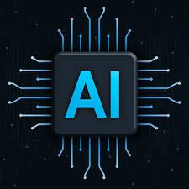
Overview of AI Based Skill Matching
1
Efficiency 📊
Automatically analyze candidate skills to streamline the hiring process.
2
Accuracy 🎯
Identify the best-fit candidates based on real-time data and performance metrics.
3
Unbiased Selection 🤝
Eliminate unconscious bias by removing human judgment from the initial screening process.

Slide 3
How to Create a Generative AI Based Skill Matching Algorithm
Collect Data
Gather a comprehensive dataset of candidate skills and job requirements.
Train the Model
Use machine learning techniques to train the AI model on the collected data.
Implement the Algorithm
Integrate the skill matching algorithm into your hiring platform .

Slide 4

Implementing Coding Tests for Candidates
1
Create Relevant Tasks
Design coding challenges that assess the specific skills required for the role.
2
Provide a Sandbox Environment
Offer a simulated coding environment for candidates to complete the tasks.
3
Automated Testing
Develop automated tests to assess the correctness and efficiency of the code.

Slide 5
Use Case
Technical interviews: Evaluate candidates 'programming skills through
Skill-based job matching: Our solution identifies the best-fit
Candidates for specific roles based on their skills and experience.
Learning and development: Leverage ChatGPT for personalized skill
Development plans and targeted learning resources
Interactive conversations with AI.

Slide 6
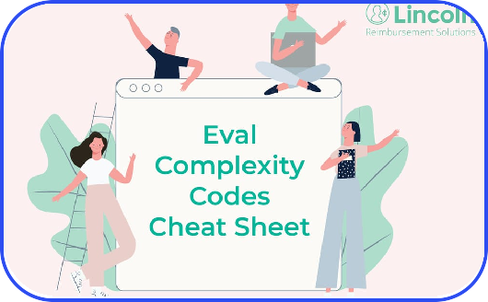
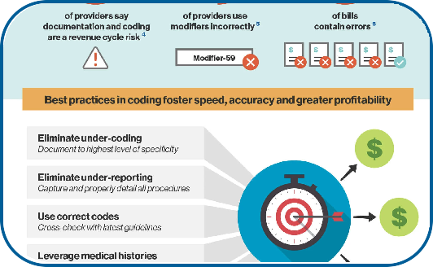
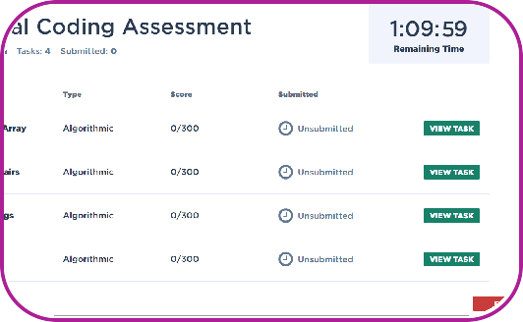
Evaluating Candidate's Code Using AI
Code Ǫuality
Analyze the structure and readability of the candidate's code using AI algorithms.
Efficiency & Performance
Assess the code's runtime efficiency and performance using AI-powered benchmarks.
Scalability & Flexibility
Determine the code's ability to handle large datasets and adapt to future needs.

Slide 7

Conclusion
By leveraging AI-based skill matching and coding tests, businesses can optimize their hiring process, identify top candidates, and build exceptional teams.

