Slide 1
Loan Default Prediction & Cost-Benefit Analysis

Slide 2
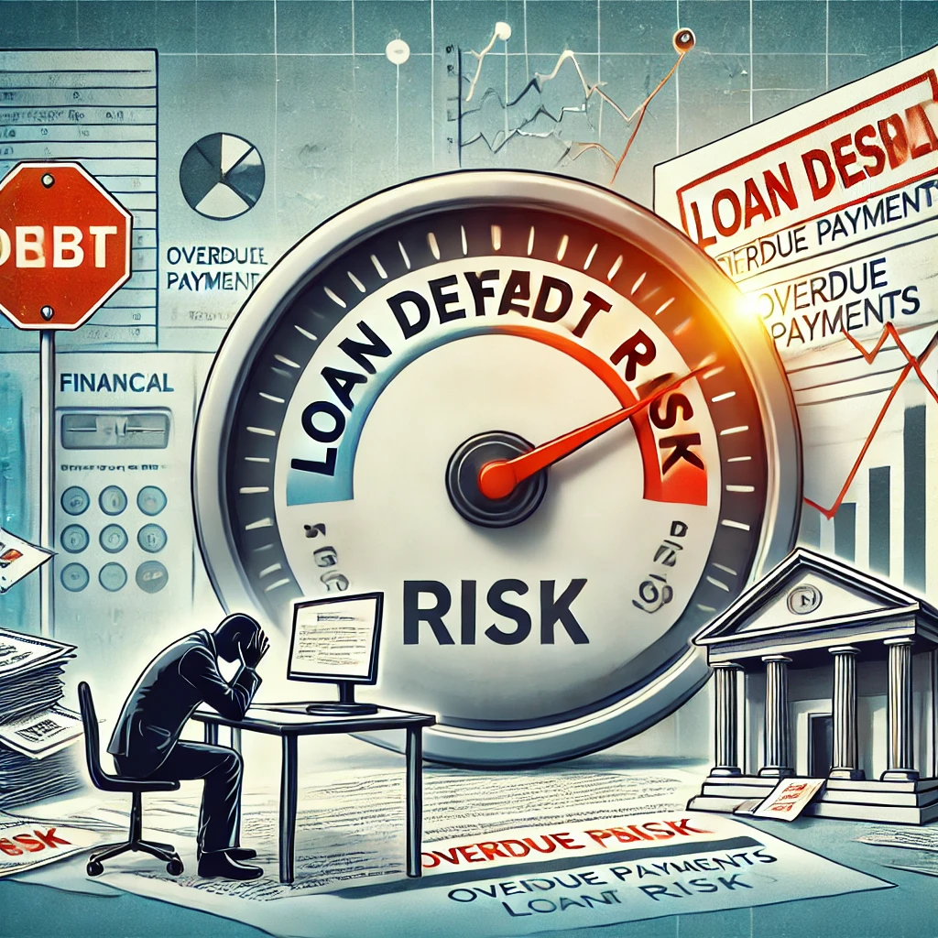
Dataset Overview
Introduction
The dataset is sourced from LendingClub.com, a peer-to-peer lending platform.
It contains loan application records from 2007 to 2010.
The goal is to predict whether a borrower will fully repay their loan or default.
Dataset Summary
The dataset includes various borrower attributes that influence loan repayment behavior.
It consists of financial indicators, credit history details, and loan terms.
Project Relevance
This dataset is used to build machine learning models to predict loan default risk.
The model will help reduce financial losses by improving loan screening.
Beyond model performance, the project will evaluate the financial impact of deploying the model.
A Cost-Benefit Analysis (CBA) will assess potential savings for LendingClub by reducing risky loans.

Slide 3
Choice of Algorithms & Evaluation Metric
Algorithm | Recall Score | Advantages | Disadvantages | Final Decision
XGBoost | 73% | High recall, interpretable, feature importance | Computationally intensive | ✅ Best choice for deployment
Logistic Regression🔢 | 59% | Works well with structured data, adaptable | Moderate recall, requires tuning | ⚠ Considered, but not the strongest
Prioritizing Recall as the Evaluation Metric 🎯
✅ Why Recall?
Recall = TP / (TP + FN) → Measures how well we identify actual defaulters.
Higher recall = More defaulters detected → Fewer financial losses.
False Negatives (FN) are costly, so we prioritize catching as many defaulters as possible.

Slide 4
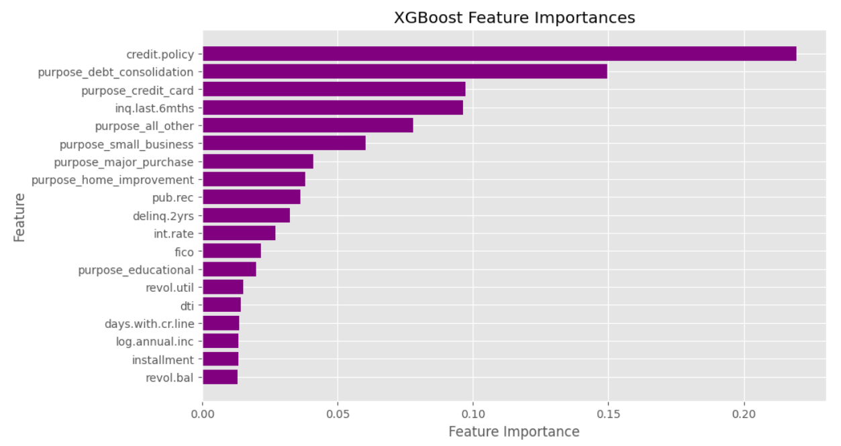
Factors being significant predictors
Lending policies: A major factor, as stricter loan approval rules and policies heavily influence repayment success.
Debt consolidation loans: This shows that loans used to pay off other debts often carry higher default risks.
Credit card loans: The loans taken for credit card payments can affect repayment consistency.
Recent loan inquiries: Indicates that more recent inquiries might point to financial stress and repayment issues.
Interest rate: As higher rates can make it harder to repay the loan on time.
Recognizing the key factors behind loan defaults helps lenders make smarter, more informed decisions. With these insights, they can fine-tune their lending policies—not just to minimize risk, but also to ensure deserving borrowers still have access to credit. It’s all about striking the right balance between protecting financial stability and supporting responsible lending.

Slide 5
Cost Benefit Analysis
📌 Problem Statement
A financial institution wants to minimize loan defaults using machine learning model. The institution currently approves all loans, leading to financial losses from missed defaulters.
Total Loan Applicants = 10,000 (assumption)
Default Rate = 15% → 1,500 applicants default per year.
Loss per defaulted loan = €50,000.
1. Cost Without a Loan Default Prediction Model (Baseline Loss)
If all loan applications are approved,15% of applicants default.
Total loss = 1,500 * €50,000 = €75 million per year.
2. Cost With XGBoost Model (Recall = 0.73)
True Positives (TP) = 0.73 × 1,500 = 1,095 (Correctly identified defaulters)
False Negatives (FN) = 1,500 - 1,095 = 405 (Missed defaulters)
False Positives (FP) = 10% of non-defaulters = 0.10 × 8,500 = 850 (Good borrowers wrongly rejected)
True Negatives (TN) = 8,500 - 850 = 7,650.

Slide 6
3. Cost Calculation with Model
Cost of missed defaulters (FN) → 405 * €50,000 = €20.25 million.
Cost of wrongly rejected borrowers (FP) → 850 * €2,000 = €1.7 million.
Total Cost with Model = €21.95 million per year.
4. Financial Savings After Model Deployment
Savings = Cost Without Model - Cost With Model.
Savings = €75 million - €21.95 million = €53.05 million per year.
Deploying the XGBoost model saves the company €53.05 million annually. 🚀
Conclusion
XGBoost outperforms all the previous models (Recall: 73%)
Higher recall → More correctly identified defaulters → Greater financial savings.
Fine-tuning hyperparameters and feature engineering can further increase recall and reduce false positives, leading to even higher cost savings.

