Slide 1
UI/UX
USER INTERFACE & USER EXPERIENCE

Slide 2
What is user interface(UI)?
A user interface(UI) is the part of computer system, website, or mobile app that allows users to interact with it. It includes all the visual elements and controls that help users perform task.
Eg of user interface:
Buttons: To perform actions(submit)
Menus: To choose options
Icons: Represent functions or application
Text boxes: To enter information

Slide 3
What is user experience(UX)?
User experience(UX) is a overall experience a person has while using a product, website, app or service. It focuses on how easy, efficient, enjoyable, and satisfying it is to use.
Eg of user experience:
Usability: Is the product easy to use?
Accessibility: Can people with different abilities use it?
Efficiency: Can user accomplish tasks quickly?
Satisfaction: Does the experience feel pleasant and valuable?

Slide 4
DIFF BETWEEN USER INTERFACE&USER EXPERIENCE
USER INTERFACE | USER EXPERIENCE
Focuses on the product’s appearance. | Focuses on overall user journey and experience.
Includes buttons, icons, colours, fonts, and layouts. | Includes usability, ease of use, efficiency, and satisfaction.
Concerned with visual design and interaction elements. | Concerned with solving user problems and meeting user needs.
Designers create the look and feel of the interface. | Designers research, plan, test, and improve the user’s experience.

Slide 5
INSTAGRAM-SOCIAL MEDIA APP
UI ELEMENTS IDENTIFIED
ICONS:
HEART, COMMENT BUBBLE, SHARE ARROW, BOOKMARK/TAG
BUTTONS:
‘FOLLOW’, ‘MESSAGE’, ‘STORY’ RING ON PROFILE
FORMS:
CAPTION INPUT,HASHTAG,LOCATION TAG
NAVIGATION
BUTTON BAR,HOME,SEARCH,REELS,SHOP,PROFILE

Slide 6
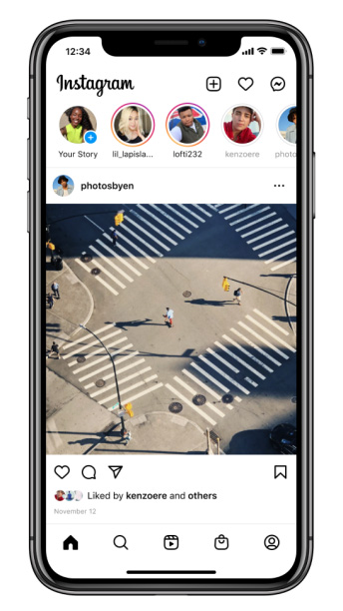
UX ANALYSIS
EASE TO USE
EASY,SIMPLE,USER FRIENDLY,SMOOTH
EFFICIENCY
EFFICIENT,OPTIMIZE,
FOCUS,FASTER
ACCESSIBILITY
ACCESSIBLE,EASY,SUPPORTIVE
CLEAR,CAPTIONS
SATISFACTION
SATISFIED,CONTENT,FULFILLED,COMPLETED

Slide 7
MEESHO-E-COMMERENCE APP
UI ELEMENTAL IDENTIFIED
BUTTONS:
‘ADD TO CART’ PINK, ‘BUY NOW’PINK—HIGH CONTRAST
FORMS:
SEARCH BAR,QUANTITY SELECTOR,ADDRESS FORM
ICONS:
STAR RATING VISUALLY SCANNABLE AT A GLANCE
NAVIGATION
MENU,HOME,ORDERS

Slide 8
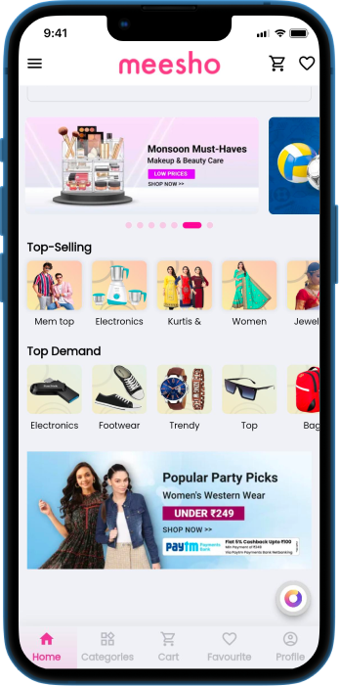
UX ANALYSIS
EASE TO USE
USER FRIENDLY,SMOOTH TO USE,EASY SHOPPING
EFFICIENCY
EFFICIENT,FAST,QUICK,
SMART.
ACCESSABILITY
ACCESSIBLE,USABLE,FLEXIBLE
SATISFACTION
SATISFIED,FAST DELIVERY,
QUALITY PRODUCT

Slide 9
SNAPCHAT-MULTIMEDIA INSTANT APP
UI ELEMENTAL IDENTIFIED
ICONS:
CAMERA,SEARCH,CREATE,SPOTLIGHT,LIKE,SAVE,MESSAGE,COMMENT,PROFILE
BUTTON:
LOG IN,SIGN IN, FOLLOW,BACK’SHARE
FORMS:
USERNAME,PASSWORD,PHONE NUMBER,NAME
NAVIGATION:
MENU,HOME,NOTIFICATION,BACK BUTTON

Slide 10
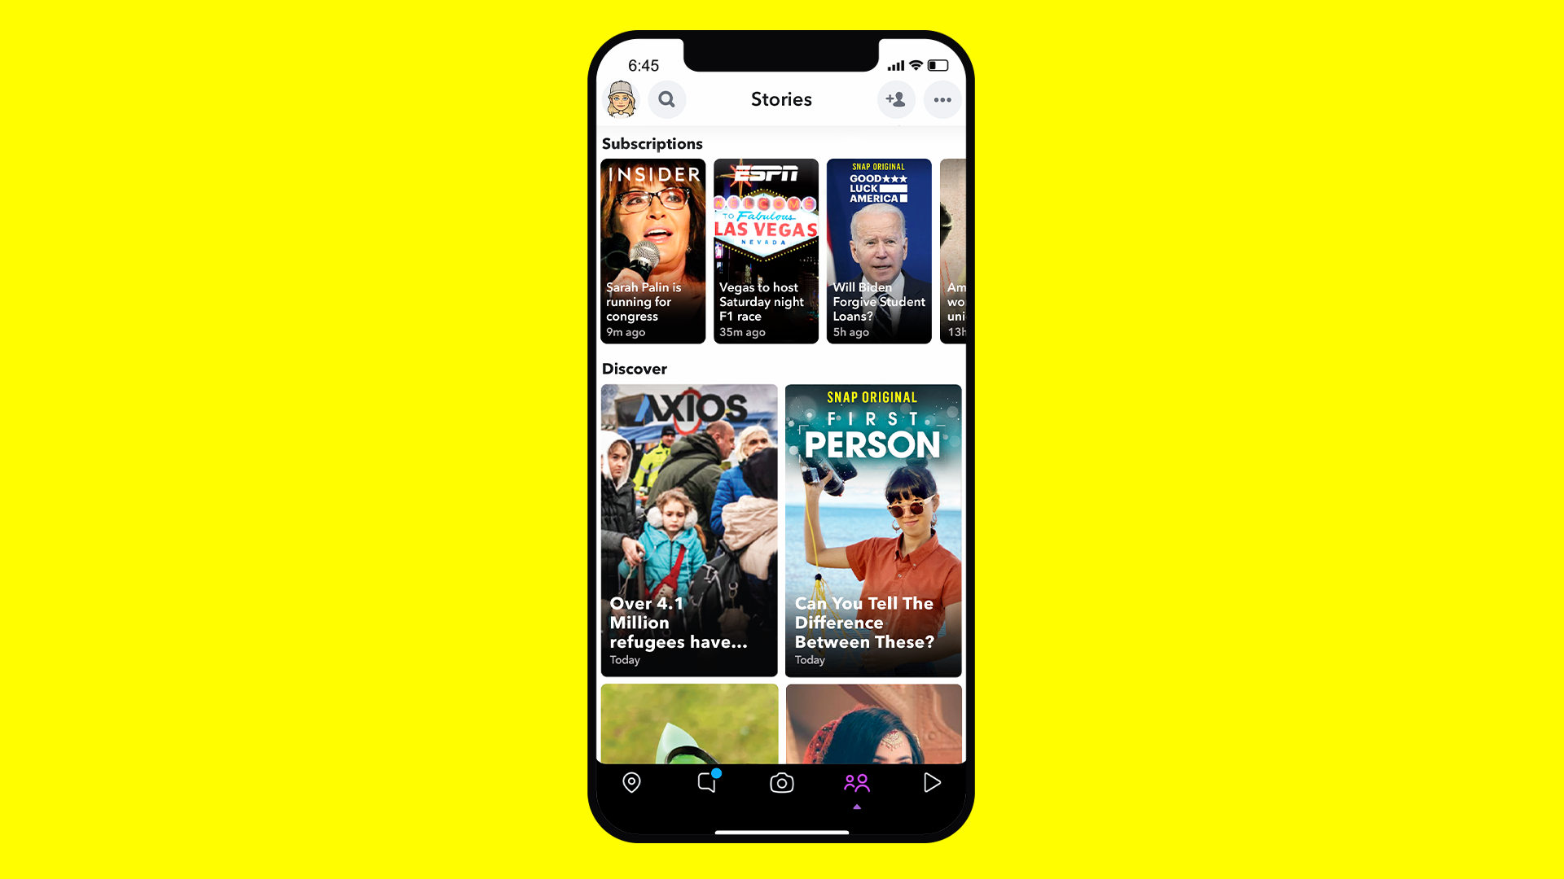
UX ANALYSIS
EASE TO USE
FAST,CONVENIENT,FUN
ACCESSIBLE
EFFICIENCY
EFFICIENT,SHARP,SNAPPY,
STREAMLINED
ACCESSABILITY
ZOOM,CONTRAST,COLOR FILTER
SATISFACTION
EXECELLENT,GREAT,
VERY SATISFIED

Slide 11
SPOTIFY-SOCIAL MEDIA APP
UI ELEMENTAL IDENTIFIED
BUTTONS
PLAY BUTTON,PAUSE BUTTON,LIKE ,SHARE
ICONS
CREATE,SHUFFLE,DOWNLOAD
FORMS
LOGIN,SIGNUP,CONTACT,PROFILE
NAVIGATION
HOME,SEARCH,LIBRARY,PLAYING BAR

Slide 12
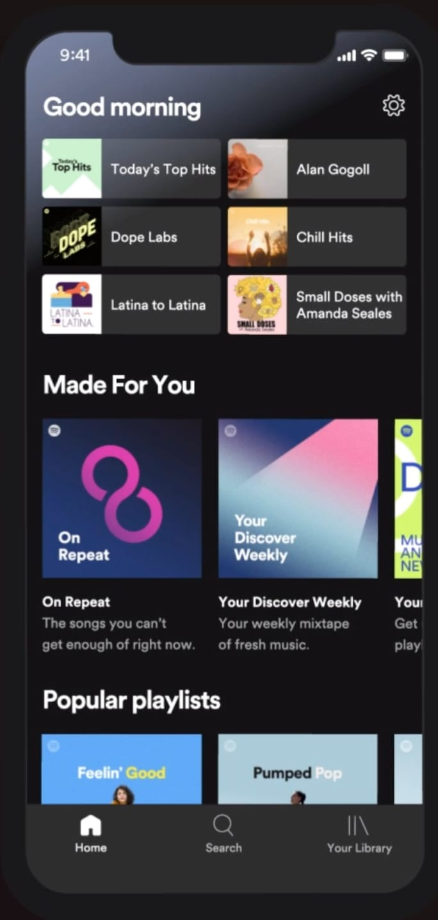
UX ANALYSIS
EASE TO USE
EASY,SIMPLE,FAST,SMOOTH
EFFICIENCY
QUICK,SEAMLESS,MINIMAL
ACCESSABILITY
READABLE,VOICECONTRO, EASY NAVIGATION
SATISFACTION
LARGE MUSICLIBRARY,OFFLINE LISTENING

Slide 13
INSHOT-EDITING APP
UI ELEMENTAL IDENTIFIED
BUTTONS
HOME,CREATE,VIDEO,PHOTO,COLLAGE,EXPORT,CROP
ICONS
TOOLBAR,TIMELINE,MENUS,SLIDERS,PROGRESS BAR
FORMS
TEXT FIELDS,DROPDOWN MENU,RADIO BUTTONS,TABS
NAVIGATION
EDIT TOOLBAR,SCROLL BAR,BACK BUTTON,UNDO BUTTON
REDO BUTTON,SETTING ICONS

Slide 14
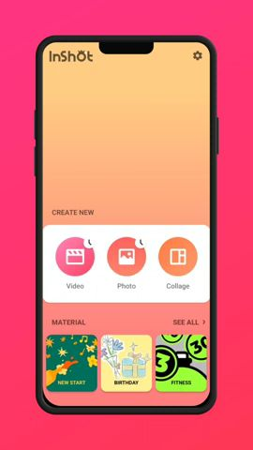
UX ANALYSIS
EASE TO USE
SIMPLE,BEGINNER FRIENDLY,,FAST EDITING,EASY CONTROL
EFFICIENCY
TIMESAVING,RESPONSIVE,SMOOTHQUICK,USER FRIENDLY
ACCESSABILITY
EASY TO READ,GOOD CONTRAST,CLEAR ICONS
SATISFACTION
EASY,ENJOYABLE,RELIABLE,
SATISFYING

Slide 15
THANK YOU

