Slide 1
PDEs and Finite Element Analysis
Yoshi Goto
Apr 12 2018

Slide 2
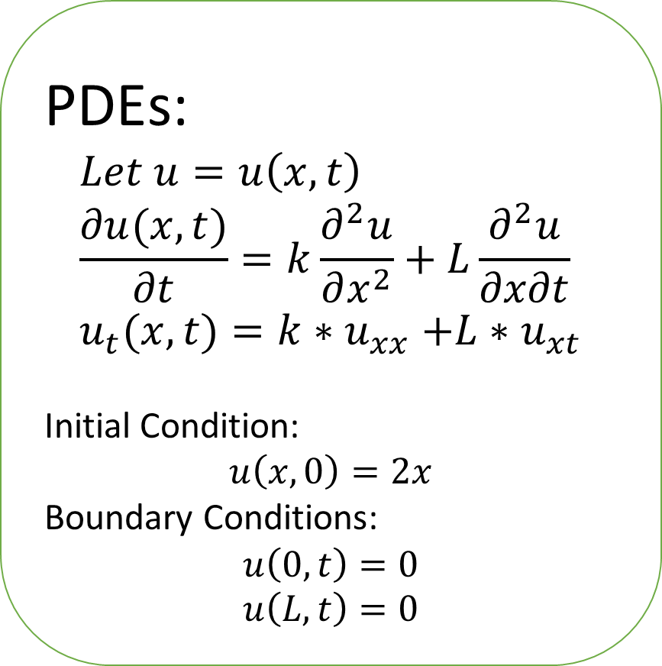
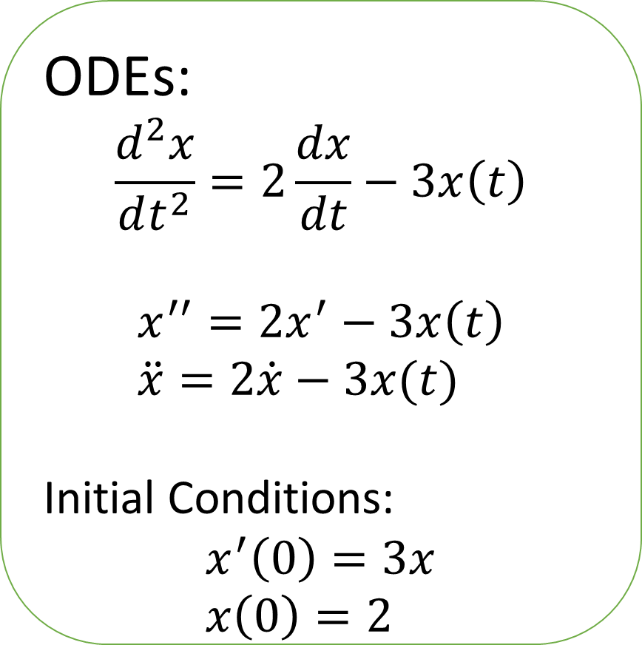
ODE vs. PDE
ODEs:
$$\frac{d^{2}x}{dt^{2}}=2\frac{dx}{dt}−3x\left(t\right)$$
$$x^{′′}=2x^{′}−3x\left(t\right) \\ \ddot{x}=2\dot{x}−3x(t)$$
Initial Conditions:
$$x^{′}\left(0\right)=3x \\ x\left(0\right)=2$$
PDEs:
$$Let u=u\left(x,t\right) \\ \frac{∂u(x,t)}{∂t}=k\frac{∂^{2}u}{∂x^{2}}+L\frac{∂^{2}u}{∂x∂t} \\ u_{t}(x,t)=k{∗u}_{xx}+L∗u_{xt}$$
Initial Condition:
$$u\left(x,0\right)=2x$$
Boundary Conditions:
$$u\left(0,t\right)=0 \\ u\left(L,t\right)=0$$

Slide 3
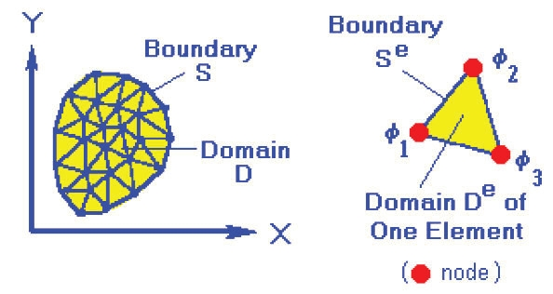
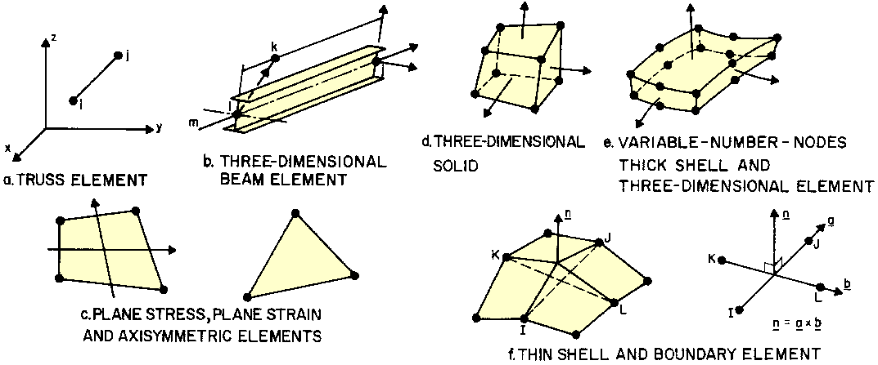
Notes:
FEA uses meshes to turn a very hard PDE problem into small ordinary-shaped PDE problems. For example, a 2D shape may turn into a bunch of triangular shapes. FEA will try to make the values at the borders of the shapes match as much as possible, to construct a “continuous” solution.

Slide 4
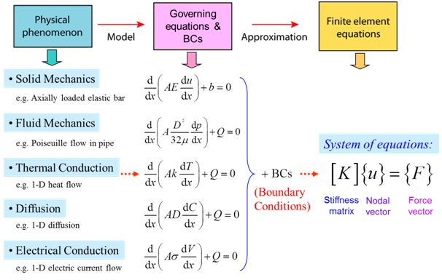
Notes:
FEA can be used with multiple different “physics” and combined for a single “governing equation”.

Slide 5
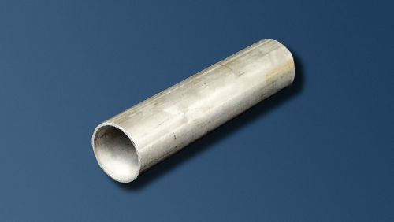
Toy Problem with COMSOL
A steel pipe in which water will flow
Notes:
This is a step-by-step walkthrough of a CFD (computational fluid dynamics) problem using FEA.

Slide 6

In diagram form, looks like this:
A pipe, with inflow and outflow.
We want to track the fluid flow as
a function u(x,y,t).
Notes:
We are looking at a cross-section of the tube

Slide 7

Let’s set up this problem...
y
Parameters
(First of all, set an axis to this problem!)
$$ρ \left(density\right), μ (viscosity)$$
d
x
l
Notes:
Set the axis for the problem. For this problem we will set the up-down direction as the y-axis and the left-right direction as the x axis.
The z-axis is going in and out of the screen.
2. We also can define the properties of the liquid, relative to terms required when simulating its motion. The minimal requirements for that are density (rho) and viscosity (mu) . They describe how “heavy” the water is to move and how “sluggish” it is when moving. Because we are simulating movement, we assume we don’t need to know things like temperature, phase change points, etc.
We also can define the tube itself: namely, its length (l) and diameter (d).
With these we have fully characterized the setup.

Slide 8
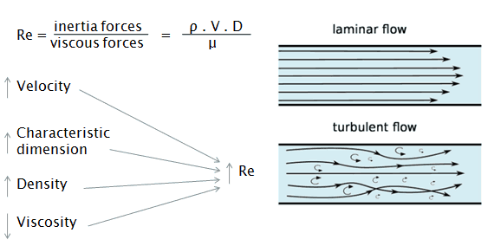
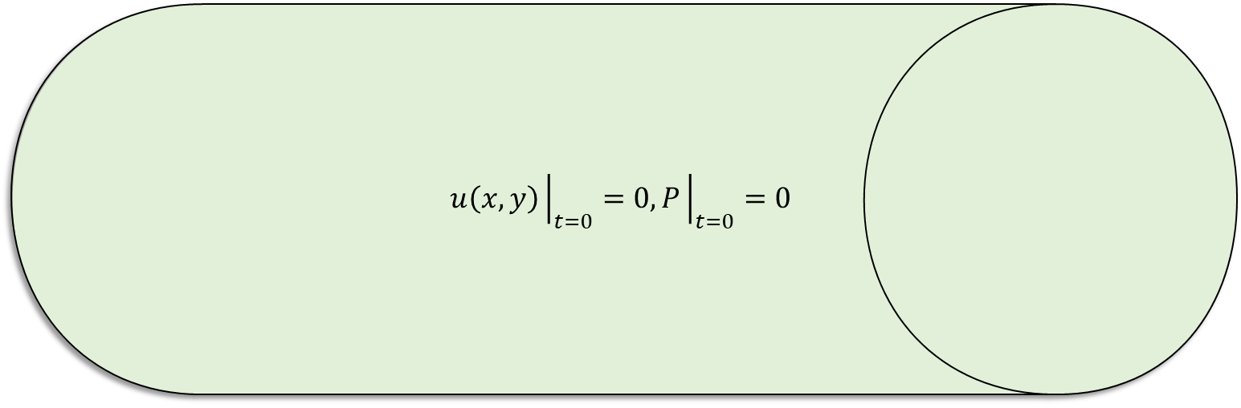


Let’s set up this problem...
$$u\left(x,y,t\right)=0$$
y
Known Behaviors
$$u\left(x,y\right){\left.​\right|}_{t=0}=0, P{\left.​\right|}_{t=0}=0$$
$$ρ \left(density\right), μ (viscosity)$$
Inflow
velocity = S
OutflowPa=0
d
x
l
Assume laminar flow
Notes:
First let’s set parameters for inflow and outflow, as the pipe will have an opening on both sides.
We assume there is already fluid in the pipe. Inflow is some initial or continuous velocity imposed on the fluid once the simulation starts. This happens at the entrance of the pipe. We also assume that more liquid flows in. In our case, we will impose a continuous velocity S into the pipe. This velocity, called the “normal inflow velocity”, can be thought of a normal force applied directly at the center of the pipe entrance.
Outflow is defined as pressure on the other side of the pipe. This is because computational models assume that there is nothing beyond the model, and the liquid simply hits a wall, not an “exit” or an “open hole”. If we don’t specify anything, it will be considered a wall. Setting Pa = 0 with no backflow means that there is no resistance or pressure against the flow, which simulates an “open tube end”: an open tube that lets liquid just flow out freely.
Next, we will set initial conditions for the fluid inside. What state are we expecting the fluid to be in at t=0?
In our case, we’ll set the velocity of the liquid inside as 0, and fluid pressure as 0 as well. In other words, the fluid is not moving or exerting force on anything (ie, it will not flow out either).
We also need to define boundary conditions, which explain how the fluid behaves at surfaces. We will define all surfaces (AKA walls) as a “no-slip boundary”, which means that the fluid will have a velocity of zero at the walls. This might seem silly and obvious, but is mathematically extremely valuable to assume. In other words, u(x,y)=0.
Lastly, we need to describe how the water flows. Long story short, we will simulate the water as “laminar flow,” an orderly type of flow. This is according to the Reynold’s number (Re). We will basically assume that laminar flow is existing, and tell the model that the water flow will be laminar.
Two good websites about Re: https://www.engineeringtoolbox.com/laminar-transitional-turbulent-flow-d_577.html
https://www.nuclear-power.net/nuclear-engineering/fluid-dynamics/reynolds-number/

Slide 9
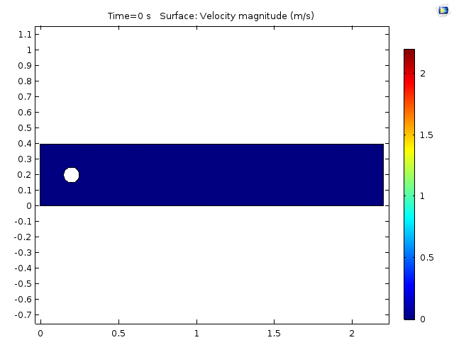
Simulate in a Finite Element Analysis Solver! (Ex. COMSOL)

