Slide 1
Guitar Shredding Under GNOME Environment
Hananto Herlambang
Guitar And Ring Buffer (GandRing)
GNOME.Asia Summit 2019
Gresik, Indonesia
12-13 October 2019

Slide 2
Hananto Herlambang
https://uduk.org
Instrumentalist
Music Information Retrieval
Digital Image & Signal Processing
Real-time Visualisation (2D)
Live coding Music (MIDI & Synthesizer)

Slide 3
Real-time Kernel Patch
Disable built-in debugger, tracer and/or profiler
Disable unused kernel modules
Disable unused services
Disable virtualization
Configure process PRIORITY
Tune limits.conf, sysctl.conf
Minimised unused 3rd party plugins
Frames/Period: 128-256 (Follow DAW System Tuning and Configuration Best Practice)

Slide 4
Cyclic Test

Slide 5
Linux Distros Designed for Musicians
Planet CCRMA
http://ccrma.stanford.edu/planetccrma/software/
Ubuntu Studio
http://ubuntustudio.org/
KXStudio
https://kx.studio/
Audiophile Linux
https://www.ap-linux.com/

Slide 6
Audio Session Managers
QJackCtl
https://qjackctl.sourceforge.io/qjackctl-index.html
Ladish
https://github.com/LADI/ladish
Cadence
https://kx.studio/Applications:Cadence

Slide 7
Linux Application Stack
< >
Jack Audio
http://jackaudio.org/
Guitarix
https://guitarix.org/
LV2 & MOD Devices
http://lv2plug.in/ https://www.moddevices.com/
Calf Studio Gear
https://calf-studio-gear.org/

Slide 8
Tone Quest Sequence
ALSA | Guitarix | LV2 | Calf Studio | MOD Devices
Jack Audio
 |  | Convolver |  | Parameter
Guitar Input | ■ | ■ | ■ | ■
 | Distortion |  | EQ
 | Expander |  | Reverb

Slide 9
Ardour - digital audio workstation

Slide 10
GIT Latest (Stable)
Build Your Own Stack
Dependencies Pain
Automated Script
Pre-selected applications build
https://github.com/soundbooze/soundbooze-daw/tree/master/build

Slide 11

LV2
http://lv2plug.in/
open extensible standard for audio plugins
simple core interface
Deep semantic plugin discovery
audio effects
synthesizers
control processors for modulation and automation

Slide 12
Mod Host
“mod-host is an LV2 host for JACK, controllable via socket or command line”
“Currently the host supports the many LV2 features”
“For each effect added one client on JACK will be created.”
“the process will be forked and it can be controlled through the socket”
https://github.com/moddevices/mod-host

Slide 13
Guitarix Patch
Live Display Visualization
https://github.com/soundbooze/soundbooze-guitarix

Slide 14
Advantages
- Tone Clustering
- Generative Impulse Response
Self-balancing Gain & Delay
Auto Adjust & Centralized
MIR
Zero Hardware Guitar Effect Processor

Slide 15
Web Audio 2.0
< >
1+
1+
1+
MIDI & Synthesizer
Timing, Event, Velocity
Generative, Soundfont
Features Extraction
Beat Tracking, Pitch Detection
Audio
Monophony, Polyphony

Slide 16
Generative Composition
Modern Methods
Hidden Markov Model (HMM) & Evolution Algorithm
Bayesian & Gaussian Process
to train a generator network that produces samples from the data distribution
Generative Adversarial Networks (GANs)
Variational Autoencoder (VAE)

Slide 17
UDUK Responsive Deviceless
https://www.youtube.com/watch?v=nSk6INaUUC8

Slide 18
Music Information Retrieval
Detecting Singer Octave Range in Polyphonic Music
Onset Detection, Pitch Tracking, Chord Estimation
Mood and/or Genre Classification
Music Recommendation, Generative Synthesizer, Similarity

Slide 19
Vocal Octave Range
https://www.youtube.com/watch?v=QvmKkXqCLX4

Slide 20
Deep Learning
Digital Image (Vision)
Digital Signal (Machine Audition)
Feature Extraction
Transformation
Learning Methods (Sequential, Generative)

Slide 21
Semantic Instrumentalist
CQT Thing
https://www.youtube.com/watch?v=yn_YEZwKxvE

Slide 22
Guitar And Ring Buffer
GANDRING
Pembebas Pergerakan
Kaki Nasional
Self-adjusting Parameter

Slide 23
Face Detection
Light Constraint
01
02
< >
Haar Cascades
“OpenCV provides a training method (see Cascade Classifier Training) or pretrained models.”
Pose Estimation
“landmark’s facial detector with pre-trained models.”
03
Depth Map
“if we have two images of same scene, we can get depth information from that in an intuitive way.”

Slide 24
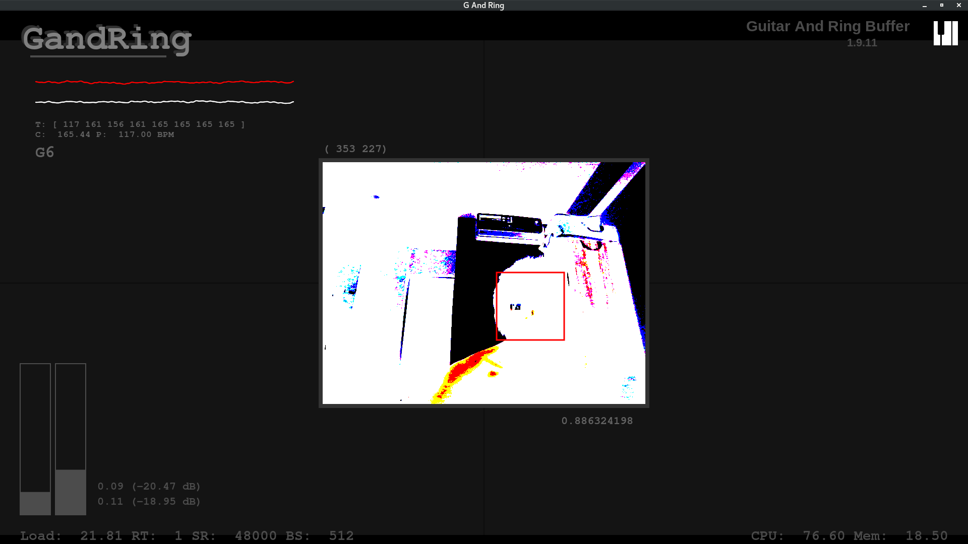
User Interface

Slide 25
Ring Buffer
Open
calling jack_client_open()
to connect to the
JACK server
Ports
registering "ports"
to enable data to be
moved toand from
your application
JACK Audio API
http://jackaudio.org/files/docs/html/index.html
Process
registering a
"process callback"
which will be called
at the right time
by the JACK server
Ready
telling JACK that
your application
is ready to start
processing data

Slide 26
Jack Ring Buffer
"The key attribute of a ringbuffer is that it can be safely accessed
by two threads simultaneously -- one reading from the buffer and
the other writing to it -- without using any synchronization or
mutual exclusion primitives.”
“For this to work correctly, there can only be a single reader and
a single writer thread. Their identities cannot be interchanged."
http://jackaudio.org/files/docs/html/ringbuffer_8h.html

Slide 27
Real-time Interpolation
Song 2
Merge()
Song 1
Interpolate()
Song 2
Pre-Transition()
Song 1
Playing()
"Given the proper values for t and t , we generate the new data by cross-fading the warped signals" - Automatic Audio Morphing (M. Slaney et. al)

Slide 28
Audio Signal Interpolation
https://www.youtube.com/watch?v=DSsitmeEqkE

Slide 29
UDUK™ Blind Undefine Morph Interpolation

Slide 30
Future of Guitar Shredder
Room for Improvements:
By using MIR, Deep Learning Methods; and combined with Computer Vision, IoT and Embedded-Devices
Measure of:
Progress
Endurance
Accuracy
Relaxation
Learning Curve
Memorization
Improvisation
Automatic Transcription
/etc
Brain-Computer Interface (BCI)
EMG
EEG
Electromyography
Electroencephalogram
Deep Learning

Slide 31
Applied Technology

Slide 32
Summary
1
General Linux DAW and
Application
2
Music Information
Retrieval (MIR) and
Applied Deep Learning
3
Web Audio 2.0
Integration
4
Ring Buffer Processing
and Computer Vision
5
Video Demos

Slide 33
Become a Friend of GNOME
Q & A
Pay a monthly subscription to become a Friend of GNOME, and help to support the GNOME project.
Donations pay for community members to attend hackfests, to keep GNOME's development infrastructure running and for outreach events and activities.
Friends receive a thank you post card from a GNOME hackerand receive a free subscription to LWN.
www.gnome.org/support-us/

Slide 34
Terima Kasih
Thank you!

