Slide 1
Reliability of Gaze Prediction for Stylized and Transformed Images
James Youngblood
University of Utah
Rogelio E. Cardona-Rivera
University of Utah

Slide 2
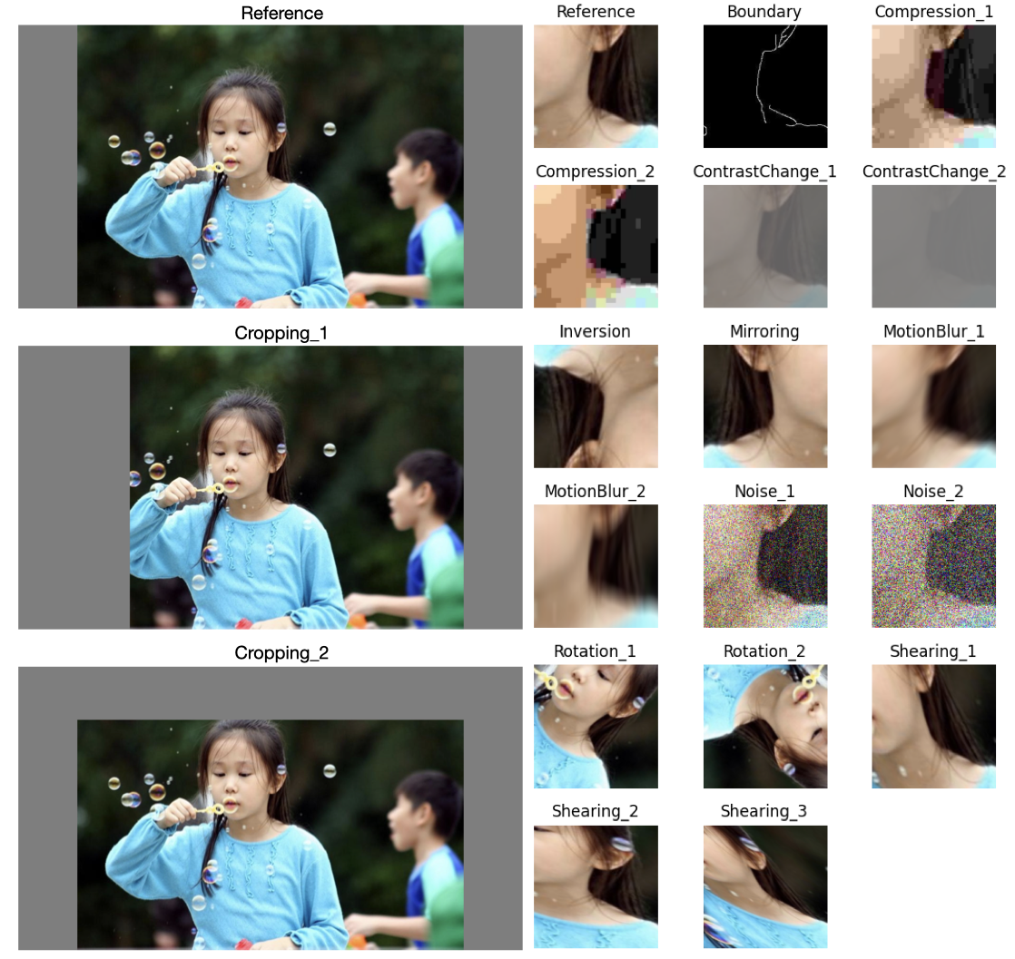
Gaze Prediction - Where will humans most likely fixate when viewing an image?
Gaze prediction is proxy for attention
State-of-the-art models run in 9ms (real-time!)
Models use deep learning
Concern: ~1% of training datasets are digitally produced images
18 common digital image transformations tested
Significant losses in accuracy!

