Slide 1


The Church:
Community
of Families
We belong to God's big family!

Slide 2
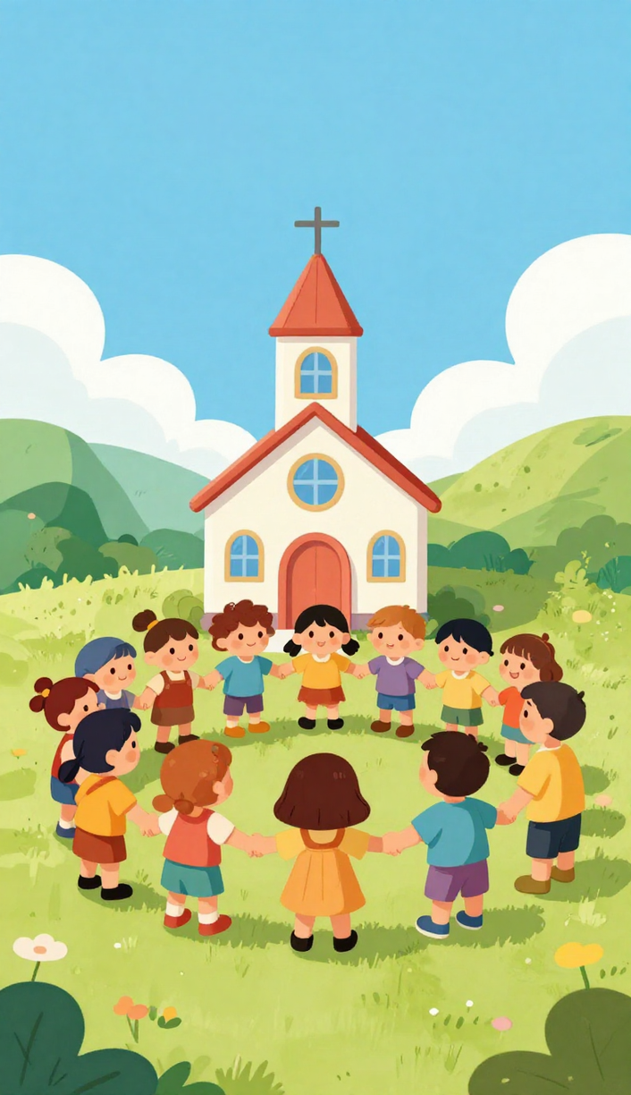

Acts 2:44
Stay Together 🤝
Jesus' friends stayed close and met together every day!
Share with Others 🎁
They shared what they had so everyone was taken care of.
Care for Each Other ❤️
"All the believers were together and had everything in common." — Acts 2:44

Slide 3

The Church Is God's Family
We Are Children of God
God loves us so much that He made us part of His big family! We follow Jesus together as brothers and sisters.
We Welcome and Love Each Other
At church, we smile, share, and care for everyone. Just like a family, we look out for one another!

Slide 4






Helping Together!
Share Food 🍞
Visit the Sick 🤍
Welcome Someone New 😊
Bring a meal to a family who needs help. Sharing food shows God's love!
Visit someone who is sick or sad. A kind visit makes them feel loved!
Say hello and be kind to a new person at church. Everyone belongs!

Slide 5


Praying Together!
At Mass Together
Before Our Meals
We go to Mass and pray as one big Church family every week!
We thank God for our food and our families before we eat.
For the Sad & Sick
Thank You, God!
We pray for people who are sad or sick so they feel God's love.
We thank God every day for our wonderful parish families!

Slide 6

















Drawing Activity!
Draw your family in the Church. Add people who help you pray, learn, sing, or feel welcome!

Slide 7
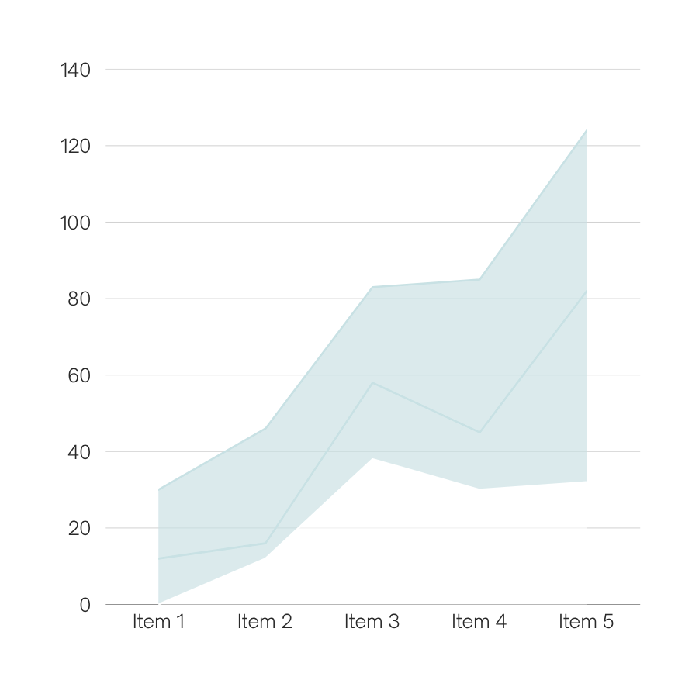
My Church
Family 💛
Think of one way to help, one person to pray for, and one kind thing you can do this week!

Slide 8



Dear God, thank You for our church family. Help us love, help, and pray for one another. Keep all parish families safe and close to You. Amen. 🙏

