Slide 1

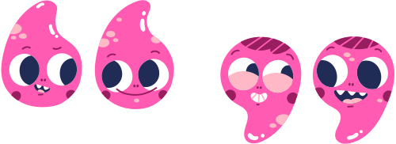
GOD CREATED ME WITH COMPANIONS
Grade 3 Bible Lesson

Slide 2




GENESIS 2:18
"It is not good for the man to be alone. I will make a helper suitable for him."
— Genesis 2:18
God made us to live with others! From the very beginning, God knew we needed friends and family by our side. He created companions for us because He loves us! 💛

Slide 3

GOD MADE US FOR EACH OTHER!
God did not want us to be alone. He made us to live, learn, and play together!
We are happier when we have friends and family by our side. We grow stronger when we help each other.
Just like puzzle pieces fit together, we were made to be companions — caring for one another every day!

Slide 4


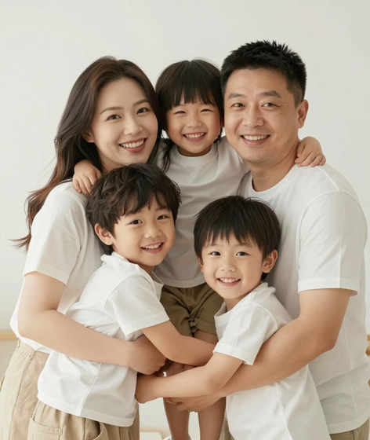
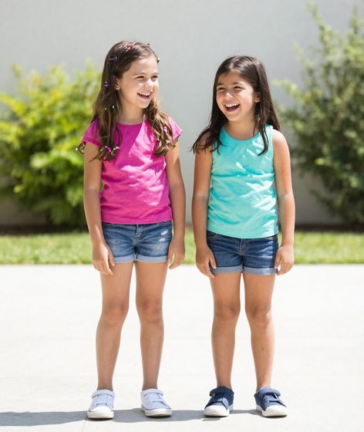

PEOPLE GOD GIVES US
Family Who
Loves Us
Friends Who
Play With Us
Classmates Who
Learn With Us

Slide 5

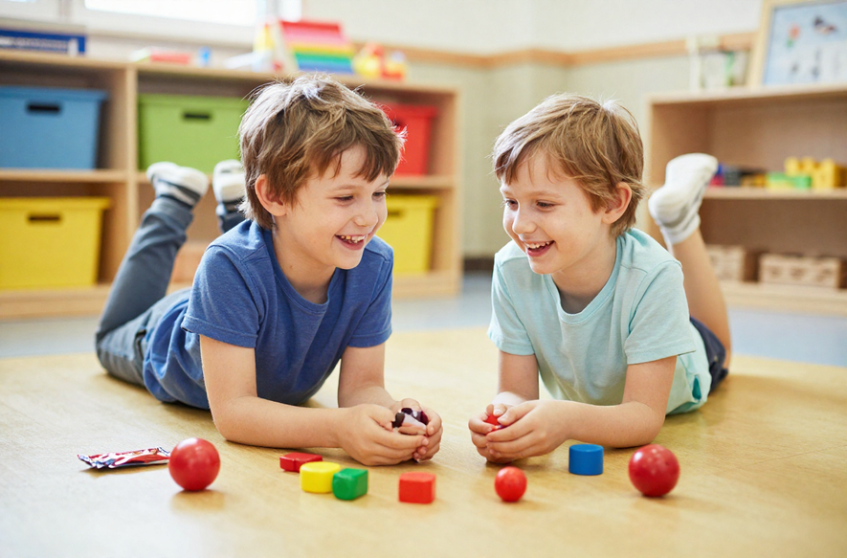

BEING KIND
1
Share a toy or snack with a friend. Sharing shows you care!
2
Use kind words like "please," "thank you," and "you are great!"
Help someone who feels sad or left out. Be their friend today!
3

Slide 6




HOW TO BE A GOOD FRIEND
1
2
3
Be Kind
Smile at your friends and listen when they talk to you!
Be Helpful
Lend a hand when someone needs help. A little help means a lot!
Be Forgiving
Say "I forgive you" and keep your friendship strong!

Slide 7
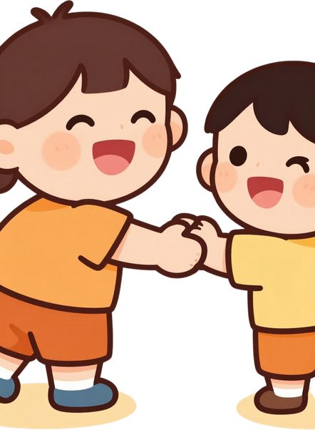

1
Think of a friend who might need help today. How are they feeling?
2
Choose one kind action you can do — share, listen, or lend a hand!
HELPING A FRIEND!
3
Do it today! Then share how it made your friend feel. 😊

Slide 8



THANK YOU, GOD,
FOR MY FAMILY
AND FRIENDS!
HELP ME BE KIND,
HELPFUL, AND LOVING.
AMEN. 🙏

