Slide 1







Jesus Established
the Holy Eucharist
Grade 3 · Religion

Slide 2





The Last Supper
The night before Jesus died, He shared a very special meal with His 12 friends called the Apostles. This meal is called the Last Supper!
At the meal, Jesus took bread and wine. He blessed them and said, "Do this in memory of Me." (Luke 22:19) He gave us the greatest gift — Himself!

Slide 3


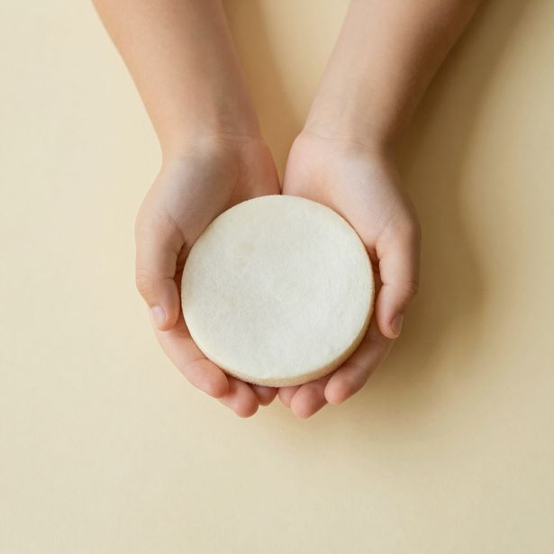


Luke 22:19
"Do this in remembrance of me."
  Luke 22:19
At the Last Supper, Jesus took bread, gave thanks, and shared it with His friends. He said, "This is my body, given for you."
Jesus asks us to remember Him every time we receive the Eucharist. It is His special gift of love for us! 💛

Slide 4





What is the Eucharist?
The bread becomes Jesus' Body!
The wine becomes Jesus' Blood!
It's Jesus' special gift to us!

Slide 5



We Say Thank You, Jesus!
Thank You, Jesus, for loving us so much! You love us more than we can imagine. You gave us the greatest gift — Yourself! That is something truly amazing and wonderful!
Thank You for giving us Your Body and Blood in the Holy Eucharist. Every time we receive You, we know how much You care for us. We are so happy and grateful for Your special gift of love!

Slide 6




Art Time!
Draw a beautiful chalice and host! ✨
A chalice looks like a fancy cup. The host is a round, flat bread.
Jesus used these at the Last Supper to share His love with us!
Get your crayons ready! 🎨
How to Draw:
★ Draw a big cup shape - that is your chalice!
★ Draw a small circle above it - that is the host!
★ Color them with bright, happy colors!
★ Think of Jesus’ love as you create! ❤️

Slide 7




Remember These 2 Things!
  Jesus gave us the Eucharist at the Last Supper. He took bread, gave thanks, and said, "This is my body, given for you." (Luke 22:19) What an amazing gift of love!
  We receive Jesus' love every time we go to Mass! When we receive Holy Communion, Jesus comes into our hearts. We are never alone — He is always with us!

Slide 8




Dear Jesus, thank You
for the gift of the
Eucharist. Help us always
remember Your love.
Amen! 🙏

