Slide 1





JESUS GIVES HIS LIFE IN THE EUCHARIST
A Special Gift of Love for Us

Slide 2

GOD'S GREATEST LOVE
"No one has greater love than this,
to lay down one's life for one's friends."
— John 15:13
Jesus said these words to teach us
how much He loves each one of us.
His love is the greatest love of all.

Slide 3
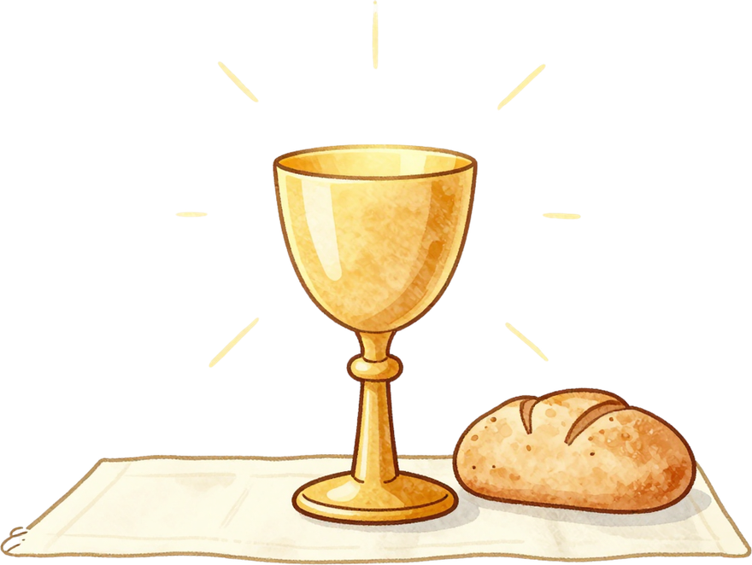
JESUS LOVES US
Jesus loves us so much that He gave us the greatest gift of all — Himself!
In the Eucharist, Jesus comes to be with us in a very special way. He shares His own life with us because He wants to be close to us always.
"Greater love has no one than this: to lay down one's life for one's friends."
— John 15:13
Every time we receive the Eucharist, Jesus is saying: "I love you. I am here with you."

Slide 4

WAYS TO SAY THANK YOU
Receive the Eucharist with a grateful heart. When we go to Mass, we welcome Jesus with love and say "Thank You" for giving us Himself.
Be kind to others just like Jesus. When we share, help, and care for our friends and family, we show Jesus we are grateful for His love.
Pray and talk to Jesus every day. A simple prayer from the heart — like "Thank You, Jesus" — is a beautiful gift we can give back to Him.

Slide 5
JESUS' LOVE IS LIKE...
A Parent's Love
A parent gives everything to keep their child safe and happy. They work hard, stay up late, and always put their child first.
Jesus loves us even more than that. He gave His whole life so we could be with Him forever.
A Best Friend's Love
A true friend shares their very best with you. They give you the last cookie, cheer you up when you are sad, and never leave you alone.
Jesus is our best friend. He shares the most precious gift of all — Himself — in the Eucharist.

Slide 6
QUIET HEART ACTIVITY
Close your eyes and take a deep breath. Imagine Jesus smiling at you with so much love. He sees you, He knows you, and He cares about you very much. Let your heart be still and peaceful in His presence.
Now think quietly in your heart: What is one thing you want to thank Jesus for today? Hold that thought gently, like a gift, and offer it back to Him with love and gratitude.

Slide 7
A PRAYER OF THANKS
Dear Jesus,
Thank You for loving us so much.
Thank You for giving us Yourself in the Eucharist.
Thank You for being with us always.
Help us to love others the way You love us.
Help us to be kind, generous, and grateful every day.
Amen. 🙏

Slide 8
JESUS
LOVES YOU
ALWAYS

