Slide 1
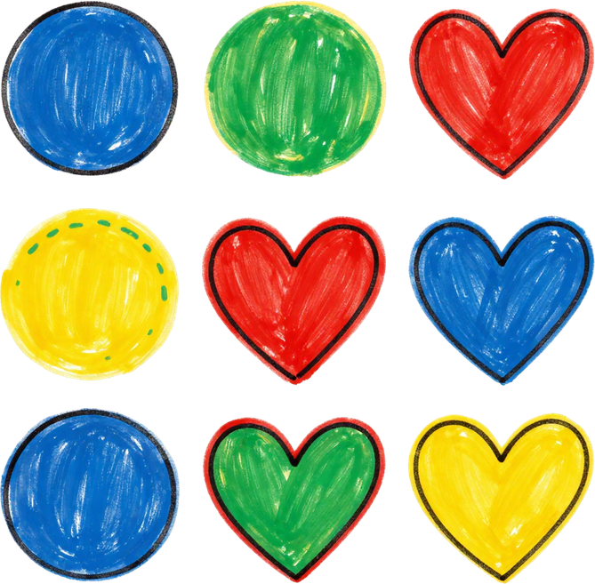
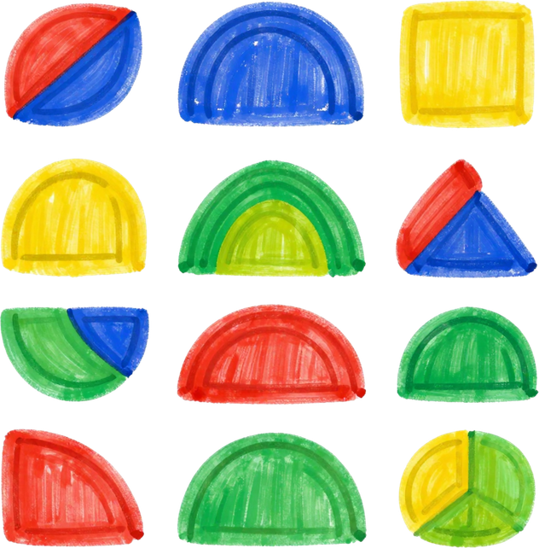
Jesus Is Merciful and Forgiving
A lesson about God's amazing love for us 💛

Slide 2

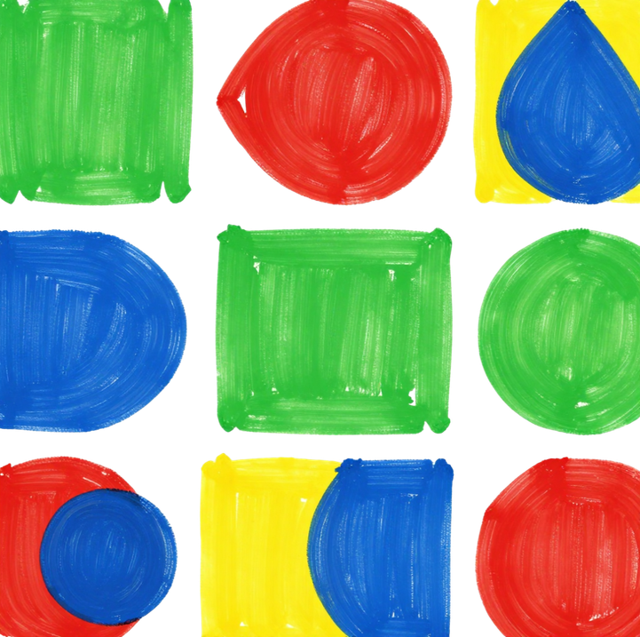
Luke 6:36
The Bible Verse
"Be merciful, just as your Father is merciful."
— Luke 6:36
What Does It Mean?
God is always kind and forgiving to us. He wants us to be kind and forgiving to others too!
How Can We Remember It?
Think: "God is kind to me, so I will be kind to others!" Say it with a smile! 😊

Slide 3






What Is Mercy?
Kindness for Mistakes
Giving Second Chances
Showing Love Always
Mercy means being kind to someone even when they do something wrong.
When we show mercy, we give others a chance to try again instead of staying angry.
Jesus shows us mercy every day because He loves us no matter what we do!

Slide 4


Forgiving Others
When a friend says sorry...
We can smile and say, "I forgive you!" Just like Jesus forgives us every day.
When someone hurts our feelings...
We can choose to be kind instead of angry. That is how we show mercy!

Slide 5


Ways to Show Mercy
Share Your Snack
Help a Classmate
If a friend forgot their lunch, share yours with a smile!
If someone is struggling with work, offer to help them out.
Be Patient at Home
Say Kind Words
Be gentle and kind with little brothers or sisters.
When someone feels sad, tell them something loving and warm.

Slide 6

Let's Pray Together!
Think of someone to forgive
Close your eyes. Is there someone who hurt your feelings? Jesus wants to help you forgive them!
Draw a heart and write their name
On your paper, draw a big heart. Write their name inside. Ask Jesus to help you be kind and merciful to them.

Slide 7

















Thank You, Jesus!
We are grateful for Your love, Your forgiveness, and Your kindness.

Slide 8
Dear Jesus, thank You for always forgiving us. Help us to be merciful and kind to others. Amen.
Close your eyes and say this prayer in your heart. 🙏

