Slide 1


My Life Is a Gift from God
God made me special and loves me! 🌟

Slide 2





Psalm 139:14
"I praise you because I am fearfully and wonderfully made!" — Psalm 139:14

Slide 3


God Made Me!
God Made Me
God carefully and lovingly made every part of you!
God Knows Me
God knows your name, your smile, and everything about you!
God Loves Me
God loves you just the way you are — always and forever!

Slide 4






My Talents Are Gifts from God!
I Can Sing!
I Can Draw!
I Can Help!
When you sing songs of praise, you share God's love with everyone around you!
When you create beautiful art, you show the world how wonderful God made it!
When you help others, you share God's kindness and love with those around you!

Slide 5


My Feelings Are a Gift!
Happy 😊
Excited 🌟
When you feel happy, thank God for the joy He gave you!
Feeling excited is wonderful! God loves to see you full of energy!
Sad 😢
Worried 😟
When you feel sad, tell God. He always listens and cares for you.
God is with you when you worry. You can talk to Him anytime!

Slide 6

You Are Special to God!
God Made You Unique!
There is no one else in the world exactly like you. God made you special on purpose, with love!
Use Your Gifts to Help Others!
Your kindness, your smile, your talents — share them! When you help others, you share God's love.

Slide 7





Draw yourself and two gifts God gave you!

Slide 8
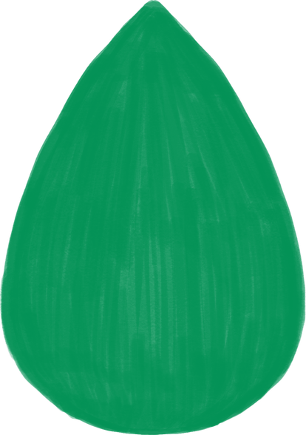






Thank You, God, for making me.
Thank You for my life, my feelings, and my talents.
Help me use my gifts to love others.
Amen. 🙏

