Slide 1




HOW TO SAY SORRY
1
2
3
Think about what you did wrong. God sees your heart and loves you always.
Tell God you are sorry in your heart. He is always ready to listen and forgive.
Say "I'm sorry" and try your best to do better. You are loved no matter what!

Slide 2


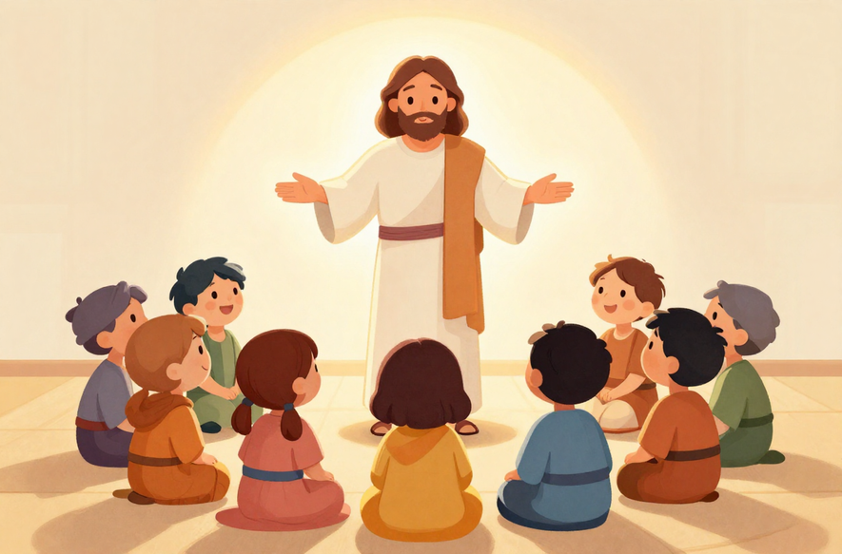

JESUS & THE HOLY SPIRIT
John 20:22–23
Jesus breathed on His apostles and said:
"Receive the Holy Spirit. If you forgive anyone's sins, their sins are forgiven."
Jesus gave His apostles a very special gift — the power to forgive sins. This is how the Sacrament of Reconciliation began!

Slide 3


WHAT IS RECONCILIATION?
Reconciliation is a special, peaceful place where we meet Jesus's love. 💛
The priest listens to us and helps us talk to God. He has the power to forgive our sins — a gift from Jesus!
It is a safe place. There is nothing to be afraid of. God is always happy when we come back to Him.
"God loves you, and He is always ready to forgive."

Slide 4
HOW TO SAY SORRY
1
2
3
Think about what you did wrong. God sees your heart and loves you always.
Tell God you are sorry in your heart. He is always ready to listen and forgive.
Say "I'm sorry" and try your best to do better. You are loved no matter what!

Slide 5



WHEN WE SAY SORRY
1
When we hurt a friend's feelings — maybe by saying something unkind — we can say sorry and make things right again.
2
When we don't listen to our parents or teachers, we can say sorry and show them we love and respect them.
3
When we forget to be kind — like leaving someone out — we can say sorry and choose to be more caring next time.

Slide 6

DRAWING ACTIVITY!
Get your crayons and pencils ready! ✏️
Draw a picture of a church confessional. Show yourself talking to the priest. Don't forget to draw Jesus standing right there with you too!
Remember: The confessional is a safe and loving place. Jesus is always close to you there. ♥️

Slide 7
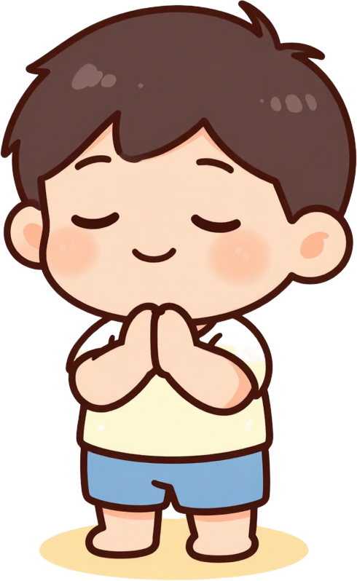
A PRAYER FOR PEACE
Dear Jesus,
Thank you for forgiving me.
Help me to be kind and loving.
Fill my heart with your peace.
Amen. 🙏

Slide 8



GOD LOVES
YOU ALWAYS!

