Slide 1











WE ARE
UNITED WITH
JESUS!
In the Eucharist — A Special Lesson for Grade 3

Slide 2




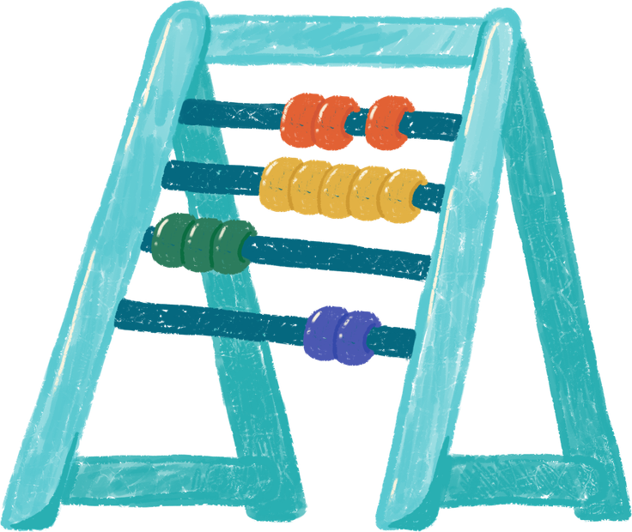
GOD'S WORD
John 6:56
"Whoever eats my flesh and drinks my blood remains in me, and I in them."
Jesus wants to be close to us — always in our hearts!

Slide 3
WHAT IS COMMUNION?
When we receive Communion, Jesus comes to live inside our hearts. He is truly present with us in a very special and loving way.
We become united with Jesus — like a hug from the inside! He stays close to us and fills us with His love and peace.

Slide 4
JESUS LIVES IN OUR HEARTS
When we receive Communion, Jesus is always with us! He never leaves our side. We are never alone because He is right here in our hearts, every single day.
Jesus fills our hearts with His love! Just like the sun warms the whole earth, His love warms us from the inside. We feel happy, peaceful, and safe when He is with us.
We carry Jesus with us wherever we go — to school, to the playground, and back home. Everywhere we walk, He walks with us. We bring His love to everyone we meet!

Slide 5
LOVE OTHERS
Share with friends
Be kind to family
Help someone sad
Say a kind word

Slide 6
HEART DRAWING ACTIVITY
Draw a big heart in the middle of your paper. Inside the heart, draw Jesus. He lives in your heart after Communion!
Around the heart, draw the people you will share His love with — your family, friends, and classmates!

Slide 7
A PRAYER
TO JESUS
Dear Jesus,
Thank you for coming into my heart today. You are so good and I am so happy you are with me.
Please stay with me always. Help me to be kind, to share, and to love others the way you love me.
I want to carry you in my heart everywhere I go.
Amen. ♥

Slide 8








JESUS
LOVES
YOU!

