Slide 1




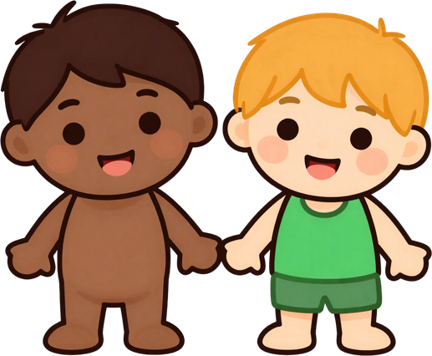

Be a Good Friend!
Jesus loves us so we can love others too! Share, be kind, listen, and help a friend who is sad. That is how we show Jesus's love!

Slide 2



"You Are My Friends"
John 15:14
Jesus said: "You are my friends if you do what I command you." Jesus chose us and calls us His friends. That means He loves us, listens to us, and is always with us!

Slide 3



Jesus Loves
You Every Day!
Jesus's love never stops! He loves us when we are happy, when we are sad, and even when we make mistakes. Nothing can change how much Jesus loves you.

Slide 4
Be a Good Friend!
Jesus loves us so we can love others too! Share, be kind, listen, and help a friend who is sad. That is how we show Jesus's love!

Slide 5




Draw a Friendship Invitation!
Create an invitation to invite someone to be friends with Jesus! Draw pictures, add colors, and write a kind message to share His love.

Slide 6


Share His
Love!
Jesus calls us to share His love with everyone around us. Smile, be kind, and show others how much they matter — just like Jesus does for us!

Slide 7



Let's Pray Together
"Jesus, thank you for calling me your friend. Help me to love others the way you love me. Amen."
— John 15:12–17

Slide 8




Jesus Is Your Friend Forever!
Go and be a good friend this week! Remember: Jesus loves you and calls you His friend always.

