Slide 1







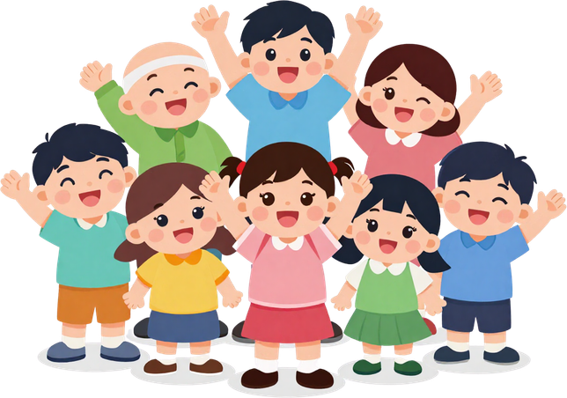

Meeting Jesus
in the Gospels

Slide 2

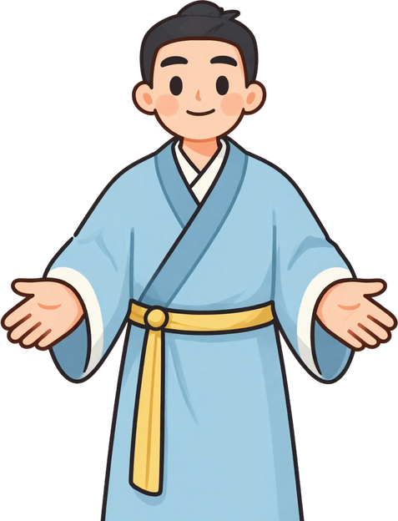
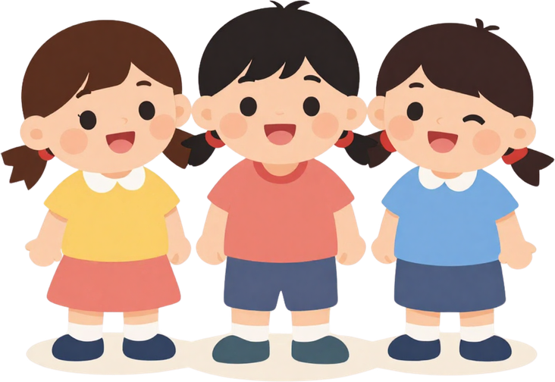
Jesus Welcomes
the Children
One day, parents brought their children to Jesus. The disciples tried to stop them — but Jesus said, "Let the children come to me!"

Slide 3

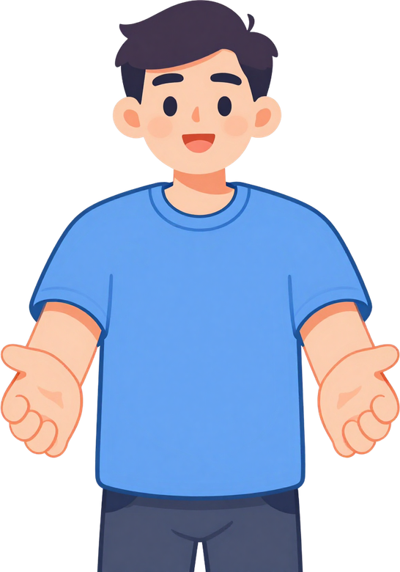
Come to Me!
Jesus said, "Let the children come to me!" He was not happy when people tried to keep the children away. Jesus loves children and wants them close to Him!

Slide 4



Jesus Blesses
the Children
Jesus held the children in His arms and blessed each one. You are special to Jesus too! He loves you just as you are.

Slide 5




Come Close to Jesus Every Day
Talk to Jesus in prayer. Listen to His words in the Gospel. He always welcomes you with open arms, just like He welcomed the children!

Slide 6




Your Turn to Draw!
Draw a picture of Jesus with the children. Then add yourself in the picture too!

Slide 7



Let's Pray Together
"Jesus, thank you for welcoming me.
Help me come close to you every day.
Amen."

Slide 8


Jesus Loves You!
You can always come to Jesus, just like the children in our story. He welcomes you with open arms every single day!

