Slide 1

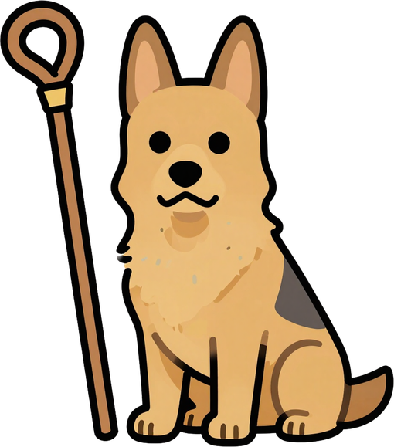
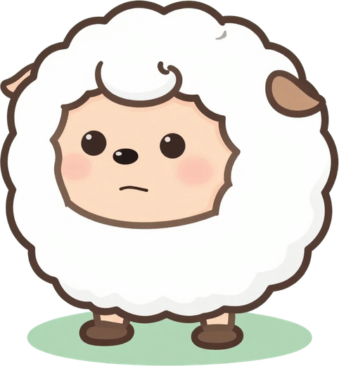
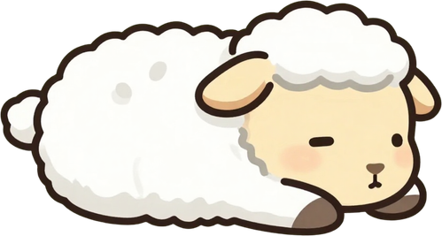
THE GOOD
SHEPHERD
John 10:11–14

Slide 2
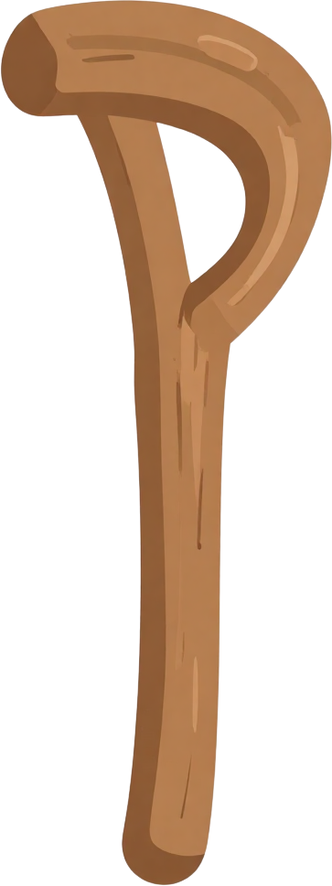

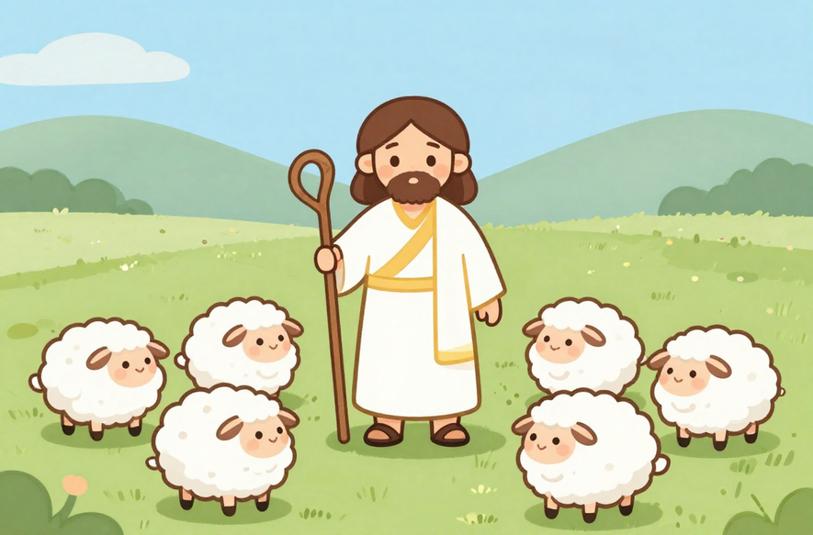
THE GOOD SHEPHERD
Jesus said:
"I am the good shepherd. The good shepherd lays down his life for the sheep. I am the good shepherd; I know my sheep and my sheep know me."
— John 10:11–14

Slide 3

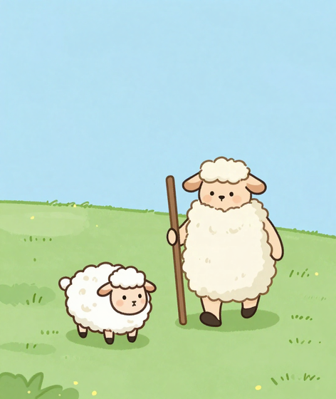
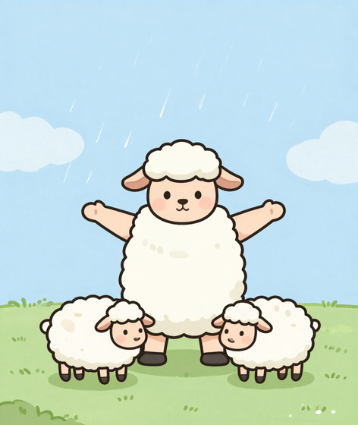
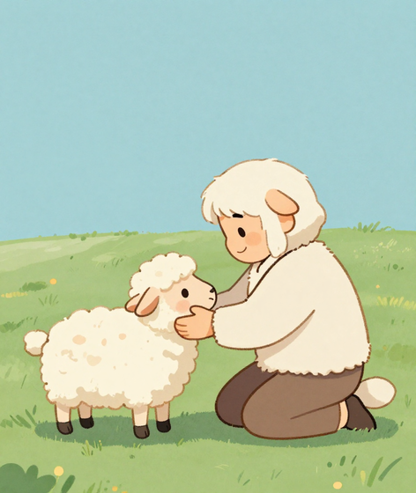
WHAT JESUS DOES
Jesus Guides Us
Jesus Protects Us
He Knows Your Name

Slide 4
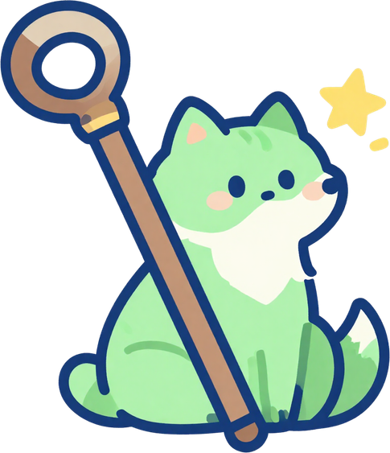

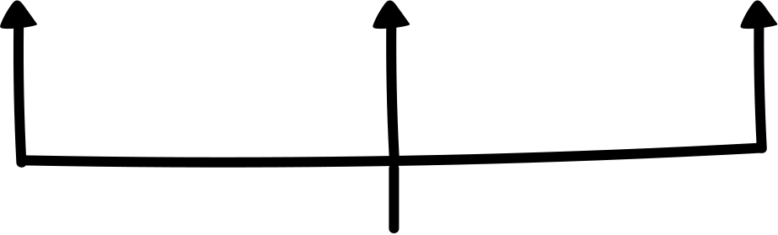
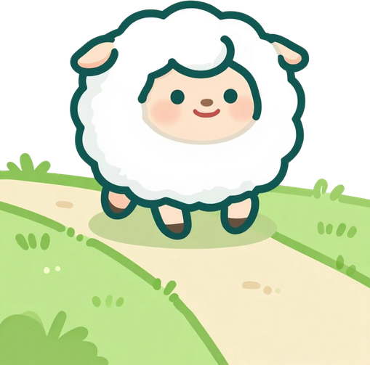
Listen to Jesus's voice in the Bible. Read His words every day and let them guide your heart and mind.
1
Follow His teachings. Be kind, honest, and loving — just like Jesus showed us how to live.
2
FOLLOW HIM
Trust Him to keep you safe. Jesus, our Good Shepherd, watches over you always. You are never alone!
3

Slide 5
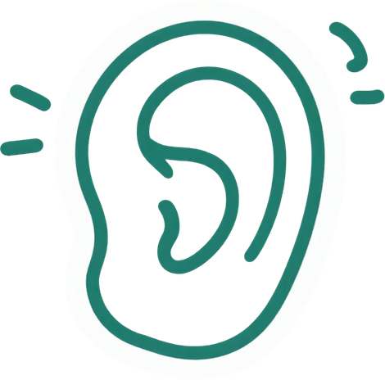

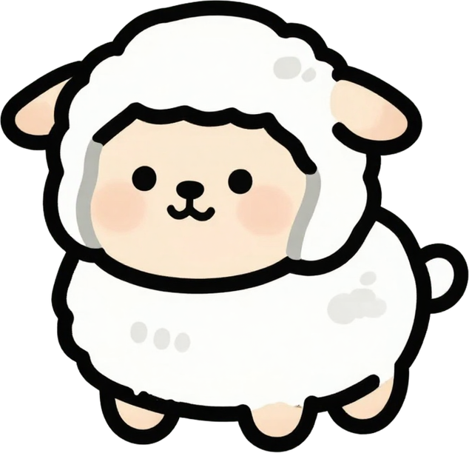

JESUS KNOWS YOU!
Jesus said: "I know my sheep and my sheep know me." (John 10:14)
Just like a shepherd knows every lamb by name, Jesus knows everything about YOU — your heart, your worries, and your joys!
How can you listen to Jesus today?
• Be quiet and pray
• Read Bible stories
• Be kind to others

Slide 6
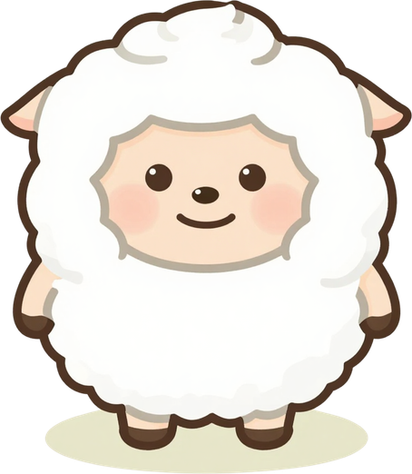

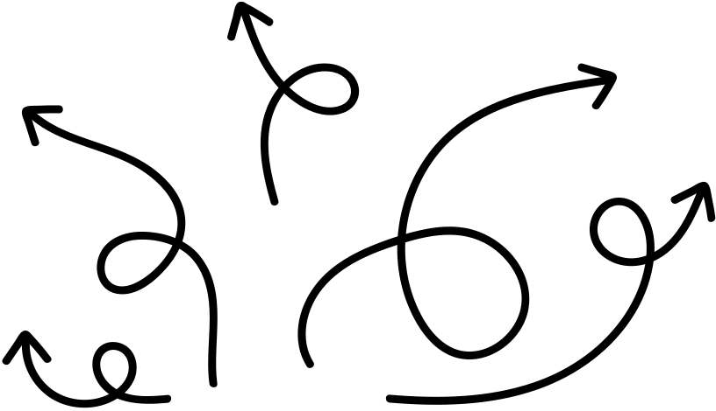
MAKE A PAPER SHEEP!
1
2
3
Cut out a sheep shape from white paper. Use scissors carefully and follow the outline!
Glue cotton balls onto your sheep for fluffy wool. Make it as woolly as you like!
Write one way you will follow Jesus this week on your sheep. Keep it somewhere special!

Slide 7

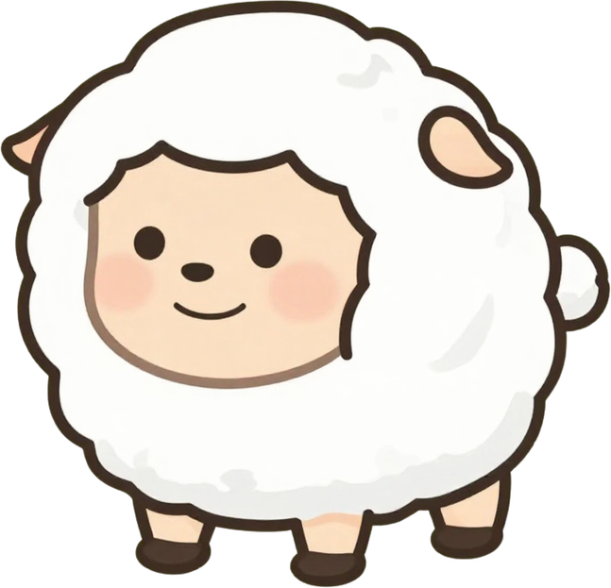
OUR PRAYER
Close your eyes, fold your hands, and pray together: "Jesus, guide me and keep me safe. Amen."
1
Remember: Jesus loves you, knows your name, and is always walking beside you every day.
2
This week, listen for Jesus' voice in your heart. He is your Good Shepherd!
3

Slide 8
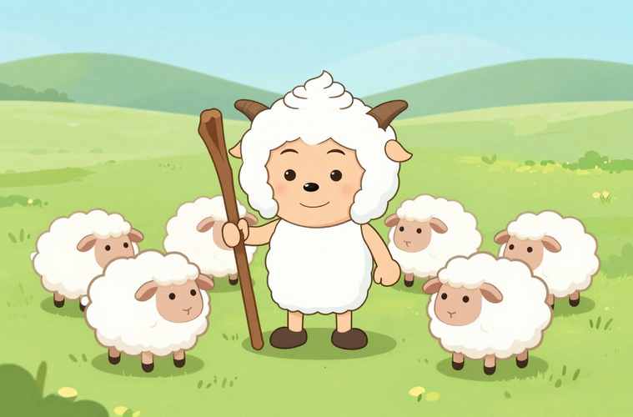
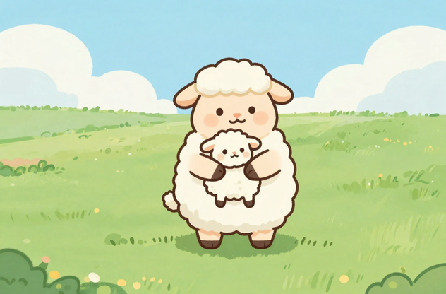
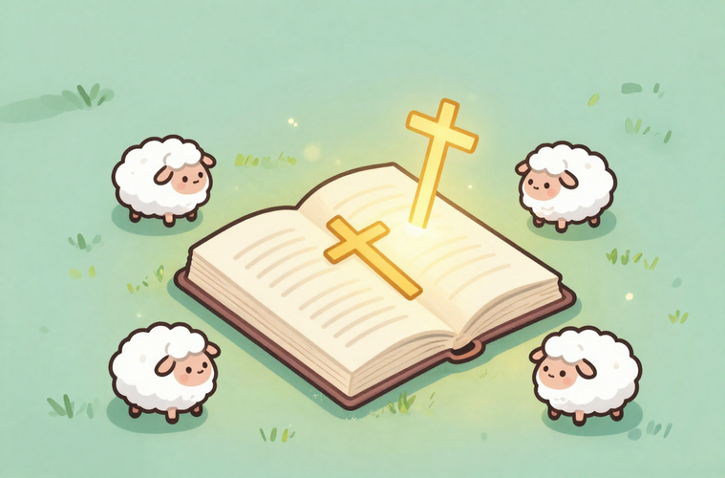

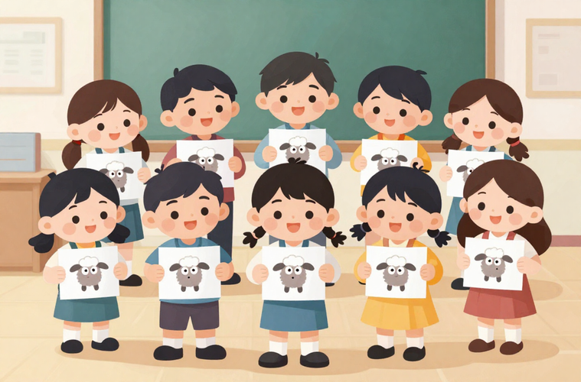
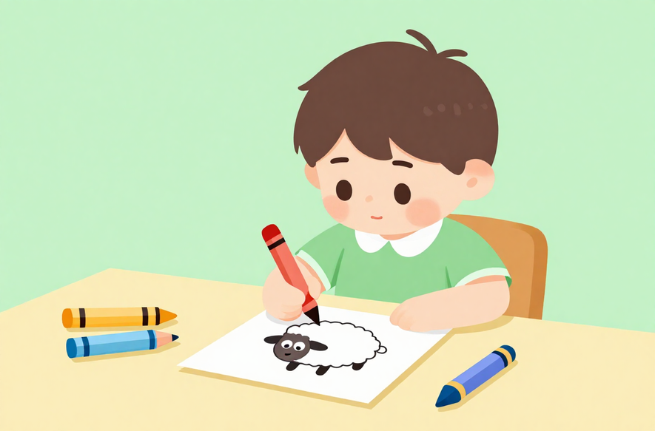
THANK YOU, GOOD SHEPHERD!
GO AND FOLLOW JESUS THIS WEEK!

