Slide 1
OUR PRAYER
"Jesus, thank you for giving yourself to us. Help us remember your love. Amen."

Slide 2
THE LAST SUPPER
On the night before He died, Jesus gathered with His 12 disciples for a very special meal. It was a time of love, friendship, and an amazing gift He was about to give them.

Slide 3
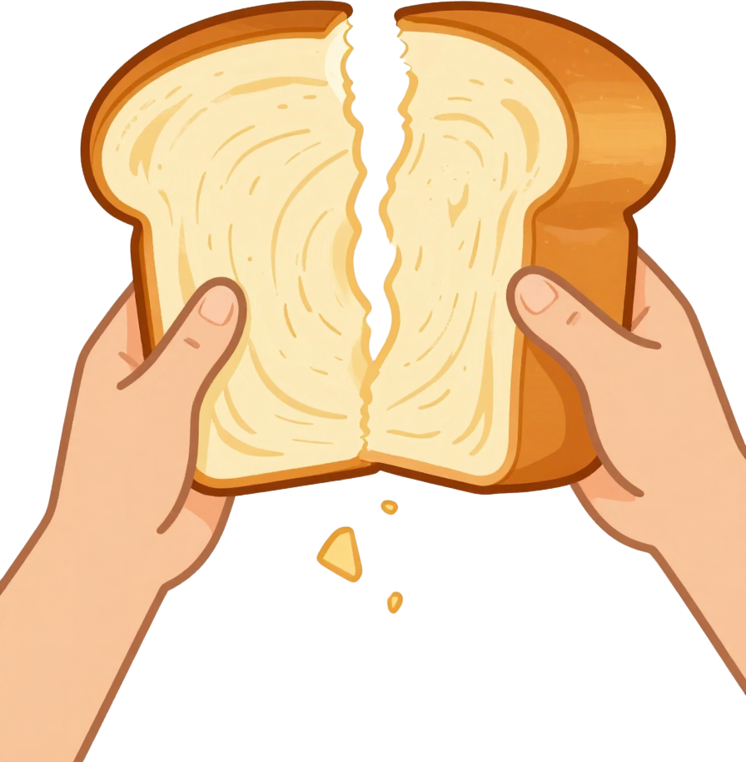
GAVE THANKS
BROKE THE BREAD
"THIS IS MY BODY"

Slide 4

THE CUP
THE WINE
THE COVENANT

Slide 5
THE EUCHARIST
Jesus gives us the Eucharist so we can remember Him and feel close to Him always — wherever we are!

Slide 6

JESUS LOVES US
JESUS GAVE HIMSELF FOR US
WE SAY THANK YOU!

Slide 7

DRAW THE LAST SUPPER TABLE
WRITE ONE THING YOU'RE THANKFUL FOR
SHARE WITH THE CLASS

Slide 8
OUR PRAYER
"Jesus, thank you for giving yourself to us. Help us remember your love. Amen."

