Slide 1


CHURCH ASSEMBLY PRAYER MEETING
Gathering in Faith and Fellowship
NOVEMBER 6, 2026
Notes:
layout:image

Slide 2

SONG 1
GRACE ABOUNDS
Your grace abounds, unending love, Lifting hearts to heaven above.
Notes:
layout:cover

Slide 3


SONG 2
HOLY SPIRIT, COME
Fill us now, breathe on us,
Guide our hearts in Your truth.

Slide 4


SONG 3
LIGHT OF THE WORLD
Shine through the darkness, lead us today, Your light our path, forever stay.

Slide 5






SONG 4
PEACE
WITHIN
Calm our souls, quiet our fears,
In Your presence, peace appears.
Notes:
layout:song1

Slide 6


SONG 5
LIFT OUR PRAISE
Lift our praise, lift our song,
Forever to You we belong.
Notes:
layout:song2

Slide 7

AGENDA
Welcome and opening prayer
Worship and praise
Group prayer sessions
Reflection and sharing
Closing prayer and blessing
Notes:
layout:content

Slide 8

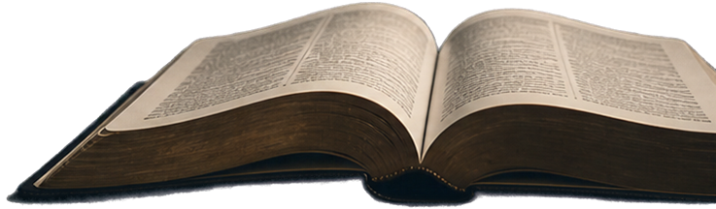
PRAYER
POINTS
Unity and faith in the community
Guidance for church leadership
Healing and comfort for those in need
Strength and hope for the coming week

Slide 9


Go in
Peace
May the peace of God guard your hearts and minds.
Let us carry His love into the world.
Notes:
layout:song3

