Slide 1
Lending Club Case Study
Soundharya
Sai Nigama Veena

Slide 2
Problem statement:
Consumer finance company which lending various types of loans to urban customers. When the company receives a loan application, the company has to make a decision for loan approval based on the applicant’s profile.
Based on the applicant profile, the company will either will approve or reject.
There are two type of risk :
1) If the applicant is likely to repay the loan, then not approving the loan results in a loss of business to the company.
2) If the applicant is not likely to repay the loan, i.e. he/she is likely to default, then approving the loan may lead to a financial loss for the company.

Slide 3
Project Objective:
Accepted loan application will end up in three type:
1)Fully paid – Repaid full loan amount
2)Charged-off(Default) – Failed to replay
3)Current – Repaying the loan amount
To find which type of loan applicant is resulting in default(failed to repay the loan amount) for to reduce business loss and risk associated with that applicant.
Dataset used for project work:
loan data of all Accepted loan applicants through the time period 2007 to 2011.

Slide 4
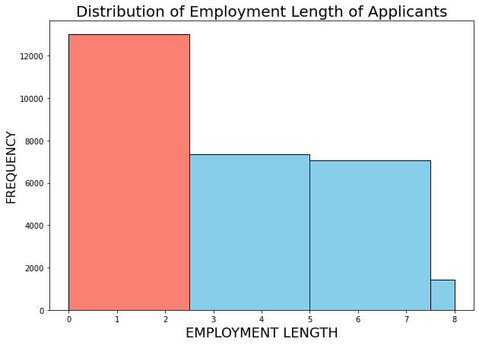
Recommendation:
Fig - 1
Conclusion 1 :
The loan applicant with the work experience 0 to 2.5 years is having more chance to end up in charge off
Recommendation 1 :
Have a valid employment proof verification of loan applicant i.e, he/she will continue to work untill loan has been repaid

Slide 5
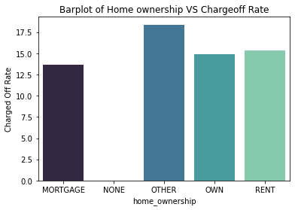
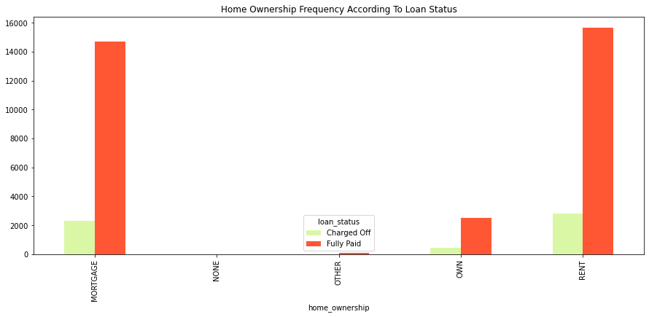
Conclusion 2 :
Even though the number of loan applicant very less in ‘other’ home ownership( As seen in Fig - 2), will have high chance to end up in default as seen in Fig - 1 .
Since, there are more loan applicant in Mortage and Rent type of home ownership, where the number of loan applicant resulting in default is also high as seen in Fig - 2.
Recommendation 2 :
Reduce giving loan approval for ‘other’ home ownership type. Since, its having highest rate in charge off with 18.36%.
Have a proper investigation and verification on Rent and Mortage home ownership before giving loan approval.
Fig -1
Fig-2

Slide 6
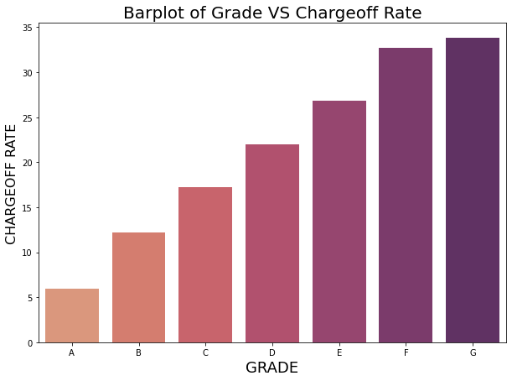
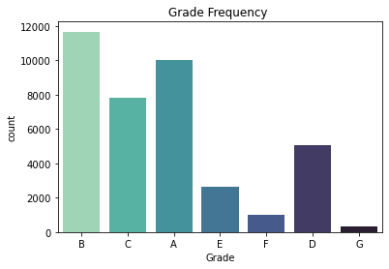
Conclusion 3 :
Though the number of applicant for grade G is less as seen in Fig - 2, 33.77 % of them resulting in default
as seen in Fig - 1. The grade – G have high chance to end up in default compared to other grades
The propability to charge off is increasing as grade increase from A to G.
2. As the number of applicant in Grade A, B and C are high , the number of charge off is also high.
Recommendation 3 :
Avoid approving loan to grade G loan applicant.
Have proper verification of Grade A,B and C loan applicant.
Fig-1
Fig-2

Slide 7
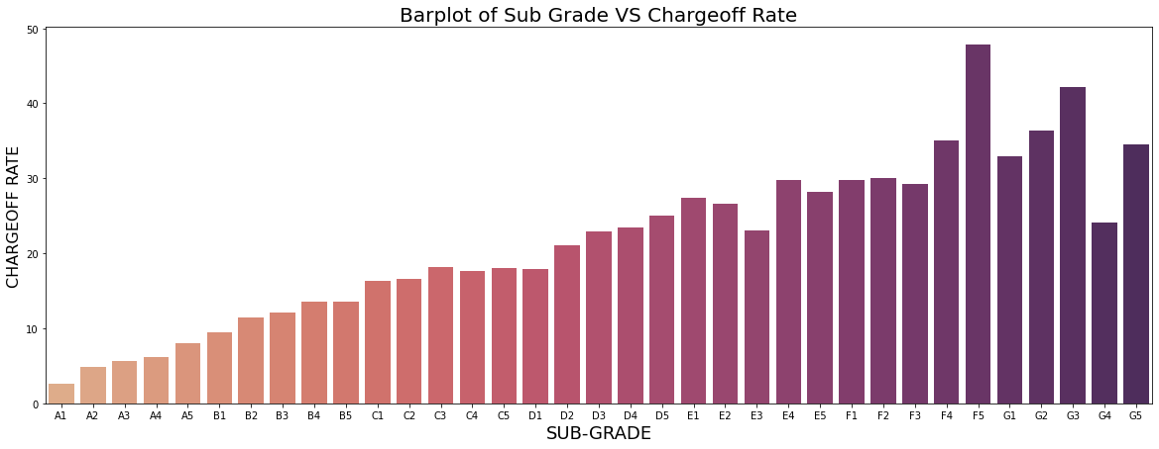
Conclusion 4 :
The loan applicant with sub grade F4,F5,G1,G2,G3 and G5 having highest probability of charge off rate.
Recommendation 4 :
Avoid giving loan approval for following subgrade F4,F5,G1,G2,G3 and G5. As number of loan applicant is also very less compared to other grades, there will be no major impact in rejecting.
Fig-1

Slide 8
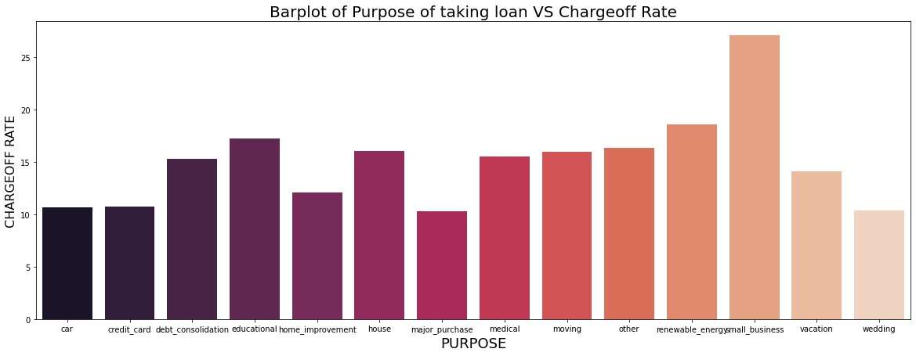
Conclusion 5 :
Applicants who take loan on 'SMALL BUSINESS' Purpose are likely to charge off with 27.08% followed by renewable energy and educational.
Recommendation 5 :
As the Small Business can't run well in initial stages and thus applicants can't repay loan immediately. So, have a proper verification on probability of business success on small scale business. Same applicable to renewable energy and education.
Fig - 1

Slide 9
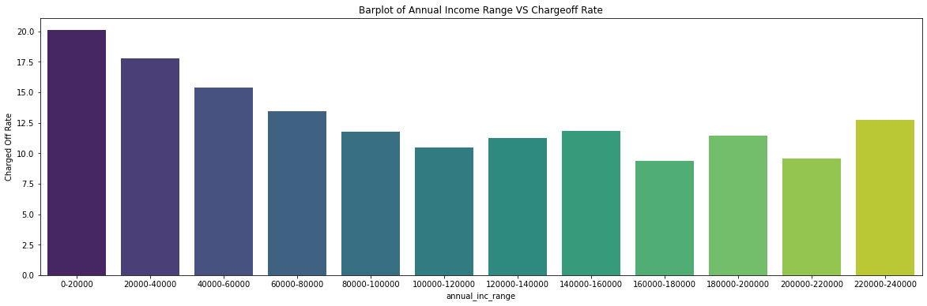
Conclusion 6 :
The lesser the annual income, the higher the probability to be default. As seen in Fig-1 , the lesser salary range 0 to 20000 have highest charge of rate as 20%.
Recommendation 6 :
If He/she posses lesser annual salary range have a proper salary verification . i.e, he/she will have salary hike in future days in order to complete loan debt.
As number of applicant is high from 20000 to 60000, so requested to follow the recommendation highly for this category.
Fig - 1

Slide 10
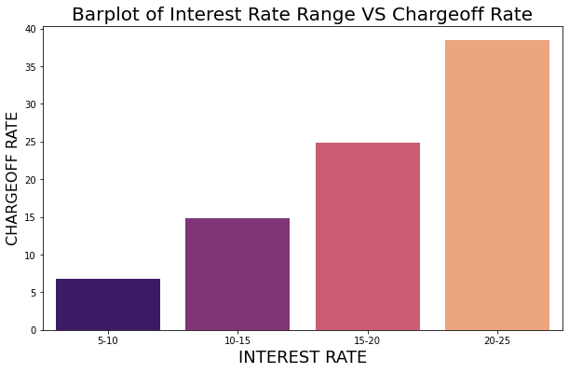
Conclusion 7 :
The higher the interest rate, higher will be the probability to default.
Recommendation 7 :
Provide appropriate interest rate for the loan amount and term period.
Fig - 1

Slide 11
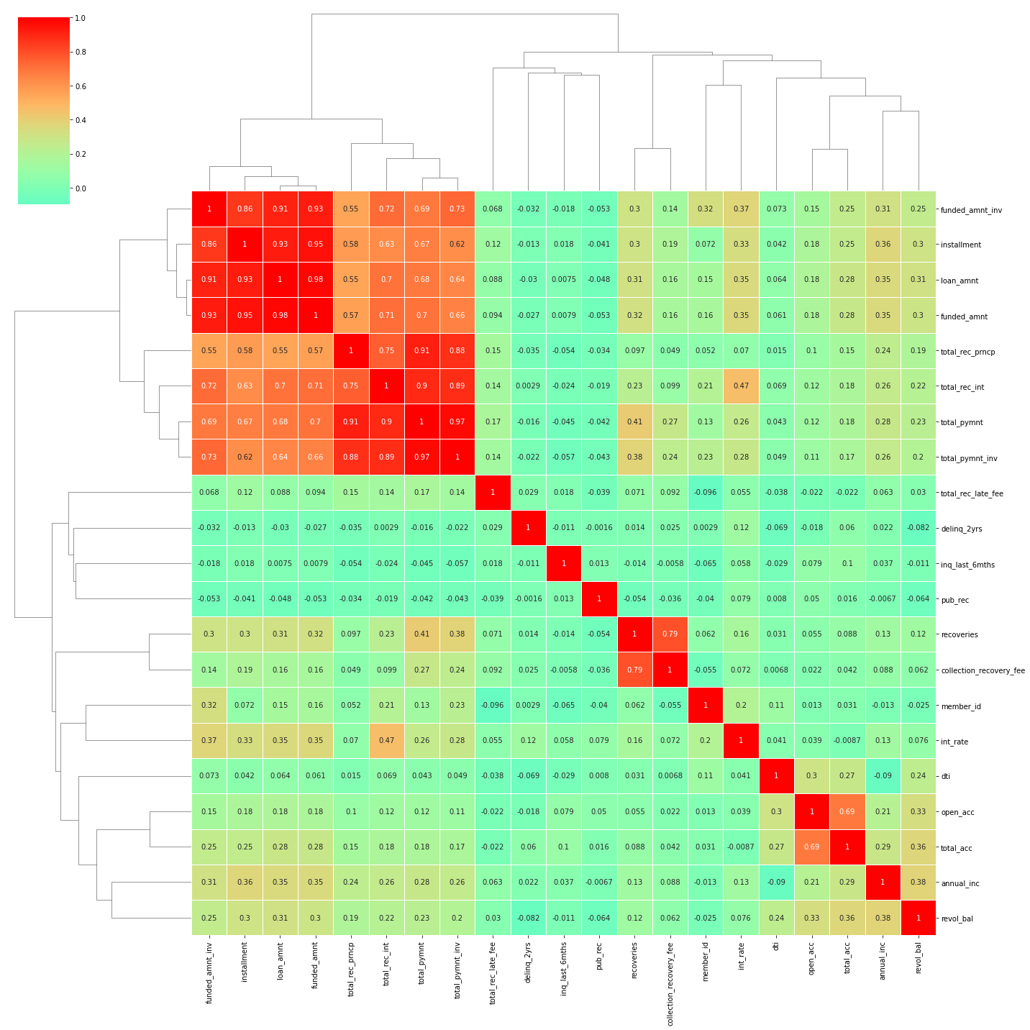
Conclusion 8 :
Installment, funded_amnt_inv, funded_amnt and loan_amnt are highly correlated.
Fig-1

Slide 12
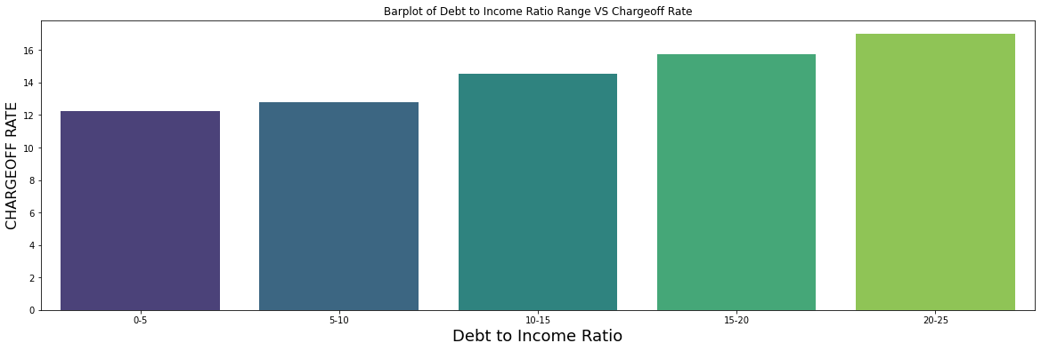
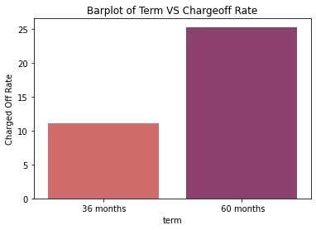
Conclusion 9 : As seen in Fig – 1 ,Higher the DTI, higher the chance for charge off.
Recommendation 9 : Reducing approving loan with 20% to 25% DTI
Fig - 1
Conclusion 10 : As seen in Fig-2 Charged off Rate is high for applicants who take 60 months term(Assumed, higher loan amount with 60 Month term
Recommendation 10 : Provide 60 Month term for lesser loan amount. Try not to give higher loan amount for 60 month term.
Fig - 2

