Slide 1
Group G members
Harry Reilly – x22459594
Cian Kavanagh – x22474114
Michael Bergin – x21779685
Tiernan Marrey - x24131695

Slide 2

Eventhive

Slide 3
Project Overview
In today's world, finding local event information and planning gatherings is becoming increasingly difficult, leading to missed opportunities for both individuals and businesses. Existing platforms like Eventbrite and Ticketmaster primarily focus on large or ticketed events, often overlooking smaller gatherings and niche interest groups.
Our platform aims to bridge this gap by prioritizing community-driven, local events with an intuitive, calendar-based interface. Unlike mainstream event platforms, we will offer a free posting system, ensuring accessibility for smaller groups that lack marketing budgets. However, all events will require approval through an organizer to maintain quality and reliability.

Slide 4
Technologies used so far
Visual Studio code
Kittl
MySQL WorkBench 8.0 CE

Slide 5
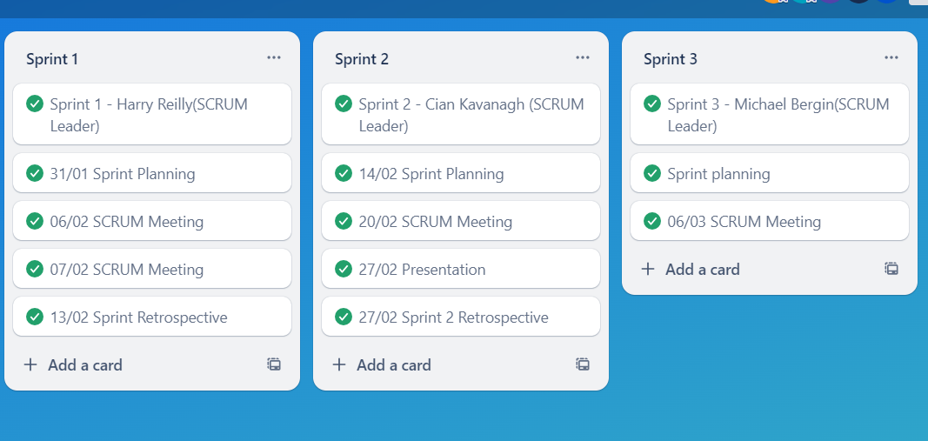
sprints(Trello)

Slide 6
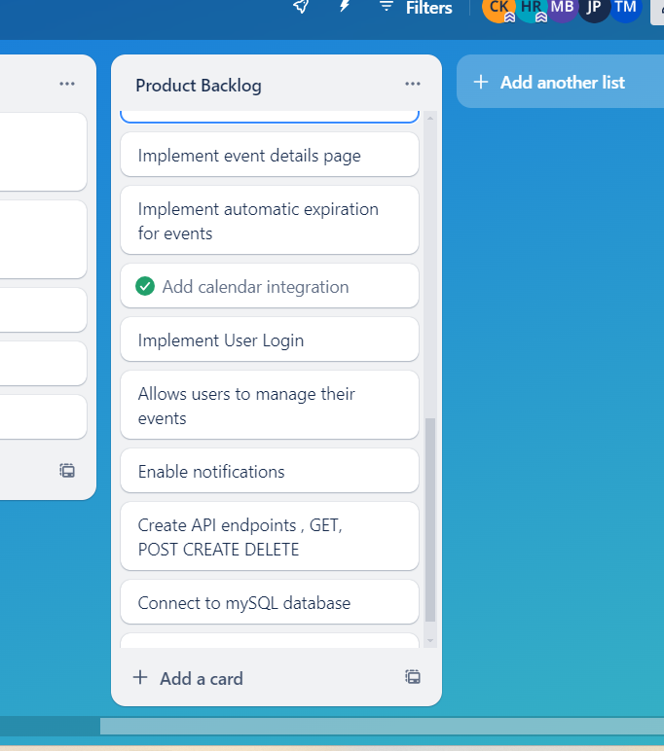
Product Backlog(To DO)

Slide 7
GitHub link
The link to our Main GitHub Repo
-https://github.com/soundjuggler/local-event-tracker

