Slide 1

Lecture 2 Complex Numbers & Signal Property

Slide 2



Complex Numbers – the basics
The notes cover the basic definitions and properties of complex numbers (Boas 2.1-2.5). The story starts from finding solutions for the simple algebraic equation . There is no real solution to the equation. But, if we introduce the notion of imaginary numbers,
one can write down the solutions . Going beyond the pure imaginary numbers, one can introduce the complex number with real and imaginary parts,
where and are real numbers, representing the real and imaginary parts respectively.
$$j≡\sqrt{−1}, \text{with} j^{2}=−1$$
$$x=±j$$
$$z=x+jy$$

Slide 3


Complex land looks different
For complex numbers, an amazing identity arises
It is quite remarkable that two irrational numbers and can be related by the magic number !
$$e^{jπ}=−1$$
$$j$$

Slide 4
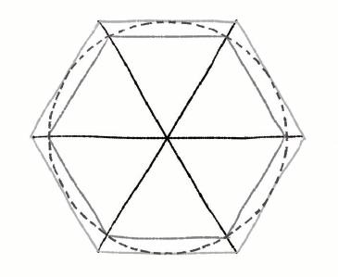
圆周率π与自然对数e
圆周率π：表示圆直径与周长之间的比例，对直径为1的圆，周长为π
圆周率的确定：对直径为1的圆，画出与其内接与外切的多边形，当边数趋于无穷大，内接与外切多边形周长趋于相等，周长为π

Slide 5
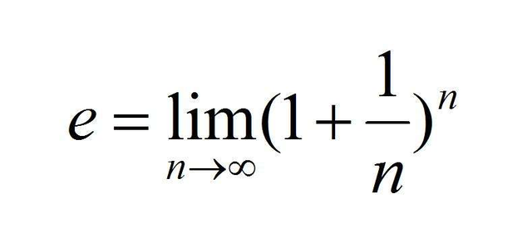

圆周率π与自然对数e
圆周率π：表示圆直径与周长之间的比例，对直径为1的圆，周长为π
圆周率的确定：对直径为1的圆，画出与其内接与外切的多边形，当边数趋于无穷大，内接与外切多边形周长趋于相等，周长为π
自然对数e：
圆周率与自然对数反映了在恒定自然规律约束下，最终收敛。
$$e^{jπ}=−1$$

Slide 6


Complex plane
It is convenient to plot in the two-dimensional complex plane, using the real part and the imaginary part as Cartesian coordinates. Clearly, one can also write the same complex number in polar form,
Here is the absolute value of (distance to the origin) and is the corresponding angle. Complex conjugate is defined as mirror mapping to the , i.e.
Since we can plot a complex number in the two dimensional plane, a natural question pops out: Is a complex number a two-dimensional vector?
$$z=x+jy$$
$$z=x+jy=r\cos{θ}+jr\sin{θ}$$
$$\bar{z}=x−jy=r(\cos{θ}−j\sin{θ})=r[\cos{(}−θ)+j\sin{(}−θ)]$$

Slide 7
Complex Numbers – the basics
Compute the following product
You can convince yourself that the real part is just the inner product and the imaginary part is the outer product for two-dimensional vectors.
$${\bar{z}}_{1}z_{2}=\left(x_{1}−jy_{1}\right)\left(x_{2}+jy_{2}\right)=\left(x_{1}x_{2}+y_{1}y_{2}\right)+j\left(x_{1}y_{2}−x_{2}y_{1}\right)$$

Slide 8



Complex equations
Since a complex number contain real and imaginary parts, a complex equation amount to two real equations. For instance, can be decomposed into two equations,
Note that both and are real. Thus, two solutions and are found for the complex equation .
$$z^{2}=2j$$
$$x^{2}− y^{2}=0 \\ 2xy=2$$
$$z^{2}=2j$$

Slide 9


Taylor expansions
Now I would like to establish an important identity
The easiest way to prove the above identity is through Taylor expansions,
Choose the variable in the Taylor expansion for the exponential function and one can check that it equals the sum of the Taylor series for the sinusoidal functions.
$$e^{jθ}=\cos{θ}+j\sin{θ}$$
$$x=jθ$$

Slide 10
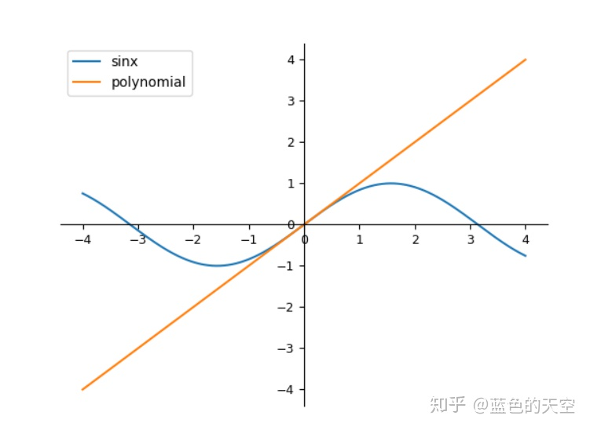
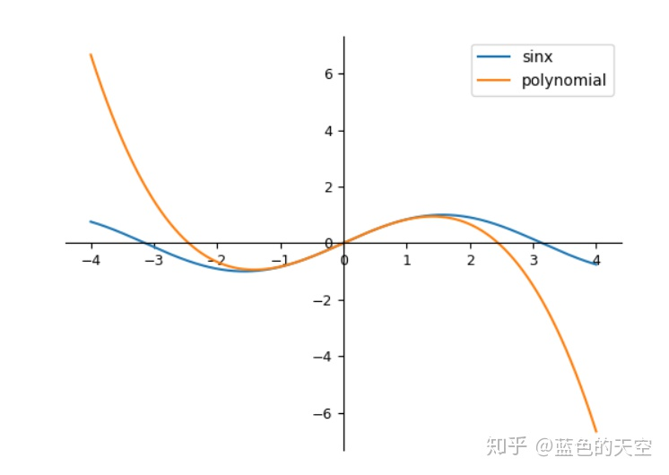
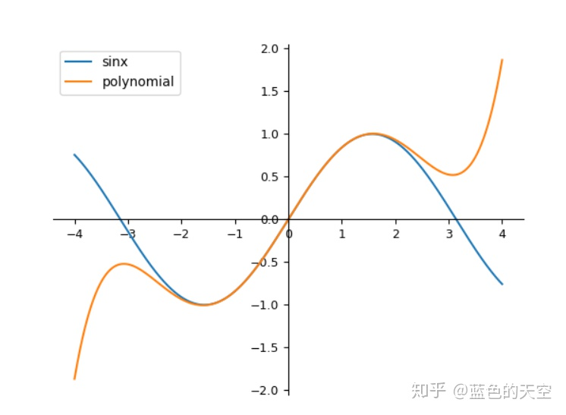

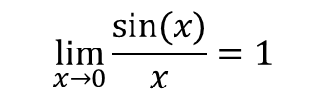
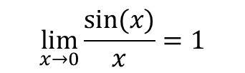

泰勒展开式
泰勒展开：很多复杂的函数可以用多项式的形式表达
对 f(x)=sin(x):
$$\lim_{x→0}{\frac{sin⁡(x)}{x}}=1$$
$$\lim_{x→0}{\frac{sin⁡(x)}{x}}=1$$
$$x−\frac{x^{3}}{3!}$$
$$x−\frac{x^{3}}{3!}+\frac{x^{5}}{5!}$$

Slide 11
Signal Property

Slide 12
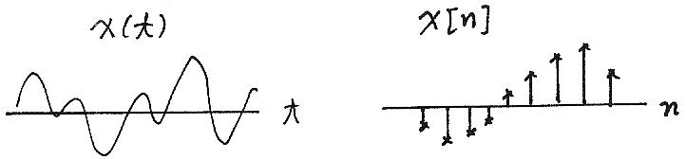
Fundamental Concepts （Signals）
Continuous/Discrete-time Signals
x(t), x[n]
Signal Energy/Power
x(t)
x[n]
t
n

Slide 13
“Electrical” Signal Energy & Power
It is often useful to characterise signals by measures such as energy and power
For example, the instantaneous power of a resistor is:
and the total energy expanded over the interval [t₁, t₂] is:
and the average energy is:
How are these concepts defined for any continuous or discrete time signal?

Slide 14
Generic Signal Energy and Power
Total energy of a continuous signal x(t) over [t₁, t₂] is:
where |.| denote the magnitude of the (complex) number.
Similarly for a discrete time signal x[n] over [n₁, n₂]:
By dividing the quantities by (t₂-t₁) and (n₂-n₁+1), respectively, gives the average power, P
Note that these are similar to the electrical analogies (voltage), but they are different, both value and dimension.

Slide 15
Energy and Power over Infinite Time
For many signals, we’re interested in examining the power and energy over an infinite time interval (-∞, ∞). These quantities are therefore defined by:
If the sums or integrals do not converge, the energy of such a signal is infinite
Two important (sub)classes of signals
Finite total energy (and therefore zero average power)
Finite average power (and therefore infinite total energy)
Signal analysis over infinite time, all depends on the “tails” (limiting behaviour)

Slide 16
Transformation of A Signal
Time Shift
Time Reversal
Time Scaling
Combination

Slide 17
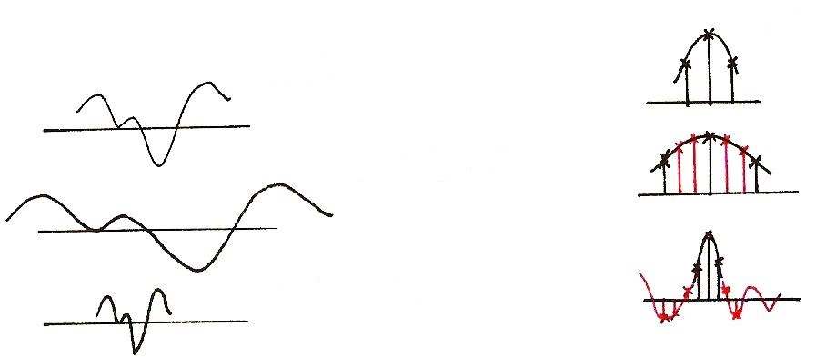
Time Scaling
x[n]
x(t)
?
x(at), a<1
?
x(at), a>1

Slide 18
Periodic Signal
T₀ : Fundamental period : the smallest positive value of T
aperiodic : NOT periodic

Slide 19
Even/Odd Signals
Even
Odd
Any signal can be discomposed into a sum of an
even and an odd

Slide 20
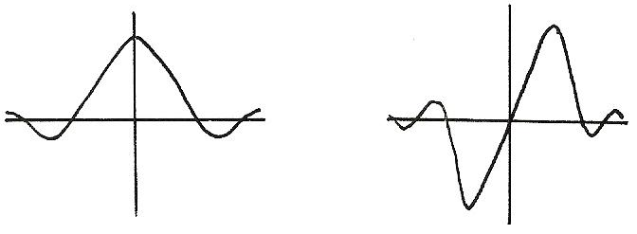
Even/Odd
Even
Odd
x(-t)=x(t)
x(-t)=-x(t)

Slide 21
Exponential/Sinusoidal Signals
Basic Building Blocks from which one can construct many different signals and define frameworks for analyzing many different signals efficiently
fundamental period
fundamental frequency

Slide 22
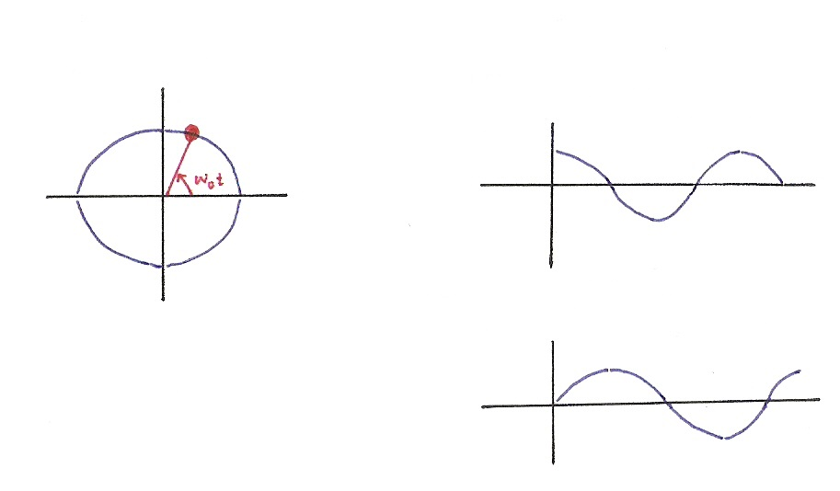






Exponential/Sinusoidal Signals
$$x\left(t\right)=e^{jω_{0}t}$$
$$Re\left\{e^{jω_{0}t}\right\}=\cos{ω_{0}t}$$
$$Im$$
$$Re$$
$$Im\left\{e^{jω_{0}t}\right\}=\sin{ω_{0}t}$$
$$e^{jx}=\cos{x}+j sin{x}$$

Slide 23
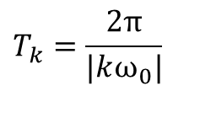

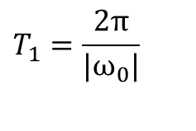

Exponential/Sinusoidal Signals
Harmonically related signal sets
fundamental period
$$T_{1}=\frac{2π}{|ω_{0}|}$$
Harmonical period
$$T_{k}=\frac{2π}{|kω_{0}|}$$
fundamental frequency
$$|ω_{0}|$$
Harmonical frequency
$$|kω_{0}|$$

Slide 24
Exponential/Sinusoidal Signals
Sinusoidal signal
General format
Discrete-Time

Slide 25
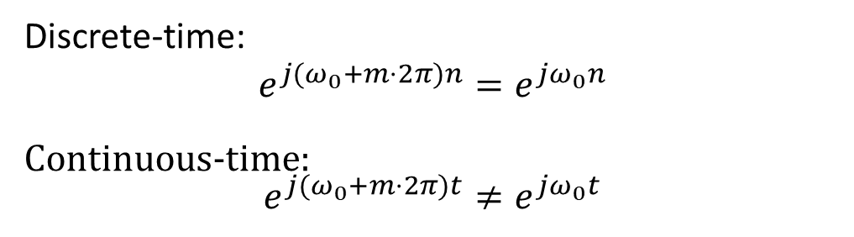
Exponential/Sinusoidal Signals
Important Differences Between Continuous-time and Discrete-time Exponential/Sinusoidal Signals
重要！
For discrete-time, signals with frequencies ω₀ and
ω₀ +m．2π are identical, where m is an integer. This is not true for continuous-time signal.
Discrete-time:
$$e^{j(ω_{0}+m⋅2π)n}=e^{jω_{0}n}$$
Continuous-time: $$e^{j(ω_{0}+m⋅2π)t}≠e^{jω_{0}t}$$

Slide 26
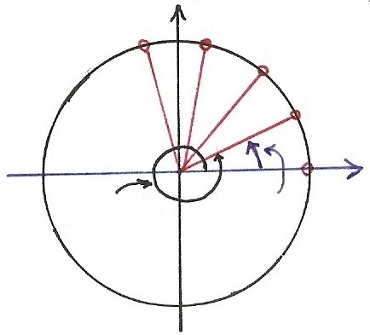










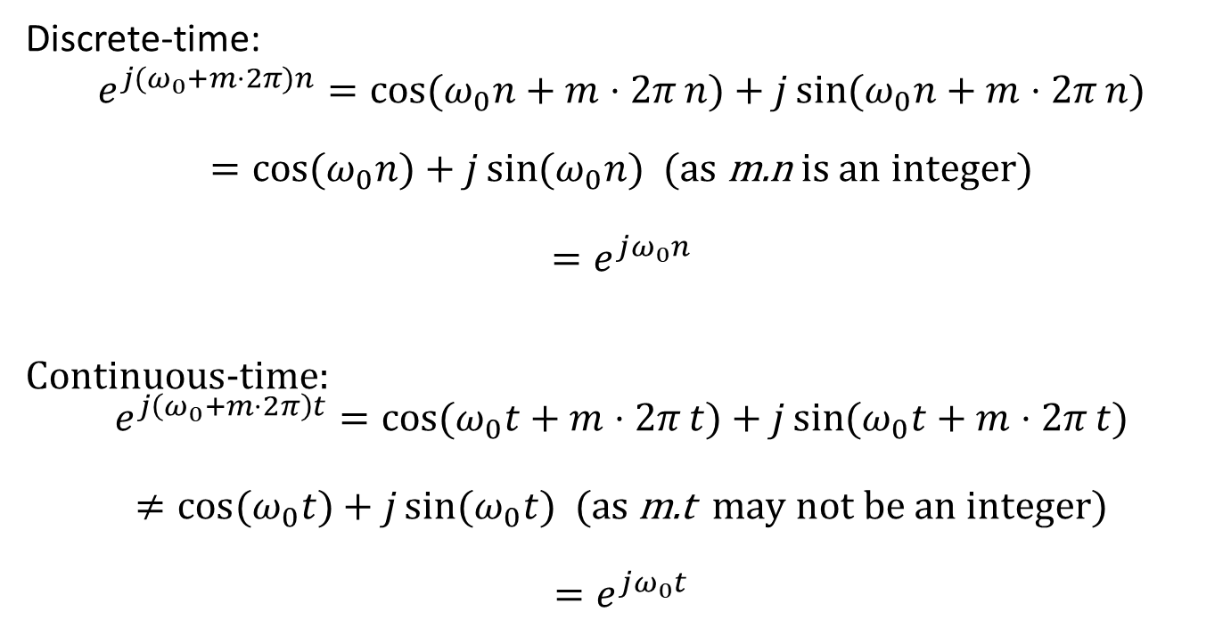
Continuous/Discrete Sinusoidals
重要！
Discrete-time:
$$e^{j(ω_{0}+m⋅2π)n}=\cos{(ω_{0}n+m⋅2π}n)+j\sin{(ω_{0}n+m⋅2π}n)$$
$=\cos{(ω_{0}n})+j\sin{(ω_{0}n})$ (as m.n is an integer)
$$=e^{jω_{0}n}$$
Continuous-time: $$e^{j\left(ω_{0}+m⋅2π\right)t}=\cos{(ω_{0}t+m⋅2π}t)+j\sin{(ω_{0}t+m⋅2π}t)$$
$$≠\cos{(ω_{0}t})+j\sin{(ω_{0}t}) \text{(}\text{as} \text{m}\text{.}\text{t} \text{may} \text{not} \text{be} \text{an} \text{integer}\text{)}$$
$$=e^{jω_{0}t}$$
$$Im$$
$$n=4$$
$$n=3$$
$$n=2$$
$$e^{j[⋅]}$$
$$n=1$$
$$Re$$
$$ω_{0}t$$
$$n=0$$
$${(ω}_{0}+2π)t$$

Slide 27
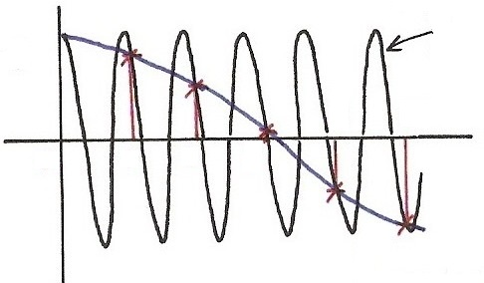
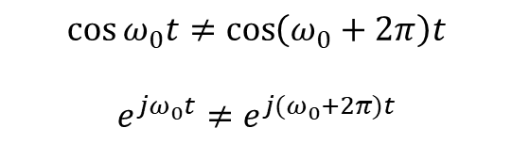




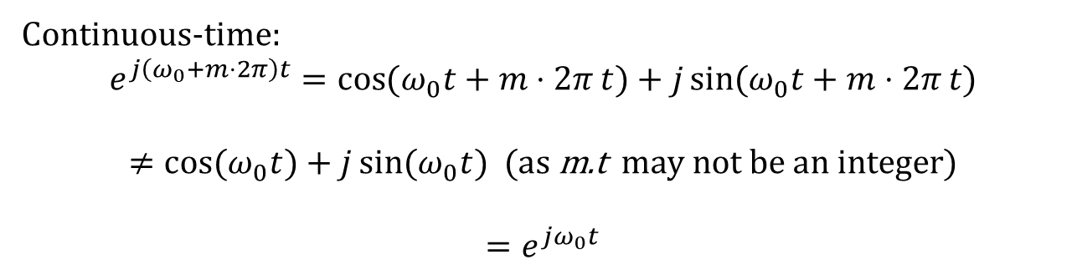
Continuous/Discrete Sinusoidals
Continuous-time: $$e^{j\left(ω_{0}+m⋅2π\right)t}=\cos{(ω_{0}t+m⋅2π}t)+j\sin{(ω_{0}t+m⋅2π}t)$$
$$≠\cos{(ω_{0}t})+j\sin{(ω_{0}t}) \text{(}\text{as} \text{m}\text{.}\text{t} \text{may} \text{not} \text{be} \text{an} \text{integer}\text{)}$$
$$=e^{jω_{0}t}$$
$$\cos{[\left(ω_{0}+2π\right)t]}$$
$$\cos{[⋅]}$$
$$\cos{ω_{0}t}≠\cos\left(ω_{0}+2π\right)t$$
$$e^{jω_{0}t}≠e^{j{(ω}_{0}+2π)t}$$
4
5
$$t$$
0
1
2
3
$$\cos{[ω_{0}t]}$$

Slide 28
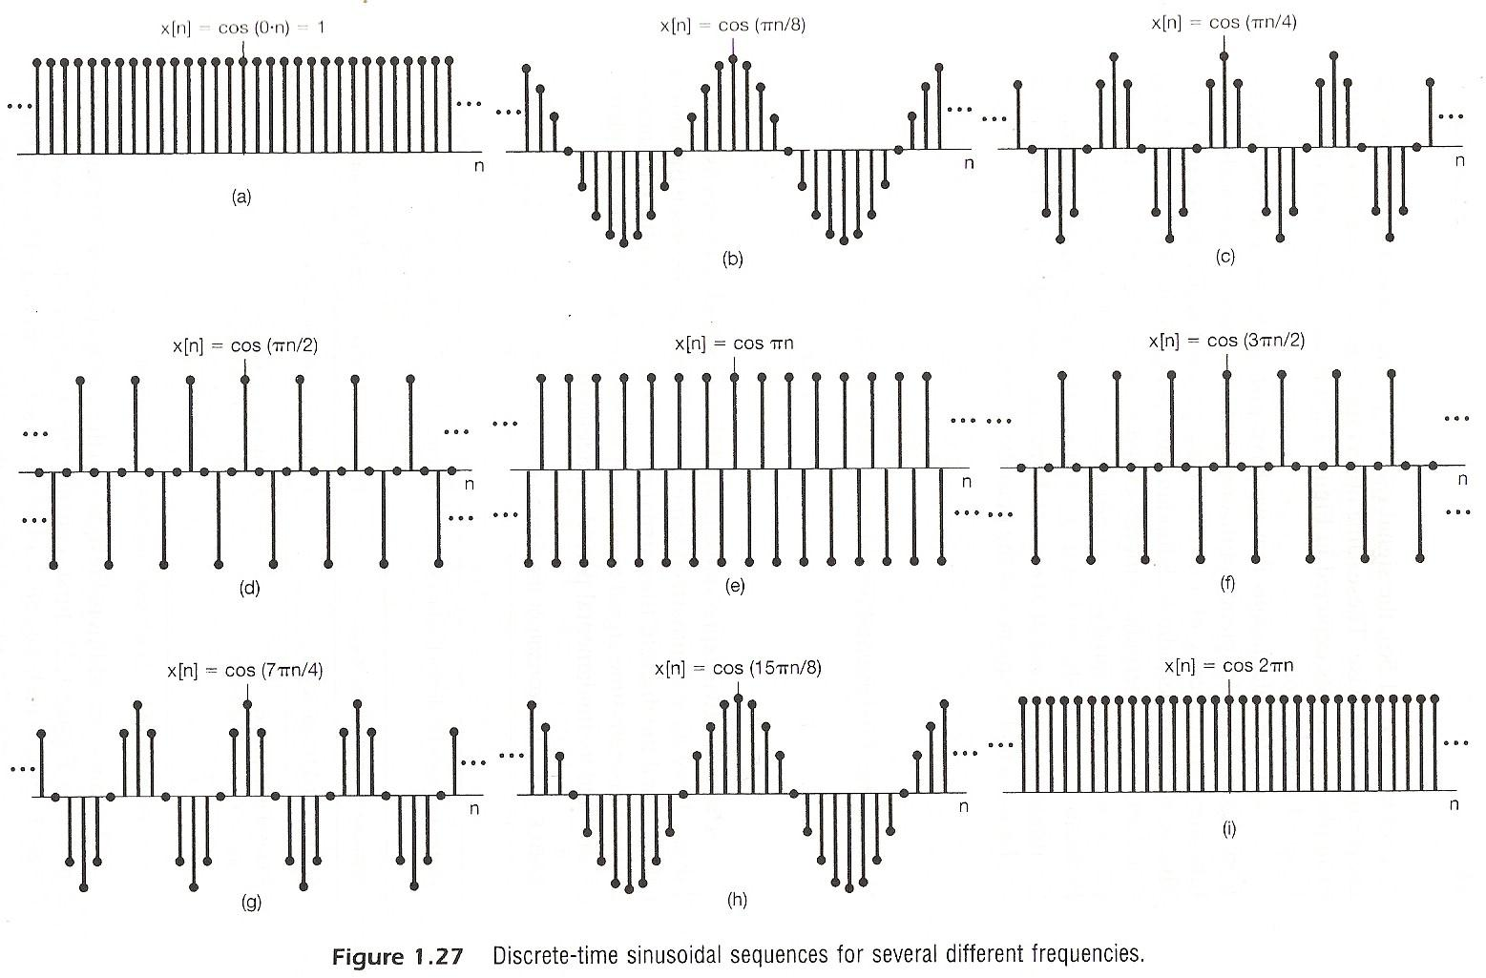
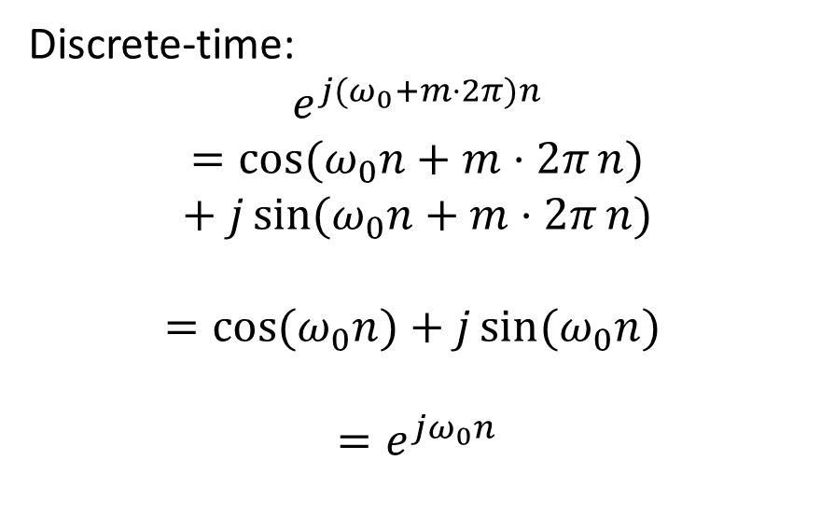
Continuous/Discrete Sinusoidals
Discrete-time:
$$e^{j(ω_{0}+m⋅2π)n}$$
$$=\cos{(ω_{0}n+m⋅2π}n)+j\sin{(ω_{0}n+m⋅2π}n)$$
$$=\cos{(ω_{0}n})+j\sin{(ω_{0}n})$$
$$=e^{jω_{0}n}$$

Slide 29
Exponential/Sinusoidal Signals
Important Differences Between Continuous-time and Discrete-time Exponential/Sinusoidal Signals
For discrete-time, ω₀ is usually defined only for [-π, π] or [0, 2π]. For continuous-time, ω₀ is defined for (-∞, ∞)
For discrete-time, the signal is periodic only when
ω₀N=2πm,

Slide 30
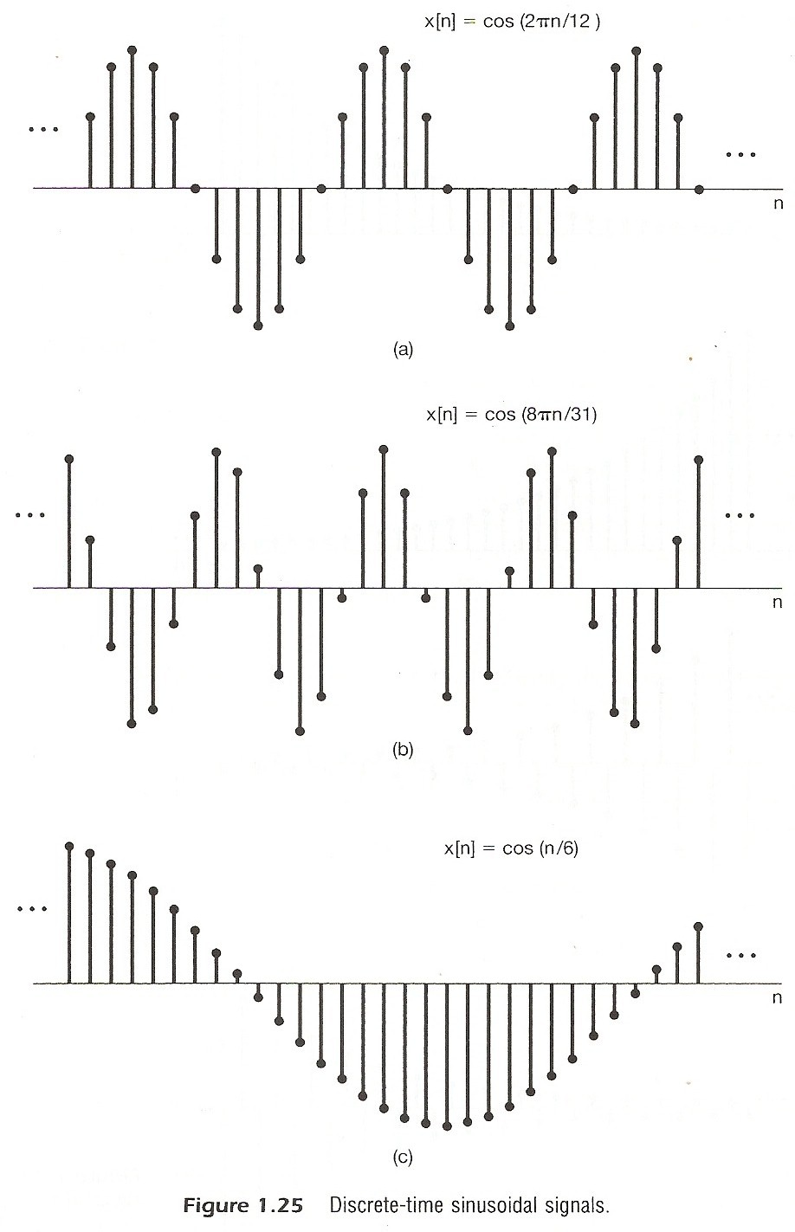
Exponential/Sinusoidal Signals

Slide 31
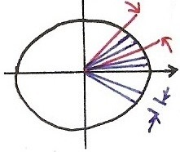
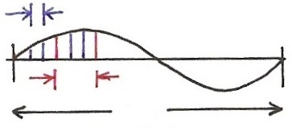









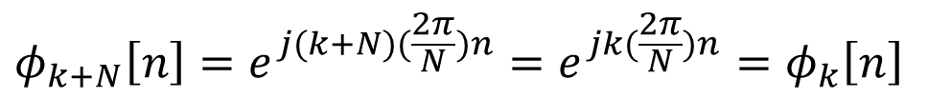
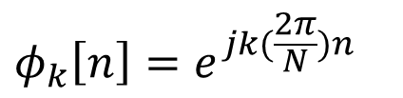

Harmonically Related Signal Sets
For being periodic
real period in cycles
$$=$$
$$ω_{k}⋅N=2π⋅k$$
$$ω_{k}=k(\frac{2π}{N})$$
$$=$$
real period in n
$$Im$$
$$\frac{2π}{N}$$
$$k\left(\frac{2π}{N}\right), k=3$$
$$Re$$
$$2π$$
divided in N
$$\frac{2π}{N}$$
$$φ_{k}\left[n\right]=e^{jk(\frac{2π}{N})n}$$
$$φ_{k+N}\left[n\right]=e^{j(k+N)(\frac{2π}{N})n}=e^{jk(\frac{2π}{N})n}=φ_{k}\left[n\right]$$

Slide 32
Exponential/Sinusoidal Signals
Harmonically related discrete-time signal sets
all with common period N
This is different from continuous case. Only N distinct signals in this set.

Slide 33
Fundamental Concepts (Systems)
Continuous/Discrete-time Systems
Interconnections of Systems
x(t)
y(t)
x[n]
y[n]
Series
Parallel
+

Slide 34
Fundamental Concepts (Systems)
Interconnections of Systems
Feedback
Combinations
+

Slide 35
Fundamental Concepts (Systems)
Stability
stable : bounded inputs lead to bounded outputs
Time Invariance
time invariant : behavior and characteristic of the system are fixed over time

Slide 36
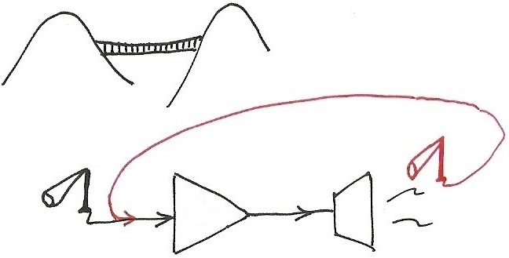
Stability
Examples of unstable systems
Amp

Slide 37
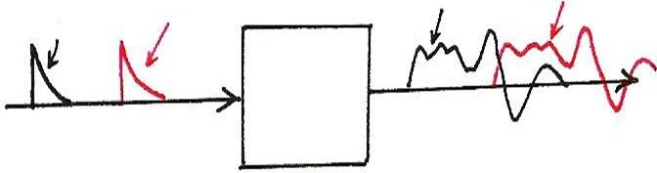
Time Invariance
x(t-T₀)
y(t)
y(t-T₀)
x(t)

Slide 38
Stability
Linearity
linear : superposition property
scaling or homogeneity property
additive property

Slide 39
Stability
Memoryless/With Memory
Memoryless : output at a given time depends only on the input at the same time
eg.
With Memory
eg.

Slide 40
Stability
Invertibility
invertible : distinct inputs lead to distinct outputs, i.e. an inverse system exits
eg.
Causality
causal : output at any time depends on input at the same time and in the past
eg.

Slide 41
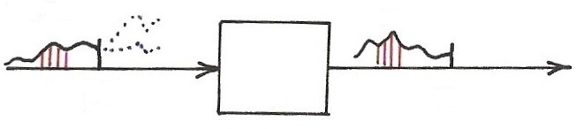
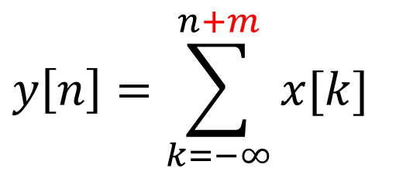




Causality
$$x[n]$$
$$y[n]$$
$$n$$
$$n$$
$$y\left[n\right]=\sum_{k=−∞}^{n+m}{x[k]}$$

Slide 42
本章部分关键词汇中英文对照表
复数 | Complex number
实数 | Real number
虚数 | Imaginary number
直角坐标系 | Cartesian coordinate
极坐标系 | Polar coordinate
欧拉公式 | Euler’s formula
泰勒展开式 | Taylor expansion
基波信号 | Fundamental signal
谐波信号 | Harmonic signal

Slide 43
Thank you for your listening!

