Slide 1

Lecture 3
Convolution and Linear Time-invariant Systems
School of Computer Engineering and Science
Shanghai University
Instructor: Shengyu Duan, Weiwei Chen

Slide 2
2.1 Discrete-time Systems: the Convolution Sum
2.2 Continuous-time System : the Convolution Integral
2.3 Linear Time-invariant Systems
content

Slide 3
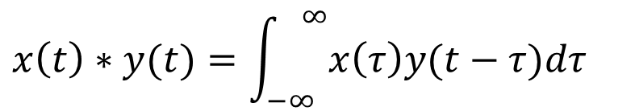
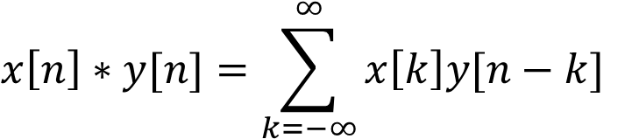
Convolution
For discrete signal, convolution sum:
$$x\left[n\right]∗y[n]=\sum_{k=−∞}^{∞}{x\left[k\right]y[n−k]}$$
For continuous signal, convolution integral:
$$x\left(t\right)∗y(t)=\int_{−∞}^{ ∞}{x\left(τ\right)y(t−τ)dτ}$$

Slide 4
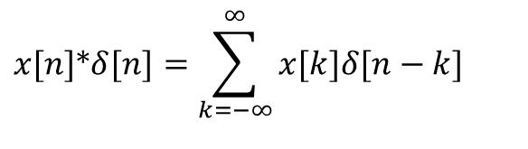
2.1 Discrete-time Systems: the Convolution Sum
Representing an arbitrary signal as a sequence of unit impulses
an unit impulse located at n = k on the index n
$$x[n]∗δ[n]=\sum_{k=−∞}^{∞}{x[k]δ[n−k]}$$

Slide 5
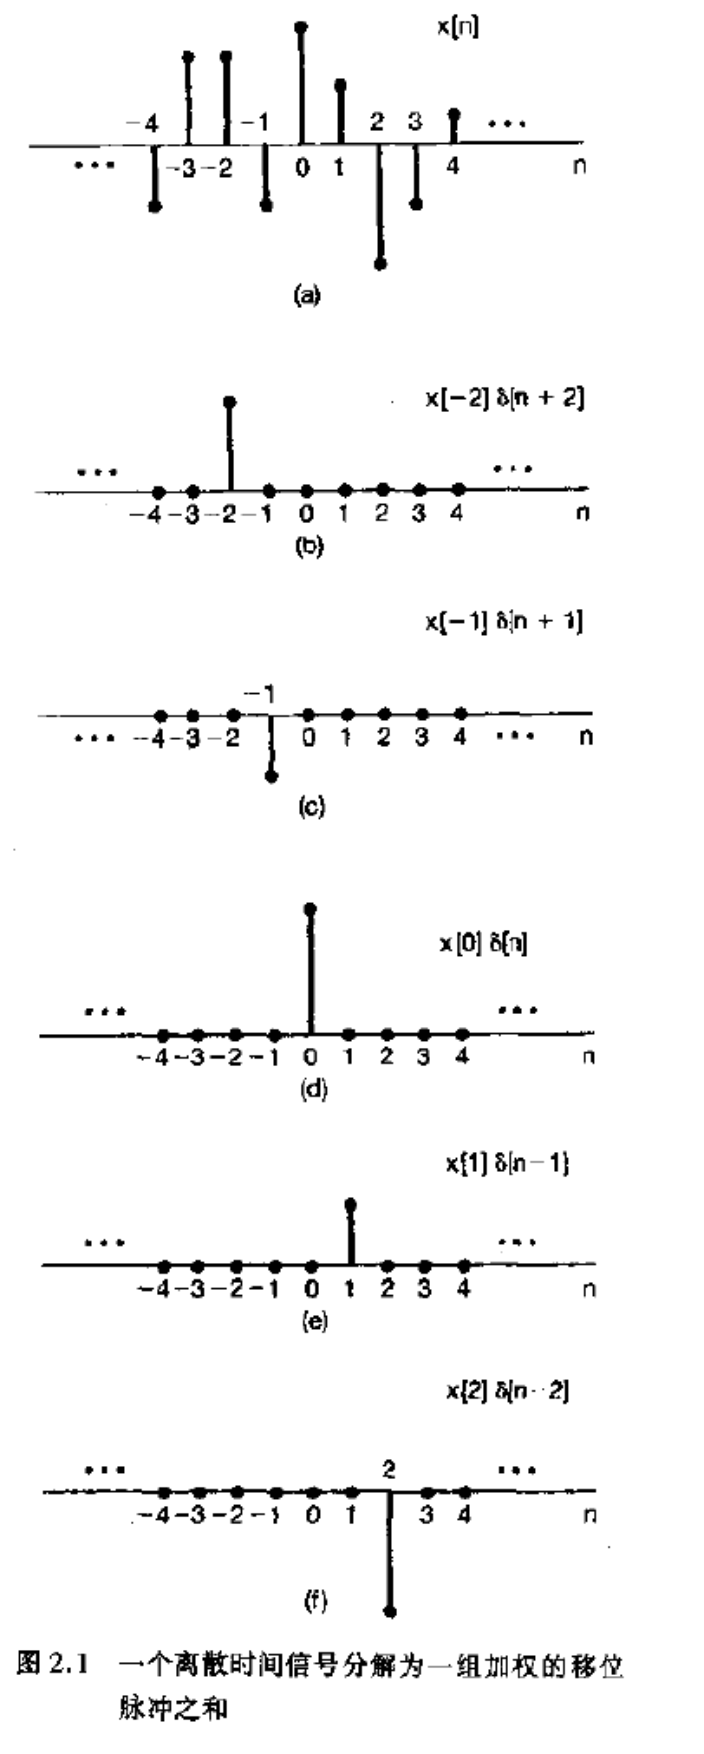

Slide 6
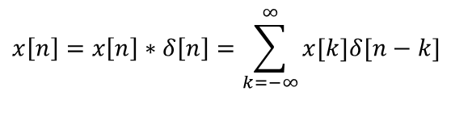
2.1 Discrete-time Systems: the Convolution Sum
Representing an arbitrary signal as a sequence of unit impulses
an unit impulse located at n = k on the index n
See Fig. 2.1, p.76 of text
a special case
$$x\left[n\right]=x\left[n\right]∗δ\left[n\right]=\sum_{k=−∞}^{∞}{x[k]δ[n−k]}$$

Slide 7
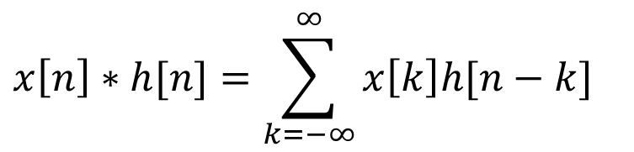
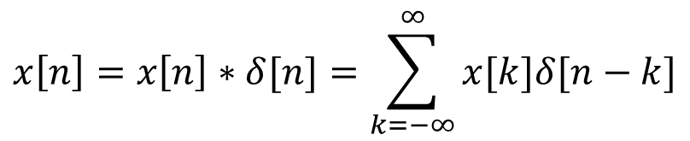
2.1 Discrete-time Systems: the Convolution Sum
Convolution sum can be used to represent an arbitrary signal as a sequence of unit impulses
$$x\left[n\right]=x\left[n\right]∗δ[n]=\sum_{k=−∞}^{∞}{x[k]δ[n−k]}$$
For discrete signal, convolution sum:
$$x\left[n\right]∗h[n]=\sum_{k=−∞}^{∞}{x\left[k\right]h[n−k]}$$

Slide 8
A Different Way to visualize the convolution sum
looked at on the index k
on the dummy index k, h[k] is reflected over and shifted to k=n, weighted by x[k] and summed to produce an output sample y[n] at time n
See Figs 2.5, 2.6, 2.7, pp. 83-85 of text
input signal
Contribution to the output signal at time n
reflected-over version of h[k] located at k = n

Slide 9
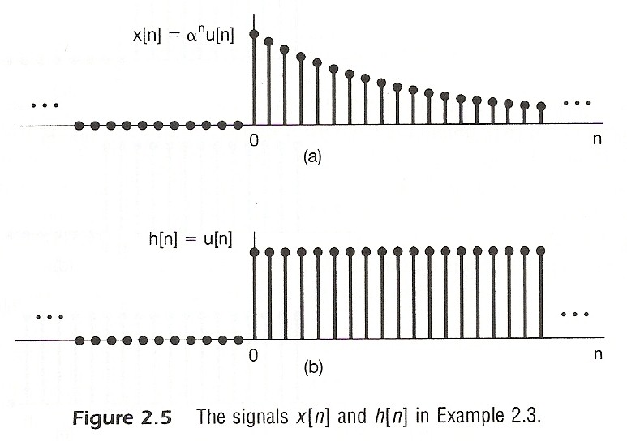

Slide 10
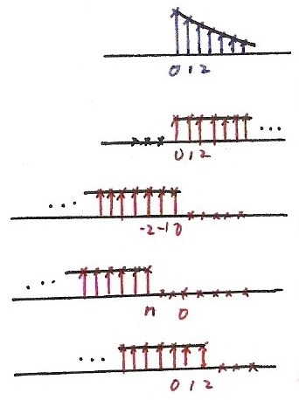










$$x[k]$$
$$k$$
Fig. 2.6
$$h[k]$$
$$k$$
$$h\left[−k\right], n=0$$
$$k$$
$$h\left[n−k\right], n<0$$
$$k$$
$$h\left[n−k\right], n=2>0$$
$$k$$

Slide 11
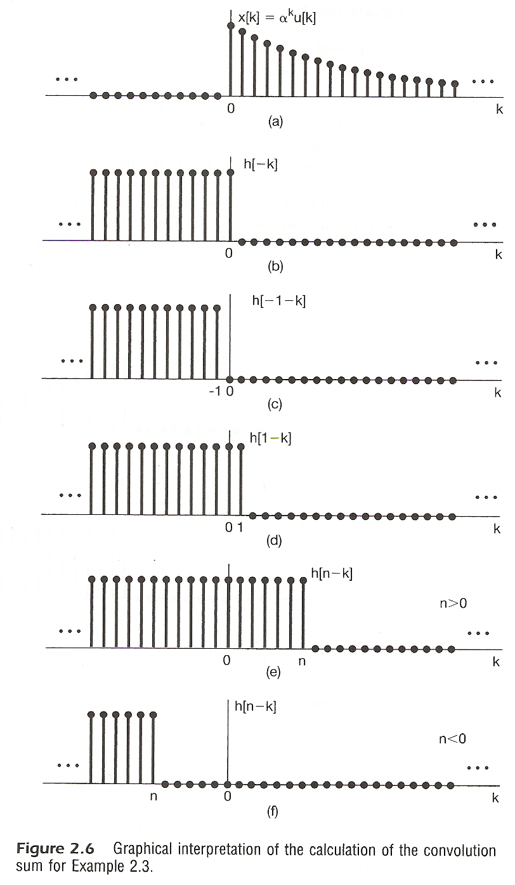

Slide 12
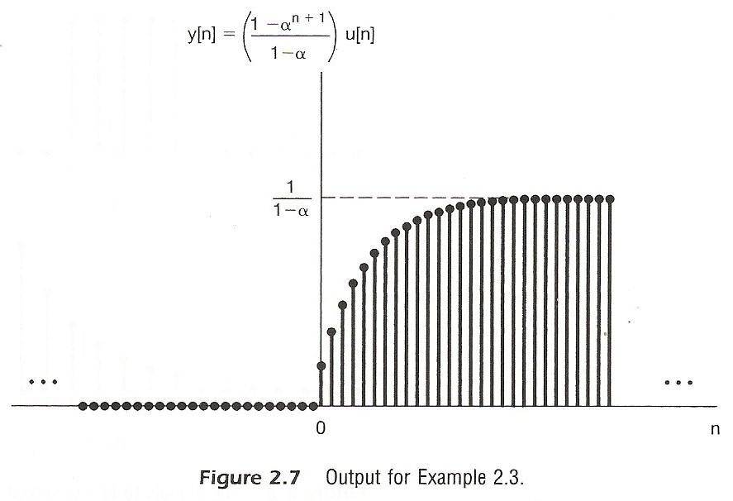

Slide 13
2.2 Continuous-time System : the Convolution Integral
Representing an arbitrary signal as an integral of impulses
See Fig 2.12 , p.91 of text
an impulse located at t = τ whose value is x(τ)
(合成)
a special case

Slide 14
A Different Way to visualize the convolution integral
Look on the index τ
input signal
output signal at time t
reflected-over version of h(t)located at τ =t
On the dummy index τ, h(t) is reflected over and shifted to τ = t, weighted by x(t) and integrated to produce the output value at time t, y(t)
see Figs.2.19,2.20,2.21,pp.100-101 of text
A linear time-invariant system is completely
characterized by its unit impulse response

Slide 15
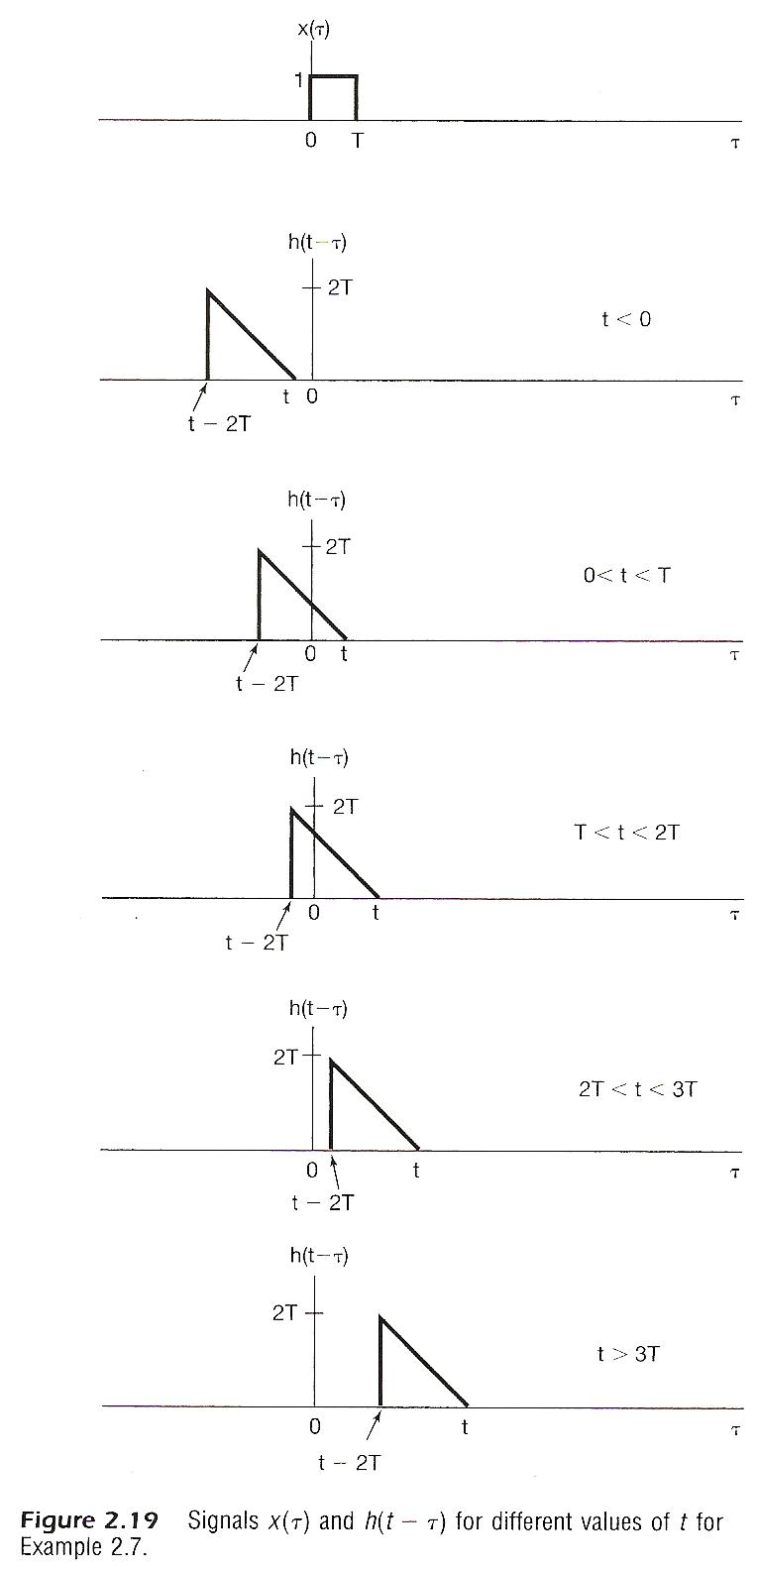
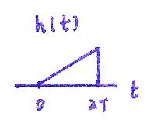


$$−2T$$
0
$$h(−t)$$

Slide 16
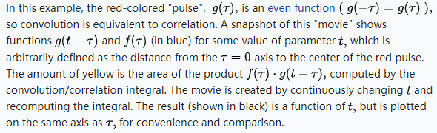
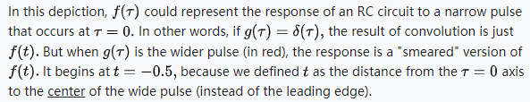

Slide 17

Matrix perspective
i | h | g
f | e | d
c | b | a
step 2
c | b | a
f | e | d
i | h | g
a | b | c
d | e | f
g | h | i
step 1

Slide 18
Convolution Example
h
1 | -1 | -1
1 | 2 | -1
1 | 1 | 1
f
2 | 2 | 2 | 3
2 | 1 | 3 | 3
2 | 2 | 1 | 2
1 | 3 | 2 | 2
Rotate
1 | 1 | 1
-1 | 2 | 1
-1 | -1 | 1

Slide 19
Convolution Example
h |  |  | 2 | 2 | 2 | 3
 |  |  | 2 | 1 | 3 | 3
 |  |  | 2 | 2 | 1 | 2
 |  |  | 1 | 3 | 2 | 2
 | 5 |  |  |  | f*h
1 | 1 | 1
-1 | 2 | 1
-1 | -1 | 1
St
ep 1
1 | 1 | 1
-1 | 4 | 2 | 2 | 3
-1 | -2 | 1 | 3 | 3
f | 2 | 2 | 1 | 2
 | 1 | 3 | 2 | 2
2
2
2
1

Slide 20
Convolution Example
1 | 1 | 1
-1 | 2 | 1
-1 | -1 | 1
2
2
2
3
h
2
1
3
3
2
2
1
2
1 | 1 | 1
-2 | 4 | 2 | 3
-2 | -1 | 3 | 3
2 | 2 | 1 | 2
1 | 3 | 2 | f2
1
3
2
2
2
2
2
5 | 4
2
1
3
f*h

Slide 21
Convolution Example
1 | 1 | 1
-1 | 2 | 1
-1 | -1 | 1
2 | 2 | 2 | 3
2 | 1 | 3 | 3
2 | 2 | 1 | 2
1 | 3 | 2 | 2
h | 1 | 1 | 1
2 | -2 | 4 | 3
2 | -1 | -3 | 3
2 | 2 | 1 | 2
1 | 3 | 2 | 2
5 | 4 | 4
2
2
3
1
3
3
f
f*h

Slide 22
Convolution Example
1 | 1 | 1
-1 | 2 | 1
-1 | -1 | 1
2 | 2 | 2 | 3
2 | 1 | 3 | 3
2 | 2 | 1 | 2
1 | 3 | 2 | 2
 |  | 1 | 1 | 1
2 | 2 | -2 | 6 | 1
2 | 1 | -3 | -3 | 1
2 | 2 | 1 | 2
1 | 3 | 2 | 2
5 | 4 | 4 | -2
2
3
3
3
f
f*h

Slide 23
Convolution Example
1 | 1 | 1
-1 | 2 | 1
-1 | -1 | 1
2 | 2 | 2 | 3
2 | 1 | 3 | 3
2 | 2 | 1 | 2
1 | 3 | 2 | 2
h
1 | 2 | 2 | 2 | 3
-1 | 4 | 1 | 3 | 3
-1 | -2 | 2 | 1 | 2
 | 1 | 3 | 2 | 2
5 | 4 | 4 | -2
9
2
2
2
1
2
2
f
f*h

Slide 24
Convolution Example
1 | 1 | 1
-1 | 2 | 1
-1 | -1 | 1
2 | 2 | 2 | 3
2 | 1 | 3 | 3
2 | 2 | 1 | 2
1 | 3 | 2 | 2
h
2 | 2 | 2 | 3
-2 | 2 | 3 | 3
-2 | -2 | 1 | 2
1 | 3 | 2 | 2
5 | 4 | 4 | -2
9 | 6
2
2
2
2
1
3
2
2
1
f
f*h

Slide 25

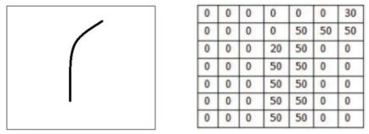
卷积运算的物理意义
对图像来说，卷积运算被用来判断输入图像与特征图像的匹配程度。
例如，对以下输入图片，找到符合特征图像的部分：
输入图像
特征图像

Slide 26
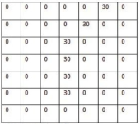

卷积运算的物理意义
对图像来说，卷积运算被用来判断输入图像与特征图像的匹配程度。
例如，对以下输入图片，找到符合特征图像的部分：
用像素值表示：
输入图像
特征图像

Slide 27
卷积运算的物理意义
例如，对以下输入图片，找到符合特征图像的部分：
输入图像
特征图像
内积
内积
6600
2500

Slide 28
卷积运算的物理意义
例如，对以下输入图片，找到符合特征图像的部分：
输入图像
特征图像
内积
内积
更符合所需特征
6600
2500

Slide 29
卷积运算的物理意义
信号处理中，卷积运算的本质与上述图像卷积运算类似：
卷积运算的结果表示一维曲线f(t)与特征曲线g(t)的匹配程度，可用来滤除我们所不希望的特征：滤波

Slide 30
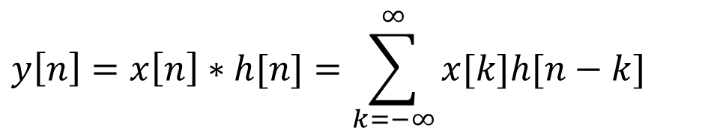
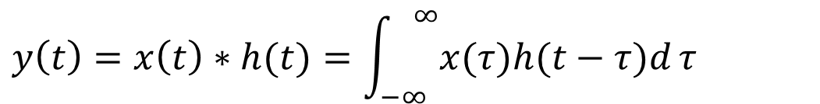
Linear Time-invariant Systems
$$y\left[n\right]=x\left[n\right]∗h[n]=\sum_{k=−∞}^{∞}{x[k]h[n−k]}$$
$$y\left(t\right)=x\left(t\right)∗h(t)=\int_{−∞}^{ ∞}{x(τ)h(t−τ)d}τ$$
But what is $h[n]$ or $h(t)$?

Slide 31
Linear Time-invariant Systems
Defining the output for an unit impulse input as the
Unit Impulse Response, h[n]
x[n]=δ[n]
y[n]=h[n]:unit impulse response
S
0
n
0
n

Slide 32
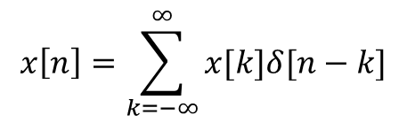

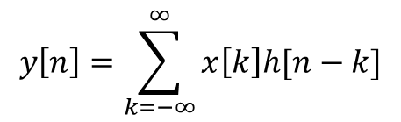
Linear Time-invariant Systems
Defining the output for an unit impulse input as the
Unit Impulse Response, h[n]
Theoretically, for any $x\left[n\right]$, which can be constructed by $δ\left[n\right]$, the system output $y\left[n\right]$ can be computed based on h[n].
$$x\left[n\right]=\sum_{k=−∞}^{∞}{x[k]δ[n−k]}$$
$$y\left[n\right]=\sum_{k=−∞}^{∞}{x\left[k\right]h[n−k]}$$
S

Slide 33

Linear Time-invariant Systems
Defining the output for an unit impulse input as the
Unit Impulse Response, h[n]
Theoretically, for any $x\left[n\right]$, which can be constructed by $δ\left[n\right]$, the system output $y\left[n\right]$ can be computed based on h[n], only if the system is a linear time-invariant system.
$$x\left[n\right]=\sum_{k=−∞}^{∞}{x[k]δ[n−k]}$$
$$y\left[n\right]=\sum_{k=−∞}^{∞}{x\left[k\right]h[n−k]}$$
S

Slide 34
线性（Linear）系统
Linear: a system is linear if the output of the scaled sum of two input signals is the equivalent scaled sum of outputs （如果输入信号是两个信号的加权和，那么输出信号也是这两个输入信号对应输出的加权和）
例：如果系统对输入信号x(t)的输出是y(t)，则系统对输入信号ax₁(t)+bx₂(t)的输出为ay₁(t)+by₂(t)
线性系统对信号在频域表示下的处理具有重要意义。

Slide 35
时不变（Time-invariant）系统
Time-invariance: a system is time invariant if the system’s output is the same, given the same input signal, regardless of time. （系统特性不随时间发生变化）
例：如果系统对输入信号x(t)的输出是y(t)，则系统对输入信号x(t-t₀)的输出为y(t-t₀)
时不变系统对信号在频域表示下的处理具有重要意义。

Slide 36

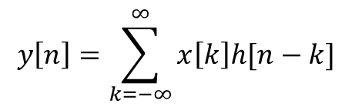
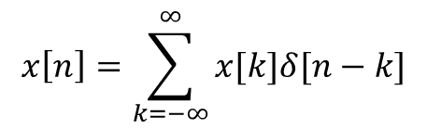


Linear Time-invariant Systems
Time-invariant: for any k, response of $δ\left[n−k\right]$ is always $h\left[n−k\right]$
$$x\left[n\right]=δ[n−k]$$
$$y\left[n\right]=h[n−k]$$
S
Linearity: response can always be represented by the scaled sum of $h\left[n−k\right]$
$$x\left[n\right]=\sum_{k=−∞}^{∞}{x[k]δ[n−k]}$$
$$y\left[n\right]=\sum_{k=−∞}^{∞}{x\left[k\right]h[n−k]}$$
S

Slide 37
Properties of Linear Time-invariant Systems
Commutative Property （交换律）
the role of input signal and unit impulse response is interchangeable, giving the same output signal
In evaluating the convolution sum or integral, the input signal can be reflected over and weighted by the unit impulse response
Notes:
交换律

Slide 38
Distributive Property (分配率)
Notes:
分配定律

Slide 39
Associative Property （结合律）
Cascade of two systems gives an unit impulse response which is the convolution of the unit impulse responses of the two individual systems
The behavior of a cascade of two systems is independent of the order in which the two systems are cascaded
Notes:
结合律

Slide 40
Causality
causal if y[n] dose not depend on x[k] for k > n
Causal iff h[n]=0, n < 0

Slide 41
Causality
continuous-time
Causal iff h(t)=0,t<0

Slide 42
Unit step response
output for an unit step function input
similarly
Running sum
First difference
Running integral
First derivative

Slide 43

Unit step response
output for an unit step function input
$$s\left[n\right]=u\left[n\right]∗h\left[n\right]=\sum_{k=0}^{∞}{h\left[n−k\right]}$$
令 $k^{′}=n−k$:
$$s\left[n\right]=u\left[n\right]∗h\left[n\right]=\sum_{k=0}^{∞}{h\left[n−k\right]}=\sum_{k^{′}=n}^{−∞}{h\left[k^{′}\right]}=\sum_{k=n}^{−∞}{h\left[k\right]}$$
$$⇒ s\left[n−1\right]=\sum_{k=n−1}^{−∞}{h\left[k\right]}$$
因此：
$$s\left[n\right]−s\left[n−1\right]=\sum_{k=n}^{−∞}{h\left[k\right]}−\sum_{k=n−1}^{−∞}{h\left[k\right]}=h[n]$$

Slide 44
本章部分关键词汇中英文对照表
卷积 | Convolution
卷积和 | Convolution sum
卷积积分 | Convolution integral
单位冲激响应 | Unit impulse response
单位阶跃响应 | Unit step response
线性 | Linearity
时不变 | Time-invariant

