Slide 1

Lecture 1 Introduction
School of Computer Engineering and Science
Shanghai University
Instructor: Jianjia Wang, Shengyu Duan

Slide 2
Outline: Lecture 1: Introduction
Preliminary
What are the signals
What are the systems
Application of signals and systems
Fundamental concepts
Signals and systems
Types of Signals

Slide 3
Outline: Lecture 1: Introduction
Preliminary
What are the signals
What are the systems
Application of signals and systems
Fundamental concepts
Signals and systems
Types of Signals

Slide 4
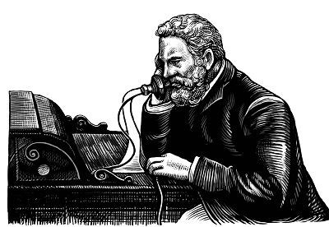
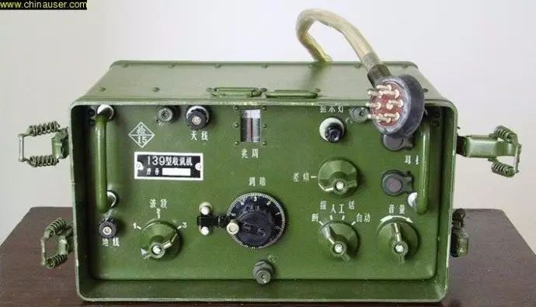


信号是什么？
电话
无线电
烽火狼烟
物联网

Slide 5
What is a Signal?
A signal is a pattern of variation of some form
Signals are variables that carry information（信号是传递信息的变量）
Examples of signal include:
Electrical signals
Voltages and currents in a circuit
Acoustic signals
Acoustic pressure (sound) over time
Mechanical signals
Velocity of a car over time
Video signals
Intensity level of a pixel (camera, video) over time
Any kind of physical variable subject to variations represents a signal
（变体约束的任何物理变量都表示信号）
Notes:
信号=模式（信息）+变量（物理）

Slide 6
How is a Signal Represented?（信号如何表示）
Mathematically, signals are represented as a function of one or more independent variables.（从数学上讲，信号表示为一个或多个独立变量的函数）
For instance a black & white video signal intensity is dependent on x, y coordinates and time t f(x,y,t)例如，黑白视频信号强度取决于 x、y 坐标和时间 t f （x，y，t）
On this course, we shall be exclusively concerned with signals that are a function of a single variable: time
（在此过程中，我们将专门关注单个变量函数的信号：时间）
f(t)
t

Slide 7
How is a Signal Represented?
A signal is a set of information of data
Both the independent variable and the physical variable can be either scalars or vectors（独立变量和物理变量都可以是标量或矢量）
Independent variable（独立变量）: time (t), space (x, x=[x₁,x₂], x=[x₁,x₂,x₃])
Signal:
Electrochardiography signal (EEG) 1D, voice 1D, music 1D
Images (2D), video sequences (2D+time), volumetric data (3D)

Slide 8
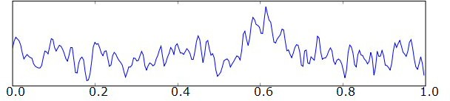
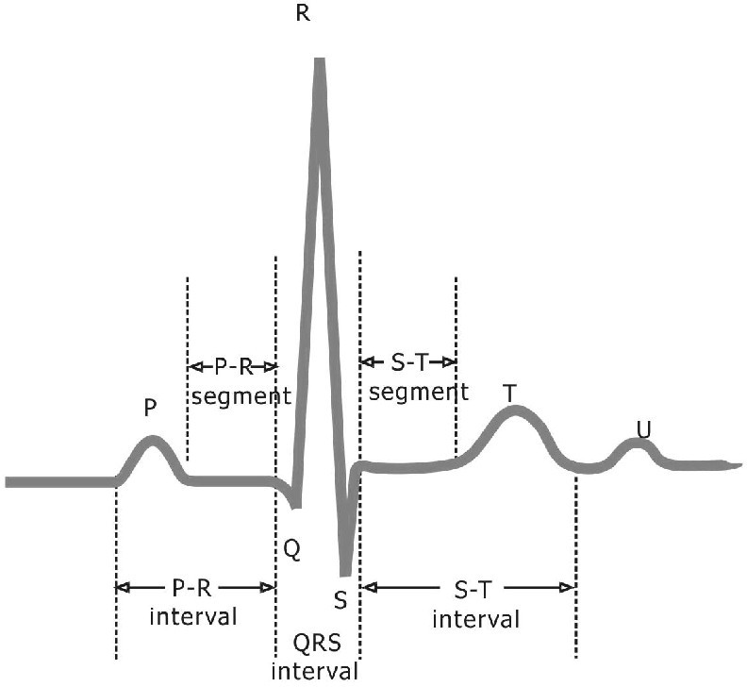
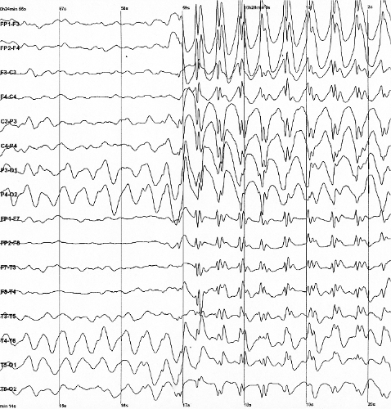
Example: 1D biological signals: ECG（示例：1D 生物信号：心电图）
amplitude
time

Slide 9
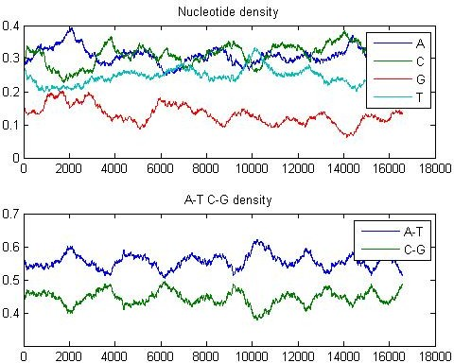
1D biological signals: DNA sequencing（1D 生物信号：DNA 测序）
GATCACAGGTCTATCACCCTATTAACCACTCACGGGAGCTCTCCATG……

Slide 10
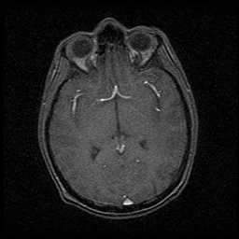
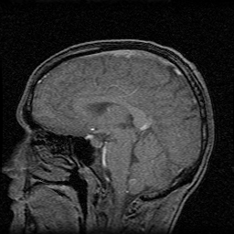
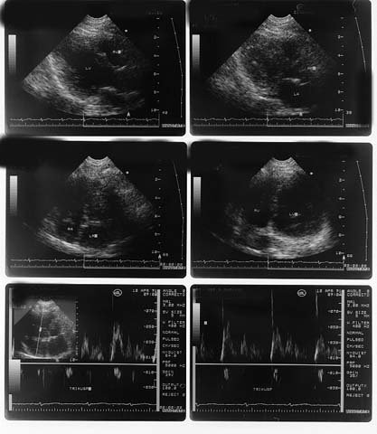
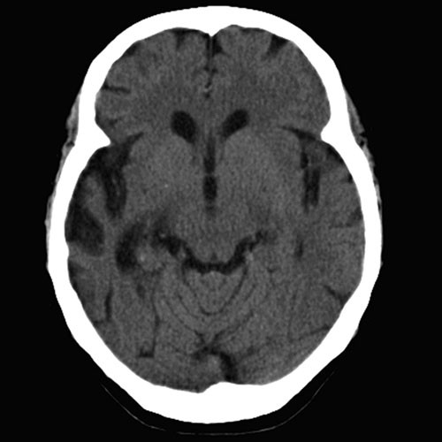
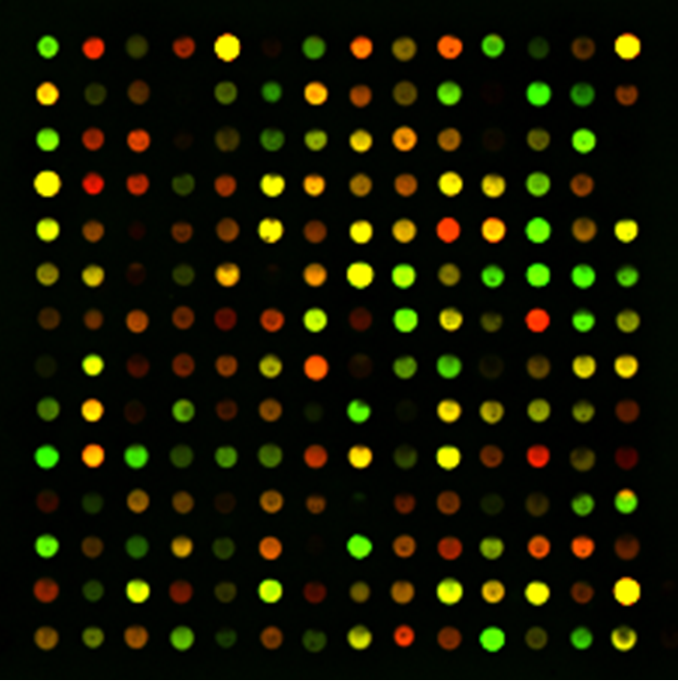
Example: 2D biological signals: MI
MRI
US
CT

Slide 11
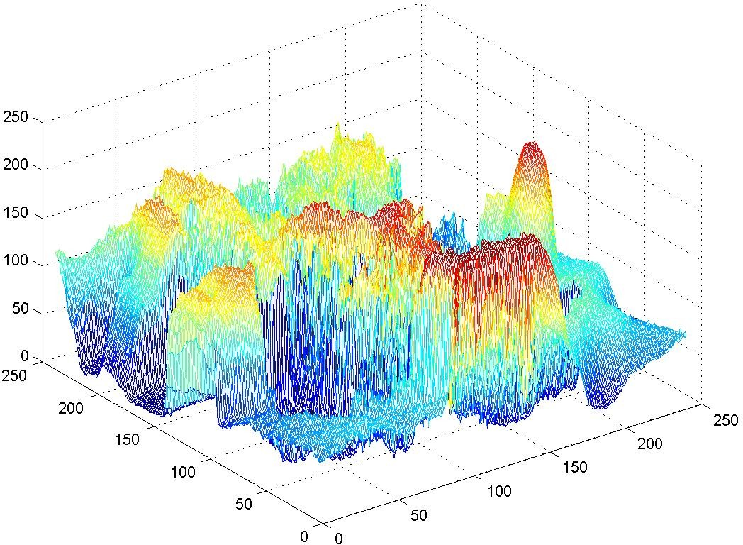
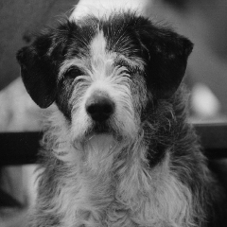
Example : Natural image

Slide 12
Signals as functions
Continuous functions of real independent variables（真正独立变量的连续功能）
– 1D: f=f(x)
2D: f=f(x,y) x,y
Real world signals (audio, ECG, images)
Real valued functions of discrete variables
（离散变量的实际价值函数）
– 1D: f=f[k]
– 2D: f=f[i,j]
Sampled signals
Discrete functions of discrete variables（离散变量的离散函数）
1D: f^{d}=f^{d}[k]
2D: f^{d}=f^{d}[i,j]
Sampled and quantized signals
Gray scale images: 2D functions（灰色刻度图像：2D 功能）
Domain of the functions: set of (x,y) values for which f(x,y) is defined : 2D lattice
[i,j] defining the pixel locations
Set of values taken by the function : gray levels
Digital images can be seen as functions defined over a discrete domain {i,j: 0<i<I, 0<j<J}数字图像可被视为在离散域定义的函数 [i，j： 0<i<I， 0<j<J]
I,J: number of rows (columns) of the matrix corresponding to the image
f=f[i,j]: gray level in position [i,j]

Slide 13
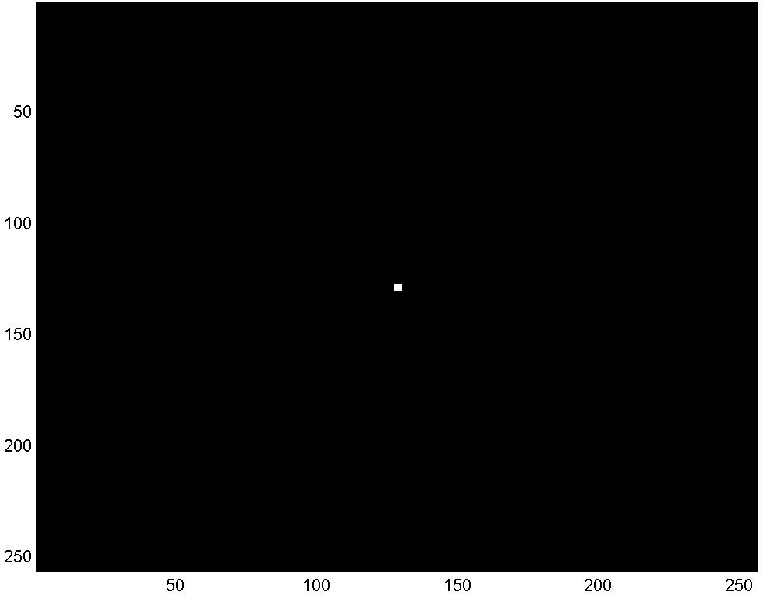

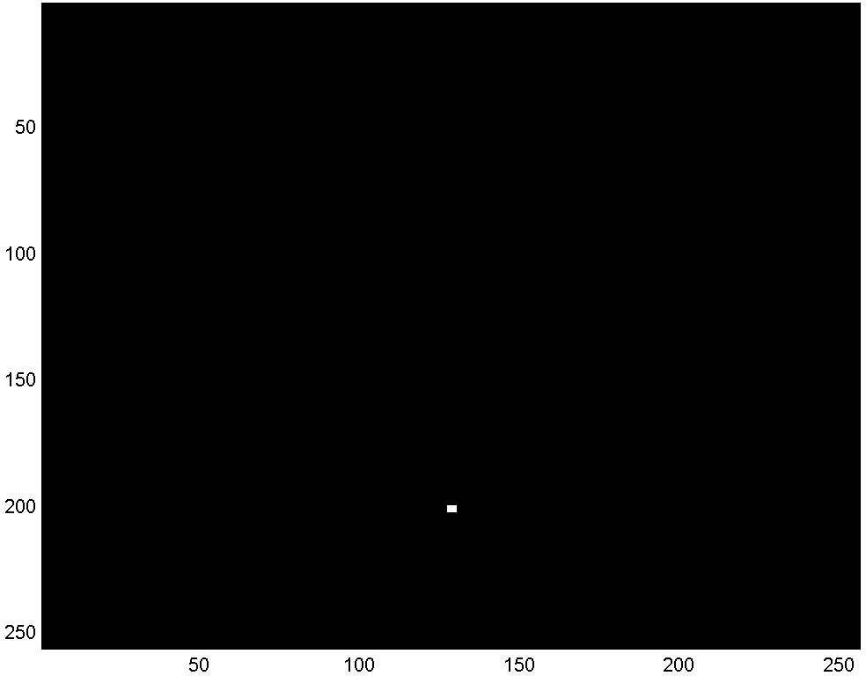
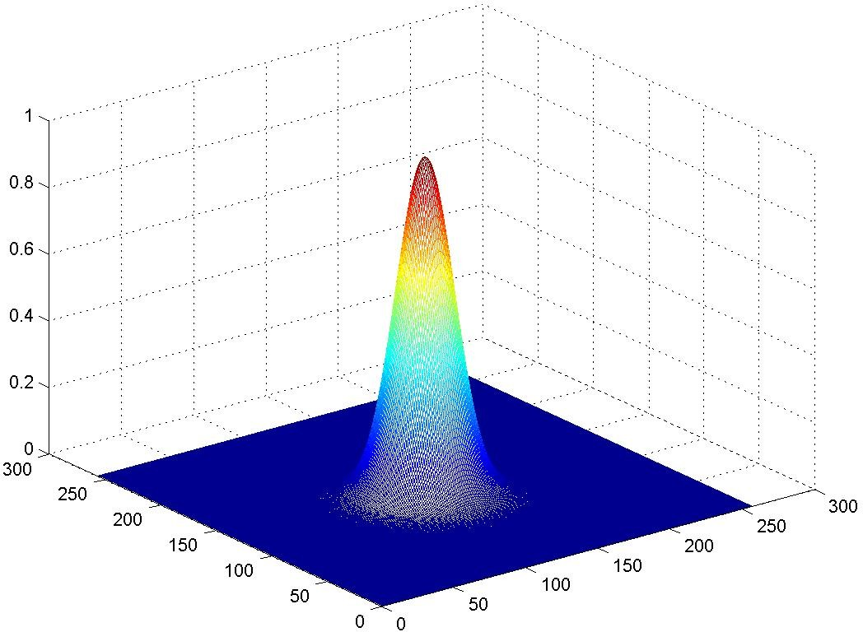
Example : function
i = j = 0
i, j ≠ 0;i ≠ j
Continuous function
δ [i, j]= ^{⎧1}
1
x² + y²
⎨₀
⎩
f (x, y) =
e
2σ ²
σ 2π
i = 0; j = J otherwise
Discrete version
δ [i, j − J ]= ^{⎧1}
⎨₀
⎩
1
i² + j ²
f [i, j] =
_{e} 2σ ²
σ 2π

Slide 14
Continuous & Discrete-Time Signals（连续和离散时间信号）
Continuous-Time Signals（连续时间信号）
Most signals in the real world are continuous time, as the scale is infinitesimally fine.（现实世界中的大多数信号都是连续时间，因为尺度是无限精细的）
E.g. voltage, velocity,
Denote by x(t), where the time interval may be bounded (finite) or infinite
Discrete-Time Signals
Some real world and many digital signals are discrete time, as they are sampled
E.g. pixels, daily stock price (anything that a digital computer processes)
Denote by x[n], where n is an integer value that varies discretely
Sampled continuous signal
x[n] =x(nk) – k is sample time
x(t)
t
x[n]
n

Slide 15
连续时间与离散时间信号
对连续时间信号x(t)， t可以是任意值（无限个数的值）；
对离散时间信号x[n]， n为有限个数的值；
x(t)
t
x[n]
n

Slide 16
连续时间与离散时间信号
对连续时间信号x(t)， t可以是任意值（无限个数的值）；
对离散时间信号x[n]， n为有限个数的值；
然而，连续与离散信号真的可以明确划分吗？
x(t)
t
x[n]
n

Slide 17
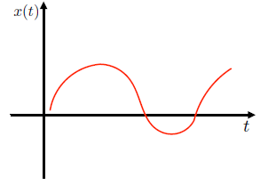
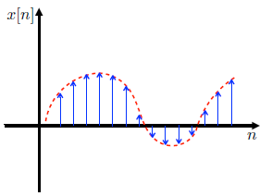
连续时间与离散时间信号
对以下连续时间信号x(t)，不断拉近
对以下离散时间信号x[n]，将n与n+1之间的间隔不断缩小
“连续”与“离散”存在主观性：连续信号是间隔无限接近于0的离散信号。
上述概念帮助理解不同信号类型的傅里叶变化及采样。

Slide 18
Continuous & Discrete-Time Signals
Time signals:
Continuous time signals (analog signals): for example, audio signals (FMsignals), AC voltages and currents（连续时间信号（模拟信号）：例如音频信号（FM信号）、交流电压和电流）
Discrete time signals (digital signals): for example, daily temperature（离散时间信号（数字信号）：例如，每日温度）
Note that continuous time signals and discrete time signals can be converted to each other.
请注意，连续时间信号和离散时间信号可以相互转换。

Slide 19
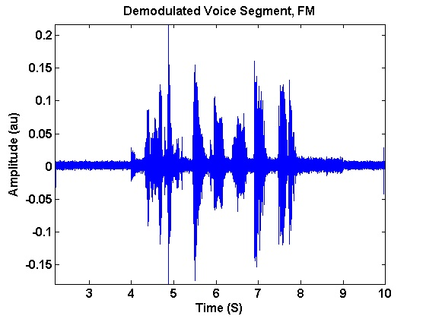
Continuous & Discrete-Time Signals
1D signal (e.g., voice, music): x(t) -> x[n]
2D signal (e.g., images): x(s₁,s₂) → x[n₁,n₂]
3D signal (e.g., videos: 2D spatial + 1D time): x(s₁,s₂,t) → x[n₁,n₂,n]

Slide 20
Signal Properties （信号属性）
On this course, we shall be particularly interested in signals with certain properties:
Periodic signals: a signal is periodic if it repeats itself after a fixed period T, i.e. x(t) = x(t+T) for all t. A sin(t) signal is periodic.
Even and odd signals: a signal is even if x(-t) = x(t) (i.e. it can be reflected in the axis at zero). A signal is odd if x(-t) = -x(t). Examples are cos(t) and sin(t) signals, respectively.
Exponential and sinusoidal signals: a signal is (real) exponential if it can be represented as x(t) = Ce^{at}. A signal is (complex) exponential if it can be represented in the same form but C and a are complex numbers.
Step and pulse signals: A pulse signal is one which is nearly completely zero, apart from a short spike, d(t). A step signal is zero up to a certain time, and then a constant value after that time, u(t).（阶跃和脉冲信号:脉冲信号是一个几乎完全为零的信号，除了一个短尖峰d(t)。 阶跃信号在某段时间内为零，在这段时间后为常数值u(t)。 ）
These properties define a large class of tractable, useful signals and will be further considered in the coming lectures
Notes:
Pulse signal: 冲激信号
Step signal：阶跃信号

Slide 21
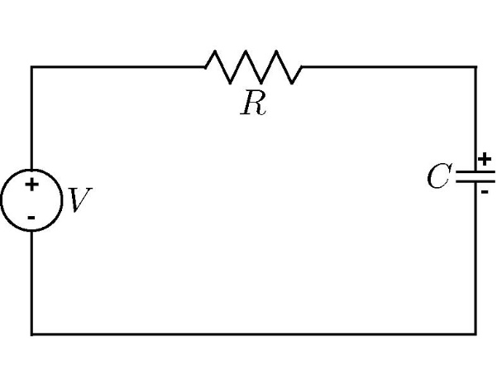
What is a System?
Systems process input signals to produce output signals（系统处理输入信号以产生输出信号）
Examples:
A circuit involving a capacitor can be viewed as a system that transforms the
source voltage (signal) to the voltage (signal) across the capacitor
A CD player takes the signal on the CD and transforms it into a signal sent to
the loud speaker
The function linking the output of the system with the input signal is called transfer function and it is typically indicated with the symbol h(•)
（将系统的输出与输入信号连接起来的功能称为转移函数，通常用符号h(•) 表示）
input
output
System
Circuit:
Notes:
Transfer function：传递函数

Slide 22
What is a System?
Communication Systems
A communication system is generally composed of three sub-systems, the transmitter, the channel and the receiver. The channel typically attenuates and adds noise to the transmitted signal which must be processed by the receiver（通信系统通常由三个子系统组成，即发射器、通道和接收器。 通道通常会减弱并增加信号的噪声，而传输信号必须由接收方处理）
s(t)
r(t)
Transmitter
Channel
Receiver
Message signal (information) data, text, audio, video
Transmitted signal
Received signal
Estimate of message signal (information)
noise, loss
distortion,
interference

Slide 23
How is a system Represented?
A system takes a signal as an input and transforms it into another signal
（系统以信号为输入，并将其转换为另一个信号）
In a very broad sense, a system can be represented as the ratio of the output signal over the input signal（从非常广义上讲，系统可以表示输出信号与输入信号的比例）
Input signal
x(t)
System
Output signal
y(t)
That way, when we “multiply” the system by the input signal, we get the output signal
This concept will be firmed up in the coming weeks

Slide 24
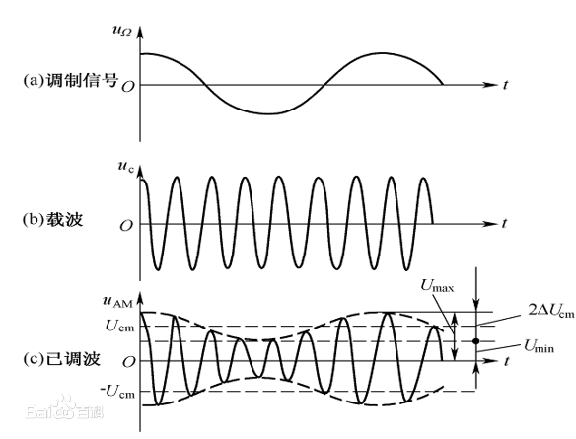
系统
Input signal
x(t)
System
Output signal
y(t)
系统往往是以一定比例（做乘法）放大、缩小输入信号
例如：幅度调制（Amplitude Modulation，AM）

Slide 25
Continuous & Discrete-Time Mathematical Models of Systems （系统连续和离散时间数学模型）
Continuous-Time Systems
Most continuous time systems represent how continuous signals are transformed via differential equations.（大多数连续时间系统表示连续信号如何通过微分方程进行转换。）
E.g. circuit, car velocity
Discrete-Time Systems
Most discrete time systems represent how discrete signals are transformed via difference equations（大多数离散时间系统表示如何通过差分方程转换离散信号）
E.g. bank account, discrete car velocity system
First order differential equations
First order difference equations

Slide 26
Properties of a System 系统的属性
On this course, we shall be particularly interested in signals with certain properties:
Causal: a system is causal if the output at a time, only depends on input values up to that time.
Linear: a system is linear if the output of the scaled sum of two input signals is the equivalent scaled sum of outputs
Time-invariance: a system is time invariant if the system’s output is the same, given the same input signal, regardless of time.
These properties define a large class of tractable, useful systems and will be further considered in the coming lectures
Notes:
Causal：具有因果性的

Slide 27
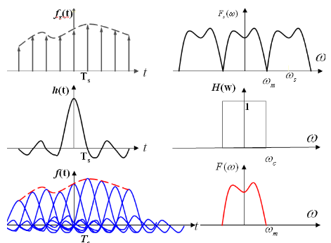
系统的因果性（Causality）
Causal: a system is causal if the output at a time, only depends on input values up to that time. （系统的输出只取决于现在的输入及过去的输入）
具有因果性的系统才是物理可实现的系统
因果性的意义：判断所设计的系统是否是可以被实现的
例：理想低通滤波器不具有因果性，是不可能被实现的

Slide 28
线性（Linear）系统
Linear: a system is linear if the output of the scaled sum of two input signals is the equivalent scaled sum of outputs （如果输入信号是两个信号的加权和，那么输出信号也是这两个输入信号对应输出的加权和）
例：如果系统对输入信号x(t)的输出是y(t)，则系统对输入信号ax₁(t)+bx₂(t)的输出为ay₁(t)+by₂(t)
线性系统对信号在频域表示下的处理具有重要意义。

Slide 29
时不变（Time-invariant）系统
Time-invariance: a system is time invariant if the system’s output is the same, given the same input signal, regardless of time. （系统特性不随时间发生变化）
例：如果系统对输入信号x(t)的输出是y(t)，则系统对输入信号x(t-t₀)的输出为y(t-t₀)
时不变系统对信号在频域表示下的处理具有重要意义。

Slide 30
Typical Examples of Signals/Systems Concerned（有关信号/系统的典型示例）
Computers
Signal Processing Systems信号处理系统
software systems processing the signal by computation/ memory
examples : audio enhancement systems, picture processing systems, video compression systems, voice recognition/ synthesis systems, array signal processors, equalizers, etc.
（软件系统通过计算/内存处理信号 示例：音频增强系统、图片处理系统、视频压缩系统、语音识别/合成系统、阵列信号处理器、均衡器等）

Slide 31
Typical Examples of Signals/Systems Concerned
Networks
user B
user A

Slide 32
Typical Examples of Signals/Systems Concerned
Information Retrieval Systems（信息检索系统）
Internet
Other Information Systems
examples : remote sensing systems, biomedical signal
processing systems, etc.
Internet
Search Engine
User

Slide 33
Internet
Internet
Digital
Libraries,
Virtual
Museums,
Electronic
Home,
Network
Entertainment
Google,
Facebook,
YouTube,
Amazon
Intelligent
Offices,
Distant
Learning,
Electronic
Commerce,
Network
Banking,
Electronic
Government
Services,
.
.
.
.
.
.
.
.
.
.
.
.
.
.
.
.
.
.

Slide 34
Internet
Network Technology Connects Everywhere Globally
Huge Volume of Information Disseminated across the Globe in Microseconds
Multi-media, Multi-lingual, Multi-functionality
Cross-cultures, Cross-domains, Cross-regions
Integrating All Knowledge Systems and Information related Activities Globally

Slide 35
Typical Examples of Signals/Systems Concerned
Control Systems
close-loop/feedback control systems（控制系统 闭环/反馈控制系统）
disturbance z(t)
error signal e(t)
control signal v(t)
input signal x(t)
controller
plant
output signal y(t)
feedback signal
sensor
example: aircraft landing systems, satellite stabilization systems, robot arm control systems, etc.

Slide 36
Typical Examples of Signals/Systems Concerned
Other Systems
manufacturing systems, computer-aided-design systems, mechanical systems, chemical process systems, etc.

Slide 37
信号处理与人工智能
例：实现一个简单的声音识别系统，对发声者的年龄、性别进行判断

Slide 38

信号处理与人工智能
例：实现一个简单的声音识别系统，对发声者的年龄、性别进行判断
以人工神经网络构建分类器：
每一层网络提取信号中的抽象特征

Slide 39
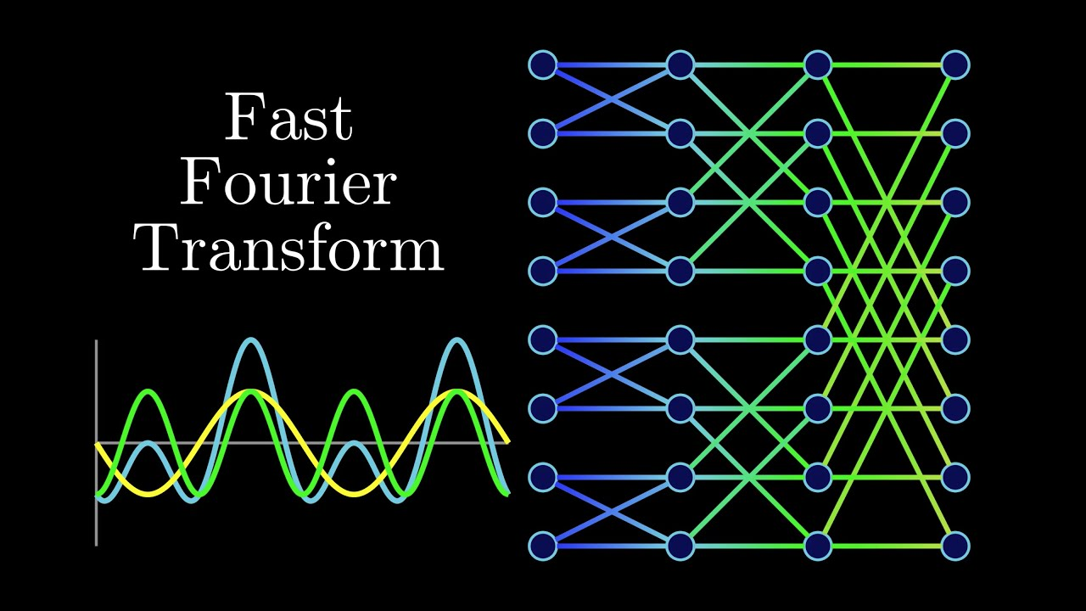
信号处理与人工智能
例：实现一个简单的声音识别系统，对发声者的年龄、性别进行判断
以人工神经网络构建分类器：
每一层网络提取信号中的抽象特征
以传统信号处理技术构建系统：
提取信号中频率特征

Slide 40
信号处理与人工智能
广义上来说，人工智能是抽象层面下的信号处理，以通过提取目前人类无法解释的特征来处理信号
信号处理：由因到果，演绎法
人工智能：由果到因，归纳法
信号处理与人工智能在未来的某一天是否会完全融合？
信号处理
人工智能

Slide 41
Outline: Lecture 1: Introduction
Preliminary
What are the signals
What are the systems
Application of signals and systems
Fundamental concepts
Signals and systems
Types of Signals

Slide 42
Classification of signals
Continuous time – Discrete time
Analog – Digital (numerical)（模拟与数字（数字））
Periodic – Aperiodic
Energy – Power
Deterministic – Random (probabilistic)
Note
Such classes are not disjoint, so there are digital signals that are periodic of power type and others that are aperiodic of power type etc.
Any combination of single features from the different classes is possible

Slide 43
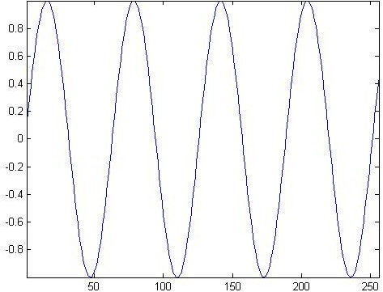
Continuous time – discrete time
Continuous time signal: a signal that is specified for every real value of the independent variable（连续时间信号：针对独立变量的每个实际值指定的信号）
The independent variable is continuous, that is it takes any value on the real axis（独立变量是连续的，即它在真正的轴上具有任何价值）
The domain of the function representing the signal has the cardinality of real numbers（信号的函数域具有真实数字的基数）
t ∈ ℝ
Signal ↔ f=f(t)
Independent variable ↔ time (t), position (x)
For continuous-time signals:
amplitude
time

Slide 44
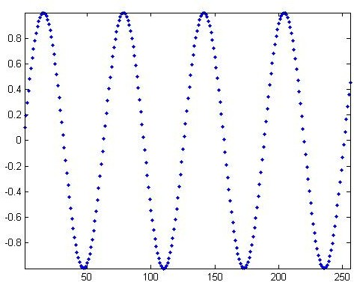
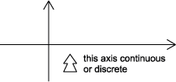
Continuous time – discrete time
Discrete time signal: a signal that is specified only for discrete values of the independent variable（离散时间信号：仅针对独立变量的离散值指定的信号）
It is usually generated by sampling so it will only have values at equally spaced
intervals along the time axis
The domain of the function representing the signal has the cardinality of integer numbers
Signal ↔ f=f[n], also called “sequence”
Independent variable ↔ n
For discrete-time functions: t ∈ Z
amplitude
time (discrete)

Slide 45
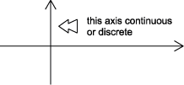
Analog - Digital
Analog signal: signal whose amplitude can take on any value in a continuous range
The amplitude of the function f(t) (or f(x)) has the cardinality of real numbers
The difference between analog and digital is similar to the difference between continuous-time and discrete-time. In this case, however, the difference is with respect to the value of the function (y-axis)
Analog corresponds to a continuous y-axis, while digital corresponds to a discrete y-axis
模拟信号：振幅可连续接收任何值的信号 函数 f（t） （或 f （x） 的振幅具有真实数字的基数
模拟和数字之间的差异类似于连续时间和离散时间之间的差异。但是，在这种情况下，功能（y 轴）值的差异是 模拟对应于连续的 y 轴，而数字对应于离散的 y 轴
Here we call digital what we have called quantized in the EI class
An analog signal can be both continuous time and discrete time

Slide 46
Analog - Digital
Digital signal: a signal is one whose amplitude can take on only a finite number of values (thus it is quantized)
The amplitude of the function f() can take only a finite number of values
A digital signal whose amplitude can take only M different values is said to be Mary
Binary signals are a special case for M=2
（数字信号：信号的振幅只能承担有限的值（因此它被量化） 函数 f （） 的振幅只能采取数量有限的值 一个振幅只能接受 M 不同值的数字信号据说是玛丽 二进制信号是 M+2 的特例）
amplitude
time

Slide 47
Example
– Continuous time analog（连续时间模拟）
Discrete time analog（离散时间模拟）
amplitude
amplitude
time
Continuous time digital (or quantized)（连续时间数字化（或量化））
binary sequence, where the values of the function can only be one or zero.
time
Discrete time digital（离散时间数字化）
binary sequence, where the values of the function can only be one or zero.
amplitude
amplitude
time
time

Slide 48
Summary
Signal amplitude/ Time or space 信号振幅/时间或空间 | Real | Integer
Real | Analog Continuous-time 模拟连续时间 | Digital Continuous-time 数字连续时间
Integer | Analog Discrete-time 模拟离散时间 | Digital Discrete time 数字离散时间

Slide 49
Periodic - Aperiodic
A signal f(t) is periodic if there exists a positive constant T₀ such that
如果存在正常数 T0，则信号 f（t） 是周期性的
f (t + T₀ ) = f (t) ∀t
The smallest value of T₀ which satisfies such relation is said the period of the function f(t)
A periodic signal remains unchanged when time-shifted of integer multiples of the period
Therefore, by definition, it starts at minus infinity and lasts forever
−∞ ≤ t ≤ +∞ t ∈ °
−∞ ≤ n ≤ +∞ n ∈ Z
Periodic signals can be generated by periodical extension
周期性信号可以通过周期性扩展生成

Slide 50
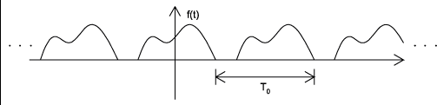
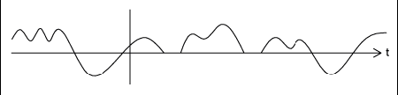
Examples
Periodic signal with period T₀
Aperiodic signal

Slide 51



Causal and non-Causal signals
Causal signals are signals that are zero for all negative time (or spatial positions), while
因果信号是所有负时间（或空间位置）为零的信号，而
Anticausal are signals that are zero for all positive time (or spatial positions).
反因果是指所有正时间(或空间位置)为零的信号。
Noncausal signals are signals that have nonzero values in both positive and negative time
非因果信号是在正时间和负时间中都有非零值的信号

Slide 52
Causal and non-causal signals
Causal signals
f (t) = 0 t < 0
Anticausals signals
f (t) = 0 t ≥ 0
Non-causal signals （非因果信号）
∃t₁ < 0:
f (t₁ ) = 0

Slide 53


Even and Odd signals
An even signal is any signal f such that f (t) = f (-t). Even signals can be easily spotted as they are symmetric around the vertical axis.
An odd signal, on the other hand, is a signal f such that f (t)= - (f (-t))

Slide 54
Decomposition in even and odd components
Any signal can be written as a combination of an even and an odd signals
– Even and odd components
任何信号都可以作为偶数和奇数信号的组合来书写
- 偶数和奇数部分
f (t ) = ¹ ( f (t ) + f (−t )) + ¹ ( f (t ) − f (−t ))
2
t + f −t even component
2
1
2
1
2
( )
( )
f t =
f
( ) ( )
e
_{o} ( )
( )
f t =
f
( ) ( )
t − f −t odd component
f (t ) = f_{e} (t ) + f_{o} (t )

Slide 55

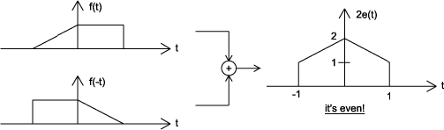
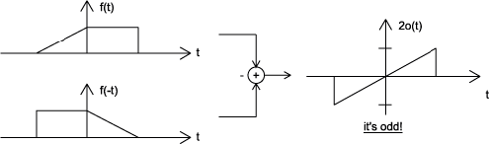
Example

Slide 56
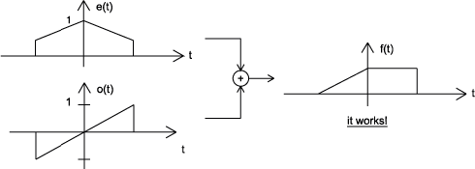
Example
Proof

Slide 57
Some properties of even and odd functions
even function x odd function = odd function
odd function x odd function = even function
even function x even function = even function
Area
a a
∫ f_{e} (t ) dt = 2∫ f_{e} (t )dt
− a 0
a
∫ f_{e} (t ) dt = 0
− a

Slide 58
Deterministic - Probabilistic
Deterministic signal: a signal whose physical description in known completely
A deterministic signal is a signal in which each value of the signal is fixed and can be determined by a mathematical expression, rule, or table.
确定性信号：完全已知物理描述的信号 确定性信号是一种信号，其中信号的每个值都是固定的，并且可以通过数学表达、规则或表来确定。
Because of this the future values of the signal can be calculated from past values with complete confidence.
There is no uncertainty about its amplitude values
Examples: signals defined through a mathematical function or graph
Probabilistic (or random) signals: the amplitude values cannot be predicted precisely but are known only in terms of probabilistic descriptors
The future values of a random signal cannot be accurately predicted and can usually only be guessed based on the averages of sets of signals
概率（或随机）信号：振幅值无法精确预测，但仅以概率描述符为已知 随机信号的未来值无法准确预测，通常只能根据信号集的平均值进行猜测
They are realization of a stochastic process for which a model could be available
Examples: EEG, evocated potentials, noise in CCD capture devices for digital cameras

Slide 59


Example
Deterministic signal（确定性信号）
amplitude
time
Random signal（随机信号）
amplitude
time

Slide 60
Finite and Infinite length signals
A finite length signal is non-zero over a finite set of values of the independent variable
在独立变量的有限值集上，有限长度信号为非零
f = f (t ), ∀t : t₁ ≤ t ≤ t₂ t₁ > −∞, t₂ < +∞
An infinite length signal is non zero over an infinite set of values of the independent variable 无限长度信号在独立变量的无限值集上为非零
– For instance, a sinusoid f(t)=sin(ωt) is an infinite length signal

Slide 61
Size of a signal: Norms
"Size" indicates largeness or strength.
We will use the mathematical concept of the norm to quantify this notion for both continuous-time and discrete-time signals.
The energy is represented by the area under the curve (of the squared signal)
"大小"表示大或强度。
我们将使用规范的数学概念来量化连续时间和离散时间信号的概念。
能量由曲线下方（方形信号）下的区域面积表示
amplitude
0
T
time

Slide 62
Energy
Signal energy
+∞
∫
−∞
+∞
∫
E =
f ² (t)dt
f
E =
f (t) ² dt
f
−∞
Generalized energy : L_{p} norm
– For p=2 we get the energy (L₂ norm)
( )
(
( )
p
)
1/ p
f t
=
∫
( )
f t
dt
1 ≤ p < +∞

Slide 63
Power
Power
– The power is the time average (mean) of the squared signal amplitude, that is the
mean-squared value of f(t)
功率是方形信号振幅的时间平均值（平均值），即 f（t） 的平均平方值
1
+T /2
P = lim
∫
f ² (t)dt
f
T →∞ _{T}
−T /2
+T /2
1
∫
2
P_{f} = lim _{T}
f (t) dt
T →∞
−T /2

Slide 64
Power - Energy
The square root of the power is the root mean square (rms) value
This is a very important quantity as it is the most widespread measure of similarity/dissimilarity among signals
It is the basis for the definition of the Signal to Noise Ratio (SNR)
⎛⎛
^{P}signal ⎞
SNR = 20log
10 ⎮
⎮
P
⎛ ⎠
noise
– It is such that a constant signal whose amplitude is =rms holds the same power content of the signal itself
There exists signals for which neither the energy nor the power are finite
f
ramp
0
t

Slide 65
Energy and Power signals
A signal with finite energy is an energy signal
Necessary condition for a signal to be of energy type is that the amplitude goes to zero as the independent variable tends to infinity
A signal with finite and different from zero power is a power signal
The mean of an entity averaged over an infinite interval exists if either the entity is periodic or it has some statistical regularity
A power signal has infinite energy and an energy signal has zero power
There exist signals that are neither power nor energy, such as the ramp
All practical signals have finite energy and thus are energy signals
It is impossible to generate a real power signal because this would have infinite duration and infinite energy, which is not doable.

Slide 66
Useful signal operations: shifting, scaling, inversion
Shifting: consider a signal f(t) and the same signal delayed/anticipated by T
移位：考虑由 T 延迟/预期的信号 f（t） 和相同的信号
seconds
f(t)
T>0
t
f(t+T)
anticipated
T
f(t-T)
t
delayed
T
t

Slide 67
Useful signal operations: shifting, scaling, inversion
(Time) Scaling: compression or expansion of a signal in time
(时间)缩放:信号在时间上的压缩或扩展
f(t)
f(2t)
t
ϕ (t ) = f (2t )
compression
f(t/2)
t
expansion ϕ (t ) = f (t / 2)
t

Slide 68
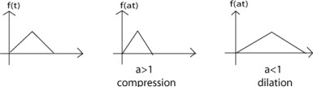
Useful signal operations: shifting, scaling, inversion
Scaling: generalization
a > 1
ϕ (t ) = f (at )
→ compressed version
ϕ (t ) = f ^{⎛⎛ t ⎞} → dilated (or expanded) version
⎮ _{a} ⎮
⎛ ⎠
Viceversa for a < 1

Slide 69
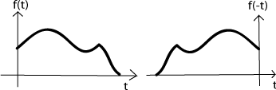
Useful signal operations: shifting, scaling, inversion
(Time) inversion: mirror image of f(t) about the vertical axis
(时间)反演:f(t)关于垂直轴的镜像
ϕ (t ) = f (−t )
f(t)
0
f(-t)
0

Slide 70
Useful signal operations: shifting, scaling, inversion 有用的信号操作：移位、缩放、反转
Combined operations: f(t) → f(at-b)
Two possible sequences of operations
Time shift f(t) by to obtain f(t-b). Now time scale the shifted signal f(t-b) by a to obtain f(at-b).
Time scale f(t) by a to obtain f(at). Now time shift f(at) by b/a to obtain f(at-b).
Note that you have to replace t by (t-b/a) to obtain f(at-b) from f(at) when replacing t by the translated argument (namely t-b/a))

Slide 71
Types in Signals

Slide 72
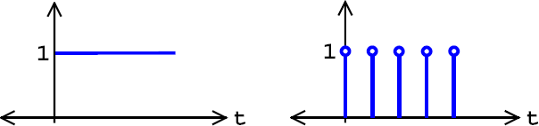
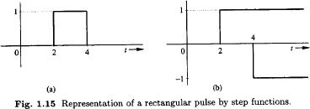
Useful functions
Unit step function（单位阶跃函数）
– Useful for representing causal signals（表示因果信号）
Continuous and discrete time unit step functions
连续和离散时间单位阶跃函数
t ≥ 0
t < 0
u(t)
u[k]
u (t ) = ^{⎧1}
⎨₀
⎩
f (t ) = u (t − 2) − u (t − 4)

Slide 73

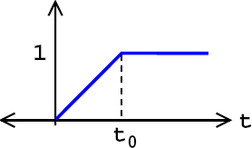
Useful functions
Ramp function (continuous time)
斜坡函数（连续时间）

Slide 74
Useful functions
Unit impulse function（单位冲激函数（面积为1））
δ (t ) = 0
t ≠ 0
+∞
∫ δ (t ) dt = 1
−∞
δ(t)
 |  | ε→0
1/ε
0
t
t
-ε/2
ε/2

Slide 75
Properties of the unit impulse function
Multiplication of a function by impulse（按脉冲乘法函数）
φ (t )δ (t ) = φ (0)δ (t )
φ (t )δ (t − T ) = φ (T )δ (t − T )
Sampling property of the unit function（单位函数的采样属性）
+∞ +∞
+∞
∫ φ (t )δ (t ) dt = ∫ φ (0)δ (t )dt = φ (0) ∫ δ (t )dt = φ (0)
−∞ −∞ −∞
+∞
∫ φ (t )δ (t − T ) dt = φ (T )
−∞
– The area under the curve obtained by the product of the unit impulse function shifted by T and ϕ(t) is the value of the function ϕ(t) for t=T

Slide 76
Properties of the unit impulse function
The unit step function is the integral of the unit impulse function
单位阶跃函数u（t）是单位冲激函数&(t)的组成部分
du
_{dt} = δ (t )
t
∫ δ (t )dt = u (t )
−∞
– Thus
t
⎧0 t < 0
t ≥ 0
∫ δ (t ) dt = u (t ) = ⎨₁
−∞
⎩

Slide 77

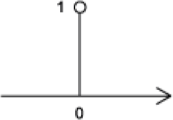
Properties of the unit impulse function
Discrete time impulse function
离散时间脉冲函数

Slide 78

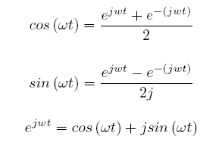

Useful functions
Continuous time complex exponential
连续时间复杂指数
f (t ) = Ae ^{jωt}
Euler’s relations
欧拉的关系
j^2=-1
Discrete time complex exponential
离散时间复杂指数
– k=nT

Slide 79
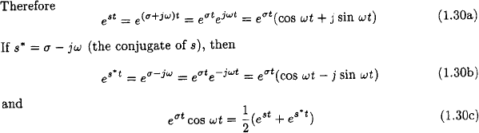
Useful functions
Exponential function e^{st} 指数函数 est –
功能概括
– Generalization of the function e^{jωt}
s = σ + jω

Slide 80
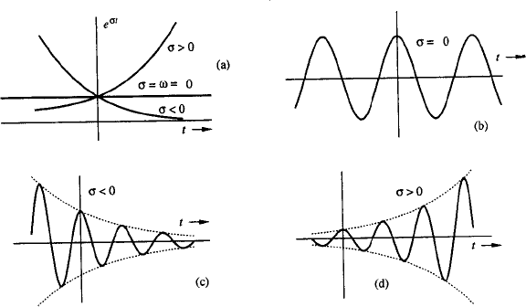
The exponential function
s=σ
s=jω
实部控制信号幅度
虚部控制信号振动频率
s=σ+jω
s=σ+jω

Slide 81
Complex frequency plan复杂频率计划
signals of constant amplitude
jω
left half plan exponentially decreasing signals
right half plan exponentially increasing signals
monotonically increasing/decreasing exponentials
σ

Slide 82
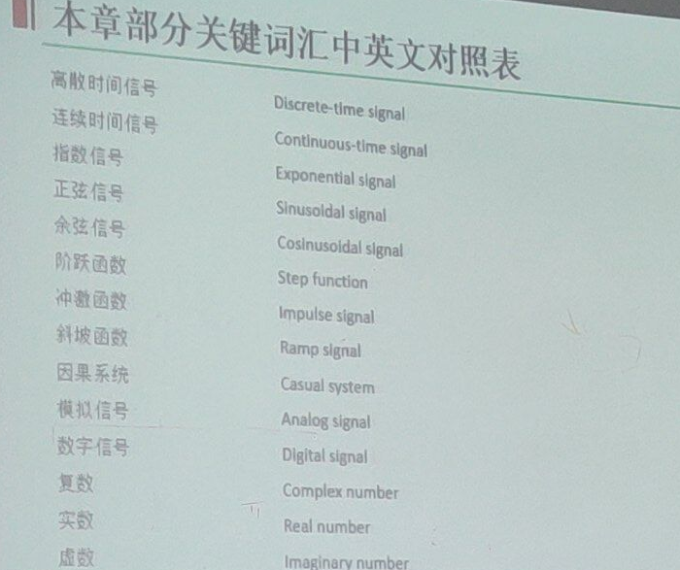
Complex frequency plan

Slide 83
Thank you for your listening!

