Slide 1

Lecture 2 Complex Numbers & Signal Property

Slide 2



Complex Numbers – the basics 复杂数字 - 基础知识
The notes cover the basic definitions and properties of complex numbers (Boas 2.1-2.5). The story starts from finding solutions for the simple algebraic equation . There is no real solution to the equation. But, if we introduce the notion of imaginary numbers,
one can write down the solutions . Going beyond the pure imaginary numbers, one can introduce the complex number with real and imaginary parts,
where and are real numbers, representing the real and imaginary parts respectively.
$$j≡\sqrt{−1}, \text{with} j^{2}=−1$$
$$x=±j$$
$$z=x+jy$$

Slide 3


Complex land looks different
For complex numbers, an amazing identity arises
It is quite remarkable that two irrational numbers and can be related by the magic number !
$$e^{jπ}=−1$$
$$j$$

Slide 4
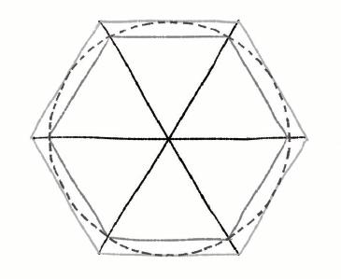
圆周率π与自然对数e
圆周率π：表示圆直径与周长之间的比例，对直径为1的圆，周长为π
圆周率的确定：对直径为1的圆，画出与其内接与外切的多边形，当边数趋于无穷大，内接与外切多边形周长趋于相等，周长为π

Slide 5
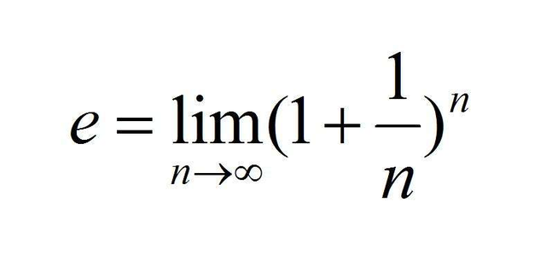

圆周率π与自然对数e
圆周率π：表示圆直径与周长之间的比例，对直径为1的圆，周长为π
圆周率的确定：对直径为1的圆，画出与其内接与外切的多边形，当边数趋于无穷大，内接与外切多边形周长趋于相等，周长为π
自然对数e：
圆周率与自然对数反映了在恒定自然规律约束下，最终收敛。
$$e^{jπ}=−1$$

Slide 6


Complex plane
It is convenient to plot in the two-dimensional complex plane, using the real part and the imaginary part as Cartesian coordinates. Clearly, one can also write the same complex number in polar form,
Here is the absolute value of (distance to the origin) and is the corresponding angle. Complex conjugate is defined as mirror mapping to the , i.e.
Since we can plot a complex number in the two dimensional plane, a natural question pops out: Is a complex number a two-dimensional vector?
$$z=x+jy$$
$$z=x+jy=r\cos{θ}+jr\sin{θ}$$
$$\bar{z}=x−jy=r(\cos{θ}−j\sin{θ})=r[\cos{(}−θ)+j\sin{(}−θ)]$$

Slide 7
Complex Numbers – the basics
Compute the following product
You can convince yourself that the real part is just the inner product and the imaginary part is the outer product for two-dimensional vectors.
$${\bar{z}}_{1}z_{2}=\left(x_{1}−jy_{1}\right)\left(x_{2}+jy_{2}\right)=\left(x_{1}x_{2}+y_{1}y_{2}\right)+j\left(x_{1}y_{2}−x_{2}y_{1}\right)$$

Slide 8


Taylor expansions
Now I would like to establish an important identity现在我想建立一个重要的身份
The easiest way to prove the above identity is through Taylor expansions,
Choose the variable in the Taylor expansion for the exponential function and one can check that it equals the sum of the Taylor series for the sinusoidal functions.选择泰勒扩展中的变量作为指数函数，可以检查它是否等于泰勒系列的正弦函数的总和
$$e^{jθ}=\cos{θ}+j\sin{θ}$$
$$x=jθ$$

Slide 9
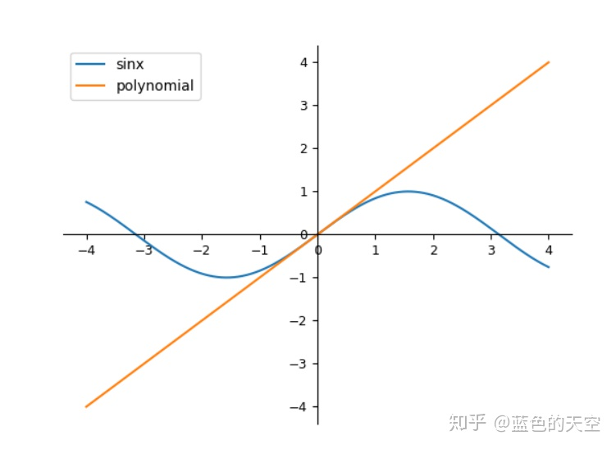
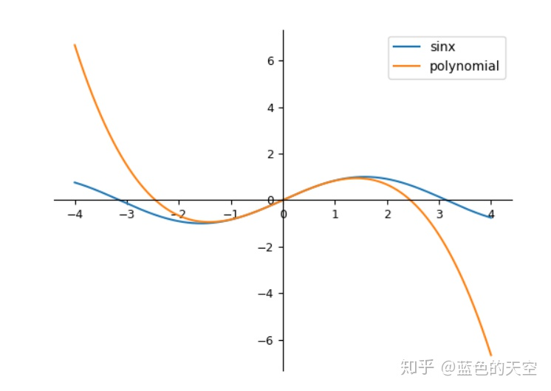
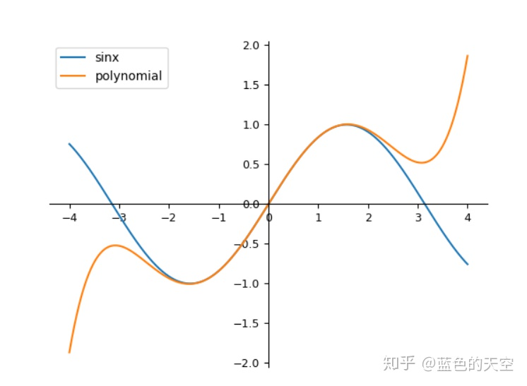
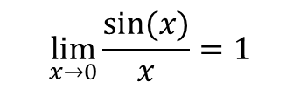
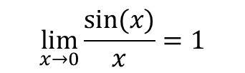


泰勒展开式
泰勒展开：很多复杂的函数可以用多项式的形式表达
对 f(x)=sin(x):
$$\lim_{x→0}{\frac{sin⁡(x)}{x}}=1$$
$$\lim_{x→0}{\frac{sin⁡(x)}{x}}=1$$
$$x−\frac{x^{3}}{3!}$$
$$x−\frac{x^{3}}{3!}+\frac{x^{5}}{5!}$$

Slide 10



Complex equations（复杂方程）
Since a complex number contain real and imaginary parts, a complex equation amount to two real equations. For instance, can be decomposed into two equations,由于复杂数字包含实部虚部的部分，复杂的方程相当于两个真实方程。例如，可以分解为两个方程，
Note that both and are real. Thus, two solutions and are found for the complex equation .
$$z^{2}=2j$$
$$x^{2}− y^{2}=0 \\ 2xy=2$$
$$z^{2}=2j$$

Slide 11

DeMoivre’s theorem （棣莫弗定理）
In the previous lecture, we introduce Euler’s formula（欧拉公式）, . Using the rule of multiplication, the DeMoivre’s theorem can be derived,
This theorem is quite useful for deriving trigonometric identities. For instance, choose in the DeMoivre’s theorem and compare the real parts on both sides,
$$e^{iθ}=\cos{θ}+j\sin{θ}$$
$$e^{inθ}=\cos{(}nθ)+i\sin{(}nθ)=(\cos{θ}+j\sin{θ})^{n}$$

Slide 12
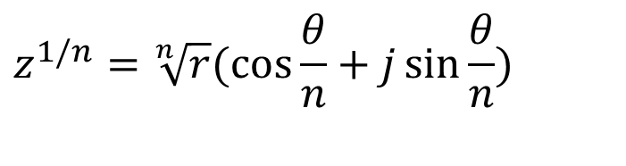
DeMoivre’s theorem（棣莫弗定理）
The theorem also provides a natural way to compute roots of complex numbers,定理还提供了计算复杂数字根源的自然方法，
However, subtleties arise for complex roots – there are more than one possible values. Therefore, when computing the root of a complex numbers, there are possible values.
$$z^{1/n}=\sqrt[n]{r}(\cos{\frac{θ}{n}}+j\sin{\frac{θ}{n}})$$

Slide 13
Signal Property（信号属性）

Slide 14
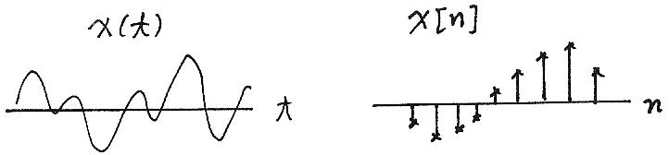
Fundamental Concepts （Signals）
Continuous/Discrete-time Signals
x(t), x[n]
Signal Energy/Power
x(t)
x[n]
t
n

Slide 15
“Electrical” Signal Energy & Power"电气"信号能量与功率
It is often useful to characterise signals by measures such as energy and power
For example, the instantaneous power of a resistor is:
and the total energy expanded over the interval [t₁, t₂] is:
and the average energy is:
How are these concepts defined for any continuous or discrete time signal?

Slide 16
Generic Signal Energy and Power通用信号能量和功率
Total energy of a continuous signal x(t) over [t₁, t₂] is:
where |.| denote the magnitude of the (complex) number.
Similarly for a discrete time signal x[n] over [n₁, n₂]:其中|.|表示（复杂）数字的大小。 同样，对于在 [n1， n2] 上离散时间信号 x [n]：
By dividing the quantities by (t₂-t₁) and (n₂-n₁+1), respectively, gives the average power, P
通过将数量除以 （t2-t1） 和 （n2-n1+1），分别提供平均功率 P
Note that these are similar to the electrical analogies (voltage), but they are different, both value and dimension.

Slide 17
Energy and Power over Infinite Time（无限时间）
For many signals, we’re interested in examining the power and energy over an infinite time interval (-∞, ∞). These quantities are therefore defined by:
If the sums or integrals do not converge, the energy of such a signal is infinite
如果总和或积分不收敛，则此信号的能量是无限的
Two important (sub)classes of signals
Finite total energy (and therefore zero average power)有限的总能量（因此平均功率为零）
Finite average power (and therefore infinite total energy)有限的平均功率（因此无限总能量）
Signal analysis over infinite time, all depends on the “tails” (limiting behaviour)

Slide 18
Transformation of A Signal
Time Shift
Time Reversal时间倒转
Time Scaling时间缩放
Combination
时间转换

Slide 19
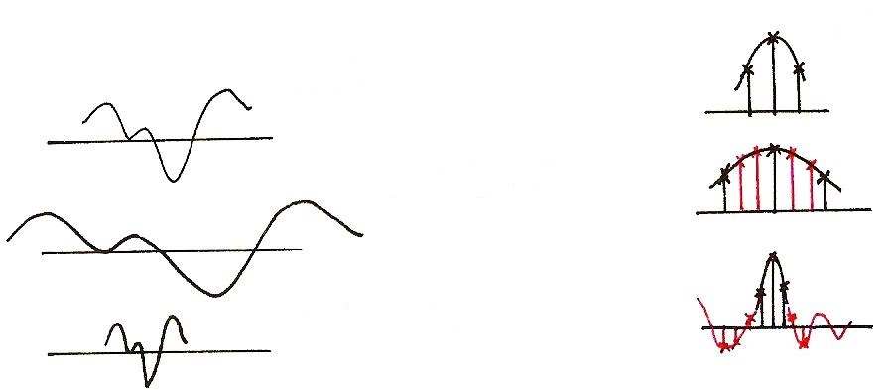
Time Scaling（时间缩放）
x[n]
x(t)
?
x(at), a<1
?
x(at), a>1

Slide 20
Periodic Signal（周期信号）
T₀ : Fundamental period : the smallest positive value of T
aperiodic : NOT periodic非周期的:非周期的

Slide 21
Even/Odd Signals
Even
Odd
Any signal can be discomposed into a sum of an
even and an odd
任何信号都可以分解成一个总和 偶函数和奇函数

Slide 22
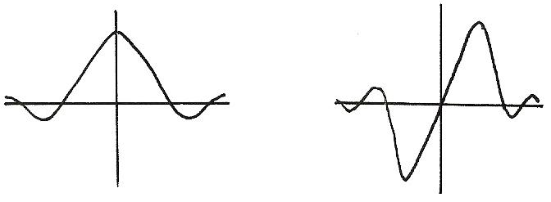
Even/Odd
Even
Odd
x(-t)=x(t)
x(-t)=-x(t)

Slide 23
Exponential/Sinusoidal Signals
Basic Building Blocks from which one can construct many different signals and define frameworks for analyzing many different signals efficiently
基础构建基块，从中可以构建许多不同的信号并定义有效分析许多不同信号的框架 基本构建块，从中可以构建许多不同的信号，并定义框架，以有效地分析许多不同的信号
fundamental period
fundamental frequency

Slide 24
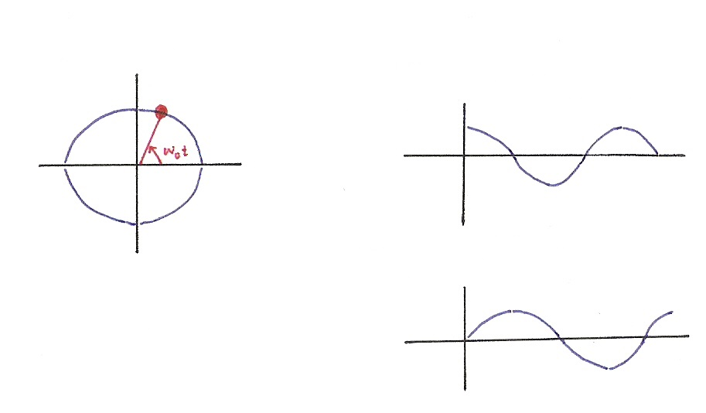






Exponential/Sinusoidal Signals
$$x\left(t\right)=e^{jω_{0}t}$$
$$Re\left\{e^{jω_{0}t}\right\}=\cos{ω_{0}t}$$
$$Im$$
$$Re$$
$$Im\left\{e^{jω_{0}t}\right\}=\sin{ω_{0}t}$$
$$e^{jx}=\cos{x}+j sin{x}$$

Slide 25

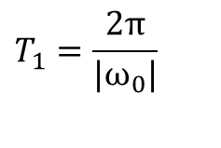

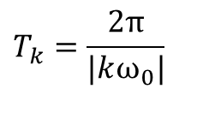
Exponential/Sinusoidal Signals 指数/正弦信号
Harmonically related signal sets（谐波）
fundamental period
$$T_{1}=\frac{2π}{|ω_{0}|}$$
Harmonical period
$$T_{k}=\frac{2π}{|kω_{0}|}$$
fundamental frequency
（基本频率）
$$|ω_{0}|$$
Harmonical frequency
（和谐频率）
$$|kω_{0}|$$

Slide 26
Exponential/Sinusoidal Signals
Sinusoidal signal
General format（一般格式）
Discrete-Time

Slide 27
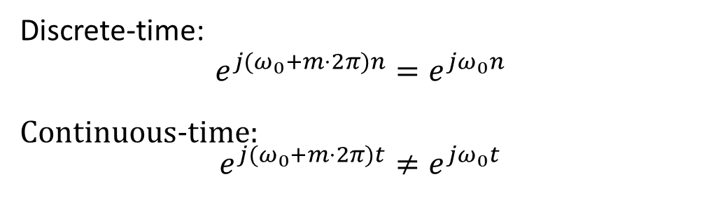
Exponential/Sinusoidal Signals
Important Differences Between Continuous-time and Discrete-time Exponential/Sinusoidal Signals连续时间和离散时间指数/正弦信号之间的重要差异
重要！
For discrete-time, signals with frequencies ω₀ and
ω₀ +m．2π are identical（相同）, where m is an integer（整数）. This is not true for continuous-time（连续） signal.（连续时间不是这样）
Discrete-time:
$$e^{j(ω_{0}+m⋅2π)n}=e^{jω_{0}n}$$
Continuous-time: $$e^{j(ω_{0}+m⋅2π)t}≠e^{jω_{0}t}$$

Slide 28
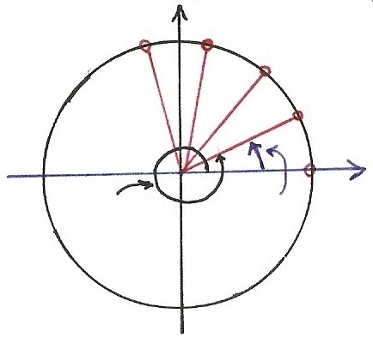










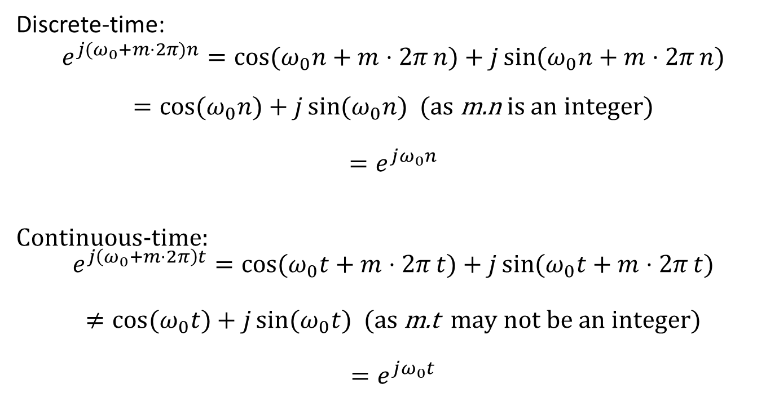
Continuous/Discrete Sinusoidals 连续/离散正弦
重要！
Discrete-time:
$$e^{j(ω_{0}+m⋅2π)n}=\cos{(ω_{0}n+m⋅2π}n)+j\sin{(ω_{0}n+m⋅2π}n)$$
$=\cos{(ω_{0}n})+j\sin{(ω_{0}n})$ (as m.n is an integer)
$$=e^{jω_{0}n}$$
Continuous-time: $$e^{j\left(ω_{0}+m⋅2π\right)t}=\cos{(ω_{0}t+m⋅2π}t)+j\sin{(ω_{0}t+m⋅2π}t)$$
$$≠\cos{(ω_{0}t})+j\sin{(ω_{0}t}) \text{(}\text{as} \text{m}\text{.}\text{t} \text{may} \text{not} \text{be} \text{an} \text{integer}\text{)}$$
$$=e^{jω_{0}t}$$
$$Im$$
$$n=4$$
$$n=3$$
$$n=2$$
$$e^{j[⋅]}$$
$$n=1$$
$$Re$$
$$ω_{0}t$$
$$n=0$$
$${(ω}_{0}+2π)t$$

Slide 29
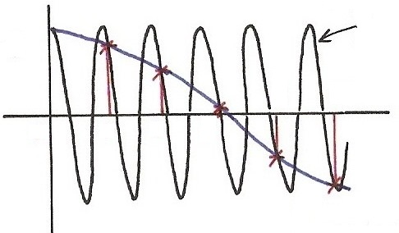
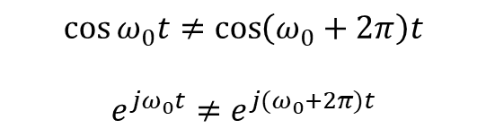




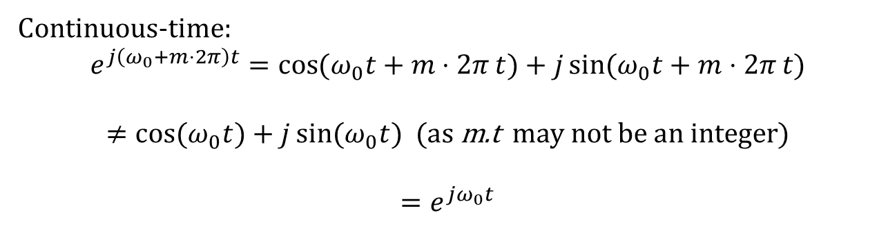
Continuous/Discrete Sinusoidals
Continuous-time: $$e^{j\left(ω_{0}+m⋅2π\right)t}=\cos{(ω_{0}t+m⋅2π}t)+j\sin{(ω_{0}t+m⋅2π}t)$$
$$≠\cos{(ω_{0}t})+j\sin{(ω_{0}t}) \text{(}\text{as} \text{m}\text{.}\text{t} \text{may} \text{not} \text{be} \text{an} \text{integer}\text{)}$$
$$=e^{jω_{0}t}$$
$$\cos{[\left(ω_{0}+2π\right)t]}$$
$$\cos{[⋅]}$$
$$\cos{ω_{0}t}≠\cos\left(ω_{0}+2π\right)t$$
$$e^{jω_{0}t}≠e^{j{(ω}_{0}+2π)t}$$
4
5
$$t$$
0
1
2
3
$$\cos{[ω_{0}t]}$$

Slide 30
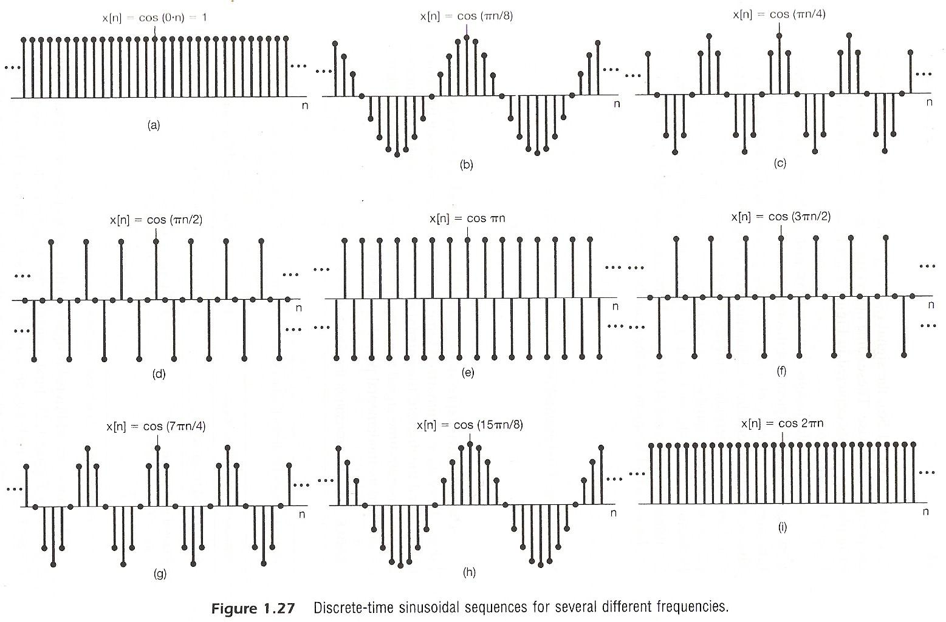

Continuous/Discrete Sinusoidals
Discrete-time:
$$e^{j(ω_{0}+m⋅2π)n}=e^{jω_{0}n}$$

Slide 31
Exponential/Sinusoidal Signals 指数/正弦信号
Important Differences Between Continuous-time and Discrete-time Exponential/Sinusoidal Signals 连续时间和离散时间指数/正弦信号的重要区别
For discrete-time, ω₀ is usually defined only for [-π, π] or [0, 2π]. For continuous-time, ω₀ is defined for (-∞, ∞)
For discrete-time, the signal is periodic（周期的） only when
ω₀N=2πm,

Slide 32
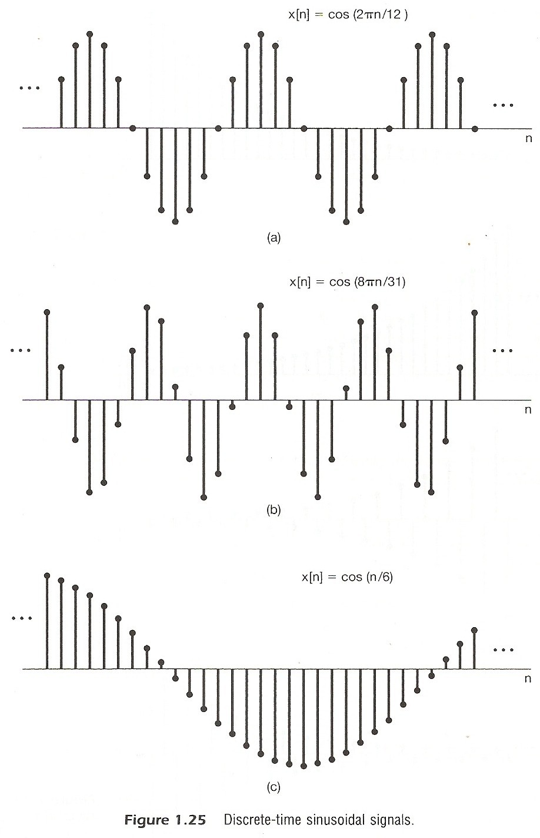
Exponential/Sinusoidal Signals

Slide 33
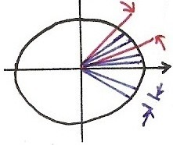
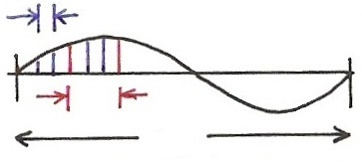









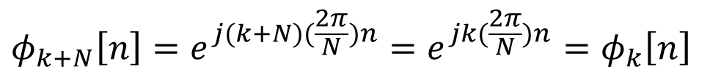
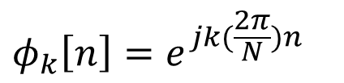

Harmonically Related Signal Sets 谐波相关信号集
For being periodic
real period in cycles周期中的实际周期
$$=$$
$$ω_{k}⋅N=2π⋅k$$
$$ω_{k}=k(\frac{2π}{N})$$
$$=$$
real period in n
$$Im$$
$$\frac{2π}{N}$$
$$k\left(\frac{2π}{N}\right), k=3$$
$$Re$$
$$2π$$
divided in N
$$\frac{2π}{N}$$
$$φ_{k}\left[n\right]=e^{jk(\frac{2π}{N})n}$$
$$φ_{k+N}\left[n\right]=e^{j(k+N)(\frac{2π}{N})n}=e^{jk(\frac{2π}{N})n}=φ_{k}\left[n\right]$$

Slide 34
Exponential/Sinusoidal Signals
Harmonically related discrete-time signal sets
谐波相关离散时间信号集
all with common period N
This is different from continuous case. Only N distinct signals in this set. 这不同于连续案例。此集中只有 N 个不同的信号。

Slide 35
Fundamental Concepts (Systems)
Continuous/Discrete-time Systems 连续/离散时间系统
Interconnections of Systems 系统互连
x(t)
y(t)
x[n]
y[n]
Series
Parallel（平行）
+

Slide 36
Fundamental Concepts (Systems)
Interconnections of Systems
Feedback 反馈
Combinations 组合
+

Slide 37
Fundamental Concepts (Systems)
Stability 稳定性
stable : bounded inputs lead to bounded outputs
有界输入导致有界输出
Time Invariance 时间不一致
time invariant : behavior and characteristic of the system are fixed over time

Slide 38
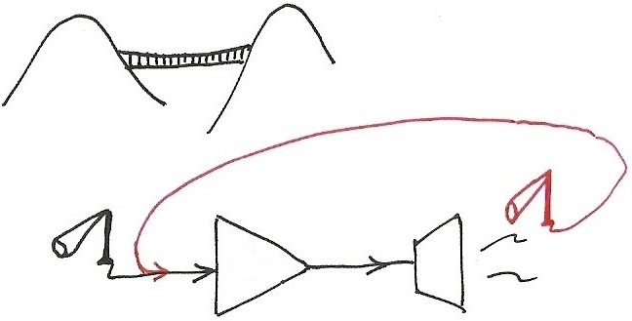
Stability
Examples of unstable systems
Amp

Slide 39
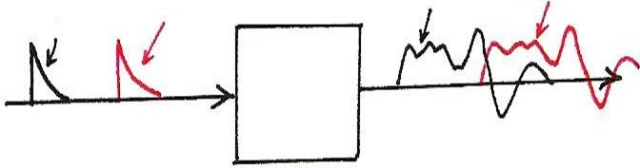
Time Invariance
x(t-T₀)
y(t)
y(t-T₀)
x(t)

Slide 40
Stability （稳定性）
Linearity 线性
linear : superposition property
线性 ： 叠加属性
scaling or homogeneity property
缩放或均匀属性
additive property
加和性

Slide 41
Stability
Memoryless/With Memory
Memoryless : output at a given time depends only on the input at the same time无记忆：给定时间的输出仅取决于同时的输入
eg.
With Memory
eg.

Slide 42
Stability
Invertibility 可逆
invertible : distinct inputs lead to distinct outputs, i.e. an inverse system exits 不可逆：不同的输入导致不同的输出，即反向系统退出
eg.
Causality 因果律
causal : output at any time depends on input at the same time and in the past因果关系：任何时候的输出都取决于同时和过去的投入
eg.

Slide 43
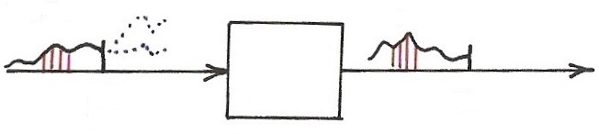
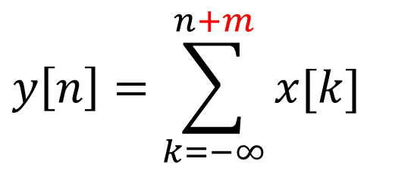




Causality
$$x[n]$$
$$y[n]$$
$$n$$
$$n$$
$$y\left[n\right]=\sum_{k=−∞}^{n+m}{x[k]}$$

Slide 44
Thank you for your listening!

