Slide 1

Lecture 3
Convolution and Linear Time-invariant Systems
School of Computer Engineering and Science
Shanghai University
Instructor: Jianjia Wang, Shengyu Duan

Slide 2
2.1 Discrete-time Systems: the Convolution Sum
2.2 Continuous-time System : the Convolution Integral
2.3 Linear Time-invariant Systems
content

Slide 3
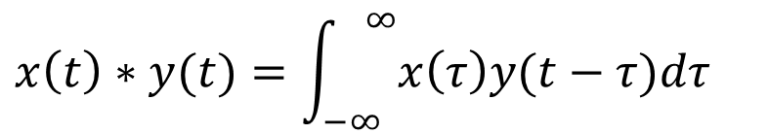
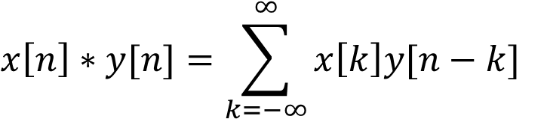
Convolution
For discrete signal, convolution sum:
$$x\left[n\right]∗y[n]=\sum_{k=−∞}^{∞}{x\left[k\right]y[n−k]}$$
For continuous signal, convolution integral:
对于连续信号，汇合积分：
$$x\left(t\right)∗y(t)=\int_{−∞}^{ ∞}{x\left(τ\right)y(t−τ)dτ}$$

Slide 4
2.1 Discrete-time Systems: the Convolution Sum
Representing an arbitrary signal as a sequence of unit impulses将任意信号表示为单位脉冲序列
an unit impulse located at n = k on the index n
位于索引 n = k 上的单位脉冲
See Fig. 2.1, p.76 of text
a special case

Slide 5
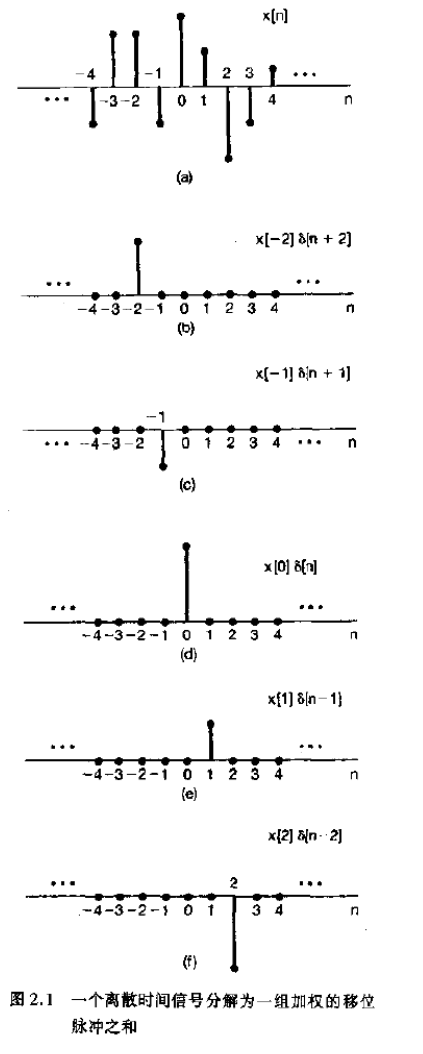

Slide 6
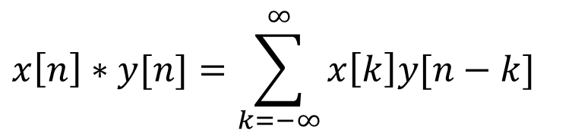
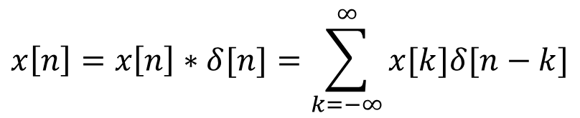
2.1 Discrete-time Systems: the Convolution Sum
For discrete signal, convolution sum:
$$x\left[n\right]∗y[n]=\sum_{k=−∞}^{∞}{x\left[k\right]y[n−k]}$$
Convolution sum can be used to represent an arbitrary signal as a sequence of unit impulses
$$x\left[n\right]=x\left[n\right]∗δ[n]=\sum_{k=−∞}^{∞}{x[k]δ[n−k]}$$

Slide 7
A Different Way to visualize the convolution sum
可视化汇总和的不同方式
looked at on the index k
on the dummy index k, h[k] is reflected over and shifted to k=n, weighted by x[k] and summed to produce an output sample y[n] at time n
See Figs 2.5, 2.6, 2.7, pp. 83-85 of text
input signal
Contribution to the output signal at time n
reflected-over version of h[k] located at k = n

Slide 8
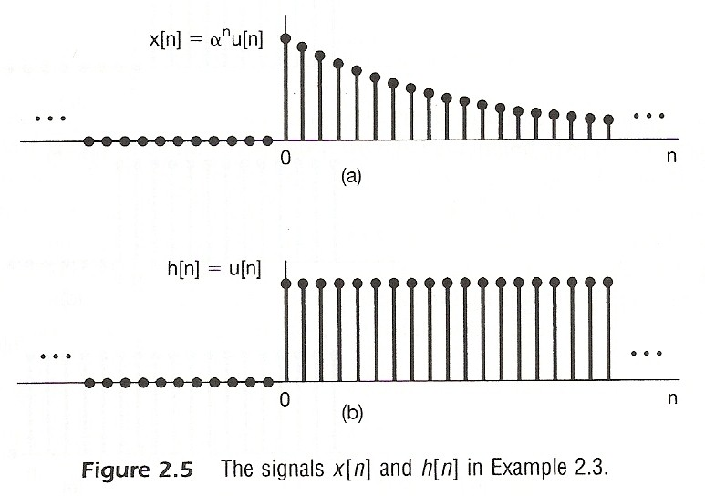

Slide 9
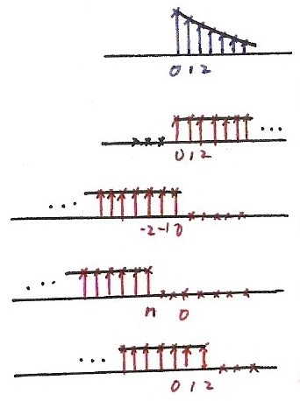










$$x[k]$$
$$k$$
Fig. 2.6
$$h[k]$$
$$k$$
$$h\left[−k\right], n=0$$
$$k$$
$$h\left[n−k\right], n<0$$
$$k$$
$$h\left[n−k\right], n=2>0$$
$$k$$

Slide 10
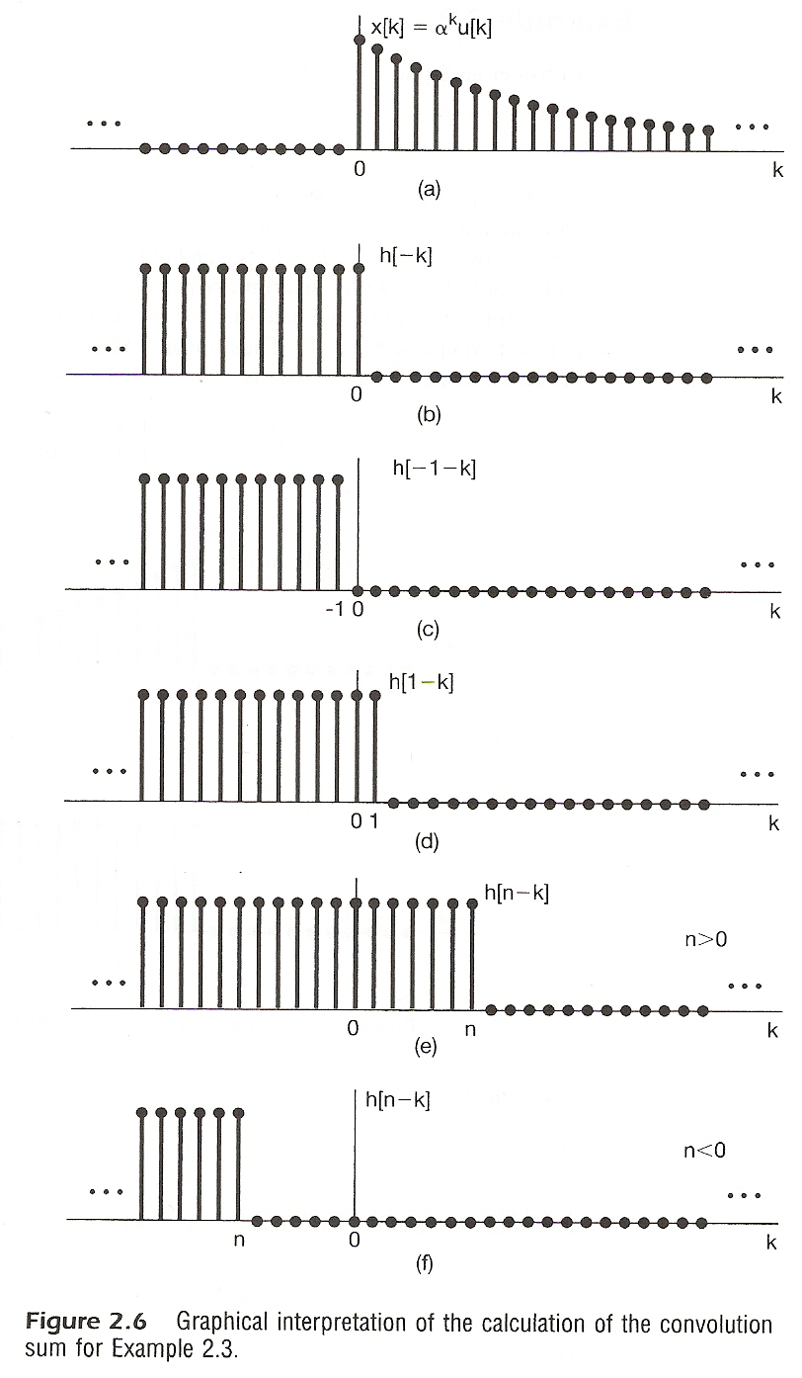

Slide 11
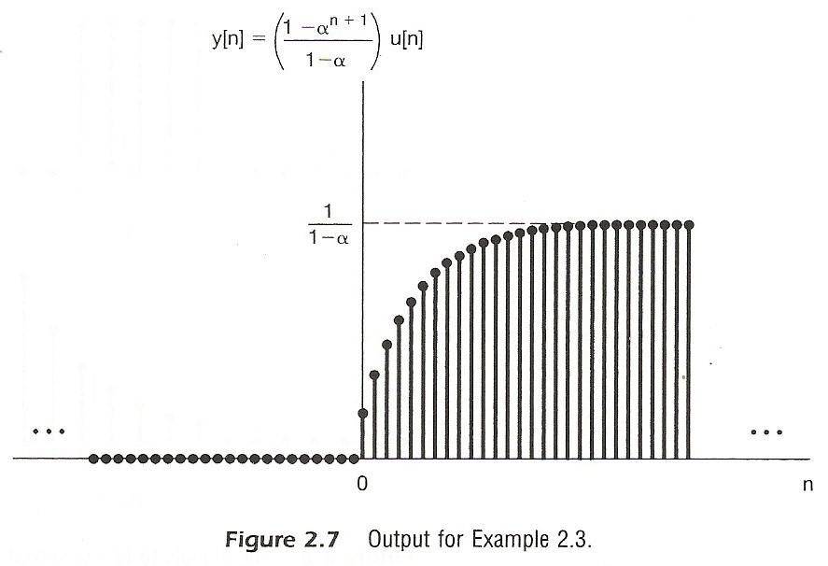

Slide 12
2.2 Continuous-time System : the Convolution Integral连续时间系统：汇合集合
Representing an arbitrary signal as an integral of impulses表示任意信号作为脉冲的组成部分
See Fig 2.12 , p.91 of text
an impulse located at t = τ whose value is x(τ)
(合成)
a special case

Slide 13
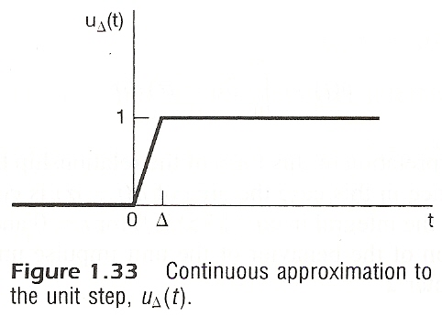
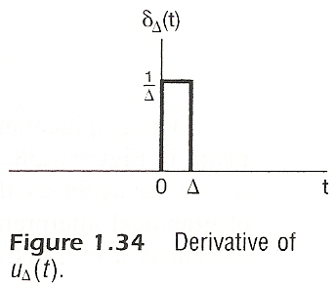

Slide 14
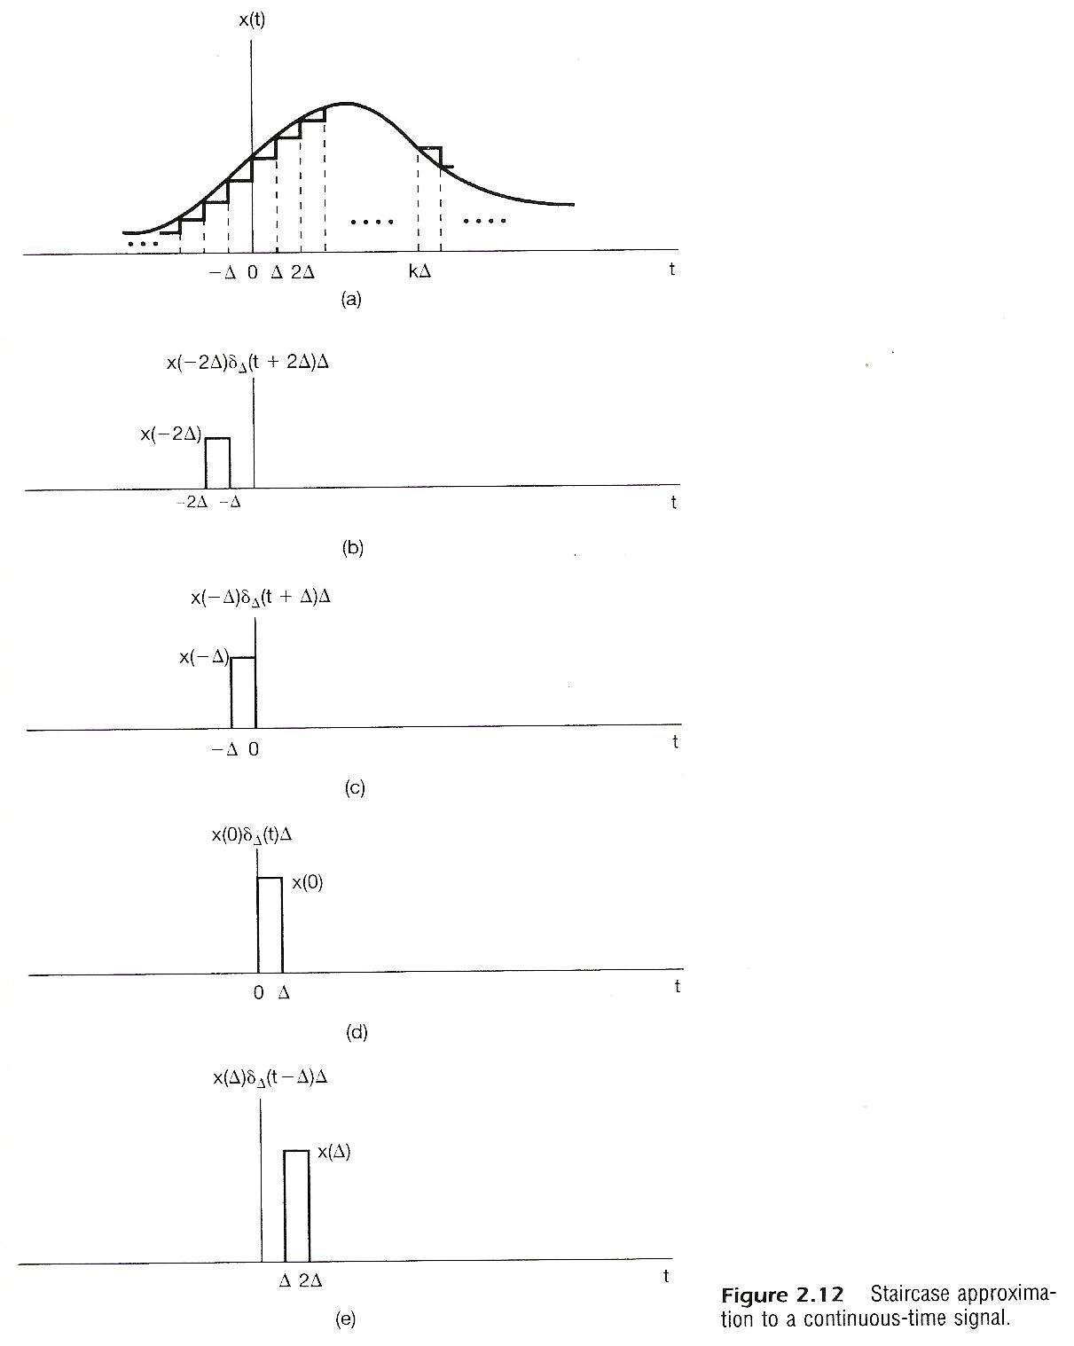

Slide 15
A Different Way to visualize the convolution integral
Look on the index τ
input signal
output signal at time t
reflected-over version of h(t)located at τ =t
On the dummy index τ, h(t) is reflected over and shifted to τ = t, weighted by x(t) and integrated to produce the output value at time t, y(t)
see Figs.2.19,2.20,2.21,pp.100-101 of text
A linear time-invariant system is completely
characterized by its unit impulse response
线性时间不变系统是完全的以其单位脉冲响应为特征

Slide 16
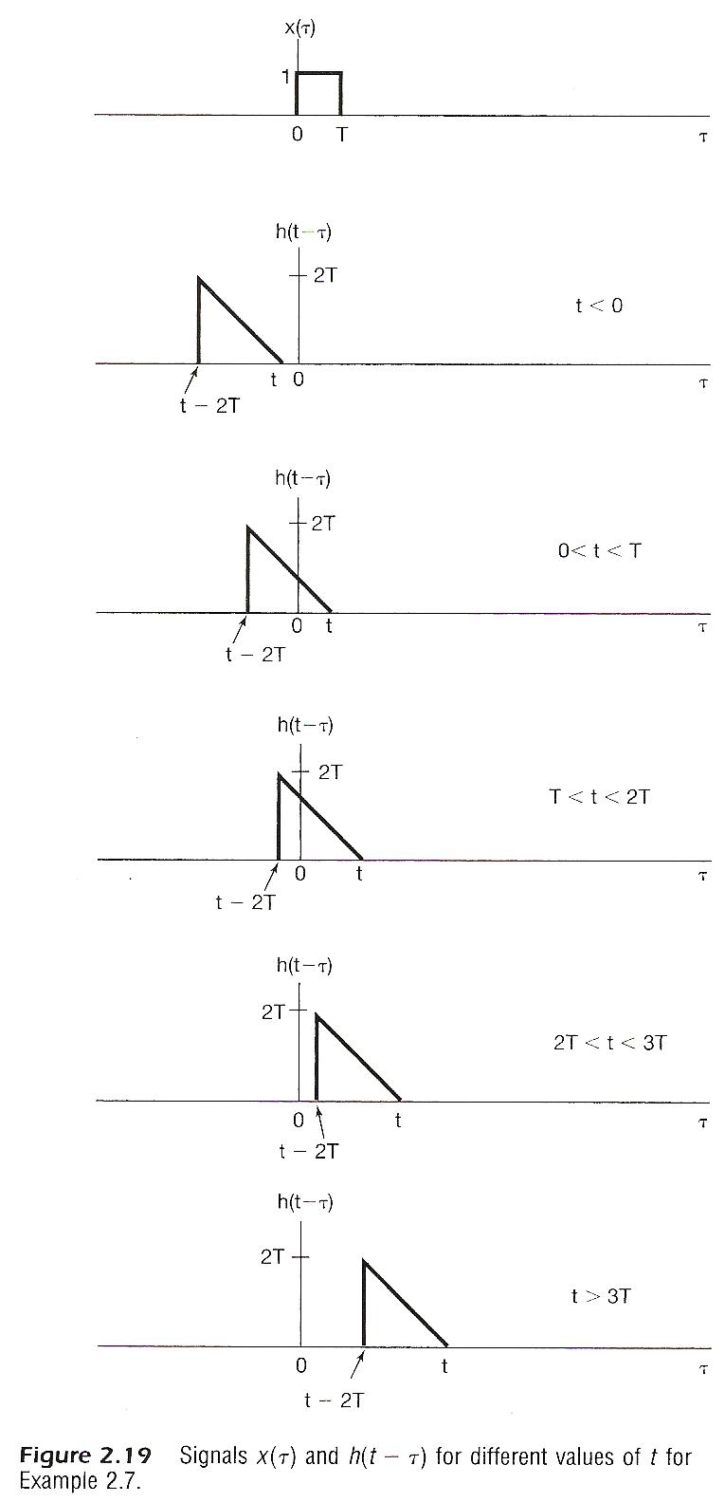
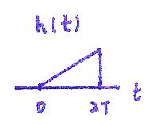


$$−2T$$
0
$$h(−t)$$

Slide 17
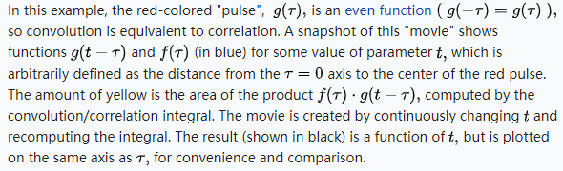
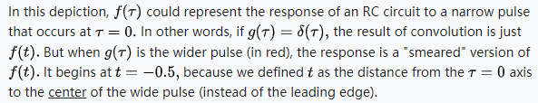

Slide 18

Matrix perspective
i | h | g
f | e | d
c | b | a
step 2
c | b | a
f | e | d
i | h | g
a | b | c
d | e | f
g | h | i
step 1

Slide 19
Convolution Example
h
1 | -1 | -1
1 | 2 | -1
1 | 1 | 1
f
2 | 2 | 2 | 3
2 | 1 | 3 | 3
2 | 2 | 1 | 2
1 | 3 | 2 | 2
Rotate
1 | 1 | 1
-1 | 2 | 1
-1 | -1 | 1

Slide 20
Convolution Example
h |  |  | 2 | 2 | 2 | 3
 |  |  | 2 | 1 | 3 | 3
 |  |  | 2 | 2 | 1 | 2
 |  |  | 1 | 3 | 2 | 2
 | 5 |  |  |  | f*h
1 | 1 | 1
-1 | 2 | 1
-1 | -1 | 1
St
ep 1
1 | 1 | 1
-1 | 4 | 2 | 2 | 3
-1 | -2 | 1 | 3 | 3
f | 2 | 2 | 1 | 2
 | 1 | 3 | 2 | 2
2
2
2
1

Slide 21
Convolution Example
1 | 1 | 1
-1 | 2 | 1
-1 | -1 | 1
2
2
2
3
h
2
1
3
3
2
2
1
2
1 | 1 | 1
-2 | 4 | 2 | 3
-2 | -1 | 3 | 3
2 | 2 | 1 | 2
1 | 3 | 2 | f2
1
3
2
2
2
2
2
5 | 4
2
1
3
f*h

Slide 22
Convolution Example
1 | 1 | 1
-1 | 2 | 1
-1 | -1 | 1
2 | 2 | 2 | 3
2 | 1 | 3 | 3
2 | 2 | 1 | 2
1 | 3 | 2 | 2
h | 1 | 1 | 1
2 | -2 | 4 | 3
2 | -1 | -3 | 3
2 | 2 | 1 | 2
1 | 3 | 2 | 2
5 | 4 | 4
2
2
3
1
3
3
f
f*h

Slide 23
Convolution Example
1 | 1 | 1
-1 | 2 | 1
-1 | -1 | 1
2 | 2 | 2 | 3
2 | 1 | 3 | 3
2 | 2 | 1 | 2
1 | 3 | 2 | 2
 |  | 1 | 1 | 1
2 | 2 | -2 | 6 | 1
2 | 1 | -3 | -3 | 1
2 | 2 | 1 | 2
1 | 3 | 2 | 2
5 | 4 | 4 | -2
2
3
3
3
f
f*h

Slide 24
Convolution Example
1 | 1 | 1
-1 | 2 | 1
-1 | -1 | 1
2 | 2 | 2 | 3
2 | 1 | 3 | 3
2 | 2 | 1 | 2
1 | 3 | 2 | 2
h
1 | 2 | 2 | 2 | 3
-1 | 4 | 1 | 3 | 3
-1 | -2 | 2 | 1 | 2
 | 1 | 3 | 2 | 2
5 | 4 | 4 | -2
9
2
2
2
1
2
2
f
f*h

Slide 25
Convolution Example
1 | 1 | 1
-1 | 2 | 1
-1 | -1 | 1
2 | 2 | 2 | 3
2 | 1 | 3 | 3
2 | 2 | 1 | 2
1 | 3 | 2 | 2
h
2 | 2 | 2 | 3
-2 | 2 | 3 | 3
-2 | -2 | 1 | 2
1 | 3 | 2 | 2
5 | 4 | 4 | -2
9 | 6
2
2
2
2
1
3
2
2
1
f
f*h

Slide 26

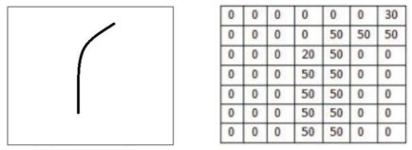
卷积运算的物理意义
对图像来说，卷积运算被用来判断输入图像与特征图像的匹配程度。
例如，对以下输入图片，找到符合特征图像的部分：
输入图像
特征图像

Slide 27
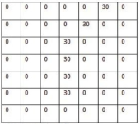
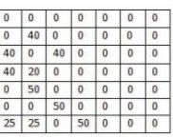
卷积运算的物理意义
对图像来说，卷积运算被用来判断输入图像与特征图像的匹配程度。
例如，对以下输入图片，找到符合特征图像的部分：
用像素值表示：
输入图像
特征图像

Slide 28
卷积运算的物理意义
例如，对以下输入图片，找到符合特征图像的部分：
输入图像
特征图像
内积
内积
6600
2500

Slide 29
卷积运算的物理意义
例如，对以下输入图片，找到符合特征图像的部分：
输入图像
特征图像
内积
内积
更符合所需特征
6600
2500

Slide 30
卷积运算的物理意义
信号处理中，卷积运算的本质与上述图像卷积运算类似：
卷积运算的结果表示一维曲线f(t)与特征曲线g(t)的匹配程度，可用来滤除我们所不希望的特征：滤波

Slide 31
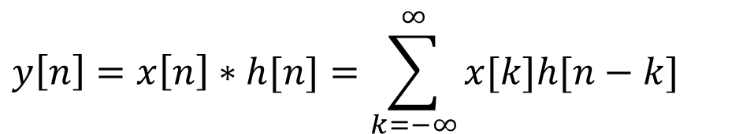
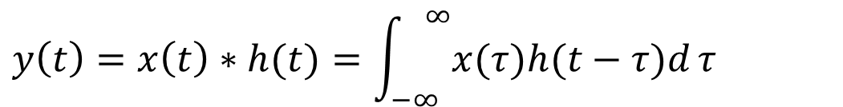
Linear Time-invariant Systems线性时间变异系统
$$y\left[n\right]=x\left[n\right]∗h[n]=\sum_{k=−∞}^{∞}{x[k]h[n−k]}$$
$$y\left(t\right)=x\left(t\right)∗h(t)=\int_{−∞}^{ ∞}{x(τ)h(t−τ)d}τ$$
But what is $h[n]$ and $h(t)$?

Slide 32
Linear Time-invariant Systems
Defining the output for an unit impulse input as the
Unit Impulse Response, h[n]
将单位脉冲输入的输出定义为 单位脉冲响应
x[n]=δ[n]
y[n]=h[n]:unit impulse response
单位冲激响应
S
0
n
0
n

Slide 33
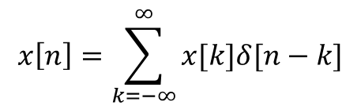
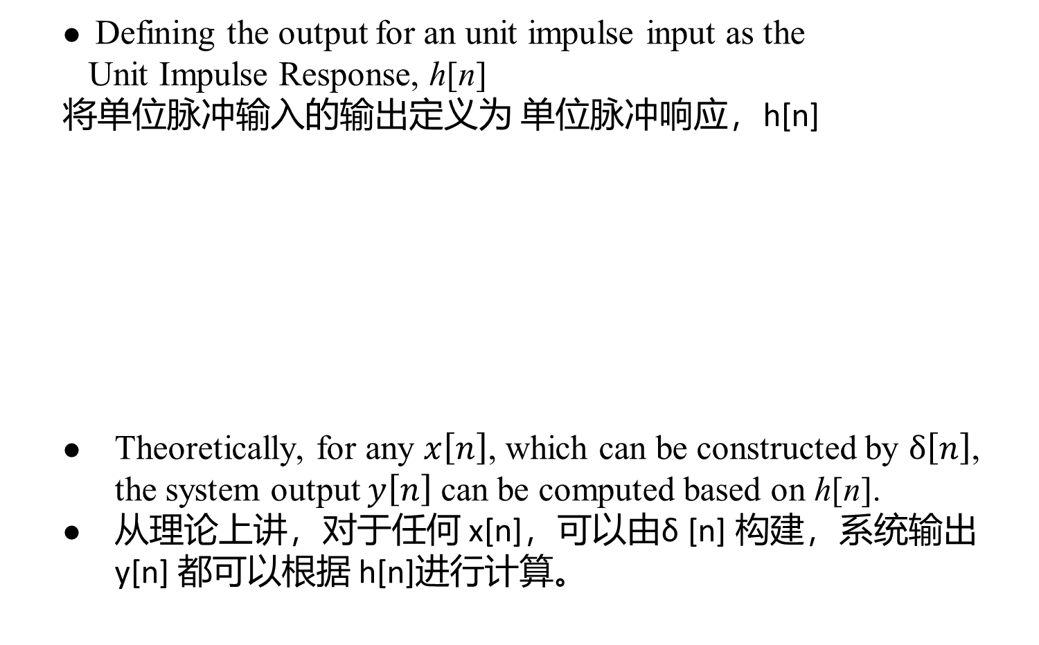
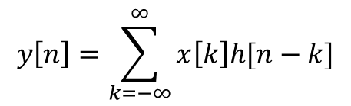
Linear Time-invariant Systems
Defining the output for an unit impulse input as the
Unit Impulse Response, h[n]
将单位脉冲输入的输出定义为 单位脉冲响应，h[n]
Theoretically, for any $x\left[n\right]$, which can be constructed by $δ\left[n\right]$, the system output $y\left[n\right]$ can be computed based on h[n].
从理论上讲，对于任何 x[n]，可以由δ [n] 构建，系统输出 y[n] 都可以根据 h[n]进行计算。
$$x\left[n\right]=\sum_{k=−∞}^{∞}{x[k]δ[n−k]}$$
$$y\left[n\right]=\sum_{k=−∞}^{∞}{x\left[k\right]h[n−k]}$$
S

Slide 34
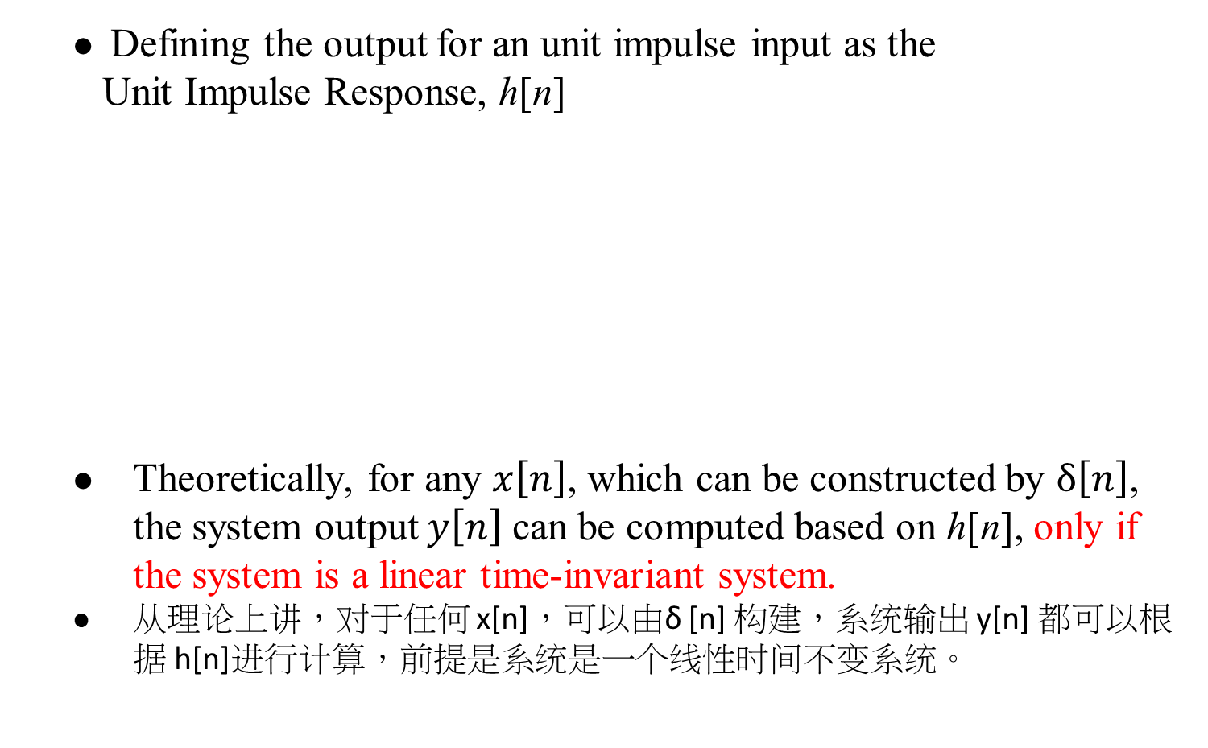
Linear Time-invariant Systems
Defining the output for an unit impulse input as the
Unit Impulse Response, h[n]
Theoretically, for any $x\left[n\right]$, which can be constructed by $δ\left[n\right]$, the system output $y\left[n\right]$ can be computed based on h[n], only if the system is a linear time-invariant system.
从理论上讲，对于任何 x[n]，可以由δ [n] 构建，系统输出 y[n] 都可以根据 h[n]进行计算，前提是系统是一个线性时间不变系统。
$$x\left[n\right]=\sum_{k=−∞}^{∞}{x[k]δ[n−k]}$$
$$y\left[n\right]=\sum_{k=−∞}^{∞}{x\left[k\right]h[n−k]}$$
S

Slide 35
线性（Linear）系统
Linear: a system is linear if the output of the scaled sum of two input signals is the equivalent scaled sum of outputs （如果输入信号是两个信号的加权和，那么输出信号也是这两个输入信号对应输出的加权和）
例：如果系统对输入信号x(t)的输出是y(t)，则系统对输入信号ax₁(t)+bx₂(t)的输出为ay₁(t)+by₂(t)
线性系统对信号在频域表示下的处理具有重要意义。

Slide 36
时不变（Time-invariant）系统
Time-invariance: a system is time invariant if the system’s output is the same, given the same input signal, regardless of time. （系统特性不随时间发生变化）
例：如果系统对输入信号x(t)的输出是y(t)，则系统对输入信号x(t-t₀)的输出为y(t-t₀)
时不变系统对信号在频域表示下的处理具有重要意义。

Slide 37

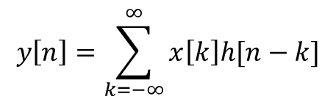

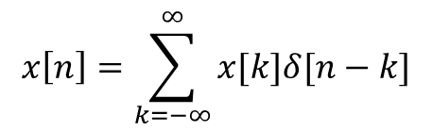


Linear Time-invariant Systems
Time-invariant: for any k, response of $δ\left[n−k\right]$ is always $h\left[n−k\right]$时间不变：对于任何 k，$δ\left[n−k\right]$ 的反应$h\left[n−k\right]$
$$x\left[n\right]=δ[n−k]$$
$$y\left[n\right]=h[n−k]$$
S
Linearity: response can always be represented by the scaled sum of $h\left[n−k\right]$线性：响应始终可以$h\left[n−k\right]$的缩放总和来表示
$$x\left[n\right]=\sum_{k=−∞}^{∞}{x[k]δ[n−k]}$$
$$y\left[n\right]=\sum_{k=−∞}^{∞}{x\left[k\right]h[n−k]}$$
S

Slide 38
Properties of Linear Time-invariant Systems
Commutative Property（交换律）
the role of input signal and unit impulse response is interchangeable, giving the same output signal
输入信号和单位脉冲响应的作用是可互换的，给出相同的输出信号
In evaluating the convolution sum or integral, the input signal can be reflected over and weighted by the unit impulse response
在评估汇总或整体时，输入信号可以通过单位脉冲响应反射和加权
Notes:
交换律

Slide 39
Distributive Property（分配律）
Notes:
分配定律

Slide 40
Associative Property（结合律）
Cascade of two systems gives an unit impulse response which is the convolution of the unit impulse responses of the two individual systems两个系统的级联得到一个单位脉冲响应，它是两个独立系统的单位脉冲响应的卷积
The behavior of a cascade of two systems is independent of the order in which the two systems are cascaded两个系统级联的行为与这两个系统级联的顺序无关
Notes:
结合律

Slide 41
Causality（）因果关系（）
causal if y[n] dose not depend on x[k] for k > n
如果 y [n] 不依赖于 x [k] 当k > n
Causal iff h[n]=0, n < 0

Slide 42
Causality（因果律）
continuous-time
Causal iff h(t)=0,t<0

Slide 43
Invertibility / Inverse system（不可逆、可逆）

Slide 44
Unit step response（单位阶跃响应）
output for an unit step function input单位阶跃函数输入的输出
similarly
Running sum
First difference
Running integral
First derivative

