Slide 1
Hacking a 15$ Quadcop…
…for Adding a Computer Interface
for Flight Control

Slide 2
Motivation
cheap, off-the-shelf quad cop
nice, but not programmable / automatable
→add a computer interface!

Slide 3
Features
display remote control status
  LEDs on signal adapter board
  GUI of QuadCop application
record remote control events
replay remote control events
TODO:
  flight control editor

Slide 4
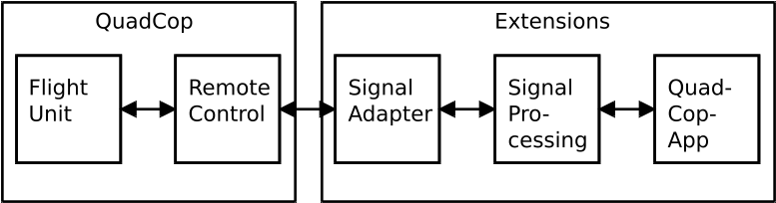
Architecture

Slide 5
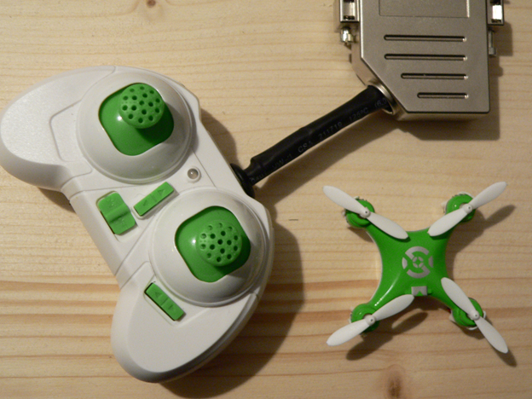
Architecture

Slide 6
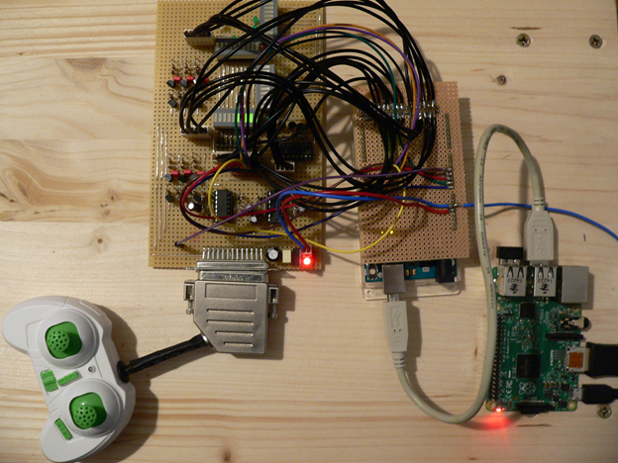
Architecture

Slide 7
Architecture
Signal Adapter Board
hardware: self-made
analog signal level adaptation (3.3V ↔ 5V)
analog signal amplification (output drivers)
analog signal filtering (signal quality)
LED status display

Slide 8
Architecture
Signal Processing Board
hardware: Arduino Mega 2560
C language low-level software
A/D conversion
D/A conversion
digital signal filtering
digital signal decomposition
digital signal composition
digital signal short-time buffering
real-time processing (timestamp based)

Slide 9
Architecture
QuadCopApp Board
hardware: Raspberry Pi 3
Java Application with Swing GUI
communication with Arduino
flight data recording
flight data persistent storing
flight data replay
graphical status display of remote control
TODO: flight data editor (piano roll view)

Slide 10
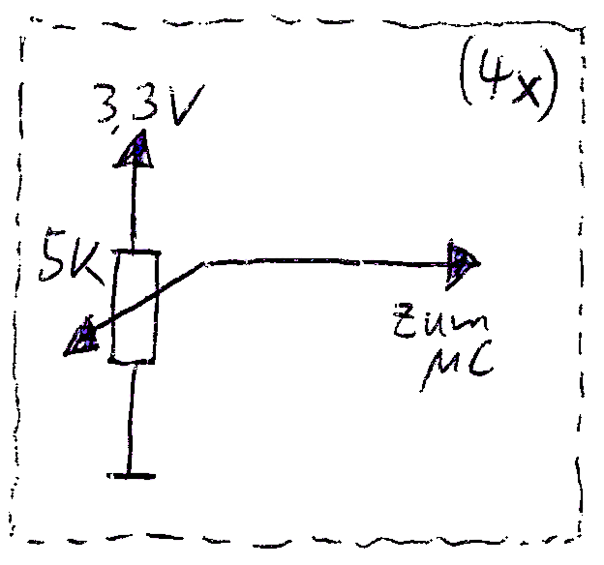
Pilot Stick Tapping
goal: grab position of potentiometer
originally state found before “surgery”:

Slide 11
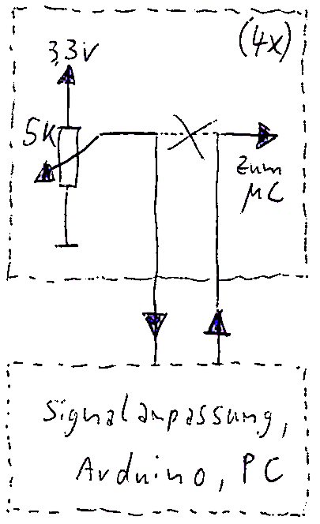
Pilot Stick Tapping
goal: grab position of potentiometer
modified state after “surgery”:

Slide 12
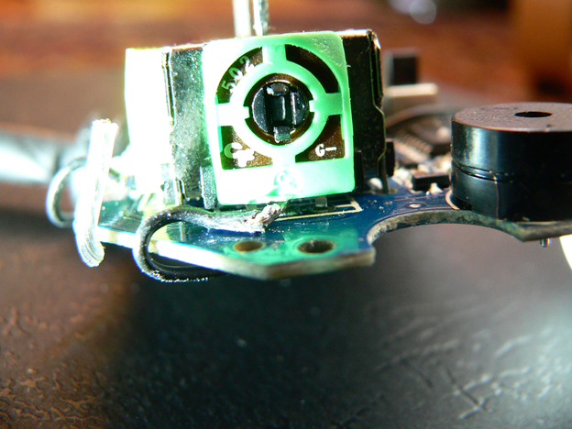
Pilot Stick Tapping

Slide 13
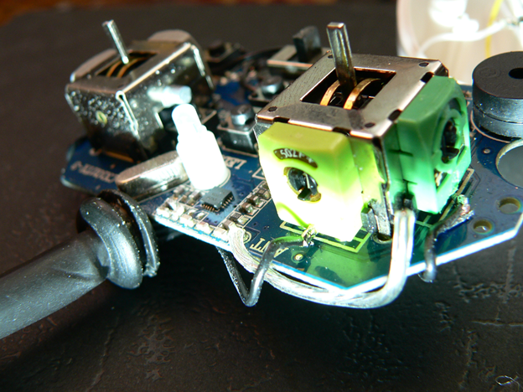
Pilot Stick Tapping

Slide 14
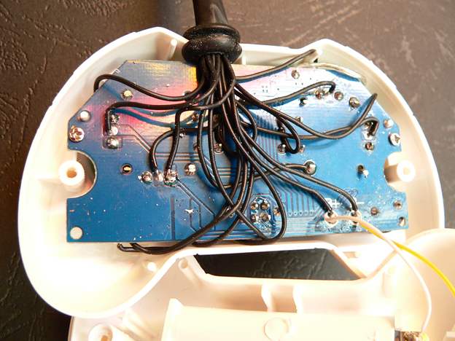
Pilot Stick Tapping

Slide 15
Pilot Stick Tapping
surgery challenges
  unsolder potentiometer
  bend up affected pin
  re-solder potentiometer
  solder a wire to bent-up pin
  solder a wire to open pin hole

Slide 16
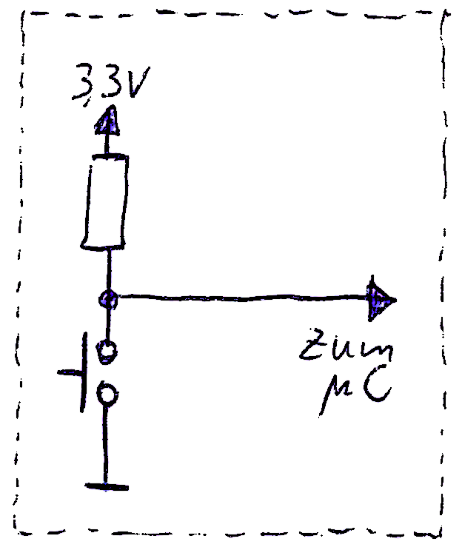
Push Button Tapping
expected circuit:

Slide 17
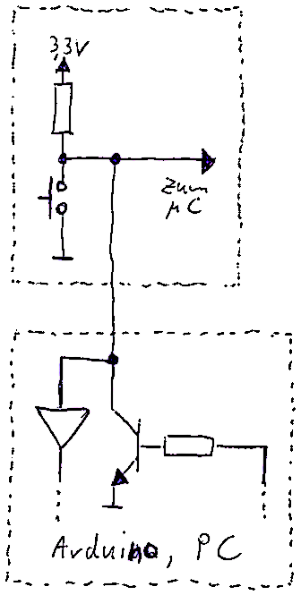
Push Button Tapping
planned surgery:

Slide 18
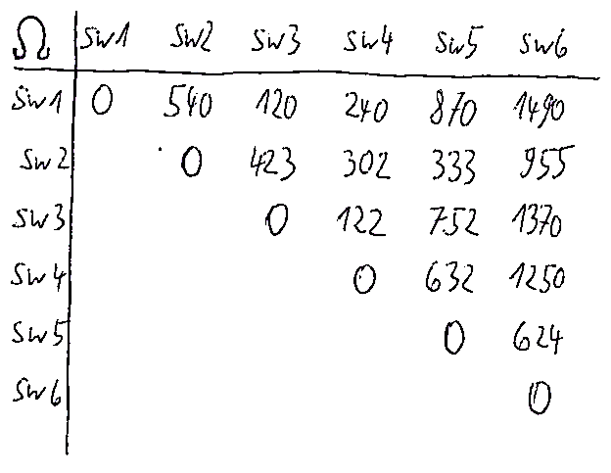
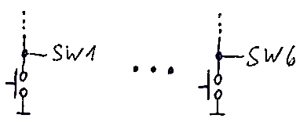
Push Button Tapping
surprise! – found curcuit:

Slide 19
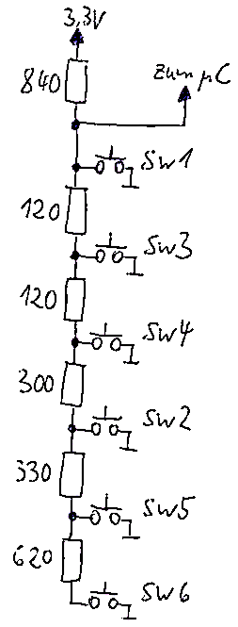
Push Button Tapping
result of analysis
(to solve, look in the table for the
lowest values for each switch for
determining its neighbour):

Slide 20
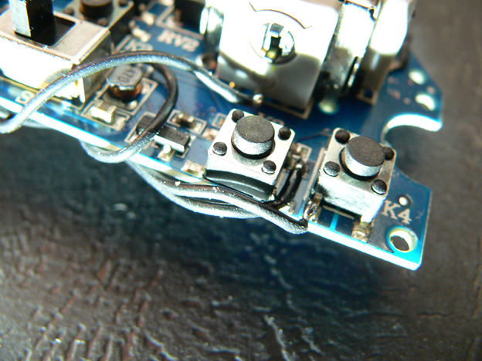
Push Button Tapping

Slide 21
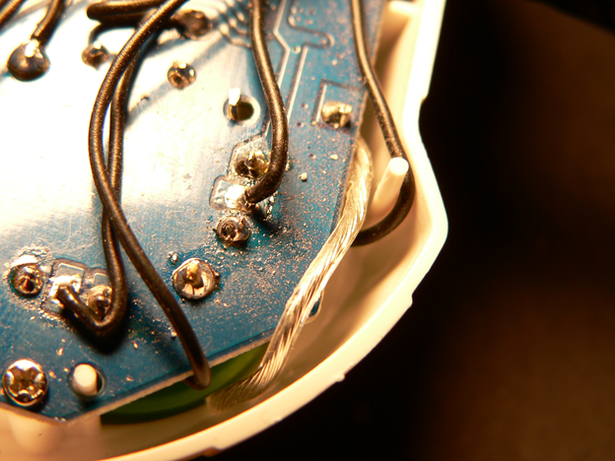
Wire Routing
do not change characteristics of antenna
keep distance
if near, prefer
orthogonal
over parallel
cable routing

Slide 22
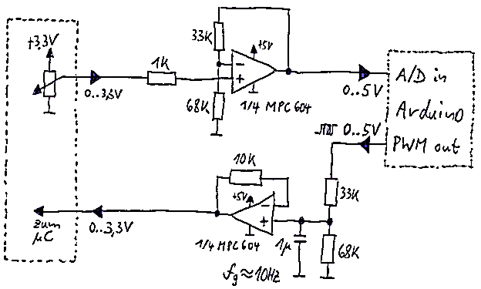
Signal Adapter Board
analog processing of pilot stick signals

Slide 23
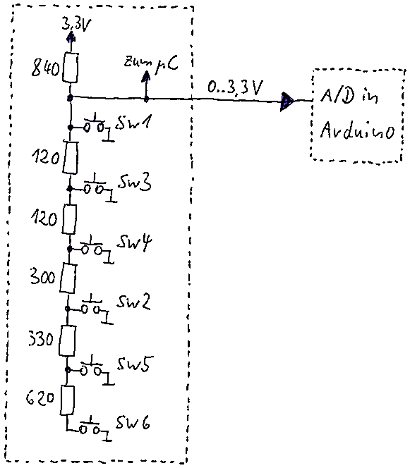
Signal Adapter Borad
analog processing of incoming push button signals
not so “critical” due to
higher signal/noise ratio
→directly transfer to
Arduino

Slide 24
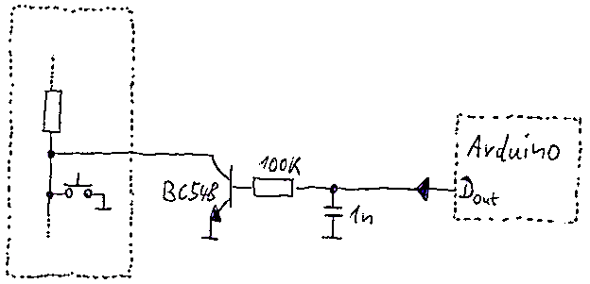
Signal Adapter Board
analog processing of outgoing push button signals

Slide 25
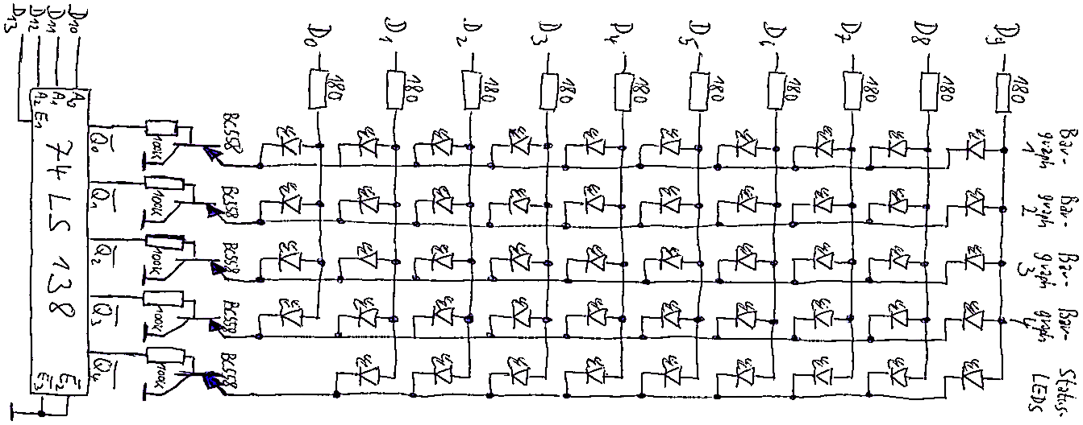
Signal Adapter Board
LED status display matrix
5 columns (multiplexed) á 10 LEDs

Slide 26
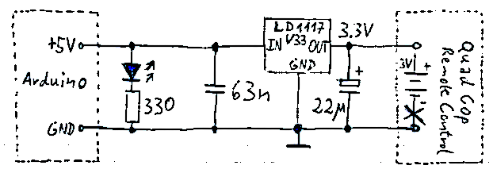
Signal Adapter Board
power supply for remote control

Slide 27
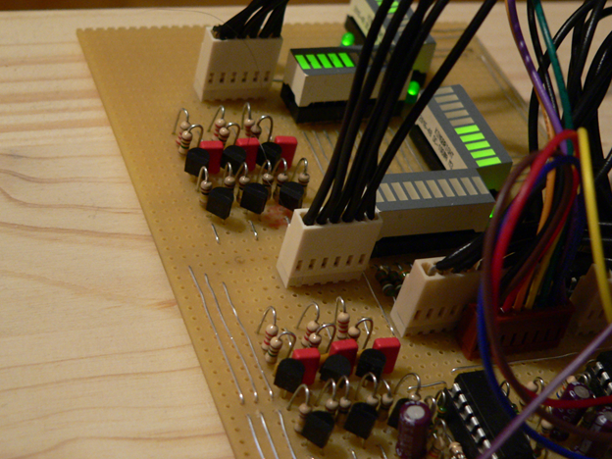
Signal Adapter Board

Slide 28
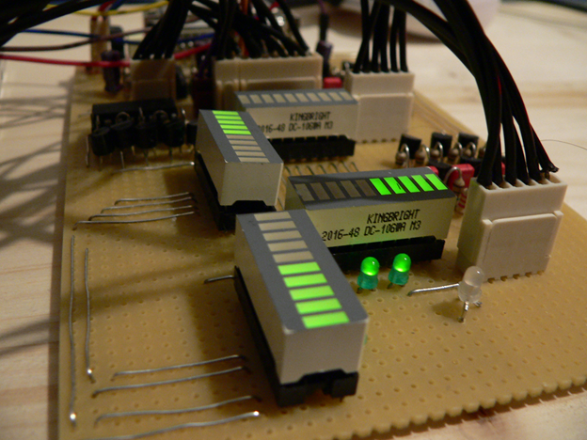
Signal Adapter Board

Slide 29
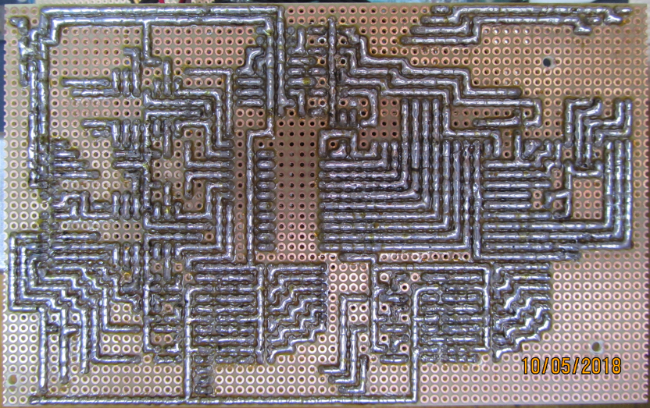
Signal Adapter Board

Slide 30
Do not try this at home…
…at least not with expensive QuadCop
and without precautions
take care for precautions
  avoid electrostatic discharge (CMOS!)
    regularly touch grounded points
    avoid synthetic clothes
    wear anti-static wristband
  avoid too much heat while soldering
    limit solder time, let it cool down
  minimize mechanical changes / damage
    capillary cracks → possible contact problems
  keep position and shape of antenna unchanged

Slide 31
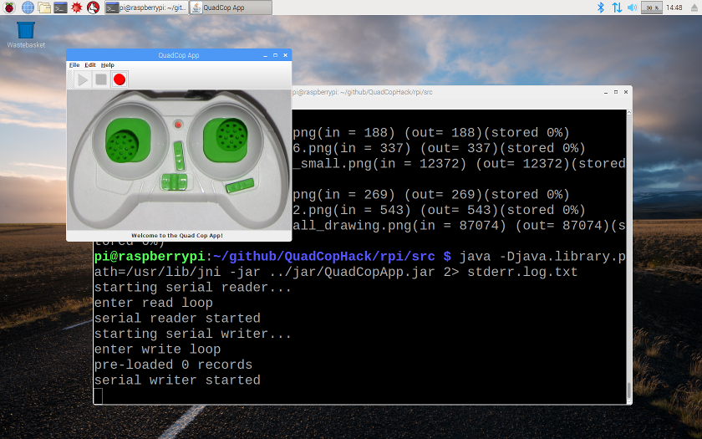
QuadCopApp

Slide 32
TODO: Enhance Flight Control Precision
Arduino’s A/D and D/A conversion
  delay of A/D conversion
  trade-off smoothness vs. response time of PWM signals
→ maybe add special A/D and D/A conversion hardware
timing in Arduino software
  precision of sampling time / replay time
→ use regular timer interrupts for precise timing
poor signal quality of quadcop remote control
  substantial signal jitter
→ choose better quadcop or pimp it up (e.g. power supply quality)
missing feedback sensor for correction
→ add e.g. pair of cameras for position tracking & flight correction

Slide 33
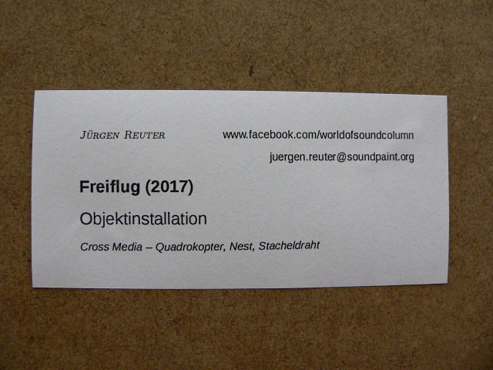
Application in Arts
exhibition UND#9, Karlsruhe 2017
nervous twitch as tiny flight curve
https://www.youtube.com/watch?v=pDwdSbA5rck

Slide 34
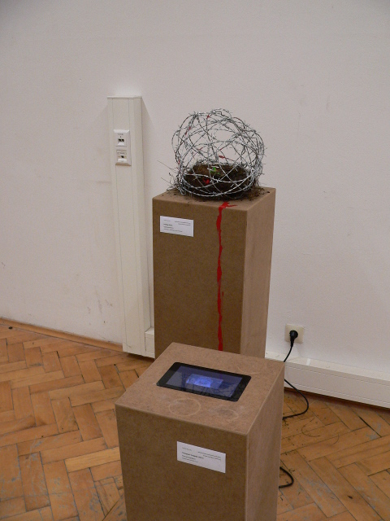
“Freiflug” (2017)

Slide 35
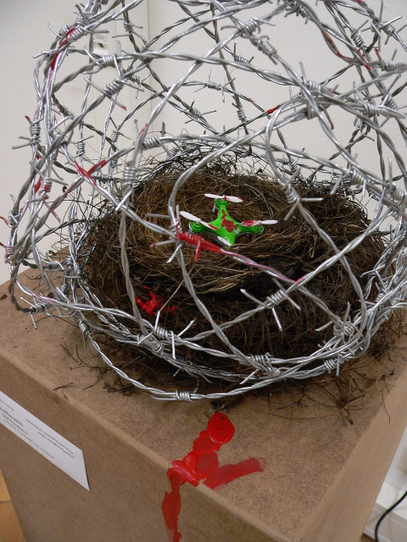
“Freiflug” (2017)

Slide 36
Questions?
Project Site on Github:
  https://github.com/soundpaint/QuadCopHack

