Slide 1
Ontological Processing of
Sound Resources
  LAC 2006
  April 30, 2006
  Jürgen Reuter
  http://www.ipd.uka.de/~reuter/

Slide 2
Composers’ Real Hard Life
“On which synth and in what sound bank was that cool trumpet sound?”
“I somewhere saved that funny synth pad patch that I created for my last song, but where did I store it?”
“Give me a list of all the string synth sounds that are scattered across my synths and banks!”

Slide 3
What’s the problem?
Too many sounds in too many synths and synth banks
Sounds mostly not at all sorted or ordered in a musical sense
No standardized, uniform way of sound browsing or lookup across synths
No central sound registry for a single lookup of sounds across all synths in a system

Slide 4
How to Order Sounds?
Instrument Taxonomies

Slide 5
How to Order Sounds? (cont.)
Acoustic Organ Registers
  Classify by pitch
    16’’, 8’’, 4’’, ...
  Classify by construction principle of pipes
    labial / lingual pipes, open / closed pipes, ...
  Classify by function of sound
    solo, principal, mixture, ...
  Classify by similarity to prototype sounds
    flute, bassoon, trumpet, ...

Slide 6
How to Order Sounds? (cont.)
Grouping, banking
  128 GM Level 1 MIDI instruments, 16 groups
  GM Level 2 banks

Slide 7
How to Order Sounds? (cont.)
Tagging
  Generalizes grouping
  Enables sound to be member of multiple groups
  Serves for annotating qualities of a sound

Slide 8
More on Tagging
Find (at least) 4 types of tags
  prototype-driven (similarity to known sound or group of sounds)
    string, violin, synth, percussive, bright, resonant, ...
  function-driven (purpose of sound)
    effect, lead, melodic, drums, ...
  construction-driven (way of creating)
    arpeggiator, decay, FM, vocoder, ...
  user-defined
    favorites, ...

Slide 9
More on Tagging (cont.)
⇒ plain Relational Database Management System (RDBMS) not sufficiently expressive
Tags are deductive
  violin ⇒ string
  drum ⇒ percussive
  vocoder ⇒ synth
  lead ⇒ melodic
  ...

Slide 10
Ontology Management System (OMS)
Builds upon description logics (aka concept languages)
  represents decidable fragment of first-order logic
  supports modeling in terms of classes, properties, and individuals
Recently has become widely supported through OWL standard

Slide 11
OMS vs. RDBMS
Like a RDBMS, can serve as a central repository of information
Unlike a RDBMS, also provides reasoning support for deducing knowledge

Slide 12
Ontologies
Classes
  create classes for tags and groups of sounds

Slide 13
Ontologies (cont.)
Individuals
  store actually available sound resources as class members

Slide 14
Ontologies (cont.)
Individuals
  infer inherited class memberships

Slide 15
Ontologies (cont.)
Properties
  associate each sound resource with related info (e.g. MIDI program number, ALSA port)

Slide 16
Ontologies (cont.)
Properties
  associate each sound resource with related info (e.g. MIDI program number, ALSA port)

Slide 17
Example: Protégé
Ontology editor and knowledge-base framework
  Developed at Stanford University
  Open source (Mozilla Public License)
  Supports ontology editing, browsing, consistency checking, reasoning, ...
  Used here to demonstrate feasibility of ontological sound resource processing

Slide 18
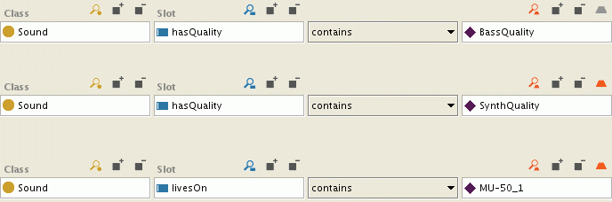
Example: Protégé (cont.)
Query: Sound ∏ ∃hasQuality.BassQuality ∏ ∃hasQuality.SynthQuality ∏ ∃livesOn.MU-50_1

Slide 19
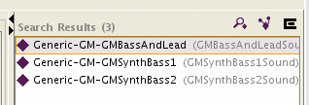
Example: Protégé (cont.)
Search yields 3 matches:

Slide 20
Example: Protégé (cont.)
Result details

Slide 21
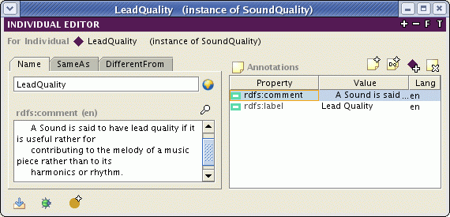
Example: Protégé (cont.)
More on the “Lead” sound quality

Slide 22
@ ALSA Developers
Based on this presentation,
  further elaborate a proper ontology
  set up OMS that
    serves as central sound registry
    tracks available sound resources
  design a registry management API
Maybe promote ontological framework as cross-platform standard

Slide 23
@ Synth Application Developers
Announce sounds to central registry
Annotate sounds with tags
Announce tags to central registry
Think about proper tags for standardization
  Can lead to much cleaner synth design!
Let synth GUI design be guided by ontology of tags

Slide 24
Conclusion
Management of sound resources is strongly desired.
It is feasible based on an ontological framework.
An OMS can serve as central registry.
Applications should use query and update the OMS database.

Slide 25
Questions?

