Slide 1
Logging Kernel Events on Clusters
Jürgen Reuter and Walter F. Tichy
Institut für Programmstrukturen
und Datenorganisation
Universität Karlsruhe, Germany

Slide 2
Motivation
Understand & improve Linux based cluster OS:
  Cooperative caching
  Distributed parallel file systems
  Checkpointing
  Gang scheduling
  …

Slide 3
Approach
Track and analyse OS events on clusters
Find bottlenecks
Patch kernel
Verify effect of patch

Slide 4
Example: Scheduling
Log task switch events
Find and analyse idle times
  problem: waiting for de-scheduled process on remote node
Co-schedule interactive processes via remote scheduling feature
Verify effect of remote scheduling feature
→ provide tools for OS-level logging & analysis

Slide 5
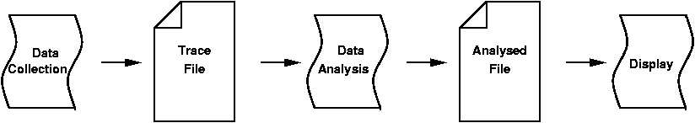
Tools Overview
Data collection: instrumented kernel code
Data analysis: offline filtering
Data display: graphical tool

Slide 6
Data Collection
Mechanisms
  Provide fast, non-blocking kernel event logging function for
    Task switch events
    Receive packet events
    Enter/leave handler events
    …
  Instrument kernel
    Manually insert call to logging function

Slide 7
Data Collection
Steps
  Log event type & time in kernel
  Transfer data kernel → user level
    Producer – consumer paradigm
  Save log data to disk in user level

Slide 8
Data Collection – Scalability
Cluster level:
  Logging performed locally per node
  Data saved to local disk
→ Scalability is not an issue at cluster level.

Slide 9
Data Collection – Scalability
Node level (SMP):
  Bottleneck log buffer
    Use per CPU log buffers
    → enables concurrent logging on SMP
    → no SMP lock required
  Bottleneck disk access
    Co-schedule all user level logger processes
    → hides effect for cluster as a whole

Slide 10
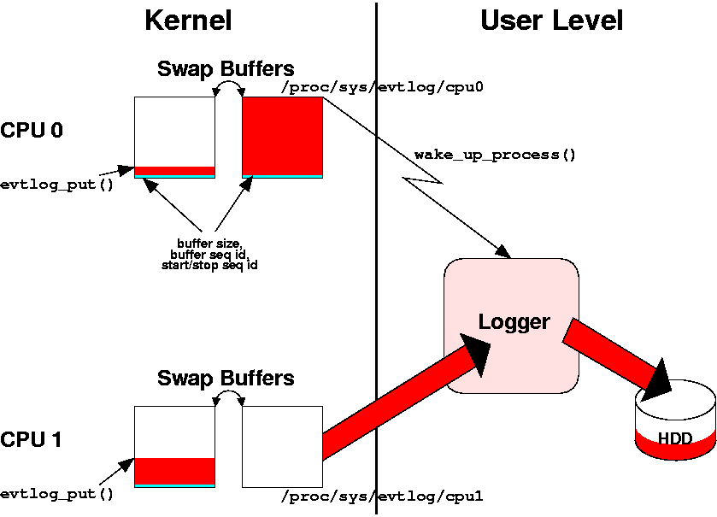
Data Collection – Architecture

Slide 11
Data Collection – Costs
User level process
  Log task switch events → record costs
Kernel code
  Logging function: short & quick
  Main costs: time measurement

Slide 12
Data Collection – Details
Locking buffer access
  Not an issue (non-preemptive kernel)
  Exception: interrupts
Cluster-wide synchronization
  Start/stop via broadcast

Slide 13
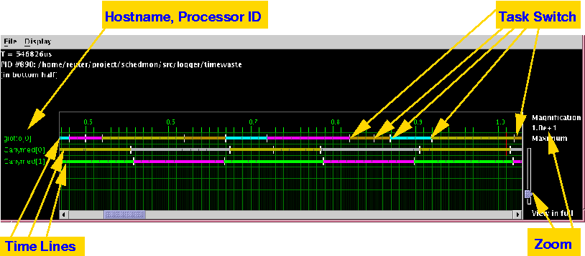
Data Analysis and Display

Slide 14
Example: Scheduling
Remote schedule feature via ICMP
Short control packets
Broadcast/multicast applicable
Short response time
  Early handling in kernel
  All in kernel
ICMP dispatch over function table → no slow down for other traffic

Slide 15
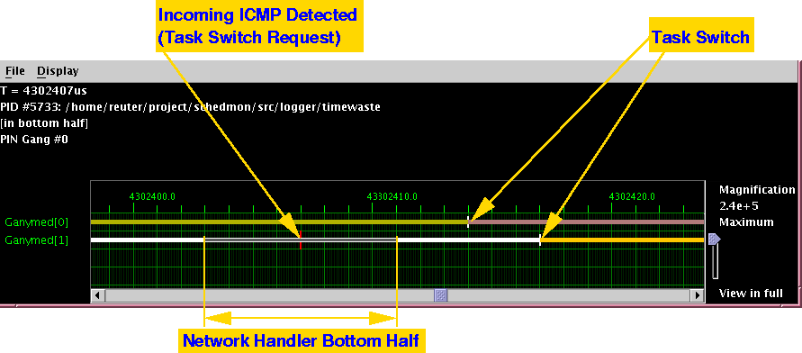
Remote Schedule Feature

Slide 16
Conclusions
Provided set of tools for OS level Performance analysis:
  Kernel logging
  Analysis and graphical display
Proved usefulness by remote scheduling implementation

Slide 17
Future Work
Verify scalability (fat SMPs, many nodes)
Need filters for huge amount of data
Enhance synchronization
Better support relation between kernel and user level events

