Slide 1
Music Player Application
OOAD Mini Project Output Presentation

Slide 2
Problem Statement
Problem:
Online Music Player Application
Aim:
To develop a project for an online music player application for Artists and Listeners.

Slide 3
Introduction
This project deals with an online music player that is created for artists, or the producers of the music, and for the listeners who use this application, or the consumers.
Login pages for Artist and Listeners available.
The music player page will consist of playlist and audio controls for the respective songs, along with volume control and download option.
Project Title- | Online Music Player Application
Project Head- | K Soundarya

Slide 4
Gantt chart

Slide 5
Output presentation
Framework used- Flask

Slide 6
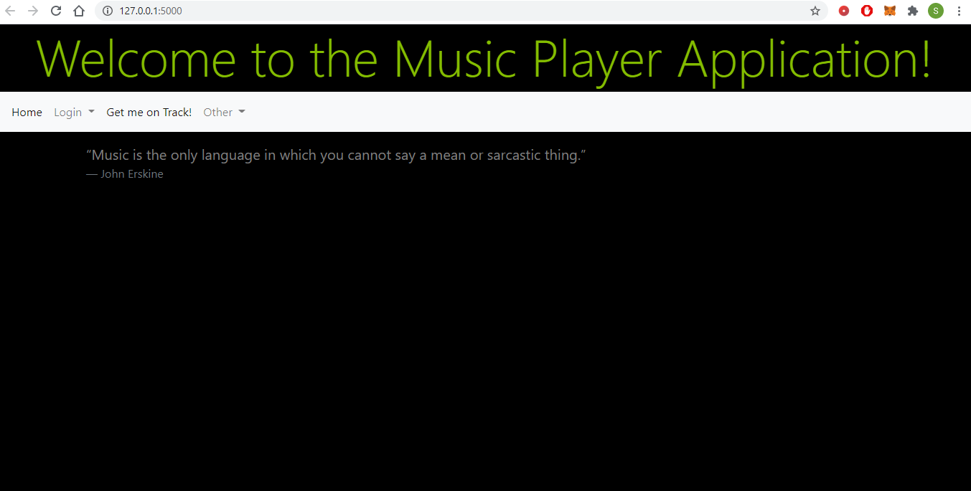
Home Page
Upon opening the application, this is the first page that will be seen.

Slide 7
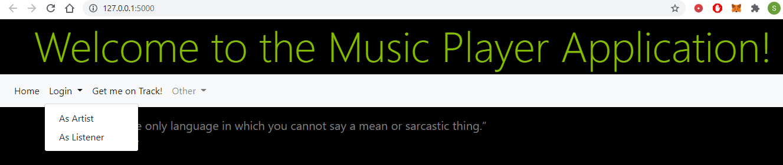
Navigation Bar
Login
As Artist
As Listener

Slide 8
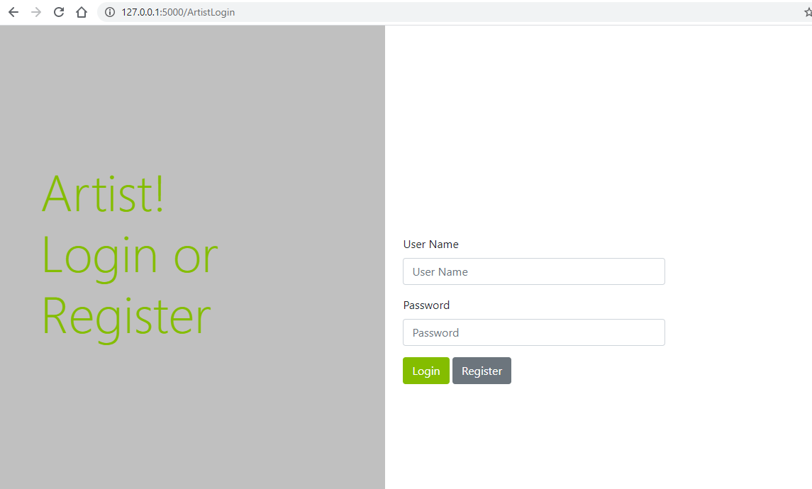
Login Page
-Login As Artist

Slide 9
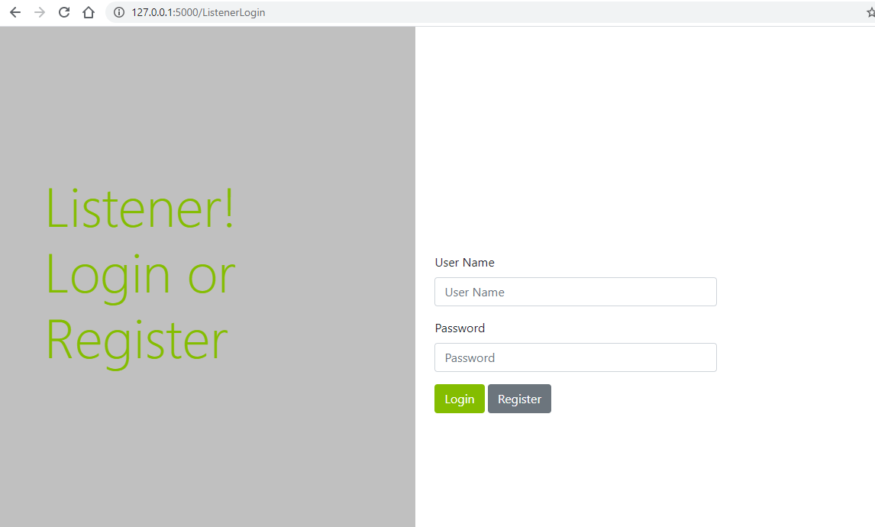
Login page
-Login As Listener

Slide 10
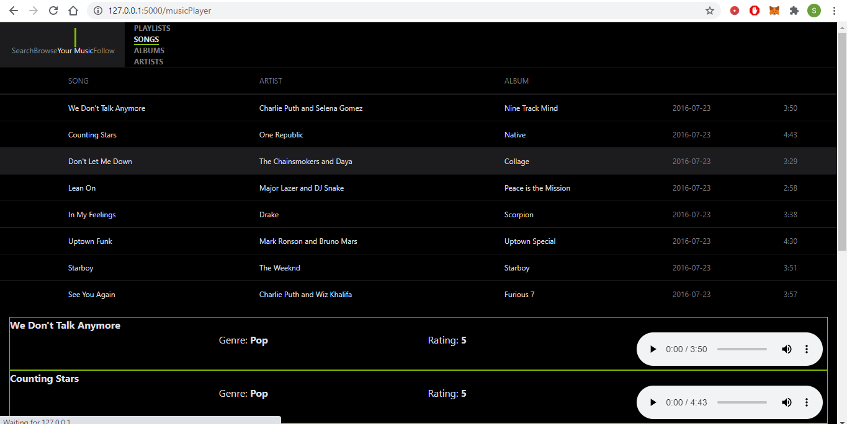
Music player page
Styling
Navigation
Playlist View

Slide 11
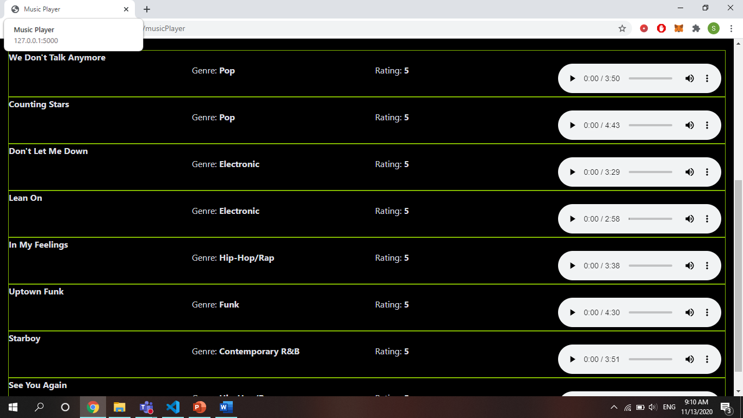
Music player page
Styling
Songs with Audio Control

Slide 12
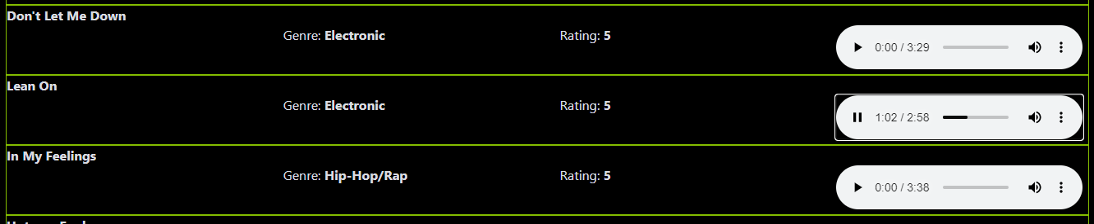
Music player page
Playing Songs

Slide 13

Music player page
Volume Control

Slide 14

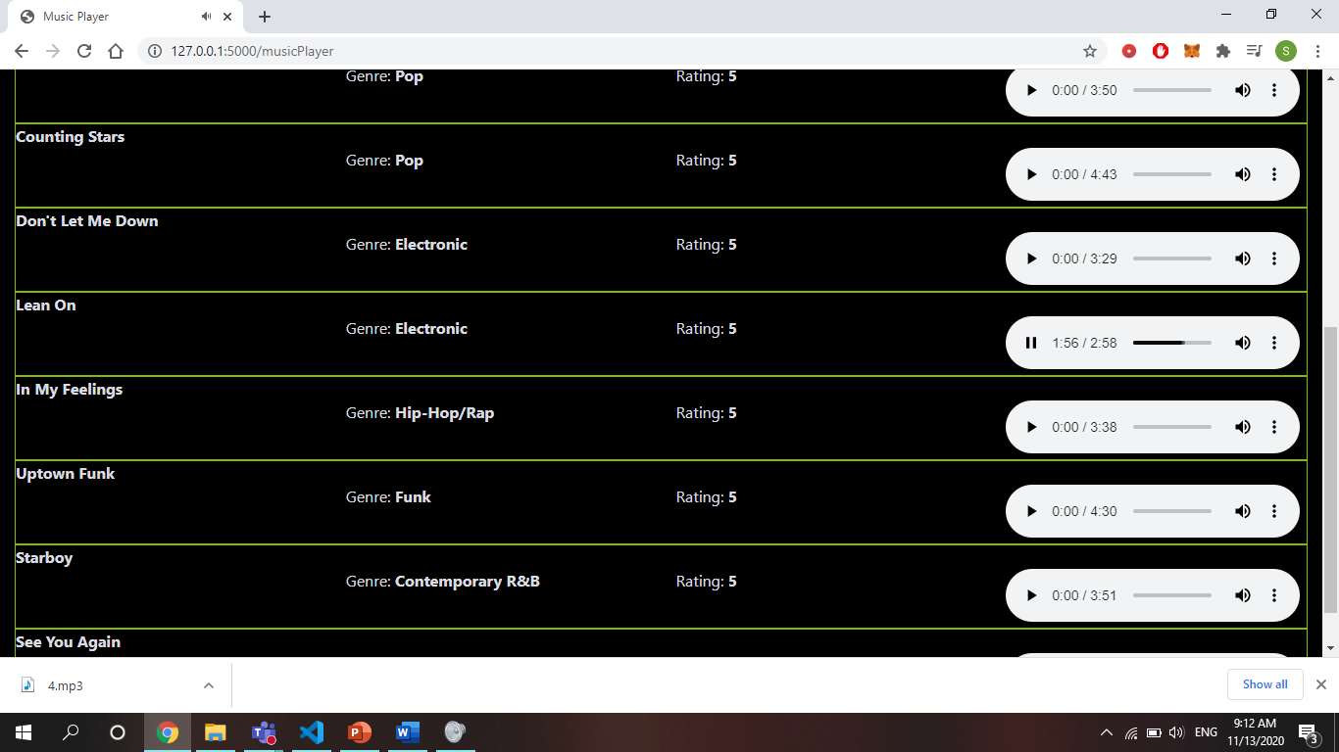
Music player page
Downloading songs

Slide 15
result
Thus the online Music Player Application’s front-end has been implemented for the OOAD MINI PROJECT successfully, using Flask framework.

Slide 16

-K Soundarya
-2018503561

