Slide 1


Slide 2
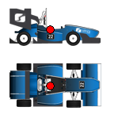
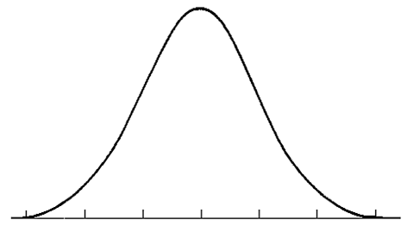
Cornering stiffness optimization
Sensor
data
Vertical force
calculation
Adaptive Extended Kalman Filter
+
Simulation
Sliding Mode Control
calculation
Gaussian noise

Slide 3
Cornering stiffness optimization
Real-Time Operation
Sensor
data
Vertical force
calculation
Adaptive Extended Kalman Filter
calculation
+
Simulation
Motors
Torque Distribution
Adaptive
Sliding Mode Control
Gaussian noise

Slide 4

Start
End

