Slide 1


Slide 2
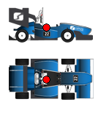
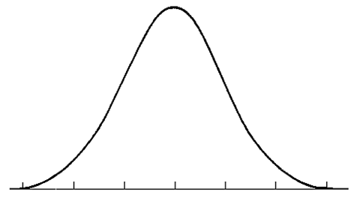
Cornering stiffness optimization
Sensor
data
Vertical force
calculation
Adaptive Extended Kalman Filter
+
Simulation
Sliding Mode Control
calculation
Gaussian noise

Slide 3
Cornering stiffness optimization
Sensor
data
Vertical force
calculation
Adaptive Extended Kalman Filter
+
Simulation
calculation
Gaussian noise
Motor
Torque Distribution
Sliding Mode Control

Slide 4

Start
End

