Slide 1
Twitter Tweaker
December 6, 2017
Wednesday
Tanmay Gore
Souparni Agnihotri
Shruti Sahu

Slide 2
Introduction
A recommendation system for Twitter based on word popularity
Cluster 1000 tweets into 6 clusters using K-means Clustering
Classify the new tweet into the 6 clusters
Recommend the tweeters to follow other tweeters based on the classification

Slide 3
TFIDF
TF - Term frequency
Measure of the number of times a word occurs in a document
TF(t) = (Number of times term t appears in a document) / (Total number of terms in the document).
IDF - Inverse Document Frequency
Measure of how important the term is in a document
IDF(t) = log_e(Total number of documents / Number of documents with term t in it)

Slide 4
K-Means Clustering
Method of clustering similar data into groups
Input: K(number of clusters); Training set ({0,0,0,2.0},{1,0,0,2}{3,2,1,5}....,{3,5,6,1})
Total number of TF-IDF values obtained – 5,542
[1000, 5,542] Dimensional matrix fed into K-means.
Notes:
K-means minimizes the sum of distances between data samples and their associated cluster centroids

Slide 5
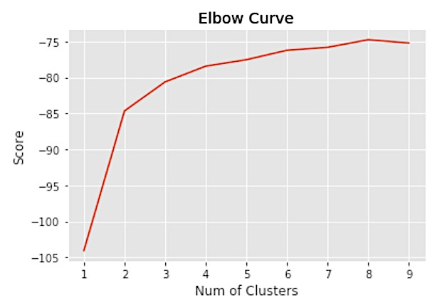
Why 6 clusters?
Notes:
Score - the percentage of variance within each cluster.
Addition of more clusters will not explain much more about the variance in our variable.
Hence, we chose 6 as the optimal number of clusters to perform k-means.

Slide 6
Twitter API
API that provides Tweets, User Information and Analysis tools
Provided officially by Twitter with API in multiple languages
OAuth Authentication for authenticating the user
Streaming API used to get large amount of Tweets based on filter
The REST API used to get user specific tweets

Slide 7
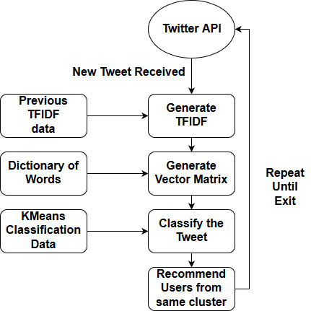
Classification of Tweets

Slide 8
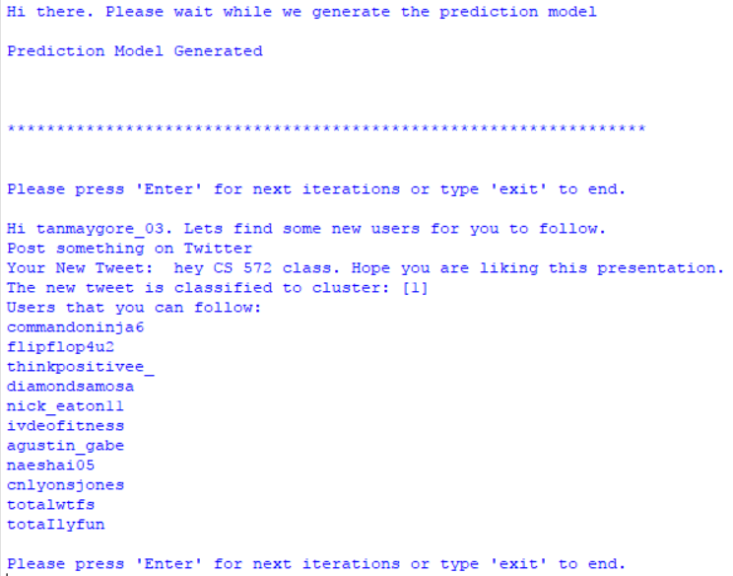
Results

Slide 9
Evaluation Metric
New tweets are classified into same cluster every time
Jaccard Similarity to check the similarities
Cosine Similarity to check the similarities
Streaming API used to get large amount of Tweets based on filter
The REST API used to get user specific tweets

Slide 10
Challenges
Unstructured tweets due to hash tags, links & annotations
K-Means clustering performs poorly when text has links in it.
Improving results (removing stopwords)

Slide 11
Conclusion
TF-IDF vectors
K-means clustering
Cosine and Jaccard similarity

Slide 12
Questions?

Slide 13
Thank you!

