Slide 1
Spam detection filter using Machine Learning
Souparna Bose

Slide 2
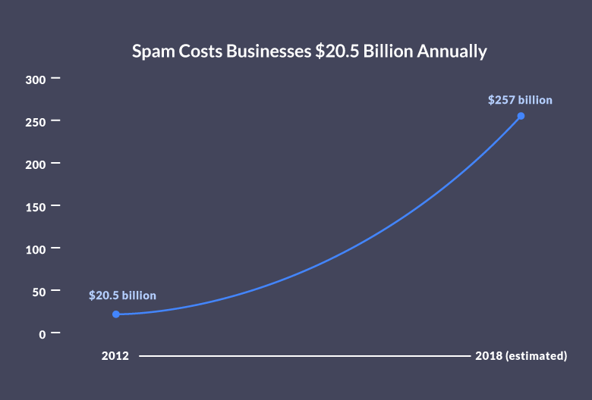
Spam Statistics:
What is Spam?
Spam in computing terms means something unwanted
Content may be anything like a sales promotion/email virus/Trojan horses/Malicious software
Spam costs
Internet connection, Software, Mailing list, Web Server
Cost to Business

Slide 3
Machine Learning Intuition:
Problem Statement : Classification of Spam vs Ham
Ham : Email/SMS that is not Spam
Solution: 1. Natural Language Processing 2. Machine Learning Algorithm
Individual topics to be discussed in detail
Code Link: https://www.github.com/souparnabose99/SpamDetectionMLModel

Slide 4
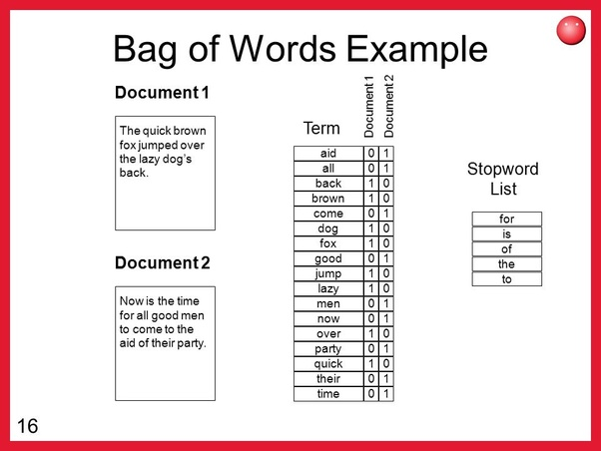
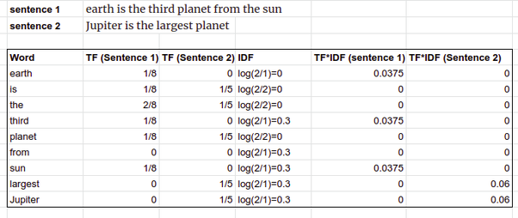
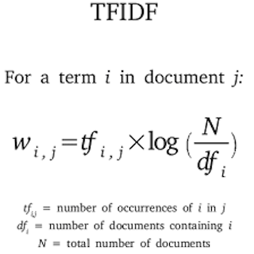
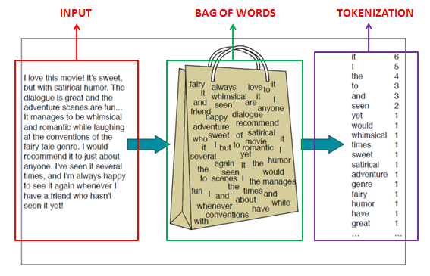
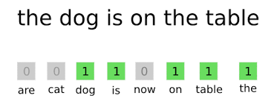
Natural Language Processing (NLP) :
NLP helps machines read text by simulating the human ability to understand language
Solution comprises of popular NLP libraries in python like NLTK/Spacy
Preparing a dataset with correct labels for training the model
Punctuation removal
Stop word removal
Bag of words creation
TF-IDF transformation of vectorised text
Final processed dataset split into Train & Test set for training and validation

Slide 5
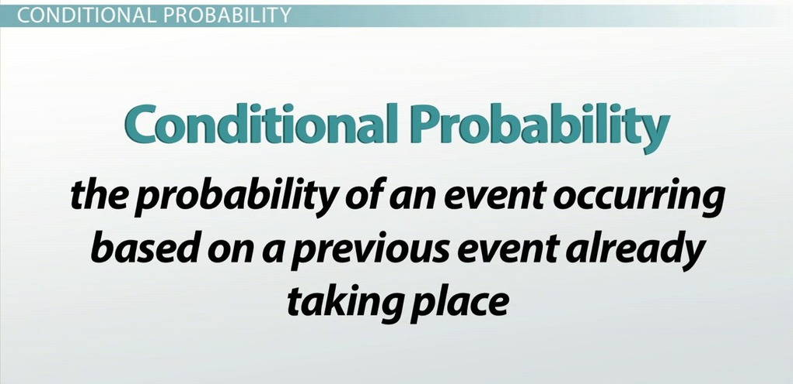
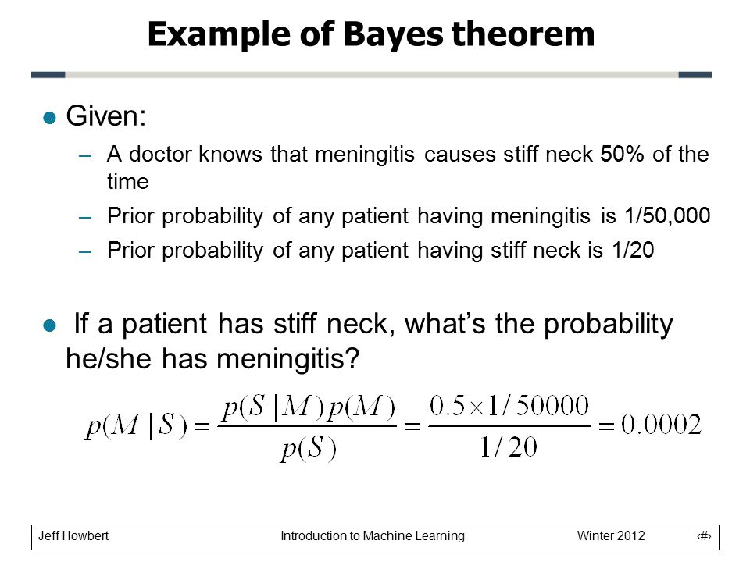
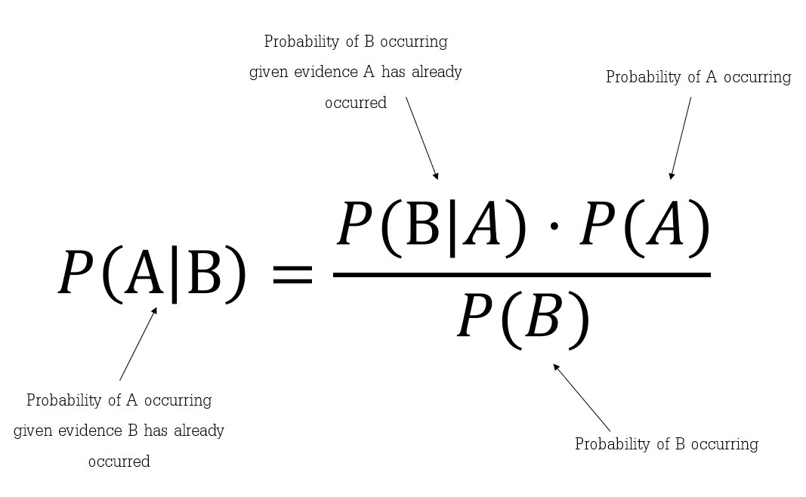
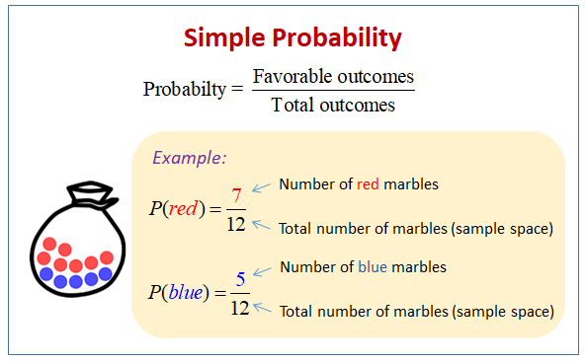
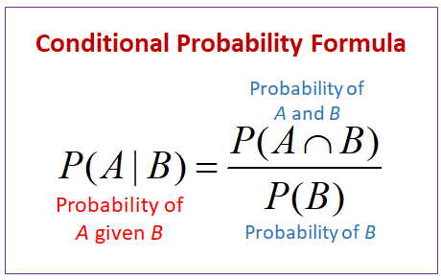
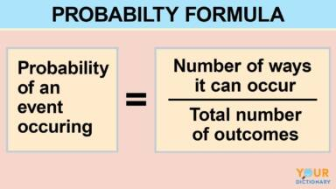
Classification using Machine Learning Algorithm:
Naïve Bayes Classifier for text classification
Few topics before explaining Naïve Bayes:
Probability
Conditional probability
Bayes Theorem

Slide 6
Intuition behind Naïve Bayes:
Suppose we are building a classifier that says whether a text is about sports or not. Our training data has 5 sentences:
Now, which tag does the sentence "A very close game" belong to?
Since Naive Bayes is a probabilistic classifier, we want to calculate the probability that the sentence "A very close game" is Sports and the probability that it’s Not Sports. And we take the largest one.
Text | Tag
"A great game" | Sports
"The election was over" | Not sports
"Very clean match" | Sports
"A clean but forgettable game" | Sports
"It was a close election" | Not sports

Slide 7
Intuition behind Naïve Bayes:
Written mathematically, what we want is P (Sports | a very close game) — the probability that the tag of a sentence is Sports given that the sentence is “A very close game”
That’s great, but how do we calculate these probabilities?
Let’s dig in!
Feature Engineering
Need to convert text data into numerical representation for machine to understand
We use word frequencies. That is, we ignore word order and sentence construction, treating every document as a set of the words it contains. Our features will be the count of each of these words

Slide 8
Intuition behind Naïve Bayes:
Now we need to transform the probability we want to calculate into something that can be calculated using word frequencies. For this, we will use some basic properties of probabilities, and Bayes’ Theorem.
Bayes' Theorem is useful when working with conditional probabilities because it provides us with a way to reverse them: P(A|B) = [P(B|A).P(A)]/P(B)
In our case, we have P (Sports | a very close game), so using this theorem we can reverse the conditional probability: P(sports|a very close game) = [P(a very close game |sports).P(sports)]/P(a very close game)

Slide 9
Intuition behind Naïve Bayes:
We can compare the bigger one among the 2: P(a very close game| sports).P(sports) vs P(a very close game|not sports).P(not sports)
However, there is a problem
“A very close game” doesn’t appear in our training data, so this probability is zero
Unless every sentence that we want to classify appears in our training data, the model won’t be very useful
So what is the solution to this?

Slide 10
Intuition behind Naïve Bayes:
Being Naïve: we assume that every word in a sentence is independent of the other ones
This means that we’re no longer looking at entire sentences, but rather at individual words
So the equation becomes: P(a very close game) = P(a).P(very).P(close).P(game)
This assumption makes this model work well with little data or data that may be mislabelled. The next step is just applying this to what we had before: P(a very close game|sports) = P(a|sports).P(very|sports).P(close|sports).P(game|sports)

Slide 11
Intuition behind Naïve Bayes:
The final step is just to calculate every probability and see which one turns out to be larger
First, we calculate the priori probability of each tag: for a given sentence in our training data, the probability that it is Sports P (Sports) is ⅗. Then, P (Not Sports) is ⅖.
Then, calculating P (game | Sports) means counting how many times the word “game” appears in Sports texts (2) divided by the total number of words in sports (11): P(game|sports) = 2/11
However, we have 1 more problem: “close” doesn’t appear in any Sports text! That means that P (close | Sports) = 0. This is rather inconvenient since we are going to be multiplying it with the other probabilities, so we'll end up with 0

Slide 12
Intuition behind Naïve Bayes:
P(a|sports).P(very|sports).0.P(game|sports) = 0
In order to fix this issue, we use Laplace smoothing
We add 1 to every count so it’s never zero
To balance this, we add the number of possible words to the divisor, so the division will never be greater than 1
In our case, the possible words are ['a', 'great', 'very', 'over', 'it', 'but', 'game', 'election', 'clean', 'close', 'the', 'was', 'forgettable', 'match']
Since the number of possible words is 14, applying smoothing we get: P(game|sports) = (2+1)/(11+14)

Slide 13
Intuition behind Naïve Bayes:
The final results are:
Now we just multiply all the probabilities, and see who is bigger: P(a very close game|sports).P(sports) = 0.0000276 P(a very close game|not sports).P(not sports) = 0.00000572
So our classifier successfully predicts the sentence as “Sports”
This is the logic and mechanism of working of this algorithm. Now we will move on to the coding section and create our model.
Word | P(word|sports) | P(word|not sports)
a | (2+1)/(11+14) | (1+1)/(9+14)
very | (1+1)/(11+14) | (0+1)/(9+14)
close | (0+1)/(11+14) | (1+1)/(9+14)
game | (2+1)/(11+14) | (0+1)/(9+14)

