Slide 1




ACCS
The Data Analytics Competition
Team Name: miscellaneous
SOUPARNA DUTTA
ARYAN PRASAD
DEVANSH MOHATA

Slide 2
APPENDIX
SR NO | TOPIC | SLIDE NO
1 | Assumptions | 3
2 | RFM Analysis : Recency | Frequency | Monetary Value Analysis | 4-5
3 | Customer Loyalty And Retention | 6-7
4 | Segment Analysis & Market Performance | 8-11
5 | Seasonality Of Markets | 12-13

Slide 3
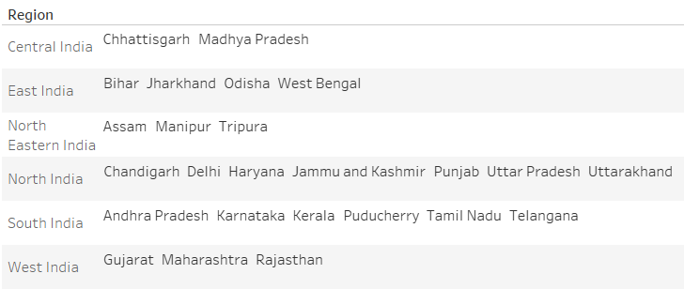
ASSUMPTIONS
We made an assumption and divided the states into following regions:

Slide 4
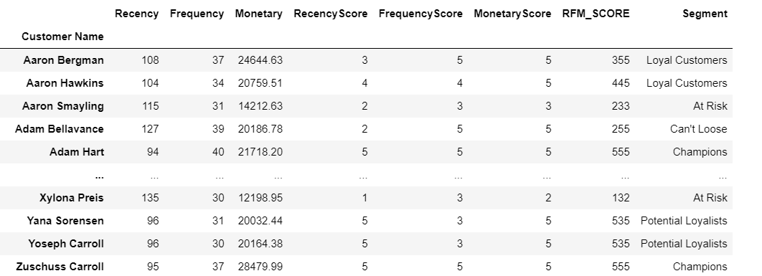
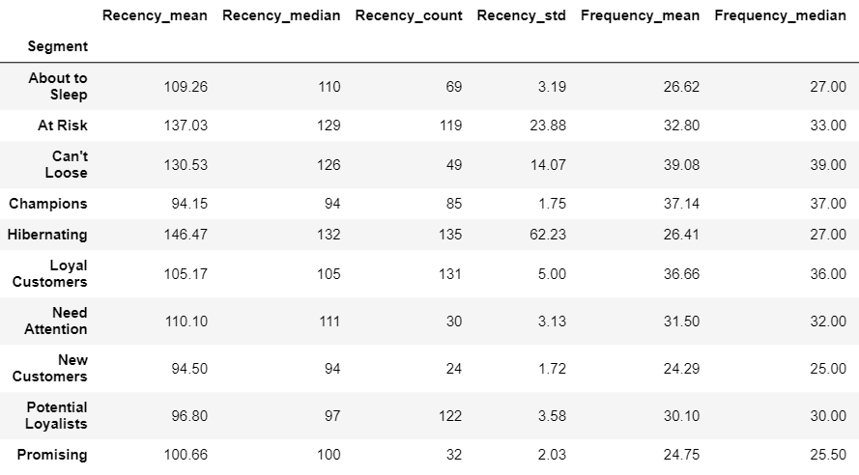
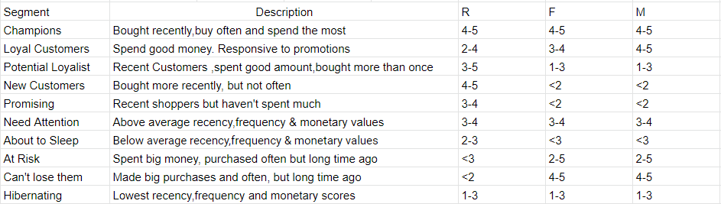
RFM ANALYSIS : Recency | Frequency | Monetary Analysis
Recency, Frequency and Monetary Performance was evaluated in the range of 1-5 where more recent, more frequent and higher sales were awarded 5 each as the RFM Score.
RFM score was calculated by concatenating individual digits of the Recency Score, Frequency Score and Monetary Score.
The RFM score was categorised into the following 10 segments :

Slide 5
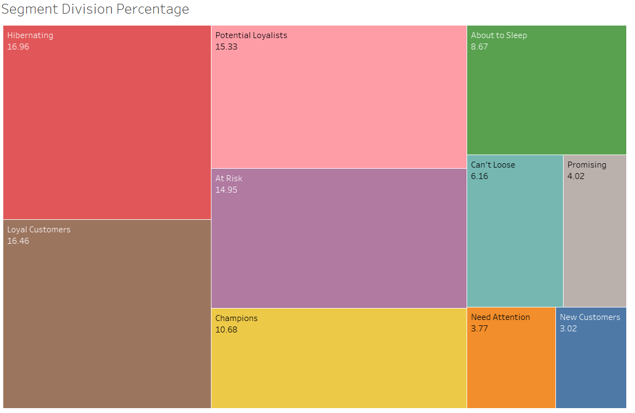
RFM ANALYSIS : Recency | Frequency | Monetary Analysis

Slide 6
CUSTOMER LOYALTY AND RETENTION
Number Of Unique Customers
2012 | 2013 | 2014 | 2015
795 | 795 | 796 | 794
• After evaluating the data we can see that from 2012 to 2014 there is 100% customer retention.
• In the period of 2014 - 2015, there is a small dip in retention of customers resulting in.
• It is also evident that even though the company's customer retention capability is good, the company lack in customers acquisition as out of all the years in the given time frame, only one new customer comes in the year 2014.

Slide 7
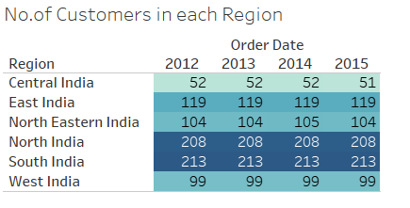
CUSTOMER LOYALTY AND RETENTION
• The company needs to invest in new strategies for the acquisition of customers.
• To set a certain priority, we should first consider Central India region as it has always seen stagnant sales in this region, so the company should first invest to acquire more customers in this region using certain marketing strategies.
• Then we can move onto other market regions first such as West India, East, North East India, as these have lesser sales as compared to North and South regions.

Slide 8
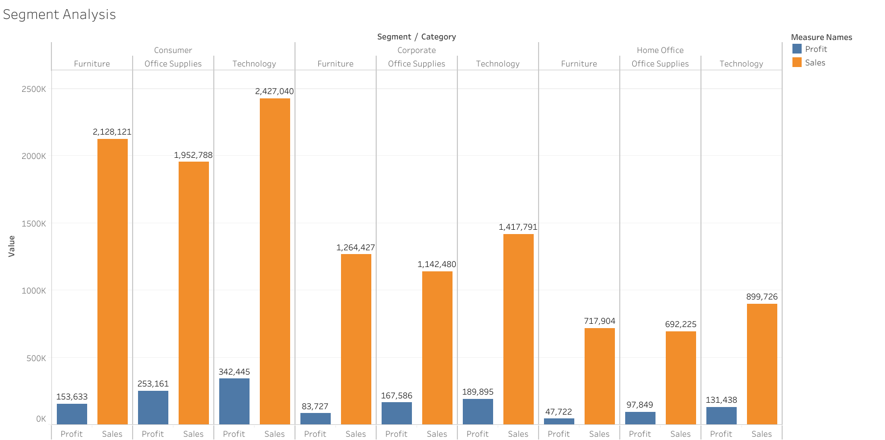
SEGMENT ANALYSIS

Slide 9
SEGMENT ANALYSIS
• There are mainly segments: Consumers, Corporate, and Home Office.
• Consumer segment is the main source of revenue for this company followed by Corporate and Home Office.
• In all the three segments, there is high sales of technology products followed by Furniture and then at the end office supplies.
• With this, we also observe a common trend which is very low profits made in all these types of products, under all the three segments, and this is something the company should focus on again.

Slide 10
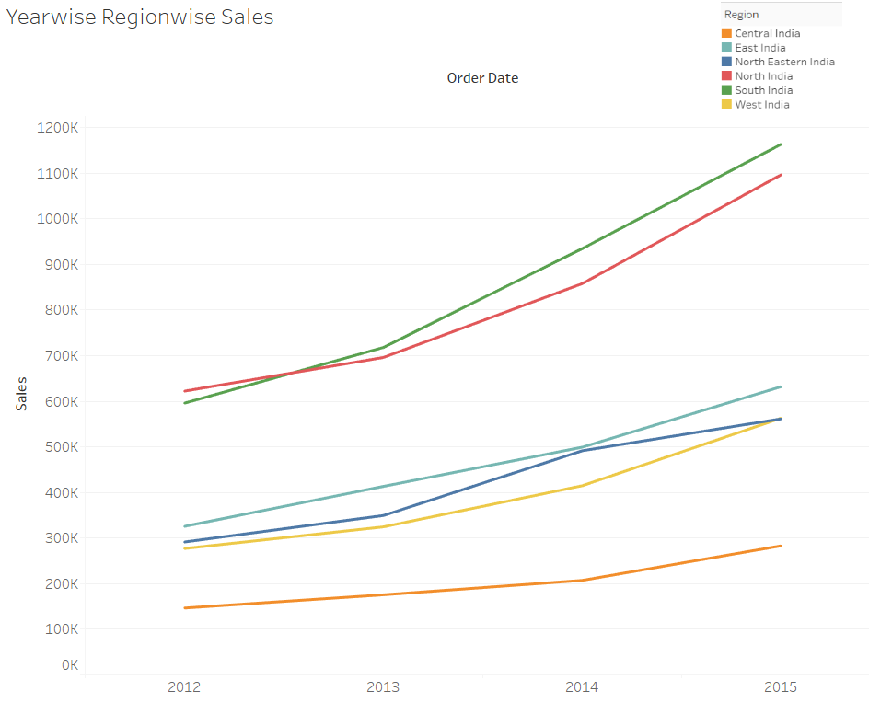
MARKET PERFORMANCE

Slide 11
MARKET PERFORMANCE
For the ease of understanding, we divided all the states of India into regions like Central India, East India, West India, North India, South India, and North East India.
South India region has the highest total sales of approximately 3.4 Million from 2012 - 2015. Whereas, Central India region has the lowest total sales of just 812K from 2012 - 2015.
All market regions have shown an overall increase in sales from 2012 to 2015.
North India and South India market regions shows a constant rate of increase in sales from 2012 - 2013 and then a surge in sales post 2013.
East India and West India market regions shows a constant rate of increase in sales from 2012 - 2014, and then shows a gradual rate of increase in sales post 2014.
In case of North East India market region, we see a constant rate of increase in sales from 2012 - 2013, then a steep increase post 2013 till 2014, and then a decrease in rate of sales post 2014 till 2015.
For Central India market region, there exist a small yet constant rate of increase of sales from 2012 - 2014, but post 2014, we see a gradual rate of increase till 2015.

Slide 12
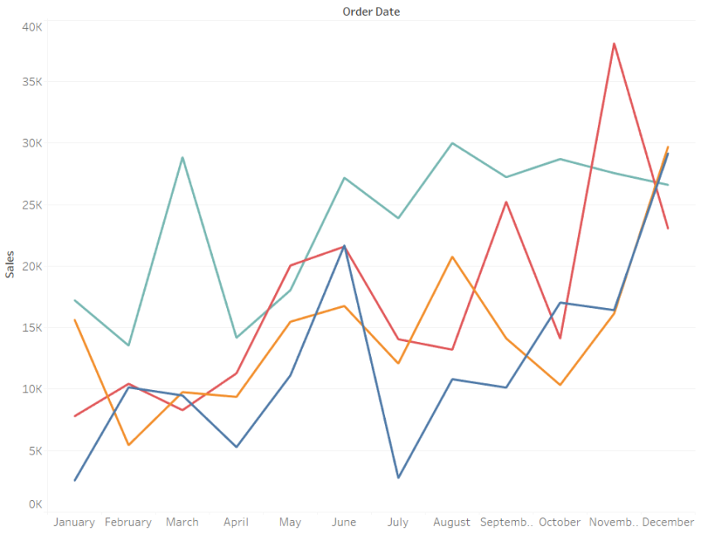
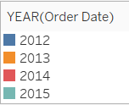
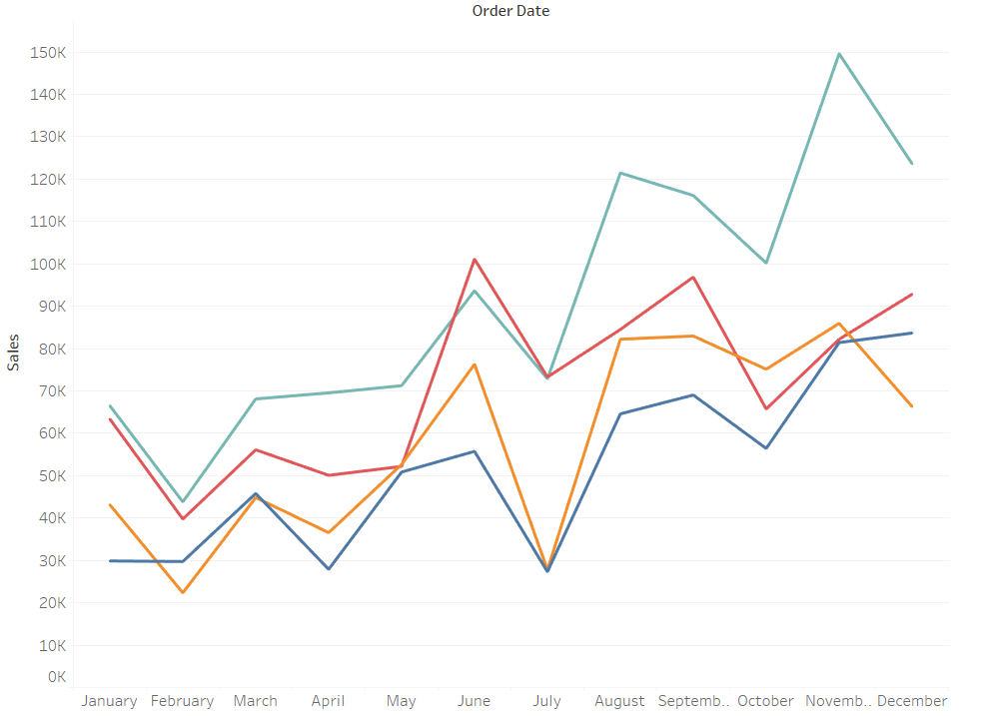
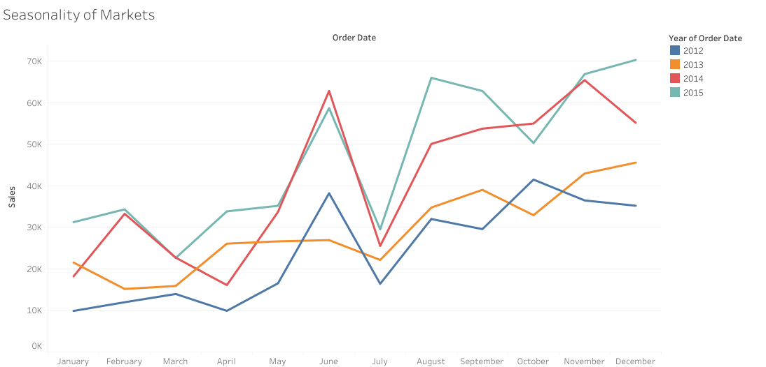
SEASONALITY OF MARKETS
North East : This region shows a significant increase in sales from April to June, and then a significant dip in July. Then we also notice that post July, there is a gradual increase in sales again with few fluctuations.
Central India: In this region, there has always been a sharp increase and decrease in sales from 2012 - 2014, like, majorly in period of April to July but this improved in the year 2015, where there was a gradual increase or decrease during these months.
North: This region shows certain fluctuations in sales from Jan to May, and then a significant increase again till June. Then again we see a significant dip in sales in July, but then post July there is a significant increase in sales till August.

Slide 13
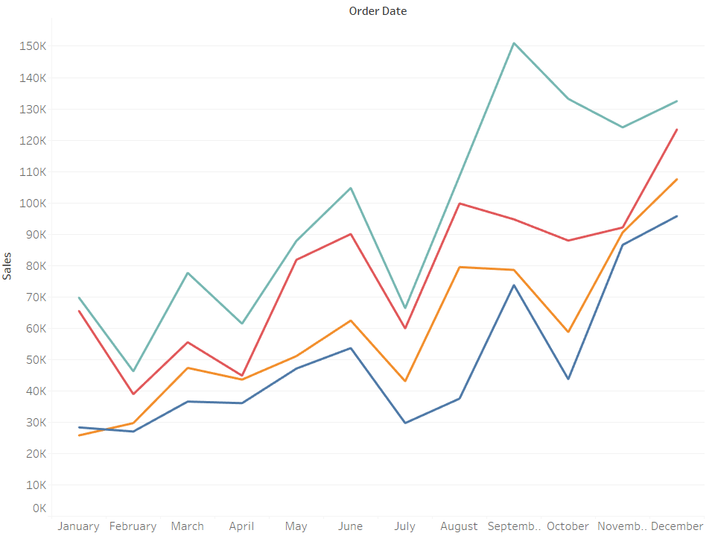
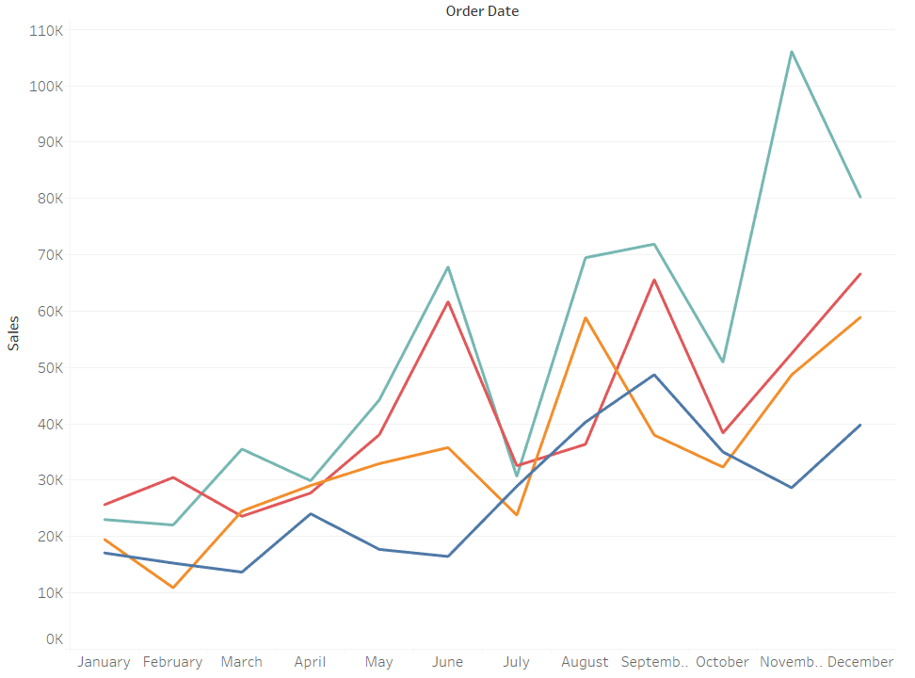
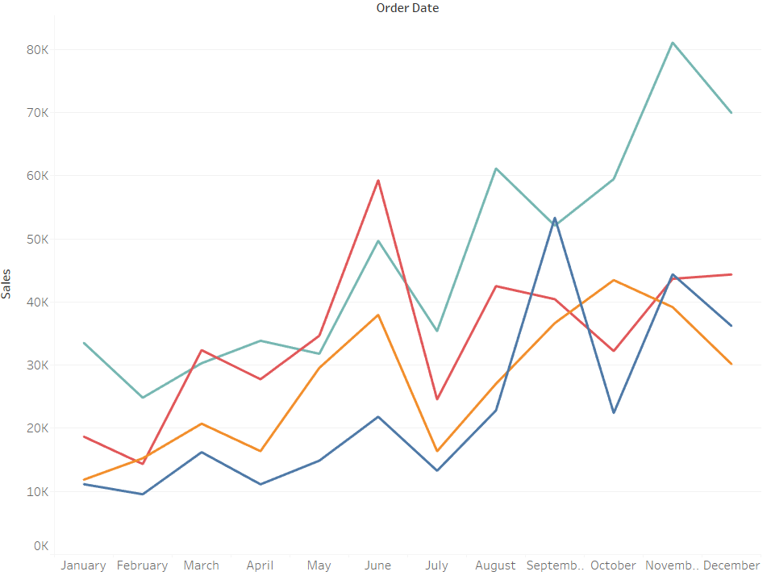
SEASONALITY OF MARKETS
West : In this region, there is a significant increase in sales post April till June, then a significant dip in July. Then again the sales start taking a increase post July, but the sales go through certain fluctuations in the second half of the year.
East: In this region, the sales are again full of significant highs and lows. In year 2014 & 2015, the month of April to June sees a steep increase in sales and then a major dip till July, but the same doesn’t take place in 2012 & 2013. After this, the second half of the year is full major fluctuations in sales full of highs and lows.
South: In this region, the sales are full of significant highs and lows. Like, from Feb to March, and then a significant dip again till April, then again a increase till June and then again a dip in July, and then a significant increase again post July which continues with gradual increase over the months.

Slide 14
THANK YOU

