Slide 1


Slide 2



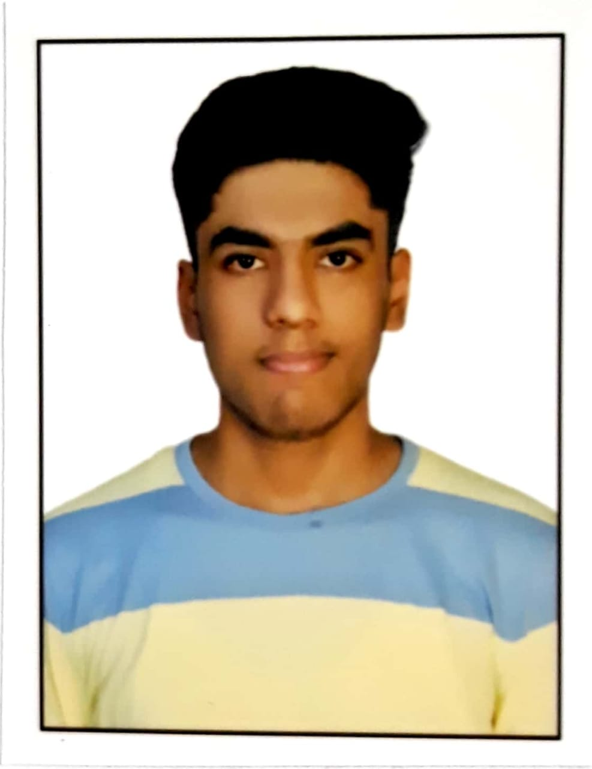
Team Name: miscellaneous
College: Maharaja Surajmal Institute of Technology
Batch: 2022
Team Members:-
Devansh Mohata
IT
Souparna Dutta
IT
Aryan Prasad
IT
Sarthak Yadav
CSE

Slide 3
Would you like to tell something about yourself?
Participated in ZS Campus Beats
COVID - 19 Dashboard, Olympics Data Mining, EDA on Home Loan Credit Defaulter
In top 11 to 150 teams bracket all over India in ZS Campus Beats

Slide 4
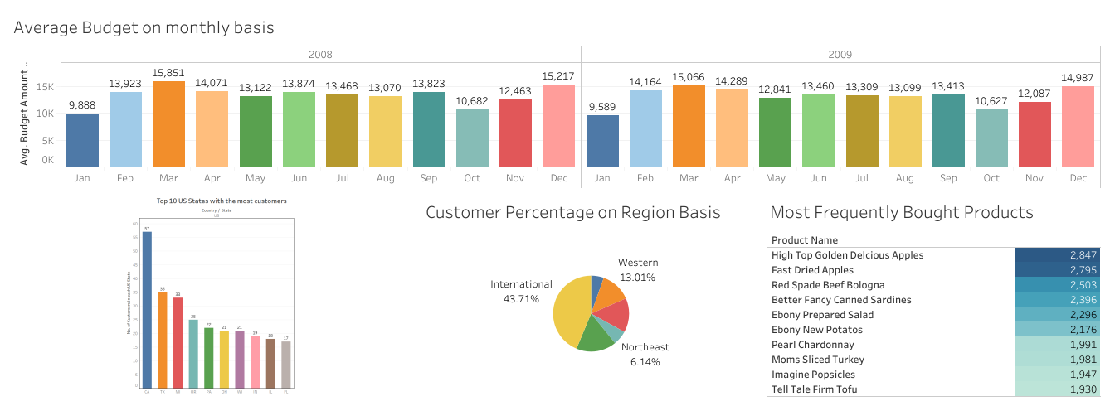
Dashboard
Link to access the supporting file/calculations:-
https://drive.google.com/drive/folders/1Rb24StppwNGp9t77eZhi151bn5hdBC94

Slide 5
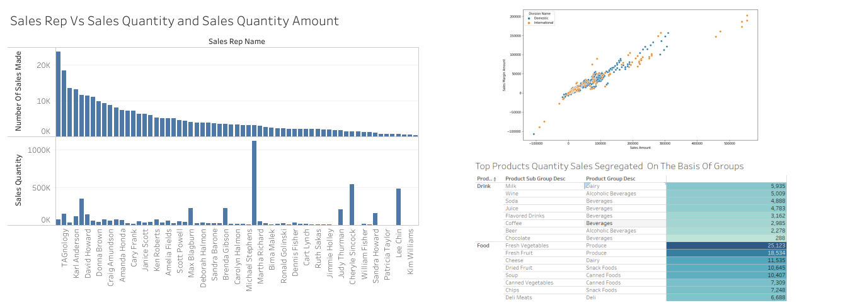
Dashboard

Slide 6
Summary: Top 10 Insights
So we studied the data carefully, did necessary calculations and performed required operations to get these particular insights, which are:-
From the database, we get an important insight regarding the kind of demands we have from different parts of the world. With 50.88% of customers residing in USA implying that the company have a major hold in there and then 43.71% hold in international markets comprising of UK, Australia, etc.
Another important insight is regarding the types of products having the highest sales, where in Drinks category, Milk tops the chart whereas in Food category, Fresh Vegetables tops the chart followed by Fresh Fruits and Cheese products.
We move further to understand various aspects of sales, first we explore the progress of each sales representative and evaluate which sales rep did a great job where Stewart Wind wins the race with sales quantity of 1,112,897.

Slide 7
Summary: Top 10 Insights
Then we also analyze the data to understand which sales representative had the highest number of sales made, where Brad Taylor finished at the top with count of 23,829.
From the scatter plot, we get an understanding of how margins vary as sales amount increases. This is an almost linear relation, and is seen across both international and domestic divisions.
As we go ahead, we also check the average budget of customers in each month during the year 2008 and 2009, and we get to know that in each year, March has the highest budget.
The general trend shows customers are willing to spend more in March. We recommend boosting up advertisements and campaigns starting from February, to get a bigger market share and hence more sales.

Slide 8
Summary: Top 10 Insights
Another inference that we can draw from this which can help the company to rethink their strategy is about how in the month of January the average budget is low, so we can offer discounts or other exciting offers to entice customers to spend more.
We checked the distribution of customers in USA too, and noticed that the company has the highest number of customers from California. A few of the possible reasons that we can think about are high population, less competitors and good advertising schemes the company might be running here.
We were even able to pinpoint the most frequently bought product, High Top Golden Delicious Apples, showing us the kind of demand their fresh fruits have.

Slide 9
THANK YOU

