Slide 1

Vehicle Accident Alert System
Carried out by
Sanjana A 4VV21EC137 Souparnika S 4VV21EC149
V R Nakshatra 4VV21EC168
Vaishnavi K 4VV21EC169
Under the guidance of
Dr. Vinay B K
Assistant Professor
Dept. of ECE, VVCE

Slide 2
PHASE-1

Slide 3
Contents
Introduction
Problem Statement
Objectives of the Project
Proposed Methodology
Hardware and Software used
Expected Outcome of the Project
Project Timeline Infographics
References

Slide 4

Introduction
Vehicle Accident Alert System
A Vehicle Accident Alert System is a safety mechanism designed to detect collisions or accidents involving vehicles and promptly alert emergency services or predetermined contacts.
This system can significantly enhance the chances of timely medical assistance, potentially saving lives and reducing the severity of injuries.
This solution utilizes an Arduino microcontroller, an ADXL-335 accelerometer sensor, and modules such as GSM and GPS in order to send an alert and indicate the precise location of the accident to the user.
(Dept. of ECE, VVCE, Mysuru)
4 / 13

Slide 5
Problem Statement
In many regions, response times to vehicular accidents are hindered by the lack of immediate and precise information about the accident location and severity. Traditional accident reporting methods often rely on delayed or manual communication, which can result in extended response times and potentially worsen the outcomes for those involved. The need for a more efficient, automated system that ensures prompt and accurate communication of accident details to emergency services is critical.

Slide 6
Objectives of the Project
Design an accelerometer-based mechanism for accurate accident detection.
Design a GSM-based system for automated alerts to emergency contacts.
Facilitate timely response by providing real-time accident information to responders.
Integrate GPS technology for precise location tracking of the vehicle.
Enhance user safety with a reliable mechanism for immediate assistance.

Slide 7
Proposed Methodology
Design:
-Plan how to connect Arduino Nano, ADXL-345, GSM SIM800L, GPS Neo-6M, LM2596, and Zero PCB.
Connect Components:
-Wire ADXL-345, GPS Neo-6M, and GSM SIM800L to Arduino Nano.
-Use LM2596 for power.
-Solder everything on Zero PCB.
Program Arduino:
-Write code to detect accidents with ADXL-345.
-Get location data from GPS Neo-6M.
-Send alerts with GSM SIM800L.
5

Slide 8
Methadology
Test:
Check if the system detects accidents.
Verify GPS accuracy.
Test if alerts are sent correctly.
Install:
Follow installation instructions to set up in a vehicle.
Maintain:
Update and fix issues based on user feedback.

Slide 9
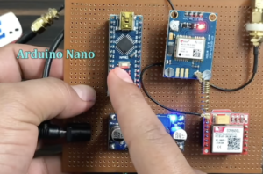
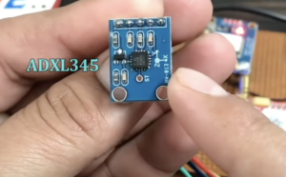
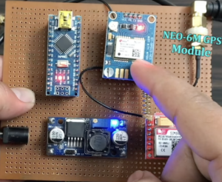
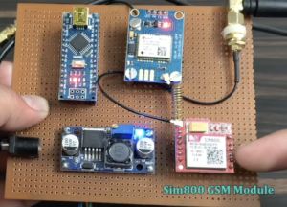
Hardware Requirements
5

Slide 10
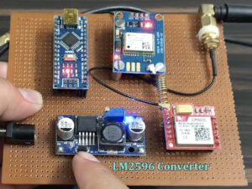
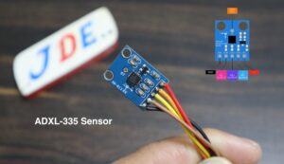
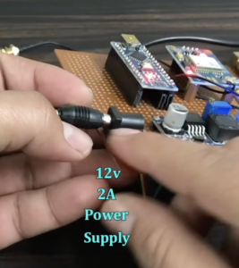
Hardware

Slide 11

Software Requirement:

Slide 12
Excepted Outcome of the Project
Reliable Accident Detection:
Accurate identification of vehicle accidents using the ADXL-345 accelerometer.
Precise Location Tracking:
Real-time GPS data providing the exact location of the accident.
Automated Alerts:
Immediate notification to emergency contacts and services via GSM SIM800L with details of the accident and location.
Enhanced Response Time:
Faster emergency response due to timely alerts and precise location information.
Improved Vehicle Safety:
Increased safety for vehicle occupants through automated accident reporting and quick assistance.
5

Slide 13
PHASE-2

Slide 14
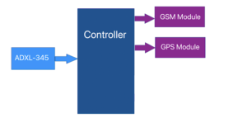
Methodology
In this project, the block diagram illustrates the system's setup: the ADXL-335 sensor is connected to the input side, while the GSM SIM800L and GPS NEO-6M modules are connected to the output side. When the ADXL-335 sensor detects movement that exceeds a predefined threshold, it triggers the GSM module to send a text message.
(Dept. of ECE, VVCE, Mysuru)
14 / 13

Slide 15
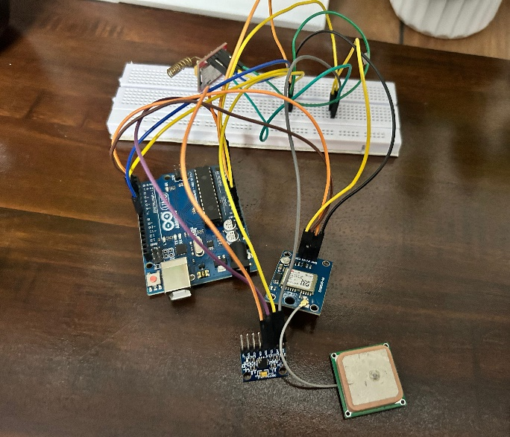
Real Time Circuit

Slide 16
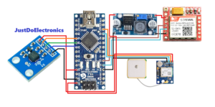
Methodology
The following is the Circuit connection of the Vehicle Accident Alert System :
(Dept. of ECE, VVCE, Mysuru)
16 / 13

Slide 17
Methodology
Accident Detection: The system incorporates an ADXL335 accelerometer to measure the vehicle's acceleration forces along the X, Y, and Z axes. These acceleration values are continuously monitored by the Arduino microcontroller. To detect an accident, the system establishes predefined acceleration thresholds for each axis. When the measured acceleration values exceed these thresholds within a specific timeframe, it indicates a sudden and significant change in vehicle motion, characteristic of an accident. To enhance accuracy and reduce false positives, the system can employ additional parameters such as deceleration rate, impact duration, and G-force magnitude.
(Dept. of ECE, VVCE, Mysuru)
17 / 13

Slide 18
Methodology
Emergency Notification: Upon confirming an accident, the system prioritizes rapid communication of the incident. A pre-configured SMS is dispatched to designated emergency contacts. To enhance the effectiveness of the alert, the system incorporates a dynamic Google Maps link generated using the vehicle's GPS coordinates. This link provides emergency responders with precise location details, facilitating a swift response.
Location Pinpointing: Upon detecting an accident, the system employs a GPS module to accurately determine the vehicle's location and generates a Google Maps link to specify the accident site. This link provides a visual representation of the accident scene, aiding emergency responders in navigating to the exact location.
(Dept. of ECE, VVCE, Mysuru)
18 / 13

Slide 19
Result
The developed vehicle accident detection system demonstrated effective performance in detecting vehicular accidents through the accurate identification of sudden changes in acceleration using the ADXL335 accelerometer.
The integration of GPS technology ensured precise location pinpointing, enabling the generation of accurate Google Maps links.
The system successfully transmitted timely SMS alerts containing essential accident details and location information to designated emergency contacts
(Dept. of ECE, VVCE, Mysuru)
19 / 13

Slide 20

Accident Alert Text Message

Slide 21
Conclusion
The implemented vehicle accident detection system proves to be a valuable tool in enhancing road safety.
By combining accelerometer-based accident detection, precise GPS location tracking, and rapid SMS communication, the system provides a robust solution for providing timely assistance to accident victims.
The system's ability to accurately detect accidents, pinpoint locations, and disseminate critical information to emergency responders significantly improves response times and potentially saves lives
(Dept. of ECE, VVCE, Mysuru)
21 / 13

Slide 22
Conclusion
Future enhancements could include the integration of additional sensors for improved accident detection accuracy, exploring alternative communication channels, and incorporating advanced features such as automatic emergency calling.
(Dept. of ECE, VVCE, Mysuru)
22 / 13

Slide 23
References
[1] S. K. Sahu, A. M. Gupta, & A. J. Chatterjee. (2023). Recent Advances in Vehicle Safety Systems: A Review. IEEE Transactions on Intelligent Vehicles, 8(2), 345-356.
[2]Monk, S. (2016). Programming Arduino: Getting Started with Sketches. McGraw-Hill Education.
[3] Bhattacharya, R. (2013). GSM Module Integration for Real-Time Applications. Journal of Electrical Engineering and Automation, 2(1), 19-23.
[4]. Joshua Hrisko, “Arduino Wall Penetrating Motion Sensor using Microwave Radar Module”, Maker Portal, 05 June 2018.
[5] Wong, Y., & Tan, S. (2018). Smart Vehicle Accident Detection and Notification System. International Journal of Automotive Technology, 19(3), 555-564
[6]M. A. Khan, J. N. Nair, & S. S. Patel. (2022). Real-Time Vehicle Accident Detection and Notification Systems: A Comprehensive Review. Journal of Embedded Systems, 15(4), 254-269.
23 / 13

Slide 24


