Slide 1


SMART INDIA HACKATHON 2026
TITLE PAGE
Problem Statement ID –SIH26057
Problem Statement Title- AI-Powered Automated Underwater Marine Debris and Anomaly Detection System using Side-Scan Sonar Imagery
Theme- Disaster Management
PS Category- Software
Team ID-SIH26-A0H-T359
Team Name-Half Squadron

Slide 2
IDEA TITLE
Half Squadron
PROBLEM
SOLUTION
UNIQUENESS
Large volumes of raw sonar data require time-consuming manual inspection.
Motion, noise and radiometric variations degrade sonar image quality.
AI detections can produce false alarms from rocks, sand ripples and reverberation.
Accurate debris location and real-time mapping are difficult offshore.
Automated preprocessing corrects motion, gain variation and sonar noise.
Dual-branch AI detects rigid debris and segments diffuse fishing nets.
D-RAV physics verification validates detections using acoustic shadow and attenuation.
Edge AI + WGS84 georeferencing provides real-time detection and location.
Handles both rigid objects and porous ghost nets in one system.
Runs offline on Jetson Orin, enabling rapid onboard processing.
Delivers confidence-scored, georeferenced results with GeoJSON/Shapefile export.

Slide 3
TECHNICAL APPROACH
Half Squadron
TECHNICAL ARCHITECTURE & MATHEMATICAL ENGINE
TELEMETRY INGESTION & HYDROACOUSTIC PREPROCESSING • Raw Binary Ingestion: Multi-threaded decoding of .xtf, .jsf, and .sdf streams with synchronous navigation packet extraction[cite: 2]. • Kinematic Rectification: Corrects vehicle heave, pitch, and speed jitter via cubic Hermite spline interpolation (Δy = SOG · Δt)[cite: 2]. • Radiometric Normalization: Excises nadir blind zone; applies EGN and TVG to equalize cross-track acoustic transmission loss[cite: 2]. • Multi-Scale NSST Despeckling: High-frequency directional soft-thresholding suppresses Rayleigh noise while preserving sharp shadow boundaries[cite: 2]. • Slant-to-Ground Conversion: x_ground = √((u · δr)² - H_alt²)[cite: 2] | DUAL-BRANCH DEEP LEARNING CORE (HYDRODEBRIS-NET) • Feature Backbone: Wavelet-embedded CSPDarknet using 2D DWT downsampling to isolate structural contours from acoustic reverberation[cite: 2]. • Directional Filters: Integrates Directional Filter Banks (DFB) to capture linear and woven synthetic geometries absent in isotropic clutter[cite: 2]. • Multi-Scale Neck: BiFPN augmented with Efficient Multi-Scale Attention (EMA) to preserve spatial features of small and narrow debris[cite: 2]. • Branch A (Rigid Anomalies): Predicts oriented bounding boxes [x, y, w, h, θ_rot, class] for pipes, drums, containers, and shipwrecks[cite: 2]. • Branch B (Diffuse Debris): Predicts pixel-level semantic masks via Focal-Dice objective: L_BranchB = L_Focal(M, M̂) + L_Dice(M, M̂)[cite: 2]. | D-RAV PHYSICS VERIFICATION & CALIBRATED CONFIDENCE • Theoretical Shadow Geometry: L_theoretical = (ĥ_o · √(R_s² - H_alt²)) / (H_alt - ĥ_o)[cite: 2] • Regime 1 (Rigid Opaque Loss): L_Phys = |L̂_s - (ĥ_o · √(R_s² - H_alt²)) / (H_alt - ĥ_o)|[cite: 2] • Dynamic Acoustic Uncertainty: σ_acoustic = √(δr² + (R_s / H_alt · σ_alt)²) ≈ 0.15 m to 1.00 m[cite: 2] • Regime 2 (Porous Net Transmittance): S_net = clip((Ī_ambient - Ī_downstream) / (Ī_ambient · (1 - κ_trans)), 0, 1)[cite: 2] • Calibrated Confidence Scoring: C_final = (0.50 · P_class + 0.35 · S_phys + 0.15 · (1 - Clutter_GLCM)) × 100%[cite: 2] | D-RAV PHYSICS VERIFICATION & CALIBRATED CONFIDENCE • Theoretical Shadow Geometry: L_theoretical = (ĥ_o · √(R_s² - H_alt²)) / (H_alt - ĥ_o)[cite: 2] • Regime 1 (Rigid Opaque Loss): L_Phys = |L̂_s - (ĥ_o · √(R_s² - H_alt²)) / (H_alt - ĥ_o)|[cite: 2] • Dynamic Acoustic Uncertainty: σ_acoustic = √(δr² + (R_s / H_alt · σ_alt)²) ≈ 0.15 m to 1.00 m[cite: 2] • Regime 2 (Porous Net Transmittance): S_net = clip((Ī_ambient - Ī_downstream) / (Ī_ambient · (1 - κ_trans)), 0, 1)[cite: 2] • Calibrated Confidence Scoring: C_final = (0.50 · P_class + 0.35 · S_phys + 0.15 · (1 - Clutter_GLCM)) × 100%[cite: 2]

Slide 4
FEASIBILITY AND VIABILITY
Half Squadron
Analysis of Feasibility | Potential Challenges & Risks | Mitigation Strategies
Power: <35W Memory: <4GB VRAM Deployment: INT8 TensorRT on NVIDIA Jetson AGX Orin / Orin NX Target Power Range: 15–50W | Compute & Memory Budget Power: <35W | VRAM: <4GB Engine: INT8 TensorRT optimized for Jetson AGX Orin / Orin NX Target: Low-power, real-time edge deployment. | Directional NSST Denoising ​Speckle Suppression: High-frequency directional sub-band soft thresholding mitigates multiplicative noise. ​Edge Preservation: Retains critical shadow boundaries and fine structural netting edges.
Real-Time Pipeline Latency Throughput: ≥35 pings/sec Processing: Triple-buffered asynchronous CUDA streams minimize I/O bottlenecks and survey delays. | Porous Ghost Net Shadow Ambiguity ​Acoustic Translucency: Permeable polymer netting allows partial acoustic signal transmission. ​Detection Failure: Conventional solid-body shadow checkers register false-negative drop signatures. | Regime 2 Transmittance Attenuation ​Downstream Assessment: Computes downstream backscatter drop against the empirical baseline. ​Non-Solid Validation: Verifies porous gear without requiring a solid, hard-cast shadow.
Real-Time Pipeline Latency Throughput: ≥35 pings/sec Processing: Triple-buffered CUDA streams minimize I/O bottlenecks and delays. | Seabed Clutter & Rocky False Positives ​Benthic Mimicry: Sand ripples and rock outcroppings replicate synthetic target geometries. ​Operational Impact: Elevates false-alarm rates within complex natural terrain. | Ray-Tracing Physics ​Geometric Enforcement: Enforces strict height-to-shadow ratios via acoustic projection modeling. ​Artifact Penalization: Suppresses flat 2D visual outputs lacking proportional acoustic shadow length.
100% Native & Air-Gapped Zero cloud dependencies Self-contained C++/CUDA binary for secure AUV deployment. | Vehicle Motion Jitter & USBL Dropouts ​Geometric Distortion: Towing speed fluctuations alter along-track aspect ratios. ​Positioning Loss: Acoustic navigation dropouts result in unreferenced anomaly detections. | Hermite Splines & Local Dead-Reckoning ​Grid Resampling: Resamples waterfall grids via SOG \cdot \Delta t using cubic Hermite splines. ​Navigation Redundancy: Falls back to local metric tracking during inertial navigation system outages.

Slide 5
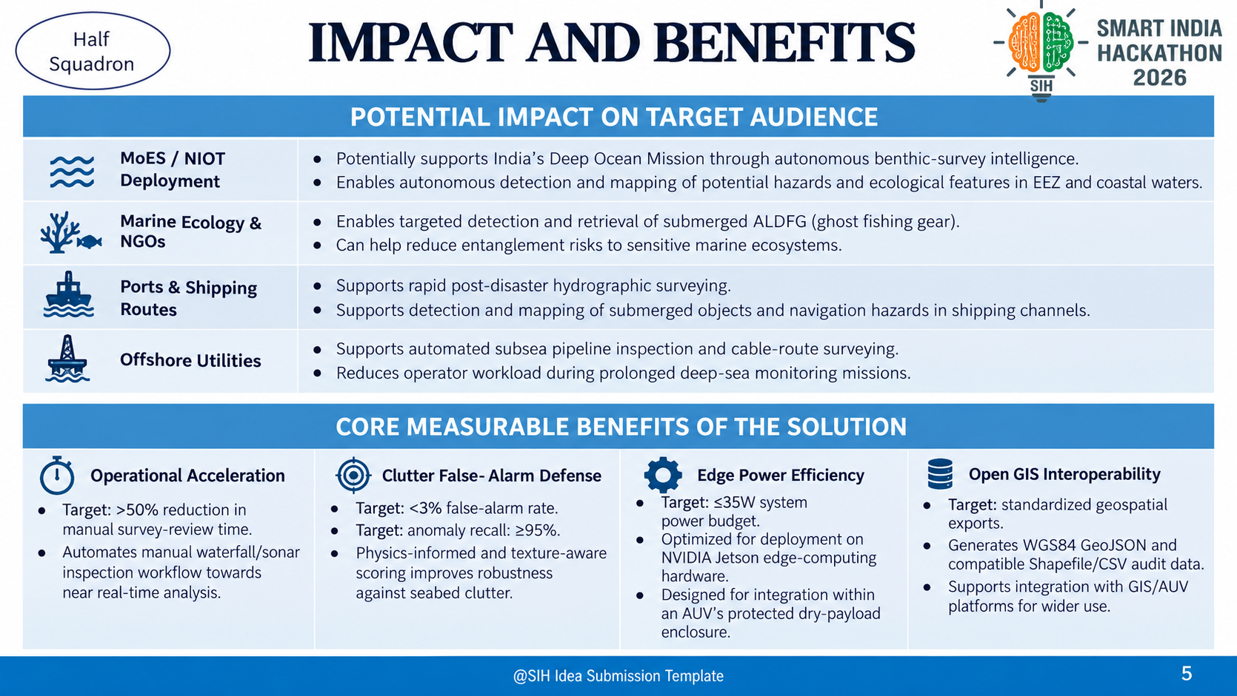

Slide 6
RESEARCH AND REFERENCES
Half Squadron
Key Publications & Research Studies:
  Zhou, Y., Chen, X., Tang, J., Gan, W., & Zhang, Y. (2024). "A Multi-Scale Fusion Strategy for Side Scan Sonar Image Correction". Remote Sensing, 16(10), 1752.
  "Physics-Informed Side-Scan Sonar Perception: Tackling Weak Targets and Sparse Debris via Geometric and Frequency Decoupling". Sensors (2026), 26(6), 1938.
  "SW-Net: A Direction-Aware Deep Learning Model for Shipwreck Segmentation in Side-Scan Sonar Imagery". Sensors (2026), 26(11), 3483.
  "AUV-Based Side-Scan Sonar Real-Time Method for Underwater Target Detection". Journal of Marine Science and Engineering (2023), 11(4), 690[2].
  GhostNetZero / Puget Sound SSS Dataset (WWF Germany / Microsoft AI for Good, 2024)[2].

